Slide 1
Flint Lead Level Detection

Slide 2
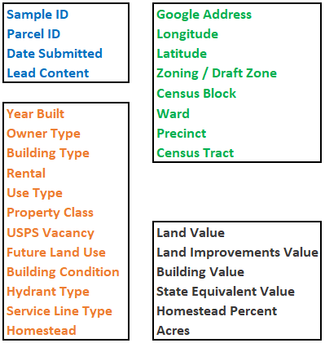
Overview of the Data
Total number of unique parcels : 8741
Total number of records : 10468
Variables : 37
Samples with more than 15 ppb are classified to have High Lead Level
Notes:
From around 9000 parcels in flint, we have 37 recorded parameters.
We have roughly grouped the variables into 4 groups. Geo, Categorical, Continuous.
And we have to predict whether or not a given parcel in is likely to have high levels of lead or not (that it has lead level > 15 ppb).

Slide 3
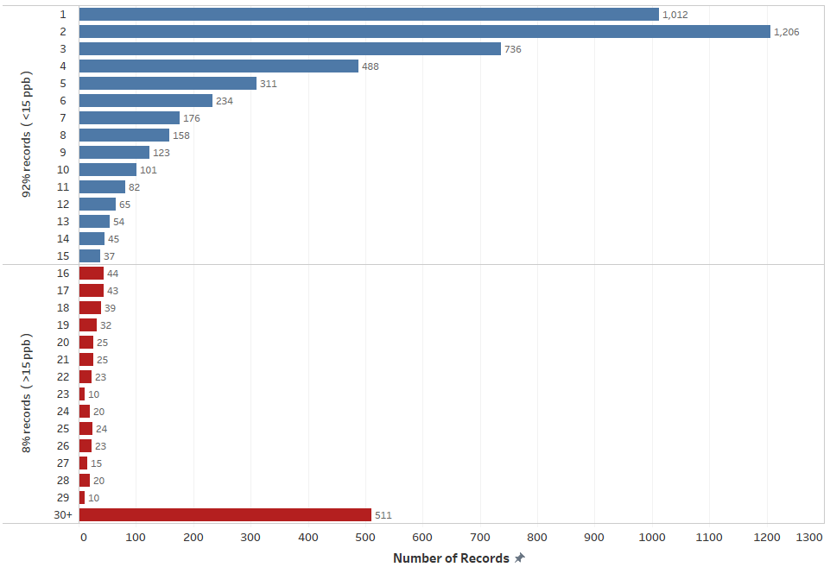
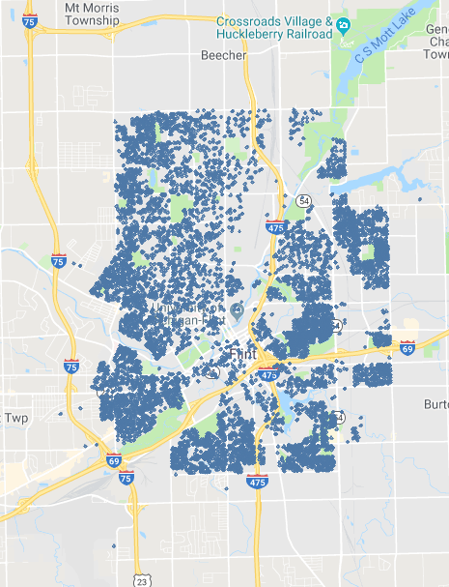
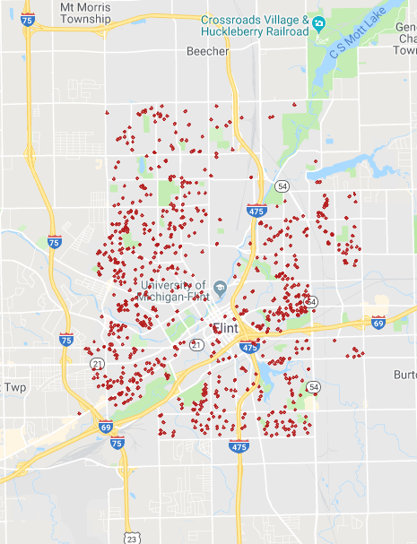
Number of Records for different Lead Content (ppb)
Notes:
So this is the distribution of lead content from different parcels in Flint. We are not able to find a specific area in Flint with high lead contamination in water.

Slide 4
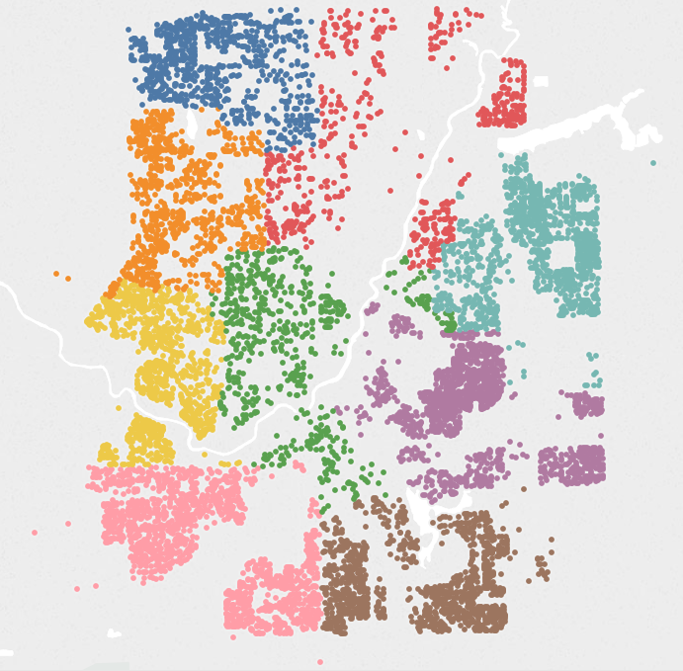
Analyzing the Geography of Flint City
Flint is divided into 9 Wards Parcels with High Lead Level

Slide 5
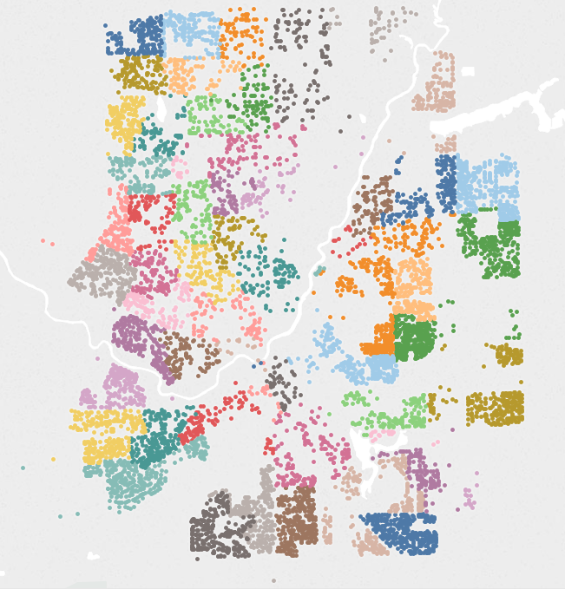
Analyzing the Geography of Flint City
Flint is divided into 61 Precincts Parcels with High Lead Level
Notes:
Maybe Precinct is an important predictor compared to ward (we see a small part in east with high lead level)

Slide 6
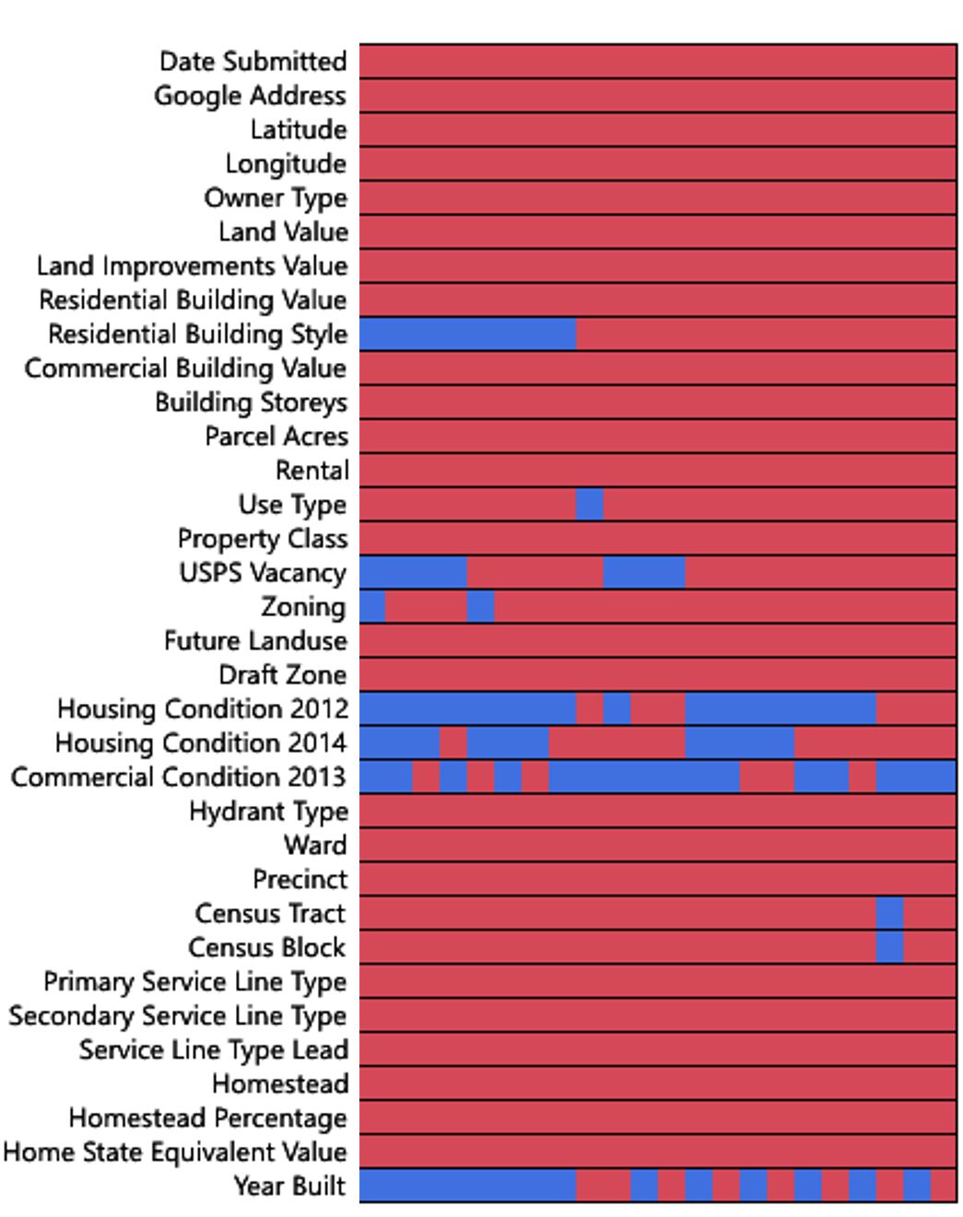
Missing Data Pattern
Missing Data
Data Available
Year Built : 0’s and 2’s replaced
Commercial Condition : Removed
Housing Condition 2012 : Removed
Replaced Google Address with
Zip Codes
Notes:
Commercial Condition Deleted was deleted because it had too many missing values
Year Built : 1900 – 2010
Housing Condition 2012 is removed : Distribution for two columns are quite similar. But there are more missing values for 2012. So we just removed 2012.
Housing condition for parcel 004582 is missing. So if we removed the records with a single variable missing, we would miss this whole parcel.

Slide 7
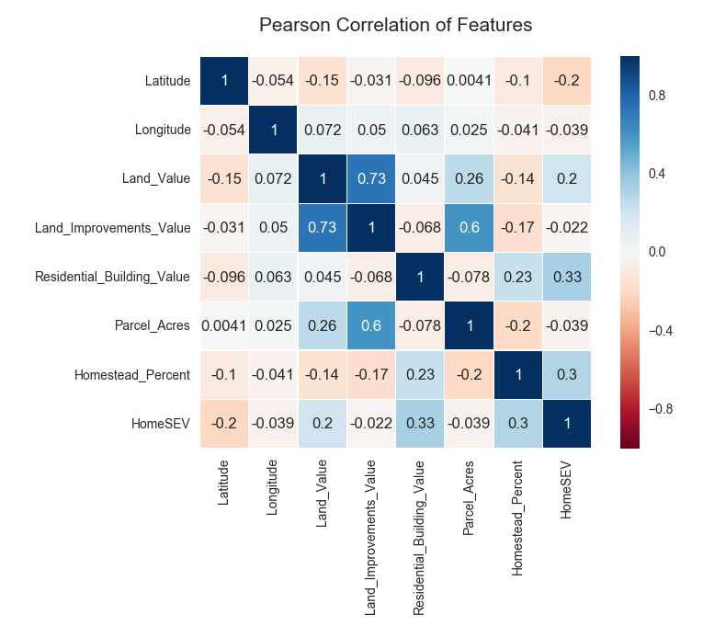
Notes:
Only Land Value and Land Imp Value show correlation (0.73)
Both of the above predictors are equally significant to the model. We should remove one of them.

Slide 8
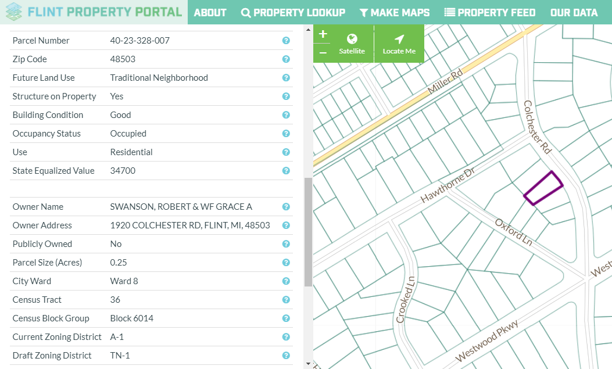
Comparing Actual Parcel ID with Parcel ID on the dataset
002671
Notes:
Pattern in real Parcel ID
No pattern in Excel Parcel ID
So even if we would have pattern in the parcel ID, we could drop some of the geographical variables like Zipcode, Ward, etc. But we cannot do that.

Slide 9
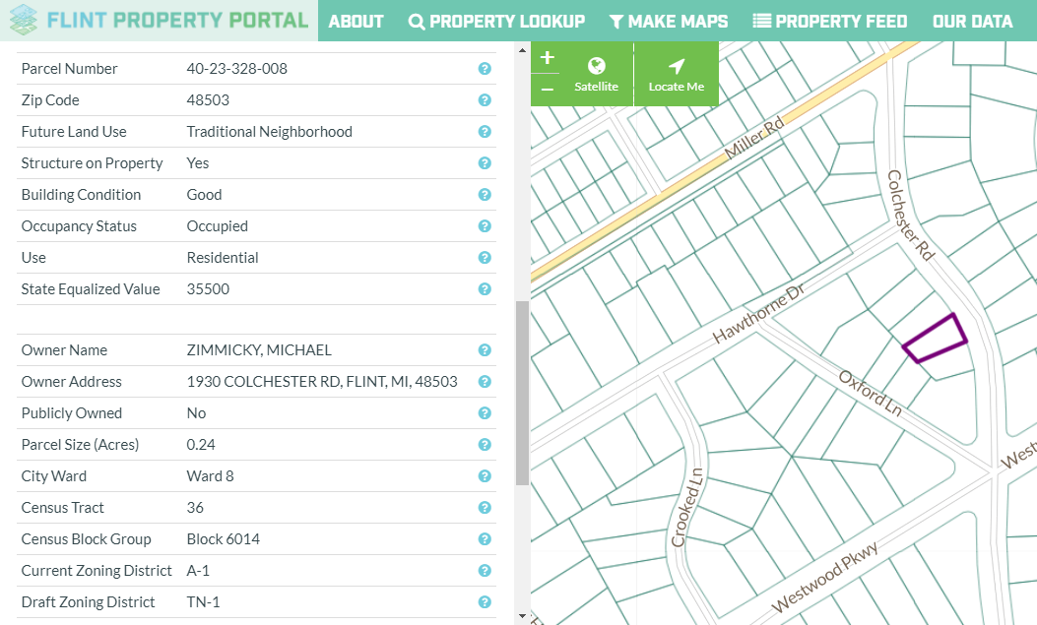
Comparing Actual Parcel ID with Parcel ID on the dataset
000036

Slide 10
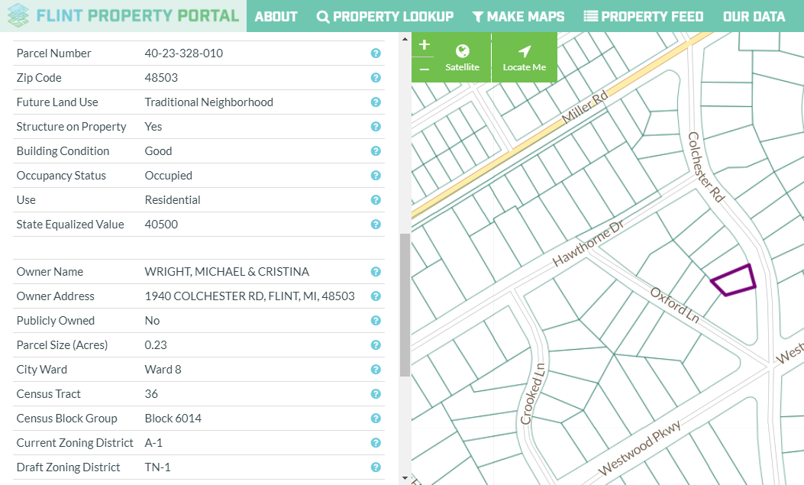
Comparing Actual Parcel ID with Parcel ID on the dataset
007507

Slide 11
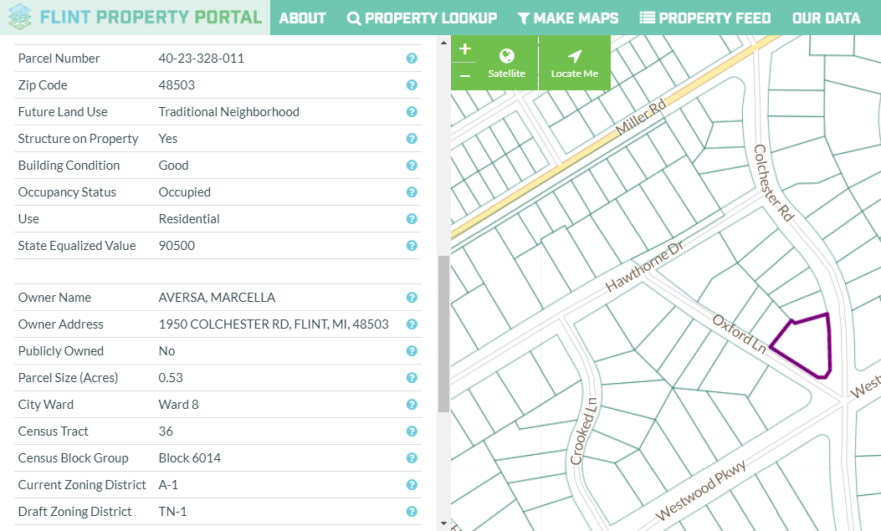
Comparing Actual Parcel ID with Parcel ID on the dataset
007397

Slide 12
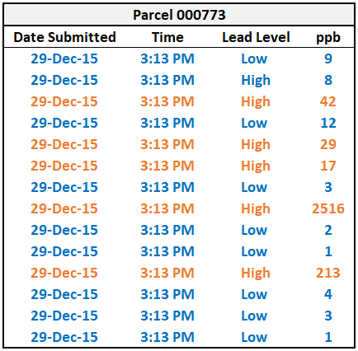
Time Series Analysis for Commercial Buildings
Notes:
We also tried to do time series analysis by considering few commercial buildings with large number of samples just to see if there is any pattern even if the lead contaminated water is sloshing around the system.
This parcel had 68 samples in total. We just analysed some of them. There is a huge difference in the lead content between the sample submitted at the same time. Samples must be taken at different times but are submitted together. We cannot get any important insight even from this data

Slide 13
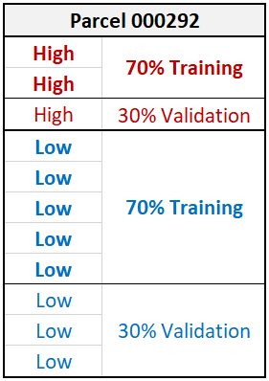
Stratified Random Sampling
Parcel ID | Lead Content | Records | Training 70% | Validation 30%
004582 | Low | 67 | 47 | 20
 | High | 5 | 4 | 1
 |  | 72 | 51 | 21
000773 | Low | 53 | 36 | 17
 | High | 14 | 11 | 3
 |  | 67 | 47 | 20
Notes:
We can see that there is a class imbalance (with more number of low lead content samples). We wanted to include each and every parcel with both low lead sample and high lead sample into the training as well as the validation set. We have performed stratified random sampling on the columns: Lead Content and Parcel ID.

Slide 14
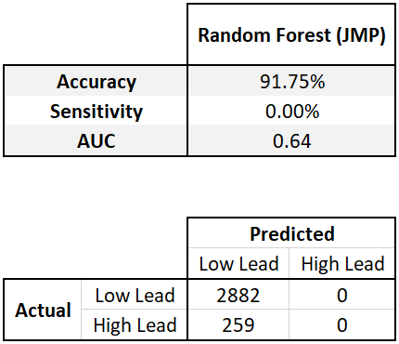
Random Forest model built using JMP
Low Lead Samples : 2882 (91.75%)
High Lead Samples : 259 (0.08%)
Notes:
So, after splitting the data into training and the validation set, we started building a predictive model using Random Forest. From our model, we found that none of the high lead samples were correctly predicted. We see here that the model just predicted all the samples to have low lead level. There are so many number of low lead samples in the dataset that model produces 92% accuracy by simply predicting every sample to have low lead. So the accuracy we are seeing is actually misleading, because we don’t want a model simply predicting everything to be in one class.

Slide 15
Class Imbalance
92%
Samples with Low Lead Level
8%
Samples with High Lead Level
Notes:
So class imbalance is the problem which we are facing in our dataset, having only 8% of the high lead samples. To handle this situation we used undersampling technique to make a better sample out of our dataset. By undersampling we drop few records of low lead samples and this way we adjust the class distribution in the dataset.

Slide 16
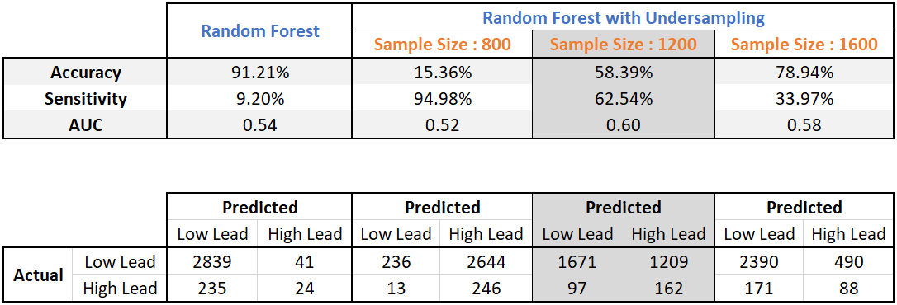
Comparing Random Forest models built using R
Notes:
So this time, we performed the random forest in R. Now, without under-sampling, we did get some sensitivity when we used R, but that’s still not good. The sensitivity is how often we are able to correctly predict high lead samples. Here we see that we have very few correct predictions for high lead samples. The AUC is 0.54 which means the model is not predictive.
So this prediction model is dominated by low lead samples. After that, we performed under-sampling over the data, and we found the sensitivity to be improving. That is correctly identifying the true positives. We used different number of sample sizes while doing under-sampling and compared the results. We found one model to be having a descent sensitivity and accuracy. And that was our best model.

Slide 17
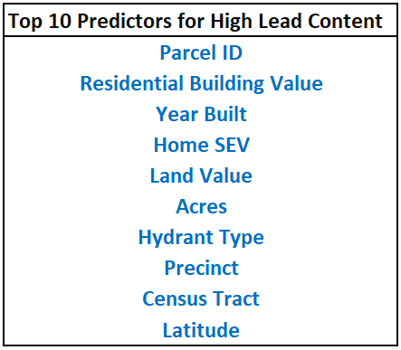
Best Model: Random Forest with Undersampling
Notes:
So these are the top 10 predictors for the best model we got. One thing we noticed while testing different models was that HomeSEV and Hydrant Type always were in the top 10 predictors in all the models.

Slide 18
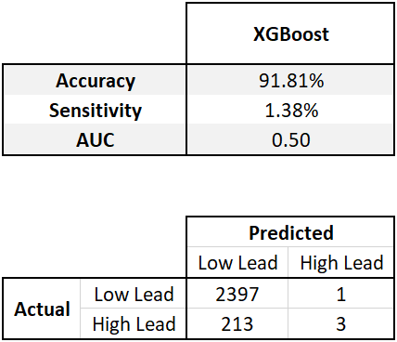
Experimenting XGBoost model with/without one-hot encoding

Slide 19
Thank you

Slide 22
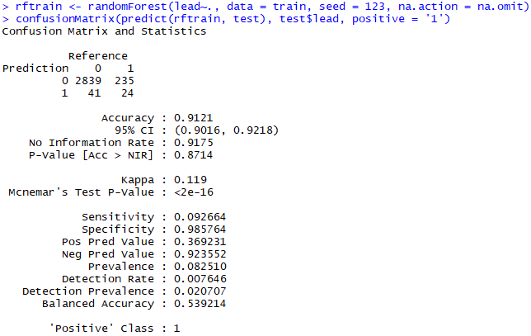
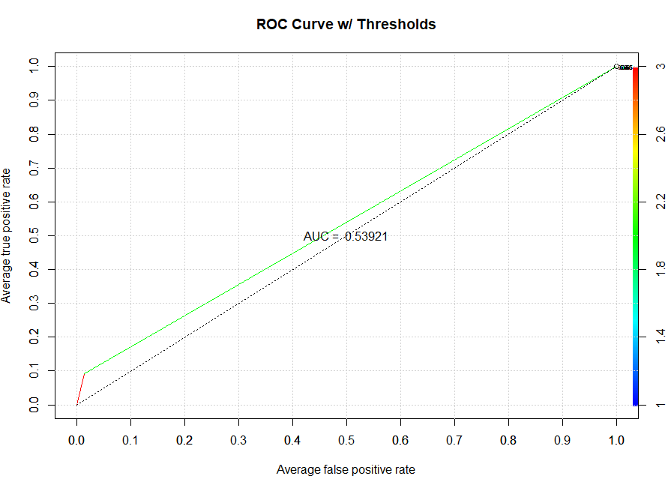
Normal Random Forest

Slide 23
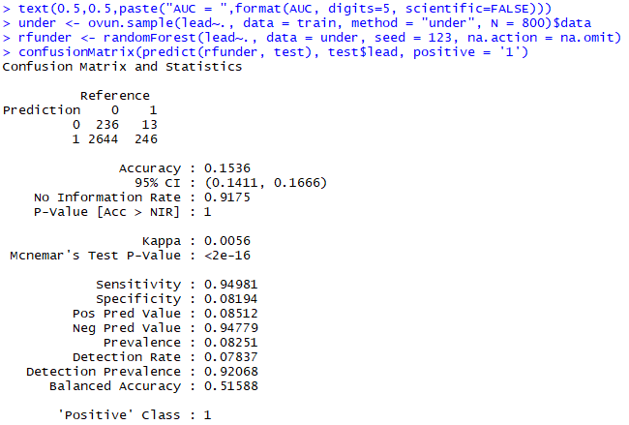
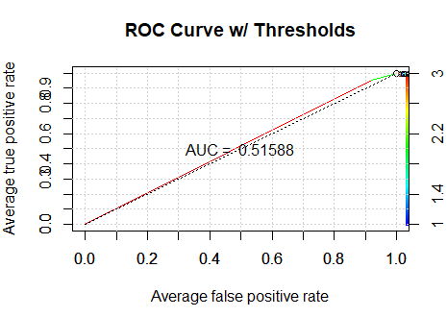
Random Forest, Undersampling, N = 800

Slide 24
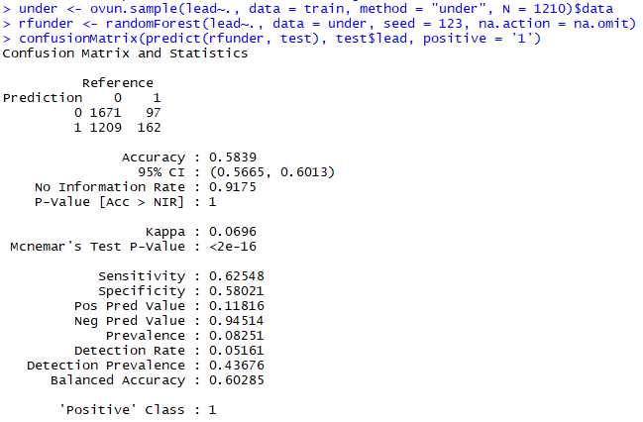
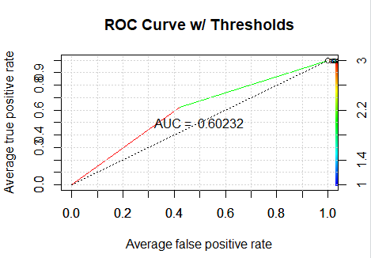
Random Sampling, Undersampling, N = 1200

Slide 25
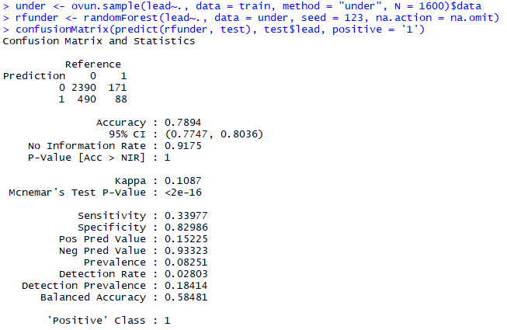
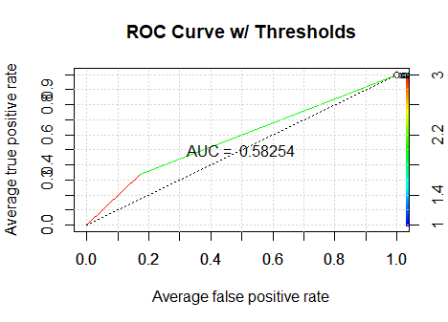
Random Forest, Undersampling, N = 1600

