Slide 1

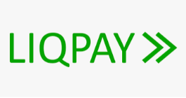






WebApi
Facade
Auth
Service
Order
Service
Payment
Service
IOS/Android
Auth
Controller
Payment
Controller
User Management
Service
Order
Controller
WEB
Stock
Controller
MSSQL Database
Stock
Service
Report
Controller
User
Controller
Admin
Report
Service
Log
Log Service
Elastic search

