Slide 1
Design and Development of an Image Analysis Based Interaction Controller for Mobile VR Edutainment Application
Safiul Kabir
ID: 120211
Aniruddha Prithul
ID: 120224
Thesis Supervisor
Kazi Masudul Alam
Computer Science & Engineering Discipline
Khulna University

Slide 2
Agenda
Introduction
Motivation
Objective
Architecture of Proposed System
The Interaction Controller
Image Analysis Based Detection
VR Edutainment Application
Experimental Results
Conclusion
Future Works

Slide 3
Introduction
What is Virtual Reality (VR)?
Immersion
Telepresence
Notes:
The meaning of ‘virtual’ is near and reality means our experience as a human being. So ‘Virtual
Reality’ means ‘near-reality’. The ideas behind virtual reality are based on theories about
human desire to cross the boundaries of the ‘real world’ by creating a virtual world. In that
world, we can interact with a virtual environment which will enable new classes of human-
machine interaction (HMI).
Immersion in Virtual Reality is the perception of being physically present in an unreal world.
This perception is created surrounding the user in images, sound or other stimuli using the VR
system.
Virtual Reality also uses the concept of Telepresence, which is the characteristic of being able
to feel present somewhere different of your real location, a remote presence. It was first
created by Marvin Minsky in 1980 and is a term widely used by the virtual reality community
for it is highly connected with the concept of immersion.

Slide 4
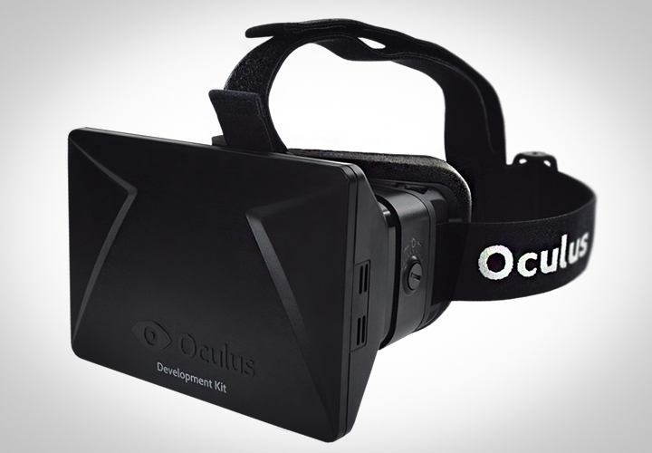
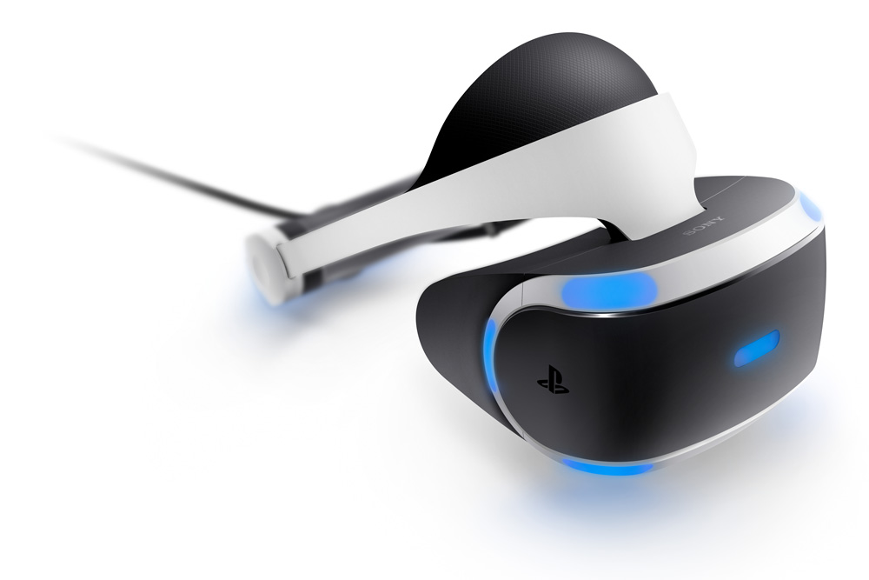
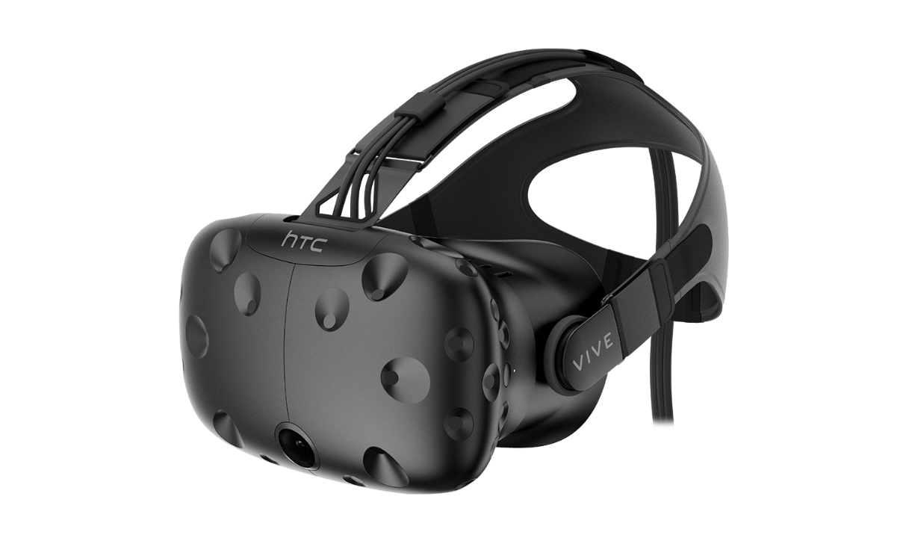
Motivation

Slide 5
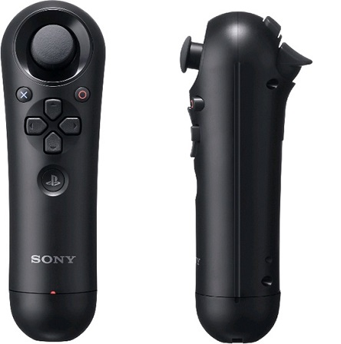
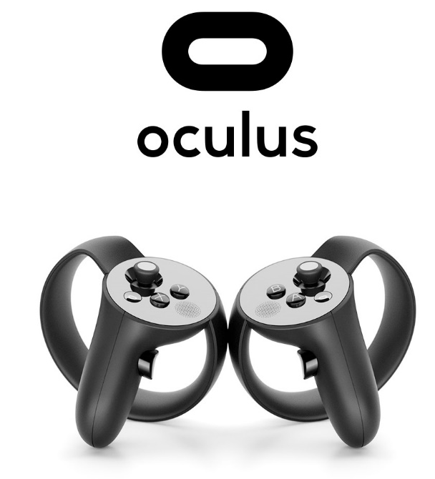

Motivation

Slide 6
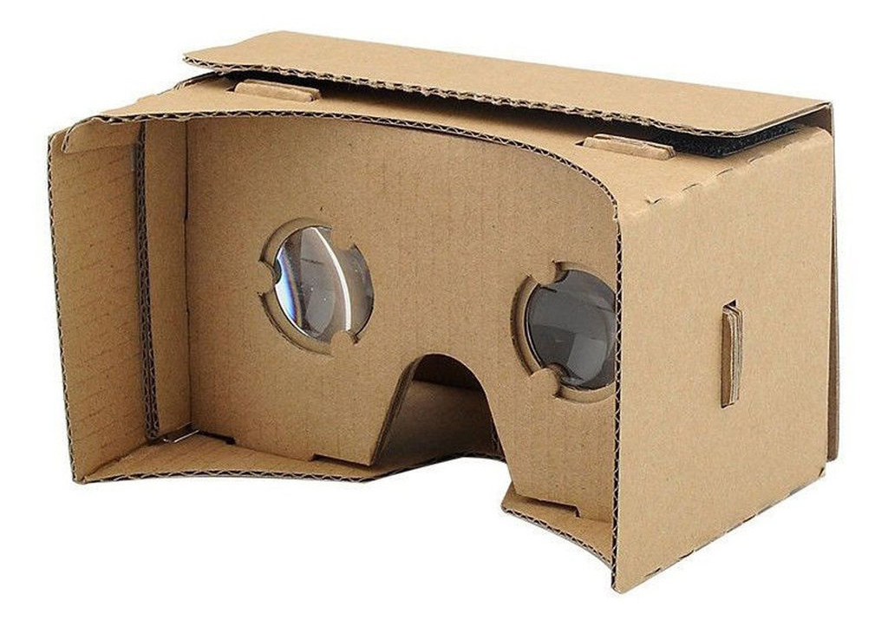
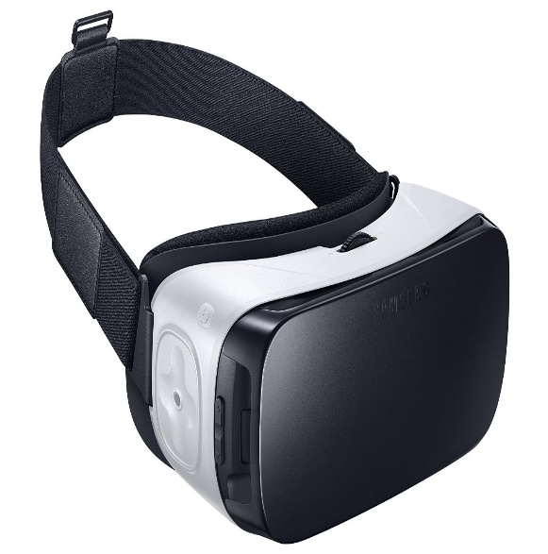
Motivation

Slide 7
Motivation
Most consumer VR systems require high power machines
They usually have complex set-ups with several connections
Most mobile VRs don’t have interaction controllers that support motion tracking
All existing controllers require some connection with VR device

Slide 8
Motivation
 | HTC Vive | Oculus rift | Playstation VR | Proposed System
Type | Tethered | Tethered | Tethered | Wireless, Mobile
Platforms | PC | PC | PlayStation 4 | Smartphone, PC
Controller | Primarily motion controllers | Xbox One gamepad | DualShock 4 and PS Move | Simple interaction controller
Additional Requirements | High-end PC with external Graphics Card | High-end PC with external Graphics Card | PS VR System, PS Move Controller | Webcam, Any laptop/desktop PC

Slide 9
Objective
To develop a image analysis based interaction controller that can be used with mobile VR devices
To develop a VR application to demonstrate the use of the interaction controller

Slide 10
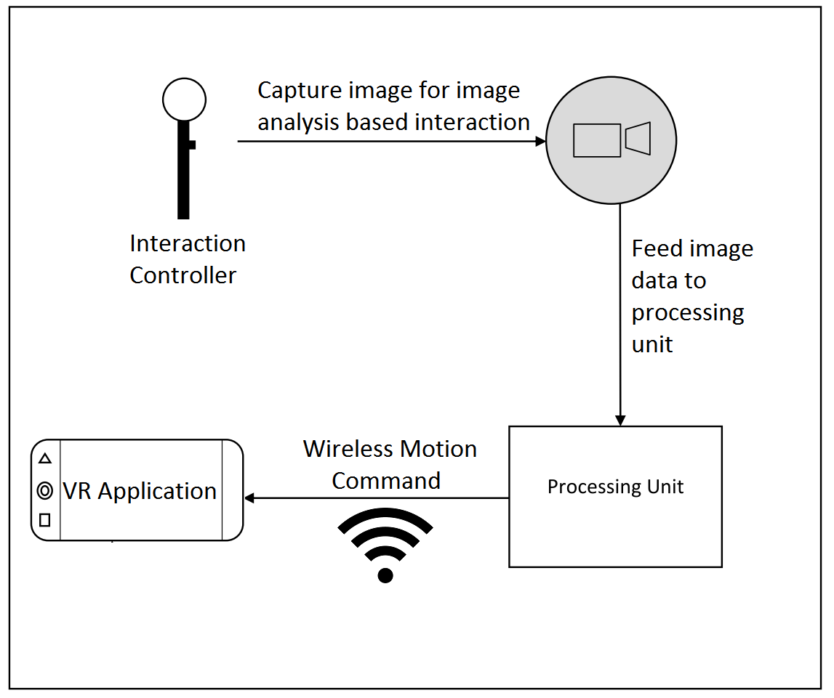
Architecture of Proposed System

Slide 11
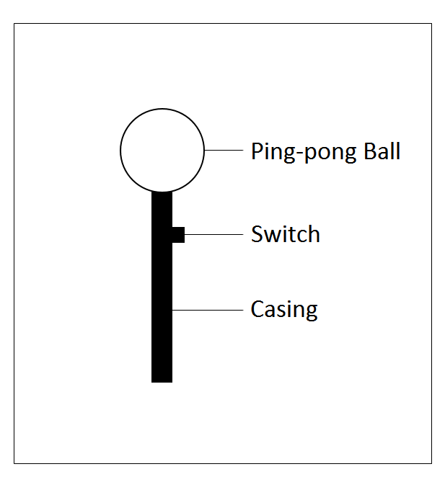
The Interaction Controller As envisioned

Slide 12
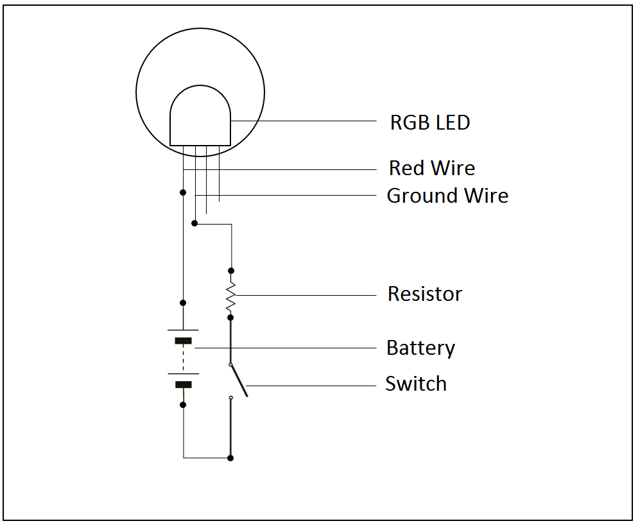
The Interaction Controller Circuit Diagram

Slide 13
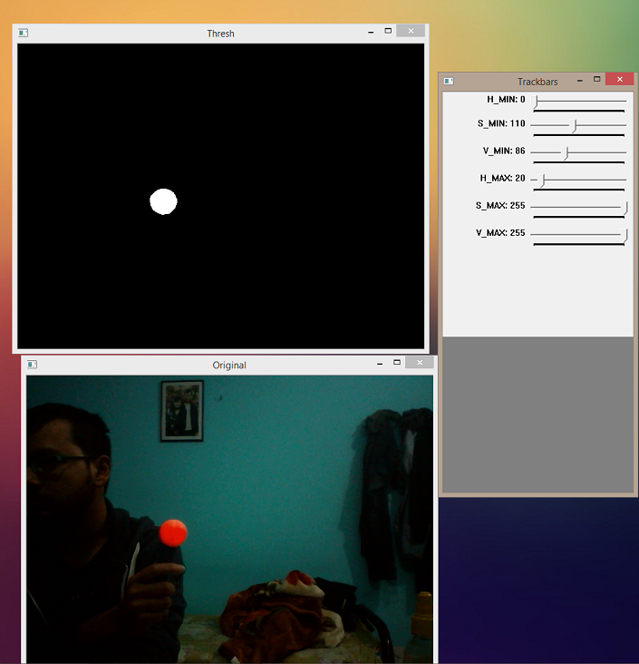
Image Analysis Based Detection Determining HSV Range

Slide 14
Image Analysis Based Detection Determining 2D Position and Radius
Capture video from camera
Apply Mask
Convert RGB to HSV color space
Find contours
Area of circle enclosing contour>= 0.5?
Apply Threshold
Perform Erosion and Dilation
Yes
Get radius and position of enclosing circle

Slide 15
Image Analysis Based Detection Depth Measurement
D’ = (W x F) / P
Here,
D’ = Distance from camera
W = Known width of the orb
P = Measured radius in pixels
F = (P x D) / W; D = Distance from camera when measuring focal length

Slide 16
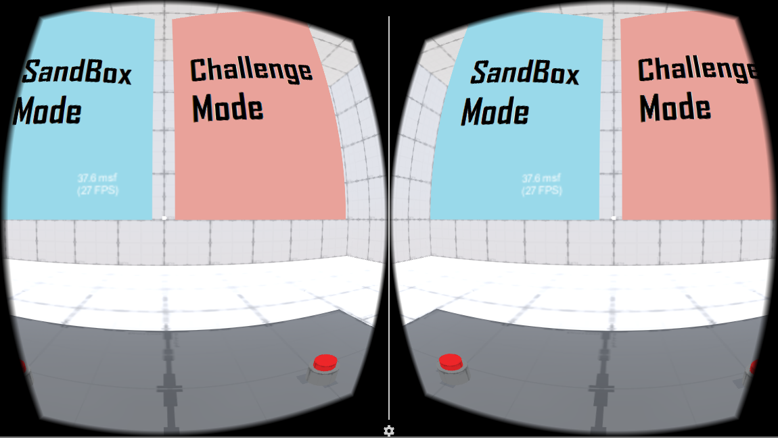
VR Edutainment Application Menu

Slide 17
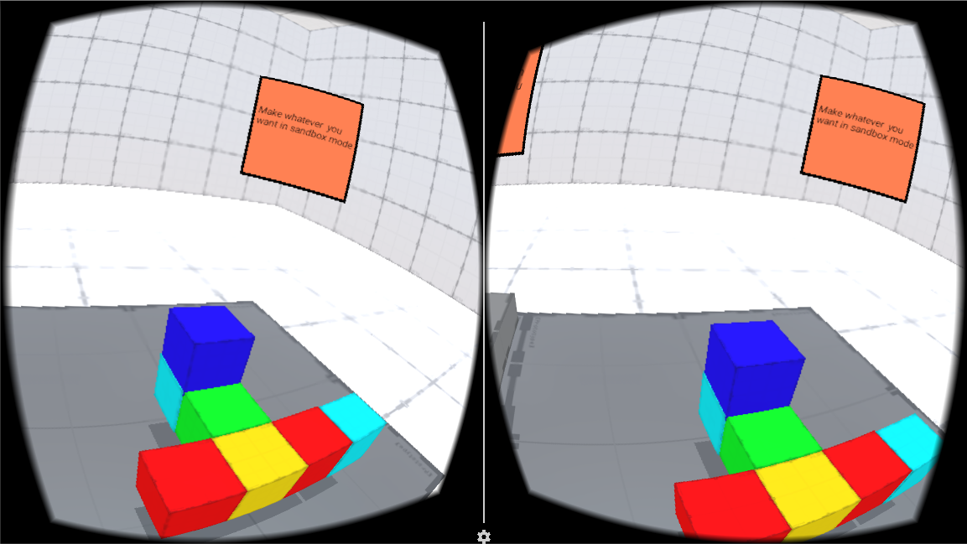
VR Edutainment Application Sandbox Mode

Slide 18
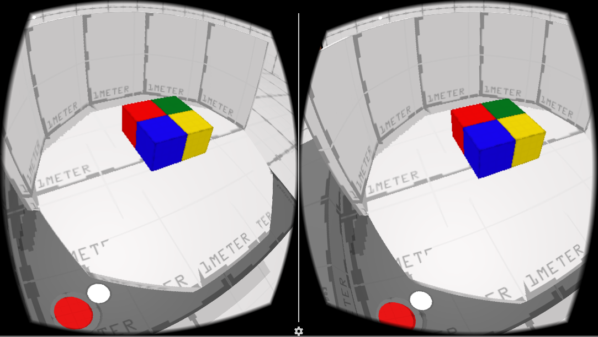
VR Edutainment Application Challenge Mode

Slide 19
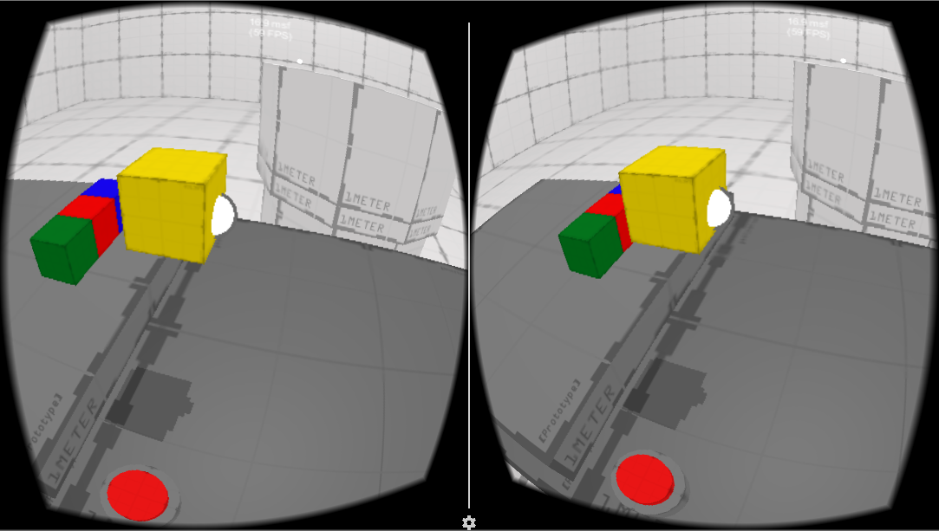
VR Edutainment Application Challenge Mode

Slide 20
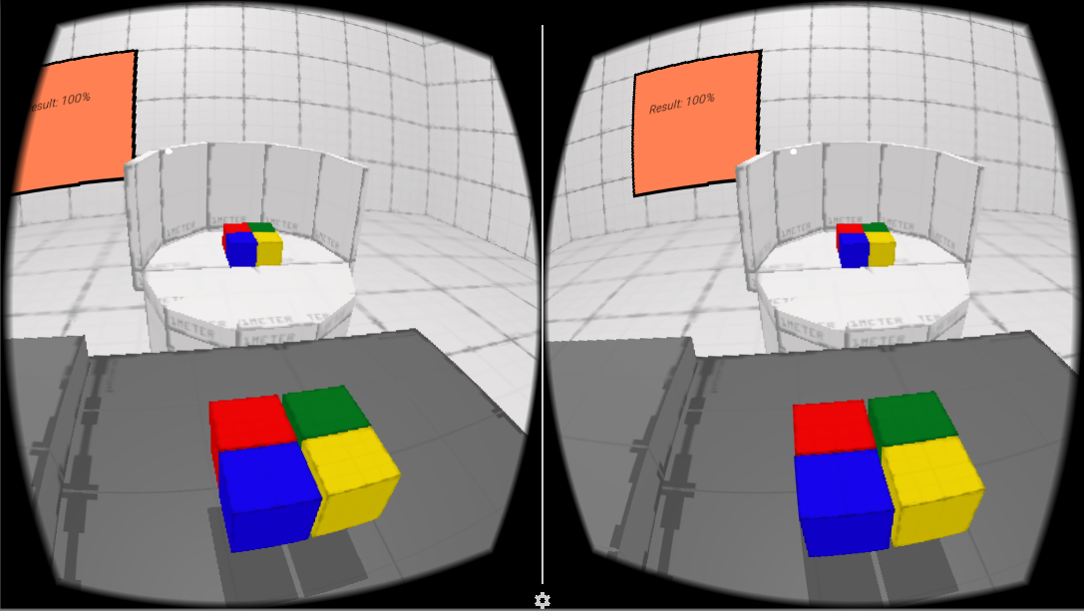
VR Edutainment Application Challenge Mode

Slide 21
Experimental Results Feedback of people having previous VR experience

Slide 22
Experimental Results Feedback of people having no previous VR experience

Slide 23
Conclusion
Image analysis based interaction controller allows more immersive experience in virtual reality
Idea can be used in more applications like pilot training in a simulated environment, educating children while playing games, sports training, making architectural structures in the 3D world, 3D paint application and many more.

Slide 24
Future Works
With more advancement in smartphones, it might be possible to do the entire processing in the background while running the VR application in the foreground of the device. This would eliminate the necessity of the external camera by using the smartphone camera for detecting the controller.

Slide 25
Thank You!

Slide 26
References
[1] "What is Virtual Reality? - Virtual Reality," Virtual Reality Society, 2016. [Online]. Available: http://www.vrs.org.uk/virtual-reality/what-is-virtual-reality.html. [Accessed 30 July 2016].
[2] I. E. Sutherland, "The Ultimate Display," in Proceedings of IFIP Congress, pp 506-508, 1965.
[3] K. Horowitz, "Sega VR: Great Idea or Wishful Thinking?," Sega, 28 December 2004. [Online]. Available: http://www.sega-16.com/2004/12/sega-vr-great-idea-or-wishful-thinking/. [Accessed 30 July 2016].
[4] "The Oregon Trail (video game) - Wikipedia," Wikipedia, [Online]. Available: https://en.wikipedia.org/wiki/The_Oregon_Trail_(video_game). [Accessed 20 January 2017].
[5] "Odell Lake (video game) - Wikipedia," Wikipedia, [Online]. Available: https://en.wikipedia.org/wiki/Odell_Lake_(video_game). [Accessed 19 January 2017].
[6] D. Nield, "How Oculus Rift works: Everything you need to know about the VR sensation," Wareable, 29 March 2016. [Online]. Available: http://www.wareable.com/oculus-rift/how-oculus-rift-works. [Accessed 30 July 2016].

Slide 27
References
[7] "New high-performance cave automatic virtual environment that functions with gesture recognition," Phys.org, 18 April 2013. [Online]. Available: http://phys.org/news/2013-04-high-performance-cave-automatic-virtual-environment.html. [Accessed 3 August 2016].
[8] Y. A. G. V. Boas, "Overview of Virtual Reality Technologies," in Interactive Multimedia Conference 2013, 2013.
[9] T. Schlomer, B. Poppinga, N. Henze and S. Boll, "Gesture Recognition with a Wii Controller," in 2nd international conference on Tangible and embedded interaction, Bonn, Germany, 2008.
[10] "Google Arts & Culture VR - Android Apps on Google Play," Google, [Online]. Available: https://play.google.com/store/apps/details?id=com.google.vr.museums&hl=en. [Accessed 21 January 2017].
[11] "Expeditions - Android Apps on Google Play," Google, [Online]. Available: https://play.google.com/store/apps/details?id=com.google.vr.expeditions. [Accessed 21 January 2017].
[12] "Erosion (morphology) - Wikipedia," Wikipedia, [Online]. Available: https://en.wikipedia.org/wiki/Erosion_(morphology). [Accessed 23 January 2017].

Slide 28
References
[13] "Dilation (morphology) - Wikipedia," Wikipedia, [Online]. Available: https://en.wikipedia.org/wiki/Dilation_(morphology). [Accessed 23 January 2017].
[14] "How to Find if Triangles are Similar," MathsIsFun.com, [Online]. Available: https://www.mathsisfun.com/geometry/triangles-similar-finding.html. [Accessed 19 January 2017].
[15] "Likert scale - Wikipedia," Wikipedia, [Online]. Available: https://en.wikipedia.org/wiki/Likert_scale. [Accessed 19 January 2017].
[16] S. P. A. W. a. E. W. R. Fisher, "Glossary - Binary Images," Informatics Homepages Server, University of Edinburgh, [Online]. Available: http://homepages.inf.ed.ac.uk/rbf/HIPR2/binimage.htm. [Accessed 30 July 2016].
[17] C. Payatagool, "Theory and Research in HCI: Morton Heilig, Pioneer in Virtual Reality Research - Telepresense Options," Telepresence Options, 19 September 2008. [Online]. Available: http://www.telepresenceoptions.com/2008/09/theory_and_research_in_hci_mor/. [Accessed 30 July 2016].

