Slide 1
TRAFFIC MANAGEMENT SYSTEM PHASE-4

Slide 2
INTRODUCTION:
First of all, we will create a web server using ESP32. After accessing the web server, the person will see three options. Basically, they will be the three lights of the system. To that, we will also keep updating the status of all the lights so that the person need not stay near the lights to observe them. Moreover, the changes could also be seen in the Serial monitor of Arduino.
In this project, I will be using a single RGB LED to show three colors for the same. For that, we need three GPIO pins of the NodeMCU. Since the LED which I am using is Common Anode, so for that only I have made the circuit. Change the common pin to GND and do the other necessary changes if you have Common Cathode type LED.

Slide 3
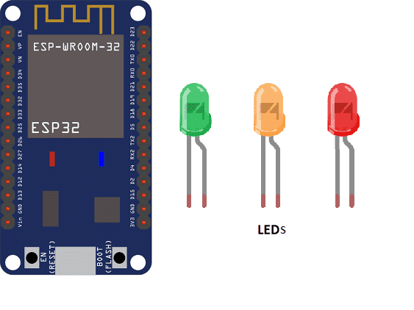
ESP32 MICROCONTROLLER

Slide 4
COMPONENTS REQUIRED: ESP32
The ESP32 is a low-cost, low-power microcontroller with built-in Wi-Fi and Bluetooth capabilities. It is a popular choice for IoT projects and is commonly used for a variety of applications such as home automation, wireless control, and sensor data logging. The ESP32 features a dual-core processor, a rich set of peripherals, and support for a wide range of protocols. It can be programmed using the Arduino IDE and various other programming languages such as C, C++, and MicroPython

Slide 5
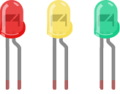
LED:
An LED (Light Emitting Diode) is a semiconductor device that emits light when an electric current is passed through it. LEDs are widely used in a variety of applications because they are energy-efficient, have a long lifespan, and are available in a wide range of colors.
LEDs can be found in many electronic devices such as televisions, smartphones, computers, and traffic lights. They are also used in automotive lighting, general illumination, and as indicator lights

Slide 6

RESISTORS:
A resistor is an electronic component that resists the flow of electrical current. It is used to control the amount of current flowing in a circuit and to adjust the voltage levels in a circuit. Resistors are made of a variety of materials, such as carbon, metal, and metal oxide, and come in a wide range of shapes, sizes, and types.
3 resistors of 220Ω

Slide 7
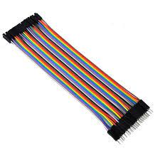
CONNECTING WIRES:
Connecting wires refers to the process of physically connecting wires or cables to a device or circuit in order to establish an electrical connection. This can be done by using various connectors such as plugs, sockets, or terminal blocks. The wires are typically color-coded to indicate their function, such as red for power, black for ground, and yellow for signals.

Slide 8
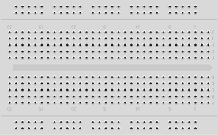
TEST PLATE:
A test plate is a type of circuit board that is used to test electronic components. It typically consists of a flat board made of a non-conductive material, such as plastic or fiberglass, with a number of holes or pads that are used to connect electronic components. The test plate allows you to connect electronic components and test them easily.

Slide 9
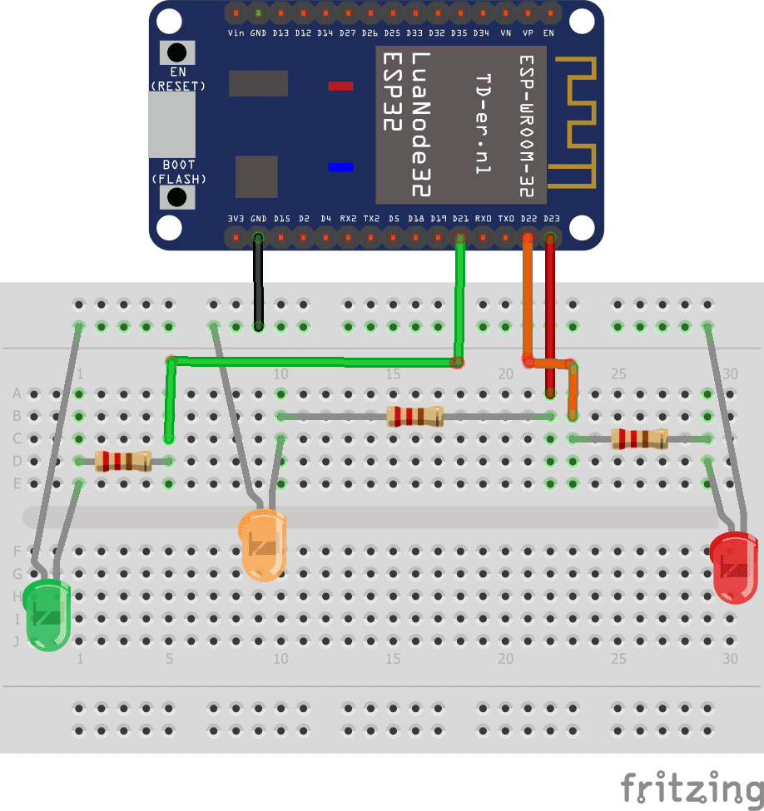
MOUNTING:
To perform the assembly, you can connect the yellow LED resistor to pin D23, the green LED resistor to pin D22 and the red LED resistor to pin D21 of the ESP32 board.

Slide 10
Python program for traffic prediction management
import time
from machine import Pin
led_jaune=Pin(23,Pin.OUT) #Sets ESP32 board pin D23 to output mode
led_rouge=Pin(22,Pin.OUT) # Sets ESP32 board pin D22 to output mode
led_verte=Pin(21,Pin.OUT) # Sets ESP32 board pin D21 to output mode
while True:
led_jaune.value(1) #Turn on yellow LED
led_rouge.value(0)
led_verte.value(0)
time.sleep(1) # wait 1s
led_jaune.value(0)
led_rouge.value(1) #Turn on red LED
led_verte.value(0)
time.sleep(3)
led_jaune.value(0)
led_rouge.value(0)
led_verte.value(1) #Turn on green LED
time.sleep(3)

Slide 11
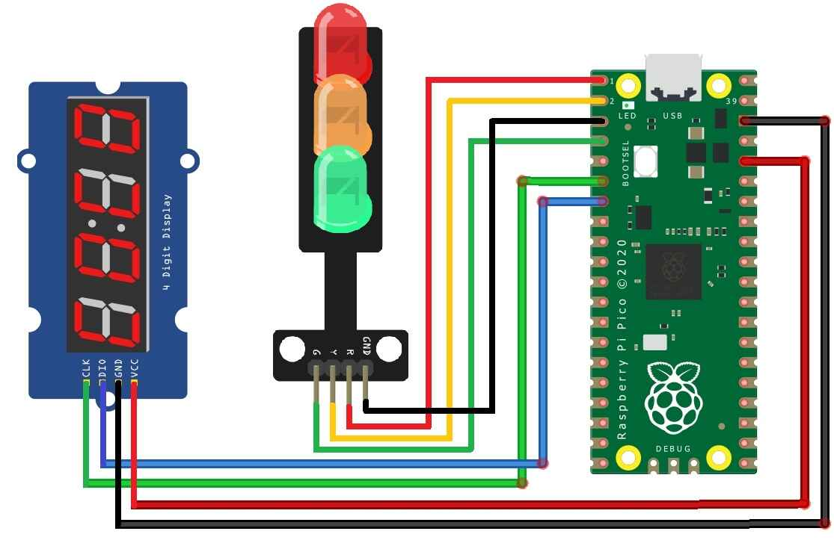

Slide 12
CONCLUSION:
We designed a smart traffic control system using ESP32 to solve the problem of congestion at the intersection of the Dor al Moalemen region, working to prevent traffic jam and reduce time, Using Arduino mega, ultrasonic sensor, and a camera esp32, the suggested technique analyses and manages everyday traffic at a three-line intersection. Humidity and temperature variations do not affect the system's accuracy.
Furthermore, the suggested system achieves three-line intersection sync and implements a balance between the number of vehicles on each side and the green light. In the case of traffic violation, the camera will capture the car number and send it to the database by using telegram.

