Slide 1
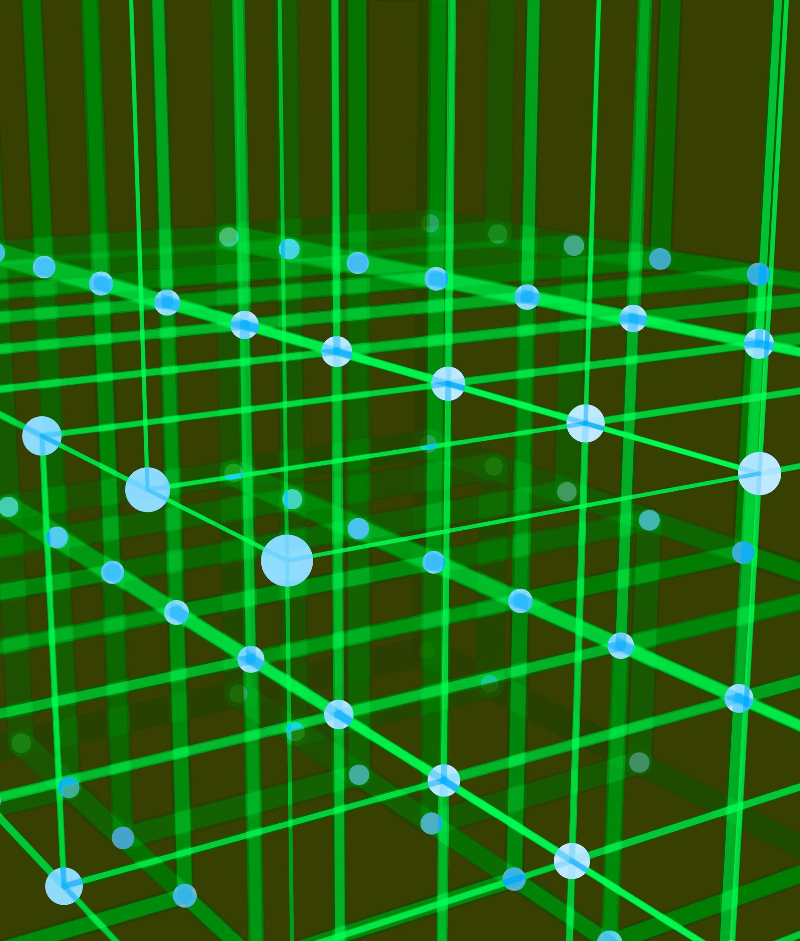
Neural Networks and Natural Language Processing

Slide 2
Revision of Neural Networks

Slide 3
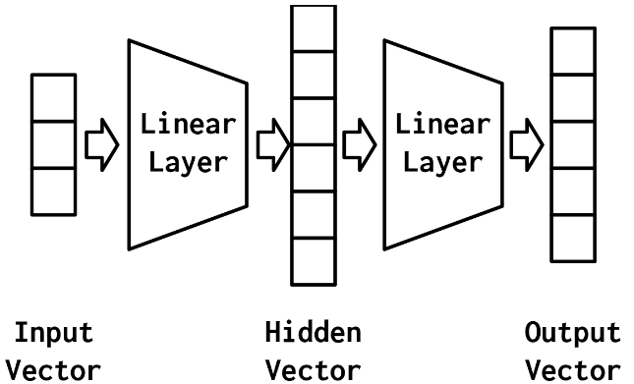
Multilayer Perceptron
Multilayer Perceptron is a type of artificial neural network.
It consists of an input layer, one or more hidden layers, and an output layer.
Each layer contains a number of artificial neurons that perform simple computations on their inputs.
The network is trained using a backpropagation algorithm.

Slide 4
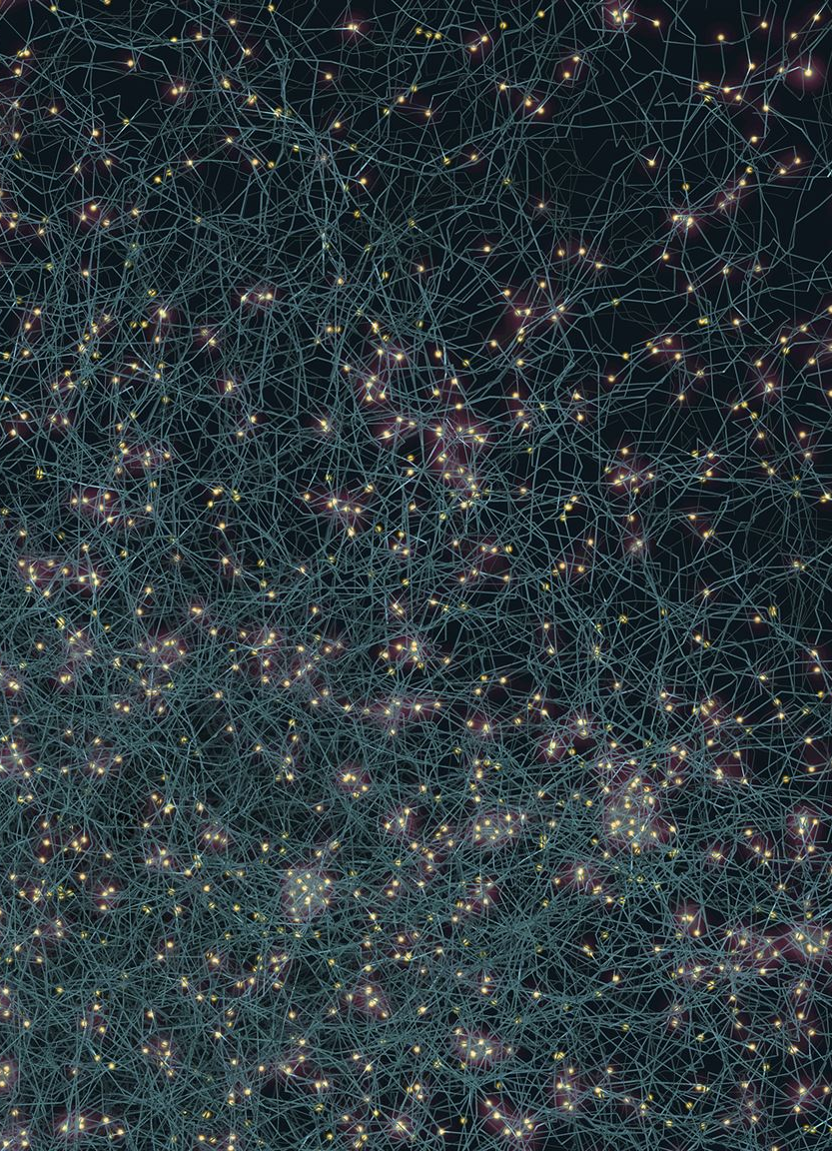
Types of Neural Networks
Feedforward Neural Networks
Feedforward neural networks are the simplest type of neural network and are used for tasks such as classification and regression. They consist of an input layer, one or more hidden layers, and an output layer.
Recurrent Neural Networks
Recurrent neural networks are designed to work with sequential data such as time-series and speech recognition. They are characterized by feedback loops that allow information to persist over time.
Convolutional Neural Networks
Convolutional neural networks are used for tasks such as image and speech recognition, and natural language processing. They consist of convolutional layers that detect features and reduce the dimensionality of the input.

Slide 5
Word Vectors

Slide 6

Word Vectors
Word vectors are numerical representations of words that capture their meaning and relationships to other words.
Word vectors are used in a variety of NLP applications, such as text classification, information retrieval, and machine translation.
Word vectors are often generated using techniques such as Word2Vec and GloVe, which use large amounts of text data to learn the relationships between words.

Slide 7
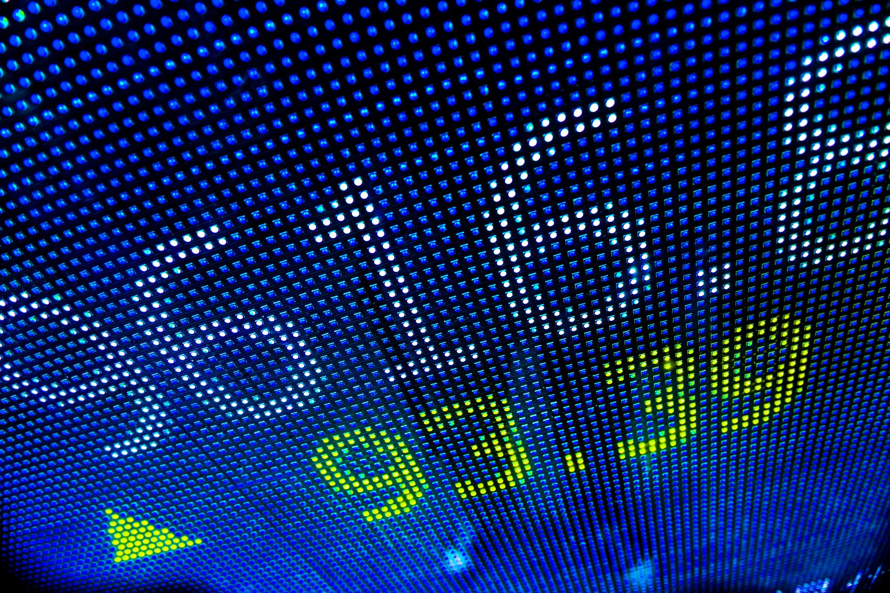
Word Vectors
We’ve ignored the nearby context of a word so far.
We ignored the words around each word, and the effect that neighbors of a word have in their meaning
The bag of words model jumbled all the words from each document together into a statistical bag.
Word vectors will help us identify synonyms, antonyms or words that just belong to the same category

Slide 8
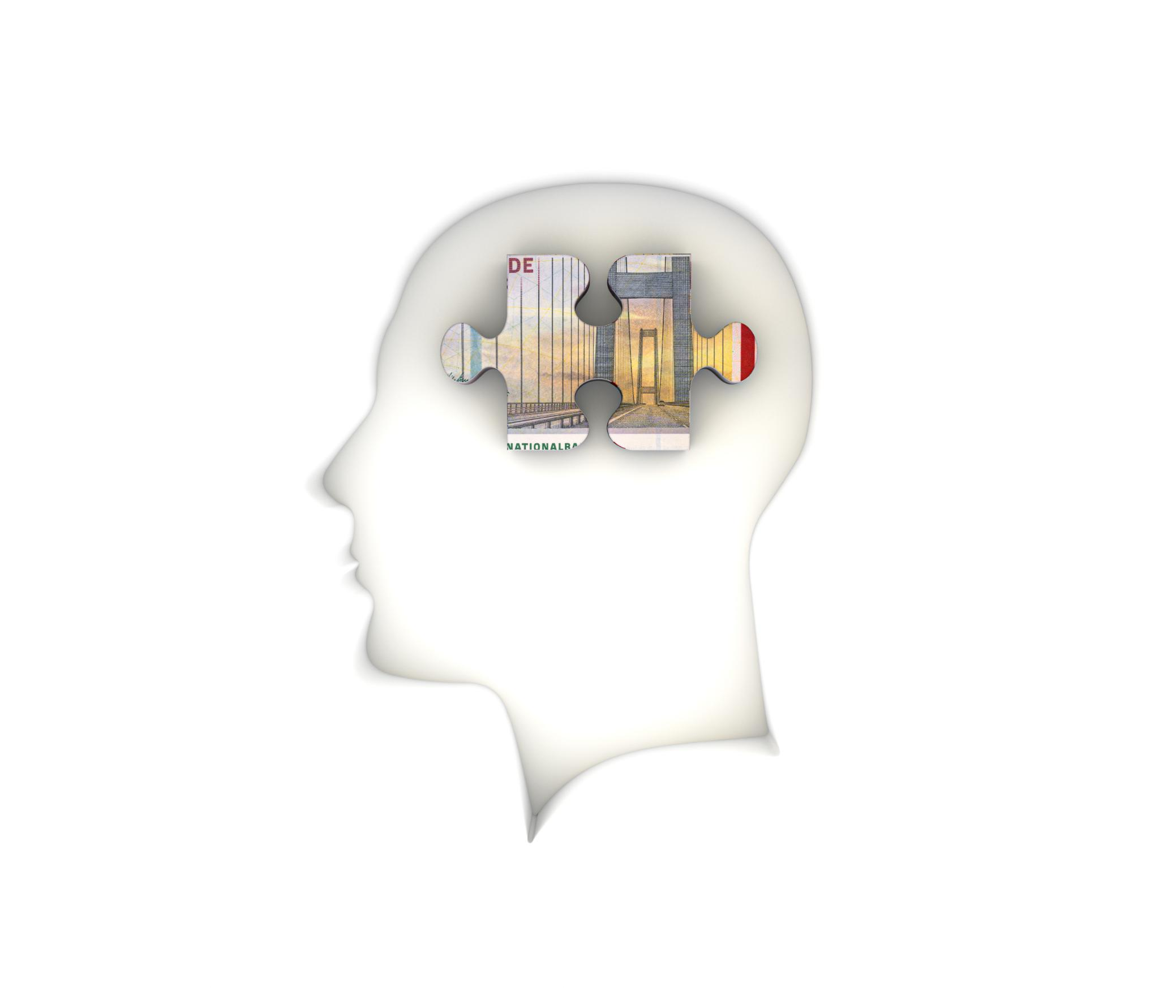
Word Vectors
Word vectors are numerical vector representations of word semantics, or meaning, including literal and implied meaning.
Word vectors can capture the connotation of words, like “peopleness,” “animalness,” “placeness,” “thingness,” and even “conceptness.”
Enter in google:
“Colombian Nobel prize winner “
“The Seahawks of San Francisco”
Represent this as vectors.

Slide 9
Calculating Word Vectors
Word vectors are calculated using algorithms that analyze large datasets of text.
There are two possible ways to train Word2vec embeddings:
The skip-gram approach predicts the context of words (output words) from a word of interest (the input word).
The continuous bag-of-words (CBOW) approach predicts the target word (the output word) from the nearby words (input words).
Companies that deal with large corpora and can afford the computation have open sourced their pretrained word vector models.

Slide 10
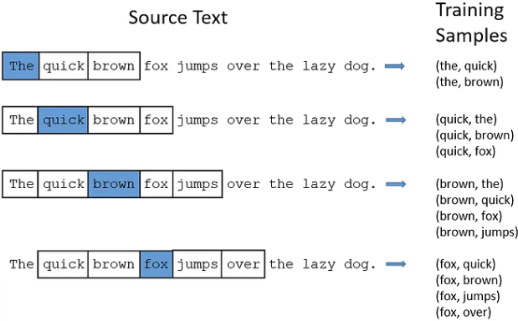
Skip-Gram
Skip-gram is a type of neural network used for language modeling and generation.
Skip-gram uses a sliding window approach to find the context words around a target word.

Slide 11
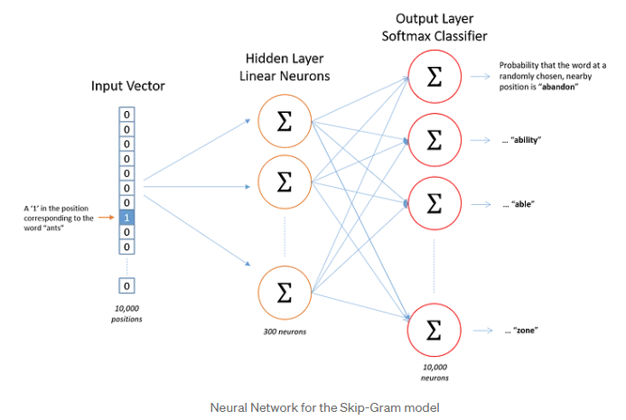
Skip-Gram

Slide 12
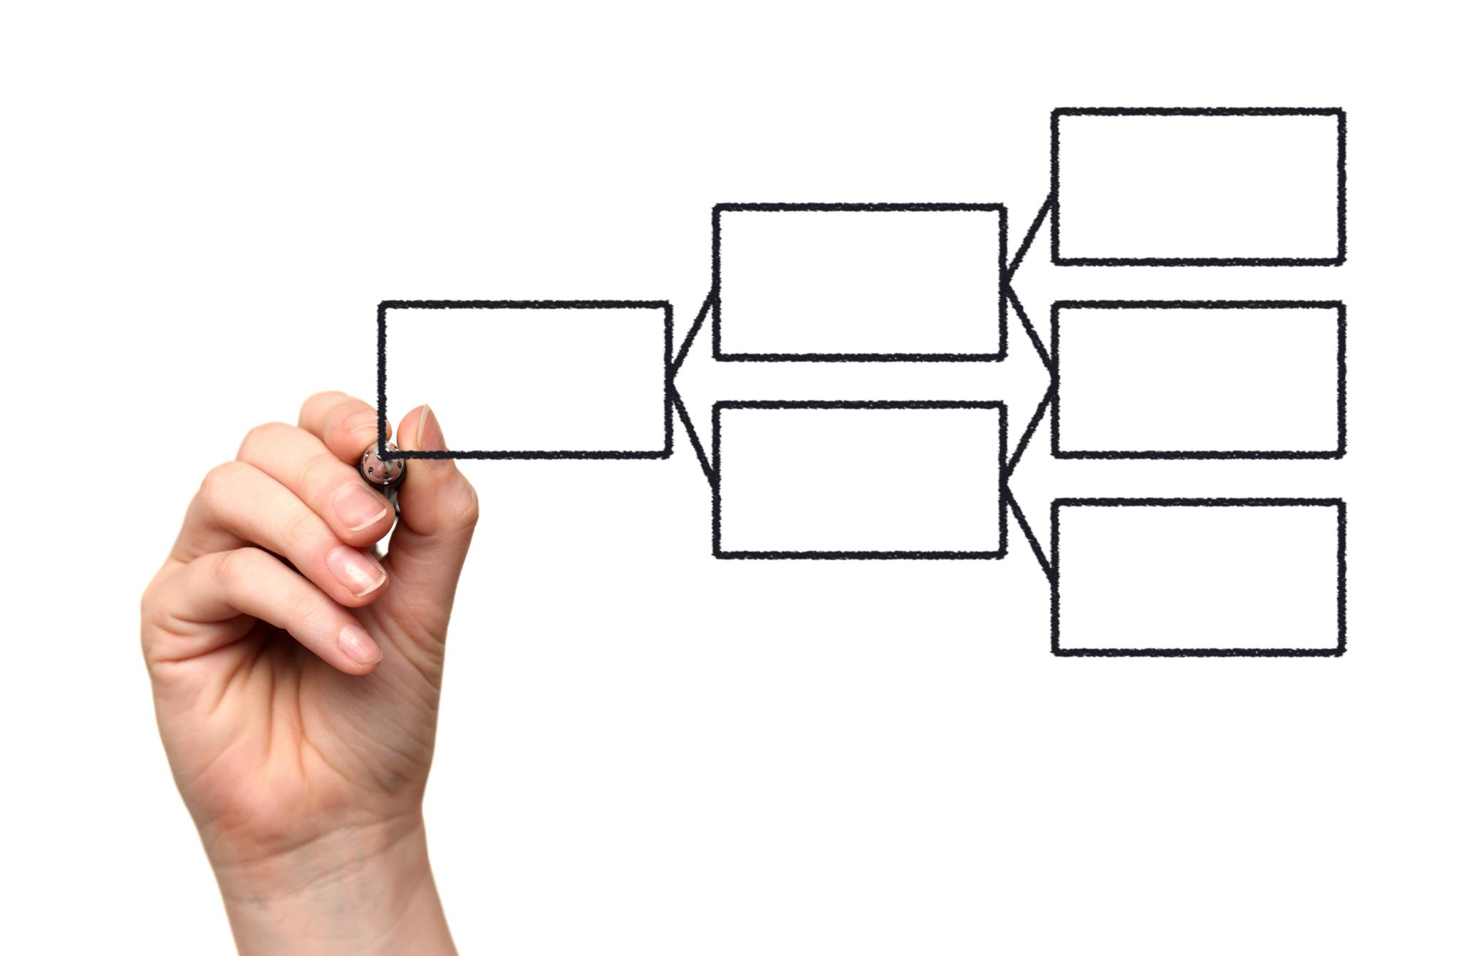
Bias in Word Vectors
Word vectors can reflect bias in the data used to train them.
Bias in word vectors can reinforce stereotypes and perpetuate discrimination.
Addressing bias in word vectors requires diverse training data and careful analysis of the resulting word vectors.

Slide 13

Similarity in Word Vectors
Word vectors can be used to determine semantic similarity between words.
Cosine similarity is a common measure used to calculate the similarity between two-word vectors.
The cosine similarity ranges from -1 to 1, with higher values indicating greater similarity.
The concept of Word2vec can also be extended to sentences, paragraphs, or entire documents.

Slide 14
Words in Order

Slide 15

Meaning
Language’s true power isn’t in the words themselves, but in the spaces between the words, in the order and combination of words.
Sometimes meaning is hidden beneath the words, in the intent and emotion that formed that combination of words.
Computational models of meaning aim to capture the nuances of language and how it is used in context.

Slide 16
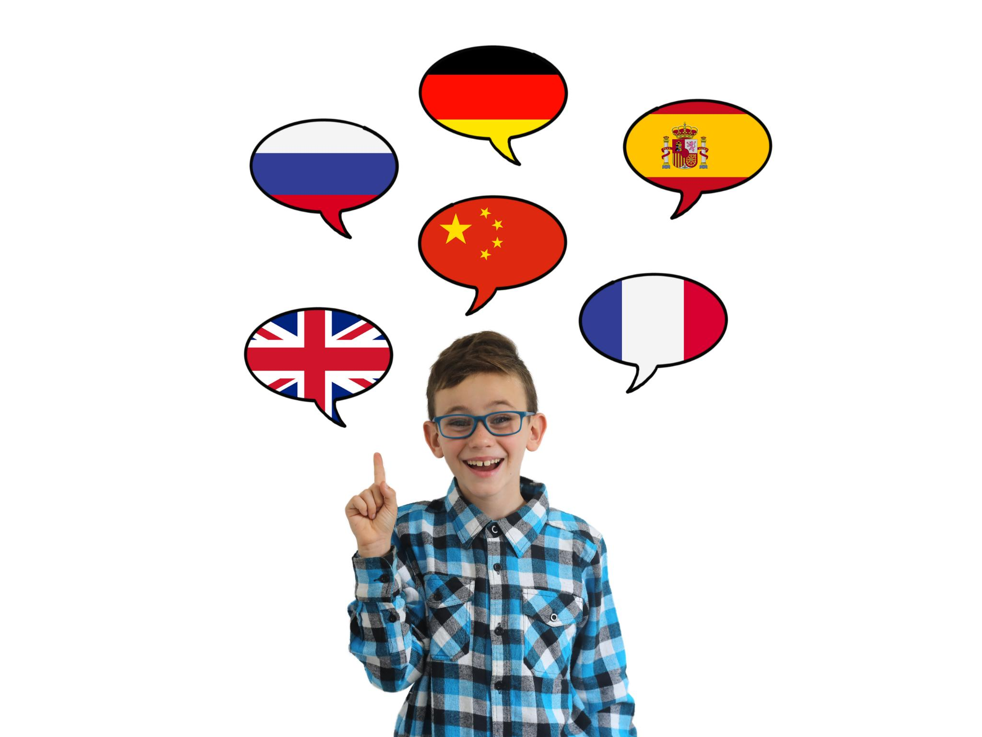
Learning Meaning
Learning meaning is a complex process that involves understanding both literal and implied meanings.
That relationship can be expressed in at least two ways:
Word order (“the dog chased the cat” or “the cat chased the dog”)
Word proximity (“the two friends, despite years of being apart, shared a special connection”)

Slide 17

Temporal and Spatial Patterns
Word order and proximity can be explored for patterns in two ways:
Spatial: examine the statement as if written on page. You’re looking for relationships in the position of words
Temporal: explore it as if spoken. The words and letters become time series data.
Basic MLPs are capable of pulling patterns out of data. However, the patterns they discover are found by relating weights to pieces of the input. Nothing captures the relations of the tokens spatially or temporally.

Slide 18
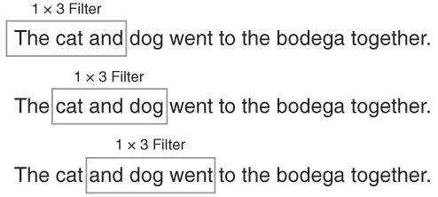
Convolutional Neural Networks
Convolutional neural networks (CNNs) are a type of neural network used in natural language processing (NLP).
CNNs are commonly used for tasks in computer vision.
We can apply CNNs in NLP by using word vectors (embeddings).
No relevant information in the patterns of text when considered vertically (with respect to the page).
Relative information is in the relative “horizontal positions”. We’ll use a one-dimensional filter over the one-dimensional filter (e.g., sentence)

Slide 19
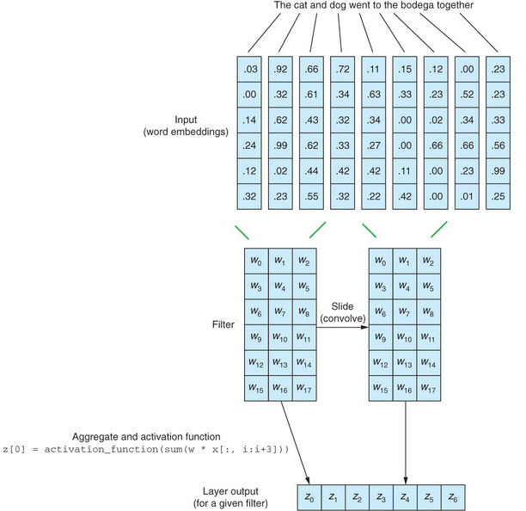
CNNs
The filter is applied to three vectors at the time.
Given that the filter weights are unchanged for a given input during the forward pass, parallel computations can be done, making the process fast and efficient.

