Slide 1

Attention Models in NLP
A detailed insight into natural language processing techniques

Slide 2
Gated Recurrent Unit (GRU)

Slide 3
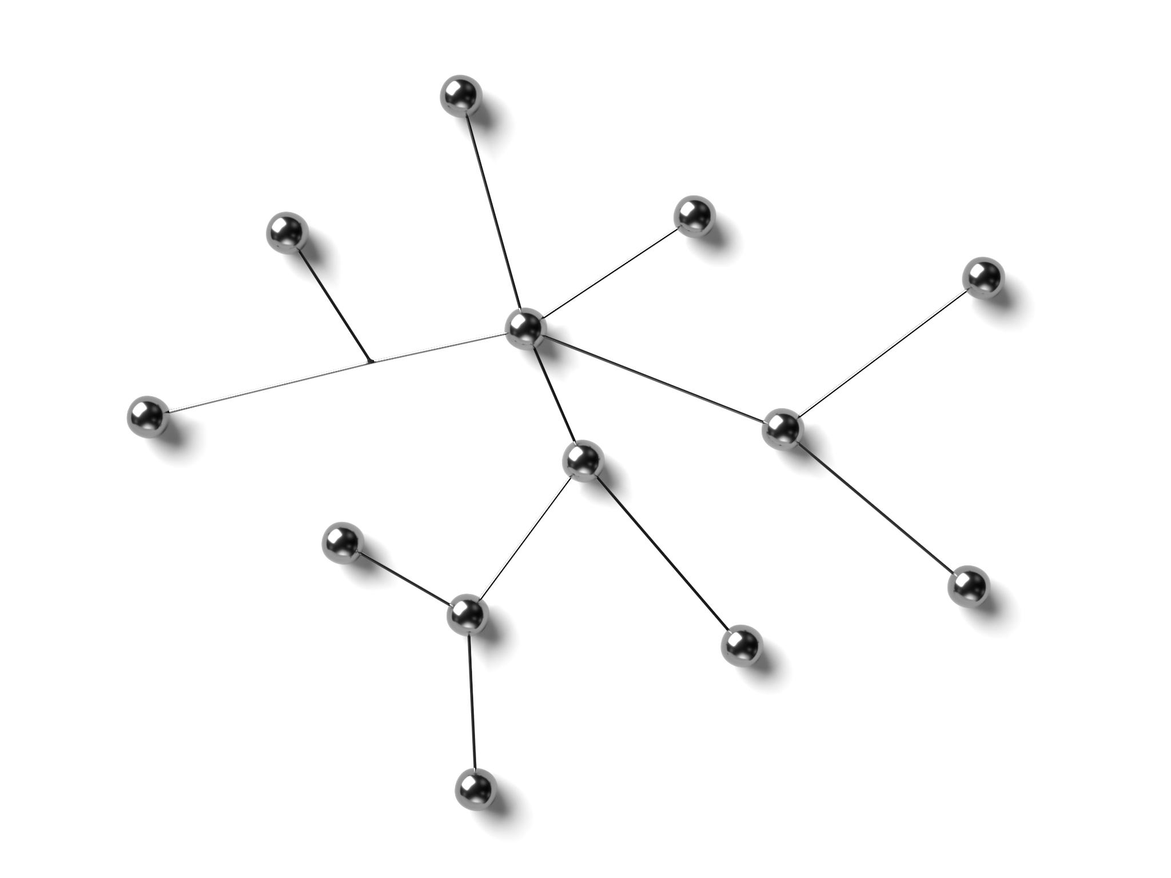
Gated Recurrent Unit (GRU) Models
GRU models are a type of recurrent neural network that are similar to long short-term memory (LSTM) models.
GRU models use gates to control the flow of information within the network, allowing them to selectively remember or forget information.
GRUs have two gates:
Reset gate – determines how much of the previous hidden state to forget
Update gate – determines how much of the candidate activation vector to incorporate into the new hidden state

Slide 4
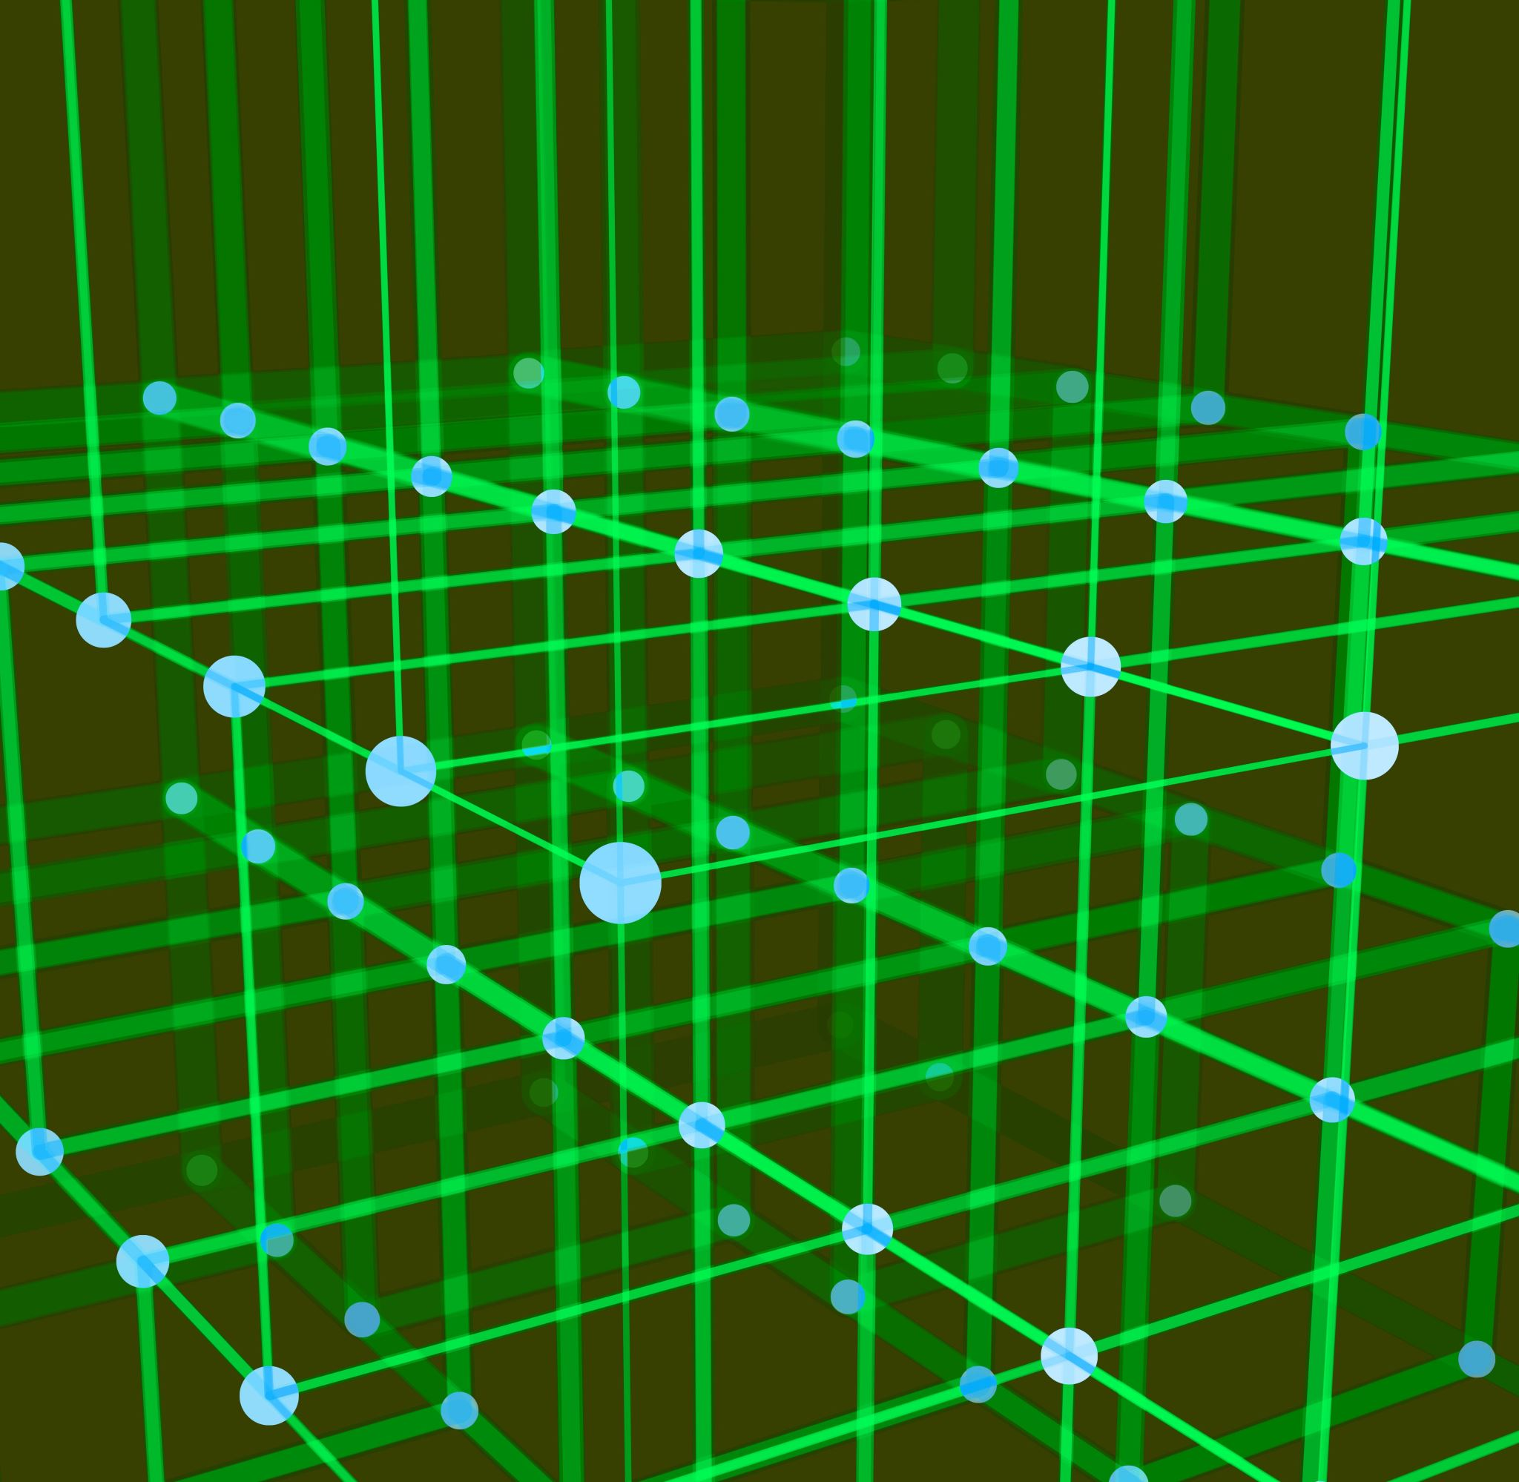
GRUs vs LSTMs
GRUs are a type of recurrent neural network that are similar to LSTMs.
GRUs have two gates (reset and update) while LSTMs have three (input, output, and forget).
GRUs are computationally less expensive than LSTMs and have better performance on small datasets.

Slide 5
Pros and Cons of GRUs
Less computationally expensive and faster to train than LSTMs
GRUs can handle long-term dependencies in sequential data by selectively remembering and forgetting previous inputs
Shown to perform well
Might not perform as well as LSTMs on modeling very long-term dependencies or complex sequential patterns

Slide 6
Evaluating Language Models

Slide 7

Perplexity
Perplexity is a standard metric to evaluate language models.
It measures the model's ability to predict unseen data.
Perplexity is computed using the probability distribution of the model over the test data.
Human evaluation is still an important aspect of language model evaluation.
Task-specific evaluation can also be used to evaluate language models.

Slide 8
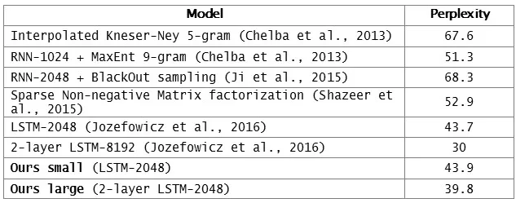
Perplexity Values of Typical Models used in NLP
A lower perplexity score indicates a better language model.
Perplexity values can vary greatly depending on the model and the dataset being used.
Source: Building an efficient neural language model over a billion words - Engineering at Meta (fb.com)

Slide 9
Sequence-to-Sequence Models

Slide 10

What are Sequence-to-Sequence Models?
Sequence-to-sequence models are designed to map an input sequence to an output sequence, with the input and output sequences having different lengths.
Examples: language translations, chatbots, etc
LSTMs are a good candidate for implementing them

Slide 11

The Encoder
In a sequence-to-sequence model, the encoder is the part of the network that processes the input sequence.
It typically turns a sequence into a lower-dimensional representation.
The encoder typically uses a recurrent neural network, such as an LSTM or GRU.
These models capture the meaning in an internal representation.

Slide 12

The Decoder
The decoder is the part of the sequence-to-sequence model that generates the output sequence based on the input sequence.
The decoder turns the vector back into human readable text.
Similarly, the decoder typically uses a recurrent neural network, such as an LSTM or GRU, to generate the output sequence.
We already know how to do these networks; we just need to learn how to make them better, more focused.

Slide 13
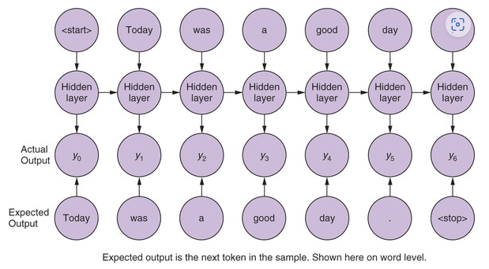
seq2seq example

Slide 14
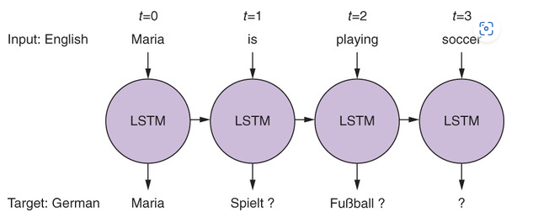
seq2seq example
Sentences in different languages have different lengths
A seq2seq model creates an input representation as a vector (context vector).
Then the context vector is used as a starting point to a second network that receives a different set of inputs to generate the output sequence.

Slide 15
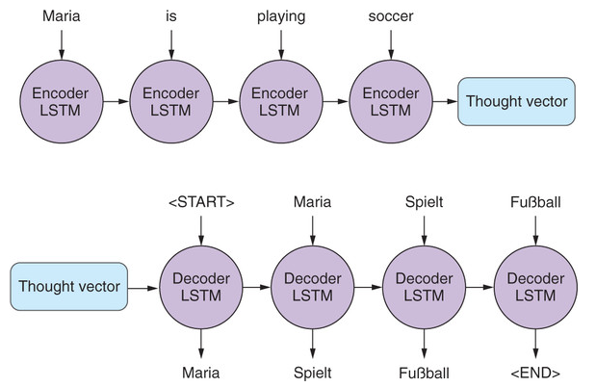
Context vector
A context vector is similar to a word vector, a neural network can compress information from any natural language statement, into a fixed length vector.
The context vector has two parts:
The output of the hidden layer of the encoder
The memory state of the LSTM cell

Slide 16
Training
Pass the starting text to the encoder
Pass the expected text as input to the decoder
The goal is to make the decoder network to learn that, given a primed stated and a key to “get started”, it should produce a series of tokens.
The first direct input to the decoder will be the start token; the second input should be the first expected (or predicted) token, which should in turn prompt the network to produce the second expected token.

Slide 17
Inference
You don’t have the expected text, so you use a generic start token.
Then take the first generated element, which will then become the input to the decoder to the next time step, and so on.
This process repeat until the maximum number of sequence elements is reached or a stop token in generated

Slide 18
Attention mechanism

Slide 19

Limitations of Seq2Seq
The final hidden state of the encoder creates an information bottleneck
It has to represent the meaning of the whole input sequence
Difficulty in handling long sequences due to memory constraints.
Inability to preserve context information, often leading to loss of meaning in translation tasks.
Challenges in handling rare or out of vocabulary words.

Slide 20
Attention Mechanisms
The main idea of attention is that instead of producing a single hidden for the input sequence, the encoder outputs a hidden state at each step that the decoder can access.
Attention mechanisms allow encoder-decoder models to selectively focus on different parts of the input sequence.
In encoder-decoder models with attention, the decoder attends to different parts of the input sequence as it generates the output sequence.

Slide 21
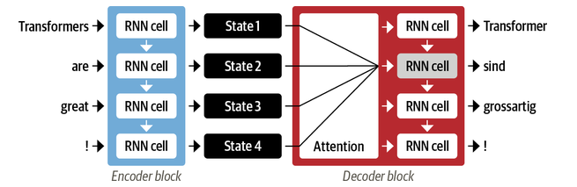
Attention Mechanisms
Using all the states at the same time would create a huge input for the decoder.
The decoder assigns a different amount of weight (or attention) to each of the encoder states at every decoder timestep.
By focusing on which input tokens are most relevant at each timestep, these attention-based models can learn nontrivial alignments between the words in a generated translation and those in a source sentence.

Slide 22

Bahdanau Attention
Also called additive attention
It employs a learned alignment model to compute attention scores between the encoder and decoder hidden states
It uses a feed-forward neural network to calculate alignment scores
An alternative (Luong attention) computes the attention scores using the dot product between the decoder hidden state and the encoder hidden states

Slide 23
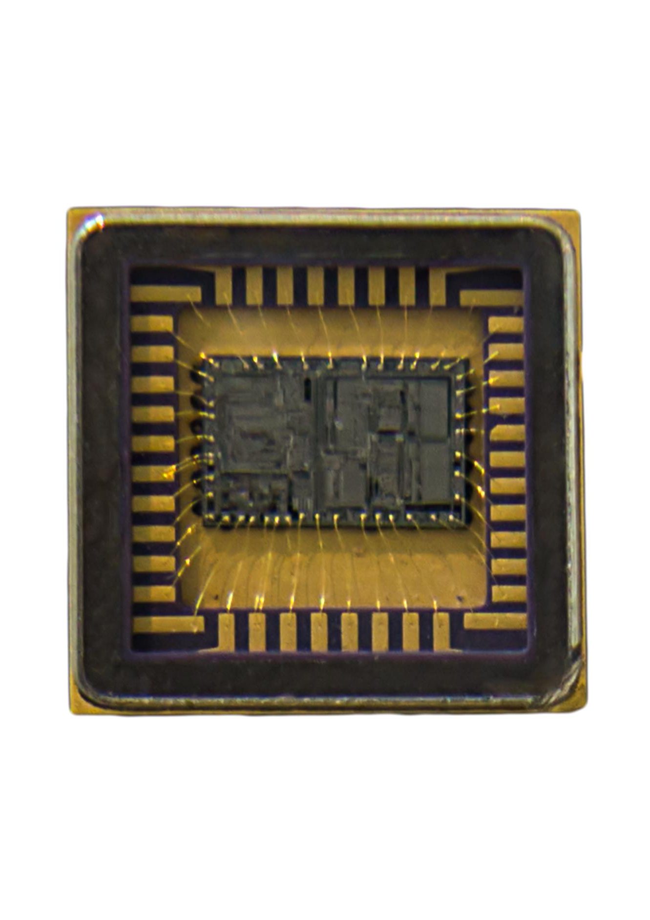
Limitations of Attention
Although attention enabled the production of better translations, the computations are inherently sequential
There was not parallelism, which made them inefficient.

Slide 24
Transformer

Slide 25

Transformers in NLP
Transformers are a type of neural network architecture that have become popular in natural language processing (NLP).
The key idea behind transformers is the attention mechanism, which allows the network to selectively focus on relevant parts of the input sequence.

Slide 26
Transformer-encoder

Slide 27
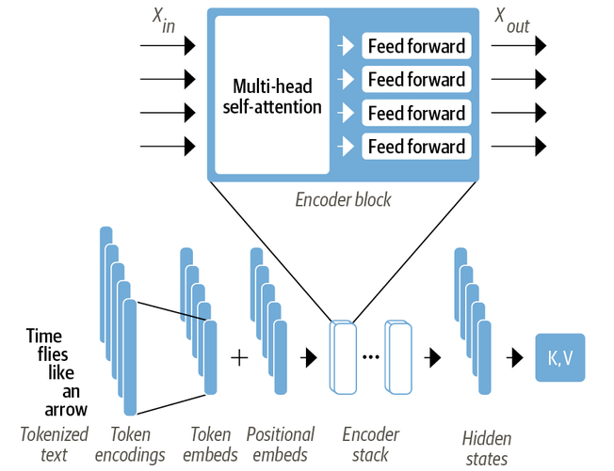
Encoder Architecture

Slide 28
Self-Attention
Self-attention is a mechanism that allows neural networks to weigh the importance of different parts of an input sequence.
In the case of text, the input sequence are token embeddings.
The weights (or attention) are computed for all the hidden states in the same set (e.g., all hidden states of the encoder).
The main idea is that instead of using a fixed embedding per token, we use the whole sequence to compute a weighted average of each embedding.

Slide 29
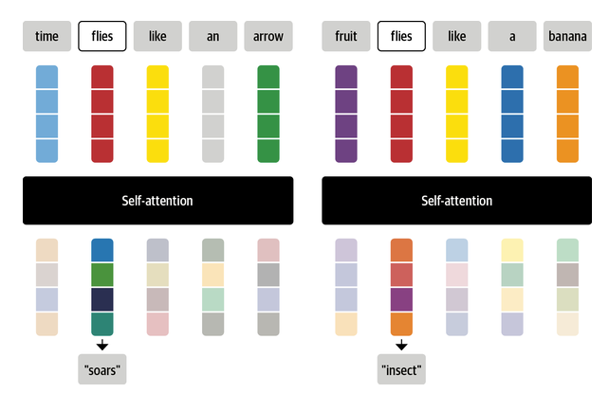
Self-Attention
Another way to formulate this is to say that given a sequence of token embeddings, self-attention produces a sequence of new embeddings where each new embedding is a linear combination of all the token embeddings
In the example, depending on the context, the self-attention mechanism would help associate the word flies with a verb or an insect

Slide 30
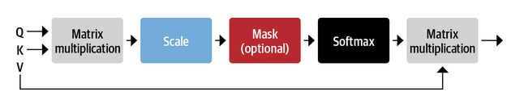
Scaled Dot-Product Attention
Scaled Dot-Product Attention is a type of attention mechanism used in neural networks.
Project each token embedding into three vectors called query, key and value
Compute attention scores.
Get similarity (dot product) of query and key vectors
Compute attention weights
Attention scores are multiplied by a scaling factor to normalize their variance and then normalized with a softmax to ensure all the column values add to 1
Update token embeddings
Multiply the value vector with attention weights

Slide 31
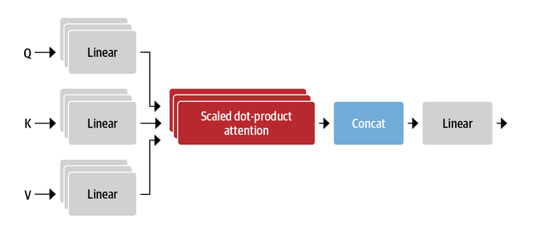
Multi-Headed Attention
Applies the same principles of self-attention
It uses multiple sets of linear projections, each one representing an attention head.
We need more than one attention head because the softmax tends to focus on mostly one aspect of similarity
For example, one head can focus on subject-verb interaction, while another finds nearby adjectives
Similar to filters in CV. One filter can focus on faces and another one on cars.

Slide 32
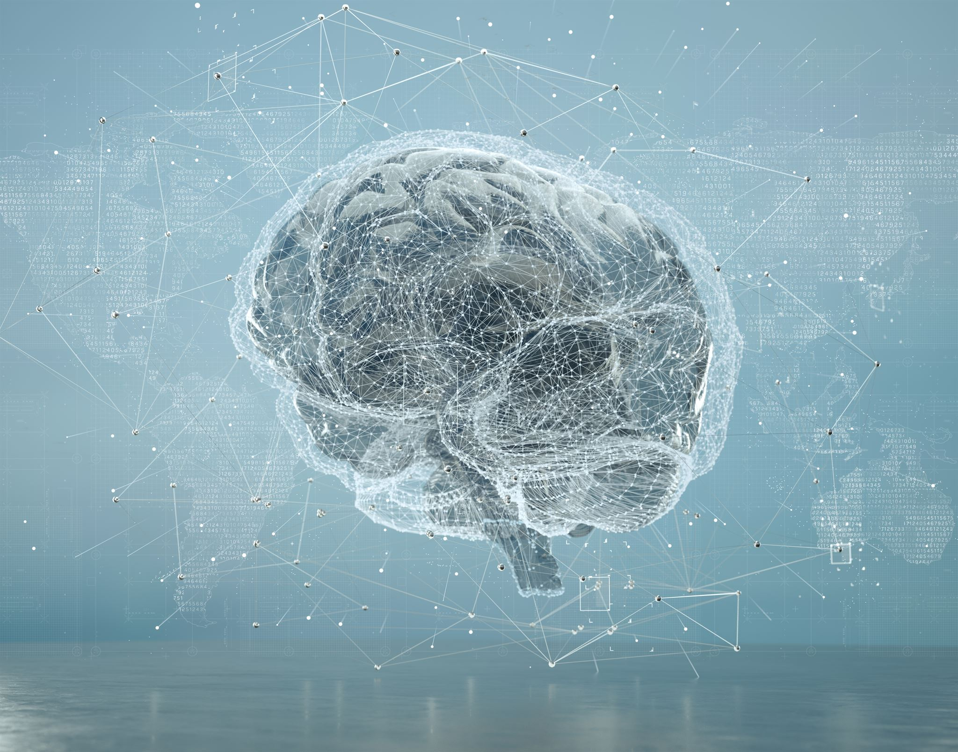
Feed Forward Layer
The feed forward layer consists of two linear transformations with a GELU activation function.
Instead of processing the whole sequence of embeddings as a single vector, it processes each embedding independently

Slide 33
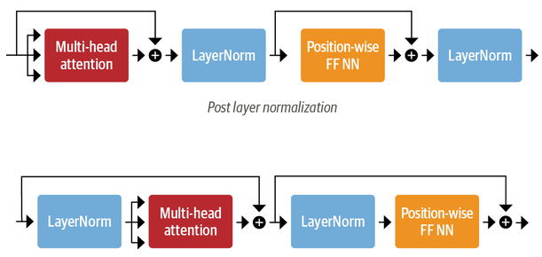
Layer Normalization
Transformers use skip connections and layer normalization
Skip connections pass a tensor to the next layer of the model without processing and add it to the processed tensor
Layer normalization is like batch normalization but is applied over the features instead of the batch dimension
Each input in the batch is normalized to have zero mean and unity variance
Post layer normalization:
Layer normalization between the skip connection
Gradients can diverge during training
Pre layer normalization:
Layer normalization within the span of the skip connections

Slide 34

Positional embeddings in encoders
Positional embeddings help encoders to interpret sequential data with respect to position in the sequence
Positional embeddings are added to the input embeddings to retain sequence information in the absence of explicit order
If the patterns is characteristic for each position, the attention heads and feed-forward layers in each stack can learn to incorporate positional information into their transformations

Slide 35
Classification Head
A classification head is a neural network layer that is added to the end of the encoder.
The purpose of the classification head is to classify the input sequence based on a specific task.
The classification head is trained using a labeled dataset, which is used to measure the accuracy of the network.

Slide 36
Transformer-decoder

Slide 37
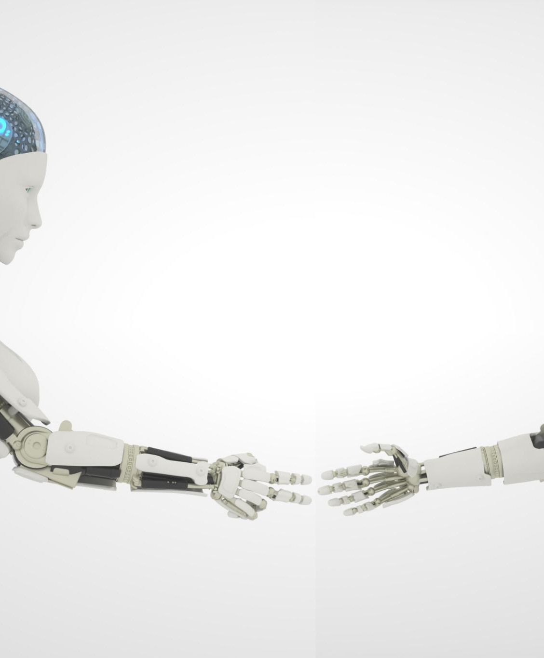
Applications of Recent Attention Models
Language Modeling
Recent attention models have been applied to language modeling tasks, improving performance in language generation and prediction tasks, such as text classification and sentiment analysis.
Machine Translation
Attention models have improved the quality of machine translation, allowing for more accurate translations between languages and reducing the need for human intervention.
Image Captioning
Attention models have been used to improve the accuracy of image captioning tasks, allowing for more natural and coherent descriptions of visual content.

Slide 38
Conclusion
Attention mechanisms have become integral in NLP
Attention mechanisms enable models to selectively focus on relevant parts of the input sequence in NLP.
Evolution of attention mechanisms
Attention mechanisms have evolved from simple additive attention to more complex mechanisms such as self-attention and multi-head attention.
Applications of attention mechanisms
Attention mechanisms are being used in various NLP tasks such as machine translation, question answering, and language modeling.

