Slide 1
Mechanizing the Metatheory of ReWire
Adam Procter University of Missouri

Slide 2
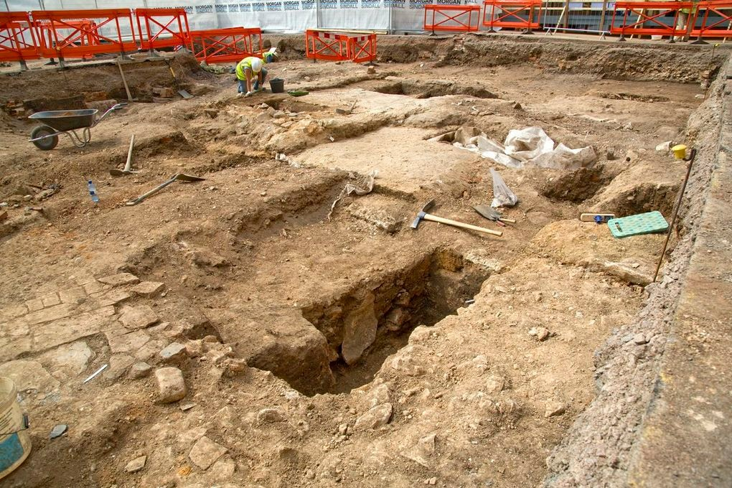
Archaeology

Slide 3
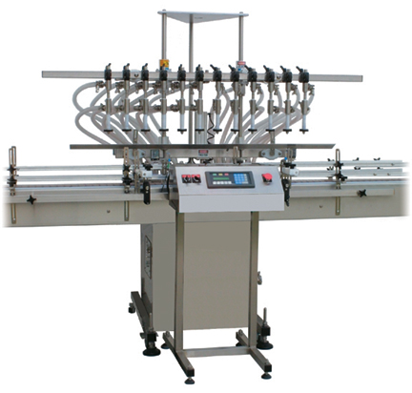
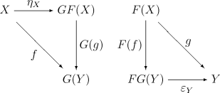
Semantic Archaeology & Formal Methods
System Implementation
Mathematical System Model formulating
precise system security properties
Notes:
Suppose, however, that we could flip the script.
Instead of going through the painstaking process of reconstructing a rigorous mathematical system model from an already implemented system,
(CLICK) can we put semantics first?

Slide 4
The ReWire Approach
ReWire is a computational lambda-calculus and a purely functional programming language for specifying secure synchronous digital hardware circuits.
Mostly a subset of Haskell.
Some restrictions on polymorphism and recursion.
ReWire Compiler [LCTES’15] generates efficient FPGA-based implementations directly from specifications.
Supports a semantics-driven hardware design style.
Verification via monadic equational reasoning.
Fundamental constructs: reactive resumption monad transformer and layered state monads.

Slide 5
Layered State Monads
The state monad transformer StateT augments an existing monad with mutable state.
If m is a monad, StateT s m “adds” a mutable store of type s to m.
We have the abstract interface (given in Haskell-style type signatures): get :: Monad m => StateT s m s put :: Monad m => s -> StateT s m () lift :: Monad m => m a -> StateT s m a deReactT :: Monad m => StateT s m a -> s -> m (a,s)
In Haskell a computation of type StateT s m a is represented internally by a function of type: s -> m (a,s) …but in ReWire, StateT is an opaque primitive (we’ll see why in a second).

Slide 6
Layered State Monads
There’s nothing stopping us from stacking the state monad transformer on top of itself, forming a layered state monad.
We require that the “base” monad be the identity monad, where Identity a is isomorphic to a.
StateT S1 (StateT S2 (StateT S3 Identity))

Slide 7
Effect-Labeled Layered State Monads
ReWire takes this idea a step further, augmenting StateT with an effect label.
Label of T means that the computation might or might not read/write from this state layer.
Label of F means it definitely does not.
Subtyping relation in a nutshell: T < F.
StateT S1 T (StateT S2 T (StateT S3 F Identity))

Slide 8
Reasoning about Information Flow
Type signatures for the primitives are now: get :: Monad m => StateT s T m s put :: Monad m => s -> StateT s T m () lift :: Monad m => m a -> StateT s F m a deReactT :: Monad m => StateT s l m a -> s -> m (a,s)
Two nice equational laws fall out.
Atomic non-interference: let M1, M2, and M3 be layered state monads where M1 < M3, M2 < M3, and the labels of M1 and M2 are disjoint. Then, if m1 :: M1 () and m2 :: M2 (), we have: m1 >> m2 = m2 >> m1
Clobber: define mask :: M () as an operation that “blanks out” every layer where M has a T label. Then if m :: M (), m >> mask = mask

Slide 9
Reactive Resumption Monad Transformer
Used to represent reactive concurrent computation.
If m is a monad, then ReactT i o m “augments” m with reactive concurrency effects.
Abstract interface: signal :: o -> ReactT i o m i lift :: Monad m => m a -> ReactT i o m a
Think of signal x as producing an output x of type o, waiting for an input of type i from the outside world (whatever that is), and then returning that input.
Internally this can be represented in Haskell with a recursive type: newtype ReactT i o m a = ReactT { deReactT :: m (Either a (o,i -> ReactT i o m a)) }

Slide 10
Why a formal metatheory?
In [LCTES’15] we construct and verify the security of a separating processor implementing the PicoBlaze instruction set.
Demonstrates very well the idea that effect-labeled state monads + reactive resumptions = secure hardware.
Proofs in the style of [LCTES’15] rely on pen-and-paper equational reasoning.
Bird-Wadler style
In order for the approach to scale to larger systems, tool support is critical.
=> formal theory is absolutely necessary
We’d like to embed this theory in an existing theorem proving system like Coq.

Slide 11
First Attempt: Denotational Semantics (“Definitional Interpreter”)
Why not just use a (typed) definitional interpreter? tyDenote : ReWireTy -> Set expDenote : forall (T:ReWireTy), Term T -> tyDenote T
Four problems, in increasing order of severity:
StateT requires functional extensionality.
Hard to see how to account for the effect labels in StateT.
Subset types?
Coq’s notion of equality for infinite objects (like ReactT) is too strong.
Must resort to bisimulation, but then ReactT isn’t really a monad transformer!
The obvious definition of ReactT is rejected by Coq!
Runs afoul of strict positivity.
Notes:
CoInductive ReactT (i o:Type) (m:Monad) : Type := ReactT : m (sum a (o * (i -> (ReactT i o m a))) -> ReactT i o m a.

Slide 12
Second Attempt: An Operational Approach
The above-stated limitations led us to adopt an operational approach.
Basic framework borrowed from Pierce et al.’s Software Foundations ☺
Basic idea:
Give an operational semantics directly to the monadic primitives.
Initially we restrict our attention just to state monads, since this is where most of the critical properties are manifested.

Slide 13
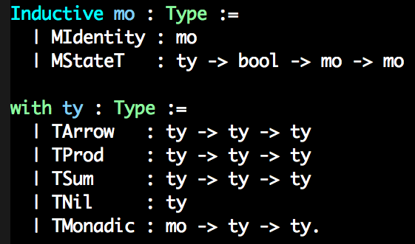
Syntax: Monads

Slide 14
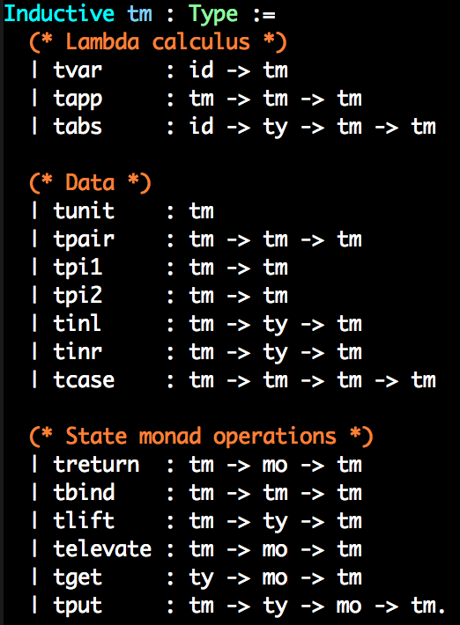
Syntax: Terms
Think of elevate as “witnessing” the subtyping relation.

Slide 15
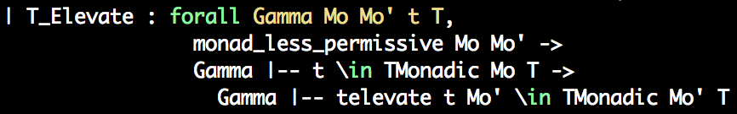
The “elevate” rule

Slide 16
Reduction
Two reduction relations.
One for “ordinary” lambda-calculus reduction.
Relates terms to terms
Another for “monadic” reduction.
Relates configurations (term * store) pairs to configurations.
A store is a list of values (one per state monad layer).

Slide 17
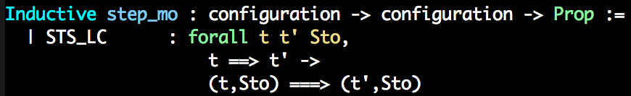
Monadic Reduction

Slide 18
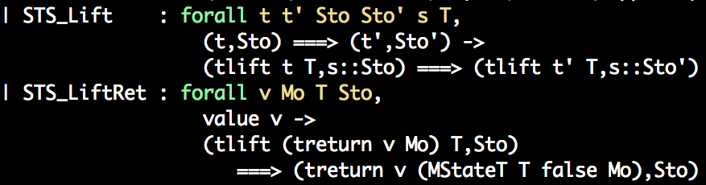
Monadic Reduction

Slide 19
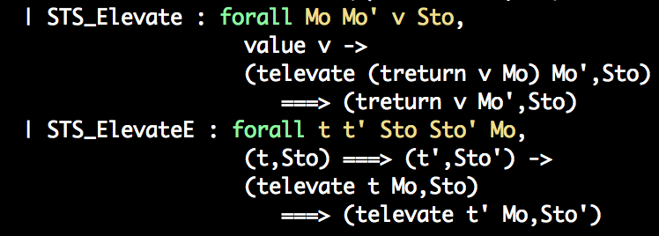
Monadic Reduction

Slide 20
Preliminary Results
Vanilla metatheoretic results
Progress (for terms and configurations)
Preservation (for terms and configurations)
Strong normalization (for terms and configurations)
Results related to the effect labels
No forbidden reads, no forbidden updates to the store.

Slide 21
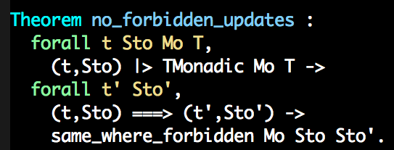
No Forbidden Updates

Slide 22
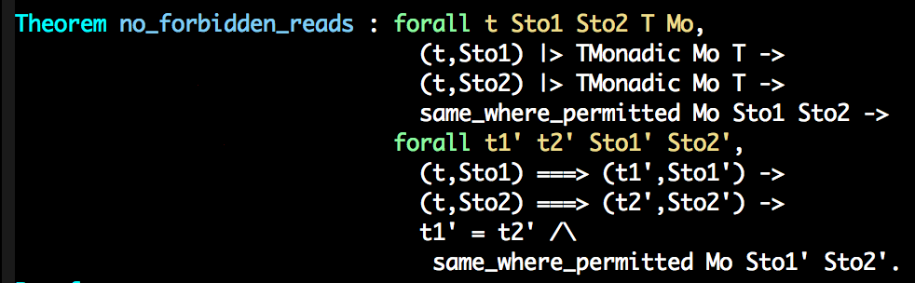
No Forbidden Reads

Slide 23
Current Work
Unify treatment of “ordinary” and monadic reduction.
Integrate reactive resumption monads.
Formalize equational theory.
Challenge: notion of equality requires coinduction (for resumptions) and logical relations.
For monads, this leads to extensive use of non-structurally-decreasing recursion.
E.g. the definition of equality at StateT s m a depends on the definition of equality at s -> m (s*a).
Surprisingly finicky!

Slide 24
Thanks!
Collaborators: Thomas Reynolds, Seth Kurtenbach, William L. Harrison, Gerard Allwein.
Support: NSF CAREER Award #00017806, Office of the Assistant Secretary of Defense for Research and Engineering.
Any questions?

Slide 25
References
[FPT’15] Ian Graves, Adam Procter, William L. Harrison, and Gerard Allwein. Provably Correct Development of Reconfigurable Hardware Designs via Equational Reasoning. 2015 International Conference on Field-Programmable Technology (to appear).
[LCTES’15] Adam Procter, William L. Harrison, Ian Graves, Michela Becchi, and Gerard Allwein. Semantics Driven Hardware Design, Implemenation, and Verification with ReWire. 2015 ACM SIGPLAN/SIGBED Conference on Languages, Compilers, Tools and Theory for Embedded Systems (LCTES 2015).
[ARC’15] Ian Graves, Adam Procter, William L. Harrison, Michela Becchi, and Gerard Allwein. Hardware Synthesis from Functional Embedded Domain-Specific Languages: A Case Study in Regular Expression Compilation 11th International Symposium on Applied Reconfigurable Computing (ARC 2015).

