Slide 1
Oxygen 21.1 New Features
Basic features
Tolvaj Ákos

Slide 2
TASK: Testing new features – Block 1.
Open the testing_oxygen_21.ditamap map file in the DITA Maps Manager of Oxygen XML Editor 21.1.
In System requirements, highlight all typos (e.g. examples of “hardwire”) with red, the unordered list in the first cell with yellow, and the first note with green.
In Software matrix, make “NSK” and “Linux” list items. Switch between them being an ordered and an unordered list.
In Linux, make the unordered list a CALS table with headings (“Series” and “Version”).
Convert the table to simple table.
Copy the left column of the OS version table of the NSK file and paste it to the end of the Linux file (make it a two-column table with headings).

Slide 3
TASK: Testing new features – Block 1. (continued)
Copy all the cells of the first table in System requirements and paste them to Collection Server Configuration at the end of the content inside the screen tag.
Create a new topic at the same level as and after System requirements and name it Workflow Nodes.
Copy section 2.1.6 Workflow Nodes of Workflows.docx including the subsections into this new topic. (Note that code blocks and code phrases are not converted correctly from a DOCX file.)
Copy sections SUPPORT COMMUNICATION - SECURITY BULLETIN through BACKGROUND from this HPE support page and paste the contents to the Support file DITA file.
Copy and paste content from this GitHub issue to the From GitHub source DITA file.

Slide 4
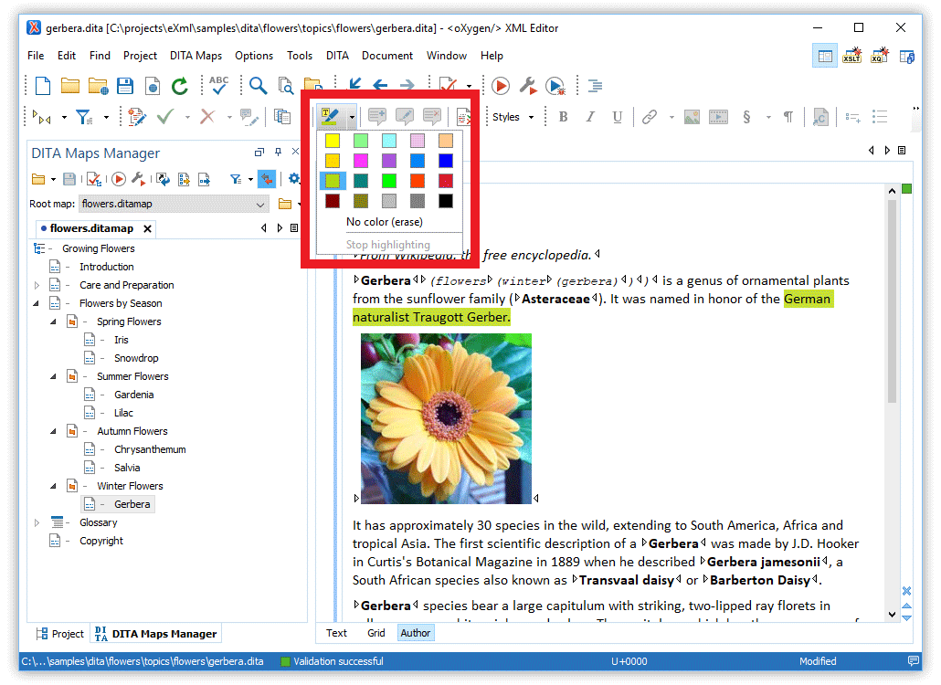
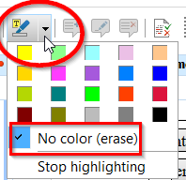
Multiple highlighting colors
You can assign different colors to different types of issues/comments
Available in author mode
Not visible in output
To remove, use Ctrl + A then
https://www.oxygenxml.com/doc/versions/21.1/ug-editor/topics/text-highlight.html

Slide 5

Converting paragraphs to lists
Insert List Item actions let you:
Convert paragraphs to list items
Toggle between unordered and ordered lists

Slide 6
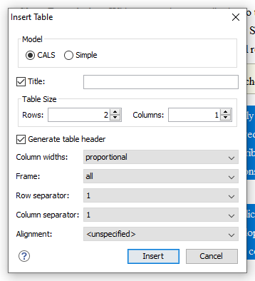
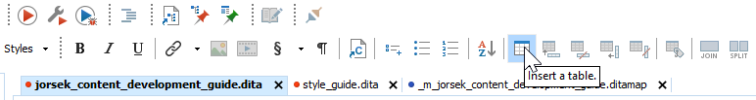
Converting lists to tables
Use the Insert a table icons to convert selected list items or paragraphs to a table.

Slide 7
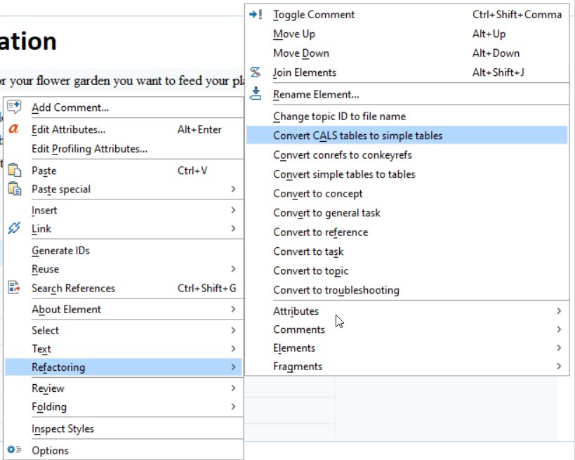
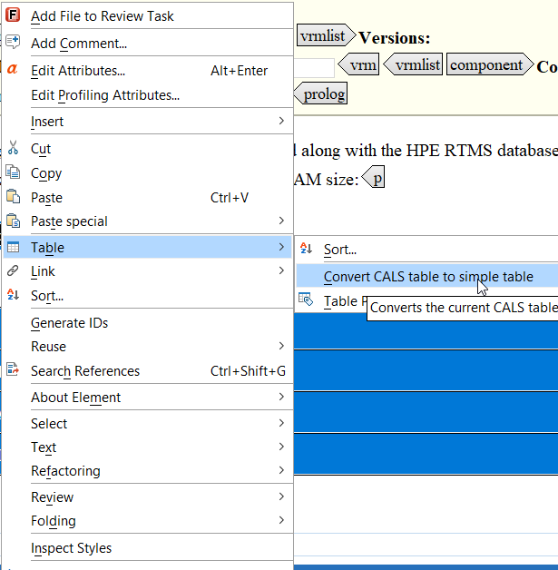
Converting CALS tables to simple tables
OR
Make sure the CALS tables that you want to convert this way have no spans (i.e. merged cells).
https://youtu.be/yDLTZic2NZw?t=95

Slide 8
Copy-pasting parts of a table
Copy a multiple selection of table cells and paste them outside the table to create a new table.
NOTE:
When pasting into space-preserved elements (e.g. code blocks), the cell content will be pasted as plain text.
.8.

Slide 9
Smart pasting from sources outside of DITA files
Copy content from various sources:
web pages
external applications (MS Office)
other documents in Oxygen XML Editor
Paste it into DITA, TEI, DocBook, JATS, and XHTML documents.
Original text styling is preserved.
https://www.oxygenxml.com/doc/versions/21.1/ug-editor/topics/smart-paste-support-x-modes2.html
NOTE:
Check Schema Aware preferences at Options > Preferences > Editor > Edit modes > Author > Schema Aware. Make sure Convert even when pasting inside space-preserve elements is NOT checked.
https://www.oxygenxml.com/doc/versions/21.1/ug-editor/topics/preferences-schema-aware.html#preferences-schema-aware__convert-even-space-preserve

Slide 10


Slide 11
TASK: Testing new features – Block 2.
Open the testing_oxygen_21.ditamap map file in the DITA Maps Manager of Oxygen XML Editor 21.1.
Right click Workflow Nodes in the DITA map and select Refactoring > Convert sections to new topics… Promote and demote topics to get the same structure as in section 2.1.6 in Workflows.docx.
Convert the type of the files nested under Sample configuration to reference.

Slide 12
TASK: Testing new features – Block 2. (continued)
Create the following hierarchy of DITA files as the following sibling of the Workflow node DITA file:
Hierarchy subsection
First level
Second level
Second level II
Second level III
First level II
Second level IV
Third level
Duplicate the Third level file and name the new file Third level II.
Extract Hierarchy subsection (with all its children) to a new map. Check what the original map looks like afterwards.

Slide 13
Refactoring: Converting sections to new topics
Convert sections to new topics (available from the contextual menu of editable maps/nodes in the DITA Maps Manager).
Use this operation on topics that contain multiple sections to convert each section to a new topic.
The new topics are added in the DITA Maps Manager as the first child topics of the original topic.
https://www.oxygenxml.com/doc/versions/20.0/ug-editor/topics/dita-maps-manager.html#dita-maps-manager__refactoring-dlentry
https://youtu.be/yDLTZic2NZw?t=82
.13.

Slide 14
Refactoring: Converting DITA topics to another type
Convert selected topics to another type.
Works with multiple topics when using multiselect.
NOTE:
The filename does not change with this operation. If you want to keep the file-names consistent, change the appended “_t”, “_c”, “_r” to the appropriate ending in the DITA files folder.
https://www.oxygenxml.com/doc/versions/19.1/ug-editor/topics/dita-convert-topics.html
.14.

Slide 15
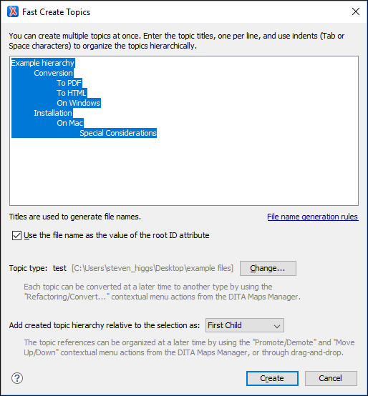
Creating multiple DITA topics at once
Right-click a node in the DITA Maps Manager
Select Fast Create Topics
In the Fast Create Topics dialog box that opens, configure the structure for the new topics
https://www.oxygenxml.com/doc/versions/19.1/ug-editor/topics/fast-create-topics.html
.15.

Slide 16
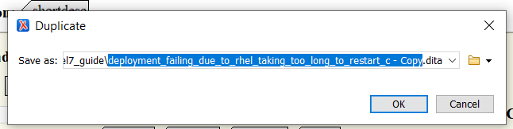
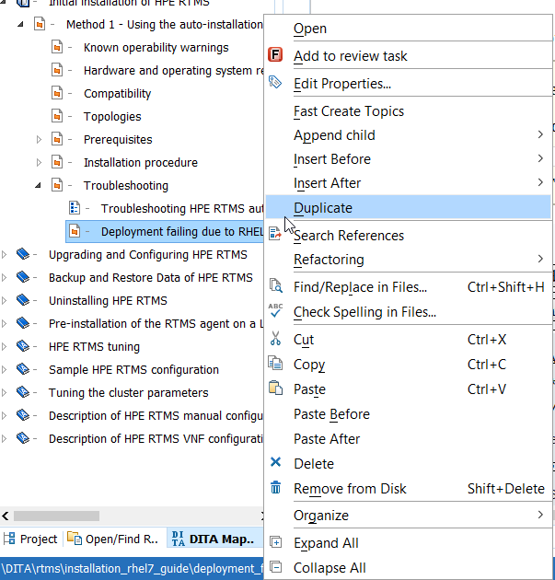
Duplicating a topic into the hierarchy as a sibling
Right-click a node in the DITA Maps Manager
Select Duplicate
In the Duplicate dialog box that opens, name the file that will be newly created
The new topic – with the same type and content – appears in the ditamap as a direct sibling of the original topic.

Slide 17
Refactoring: Extracting topics to a new DITA map
Create new DITA maps from parts of existing DITA maps using the Extract to New DITA Map refactoring action.
Right-click a node in the DITA Maps Manager
Select Refactoring > Extract to New DITA Map…
Select map type
Results:
A new DITA map is created.
The selected topic references are moved inside the new map.
The selected topic references from the initial map are replaced with a reference to the newly created map.

Slide 18
Refactoring: Converting nested topics to new topics
Nested topics
You might stumble upon topics that contain nested <topic> (or <concept>, <task> , <reference> , and <glossentry>, which are specialized version of <topic>) elements.
Topics can be defined inside other topics. However, nesting requires special care because it can result in complex documents that are less usable and less reusable.
Nesting may be appropriate for information that is first converted from desktop publishing or word processing files or for topics that are unusable independent from their parent or sibling topics.
The rules for topic nesting can be configured in a document-type shells. Nesting might be blocked altogether at document level.
Converting nested topics to individual topic files
Use refactoring as described in previous slides and select Convert nested topics to new topics… .
The new topics are added in the DITA Maps Manager as the first child topics of the original topic.
.18.

Slide 19
Questions
… with subtitle
How to smart paste pictures (from video)
What is schema aware
How to generate output
Oxygen xml editor vs author

