Slide 1
A little maths journey behind the GLM algorithm

Slide 2
Together:
Model outputs
Field observations
Forward model
Model input parameters

Slide 3
Errors
Field observations
Forward model
Model input parameters
rearranging….

Slide 4
So we should minimize these errors right?
For nice mathy reasons, easier to minimize the square,
so let’s define an objective function as the “sum of squared errors”
But….should each observation be reproduced with equal quality by the model?

Slide 5
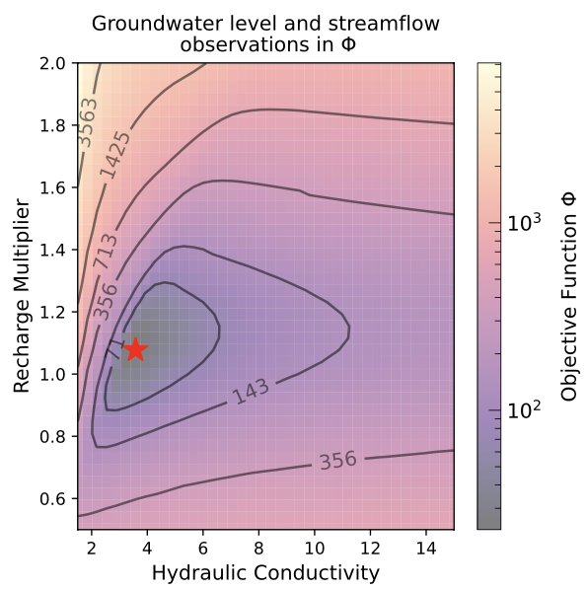
How about a simple groundwater-based example?
Groundwater levels and
Streamflows ….
MODFLOW GW
model
K and R
x
?

Slide 6
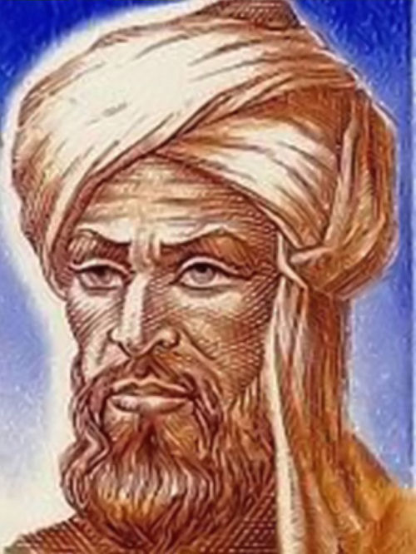
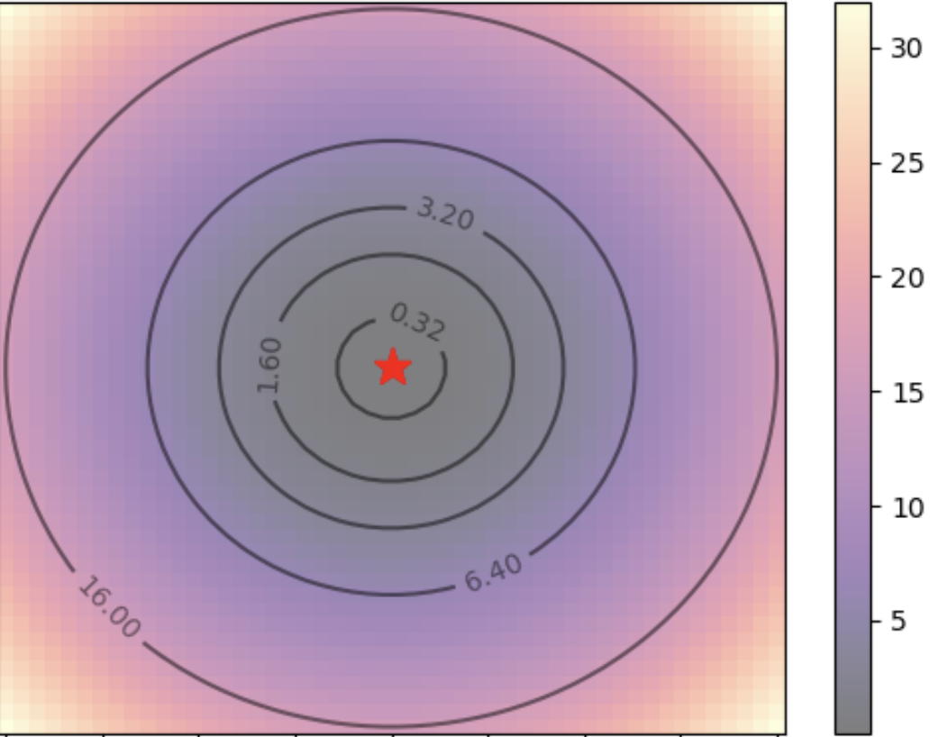
How can we find the minimum of this?
Take the derivative and set it to zero
x
…through the magic of algebra
(thanks Al-Khwarizmi!)
🧑‍🍳🤌
Al-Khwarizmi

Slide 7
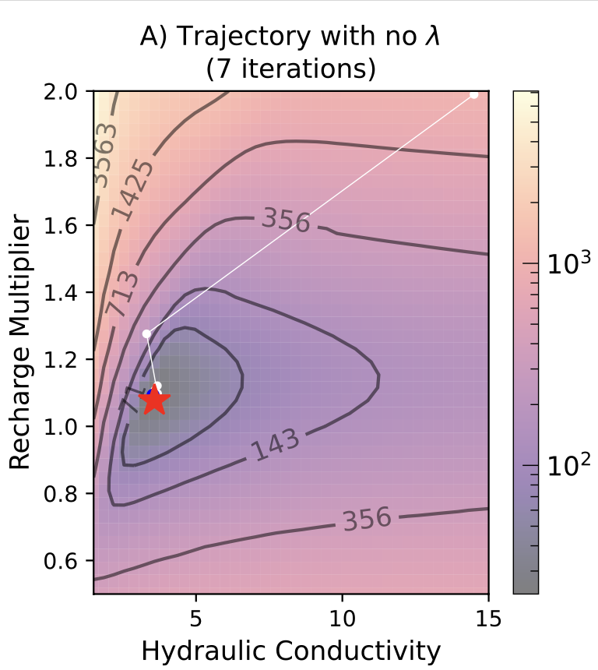
But this is usually nonlinear
Curvature
(2nd derivative)
Gradient/Slope
(1st derivative)

Slide 8
So……let’s iterate!
Previous
parameters
Upgrade
Current
misfit

Slide 9
Can we improve this?
Curvature
(2nd derivative)
Gradient/Slope
(1st derivative)
Lambda – a way to adjust
the tradeoff of slope
And curvature

Slide 10
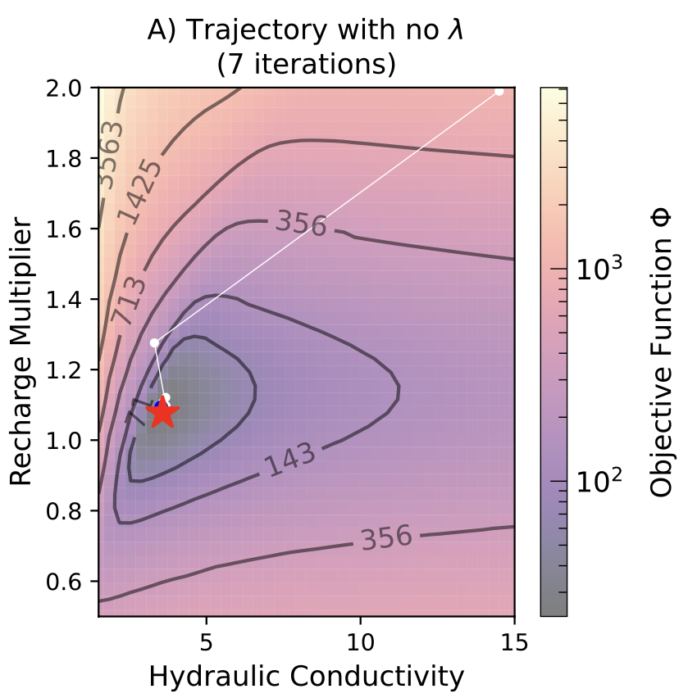
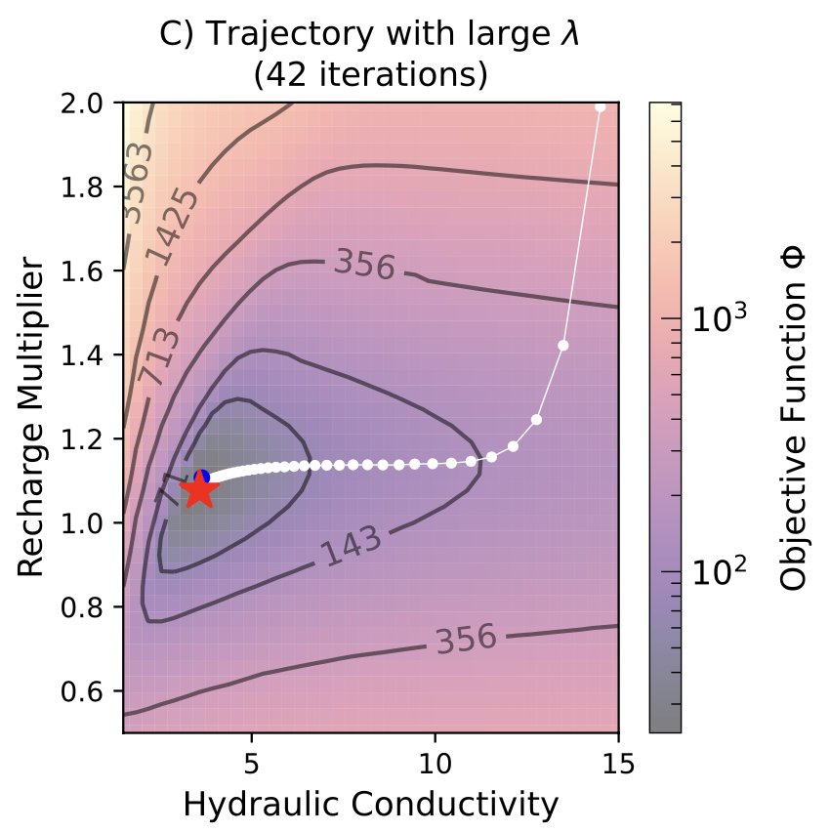
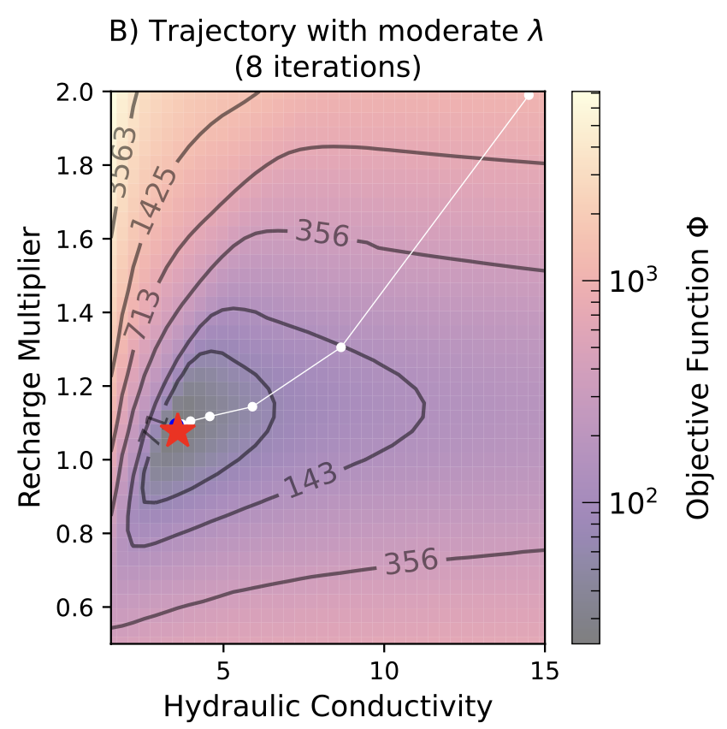
Knocks out the
Curvature.
All gradient.
Small steps.
Nice balance.
Happy medium.
World peace.

Slide 11
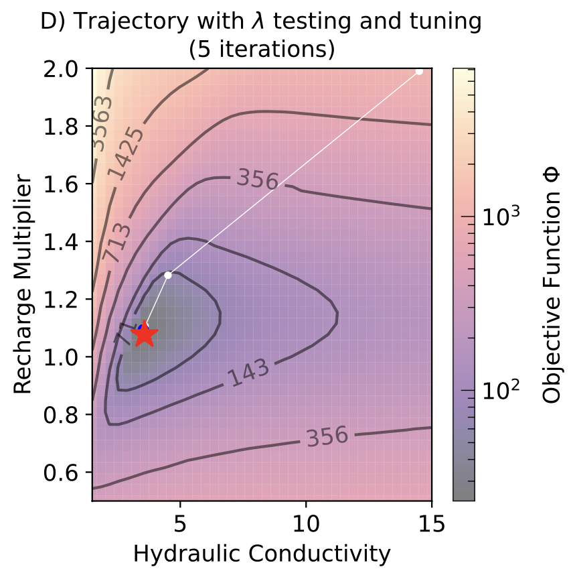
Sweet! So lambda is useful. What’s the right value?
We need heuristics – basically smart grid search
🤷‍♂️

Slide 12
Cool, but this was all about a deterministic approach and the cools kids keep talking about ensembles.

Slide 13
First let’s go back to the gradients

Slide 14
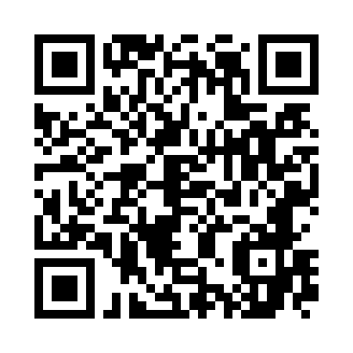
Want more details?
Paper in Groundwater
Fienen, White, Hayek (2024) Methods Brief/ Parameter ESTimation with the Gauss Levenberg Marquardt algorithm: an intuitive guide. Groundwater
https://ngwa.onlinelibrary.wiley.com/doi/10.1111/gwat.13433

