Slide 1
3D Printed FlexMask V1
The following presentation is a compilation of designs, notes, and instructions for printing and assembling a FlexMask
Andrew Przyjemski
awp5357@psu.edu

Slide 2
Materials

Slide 3
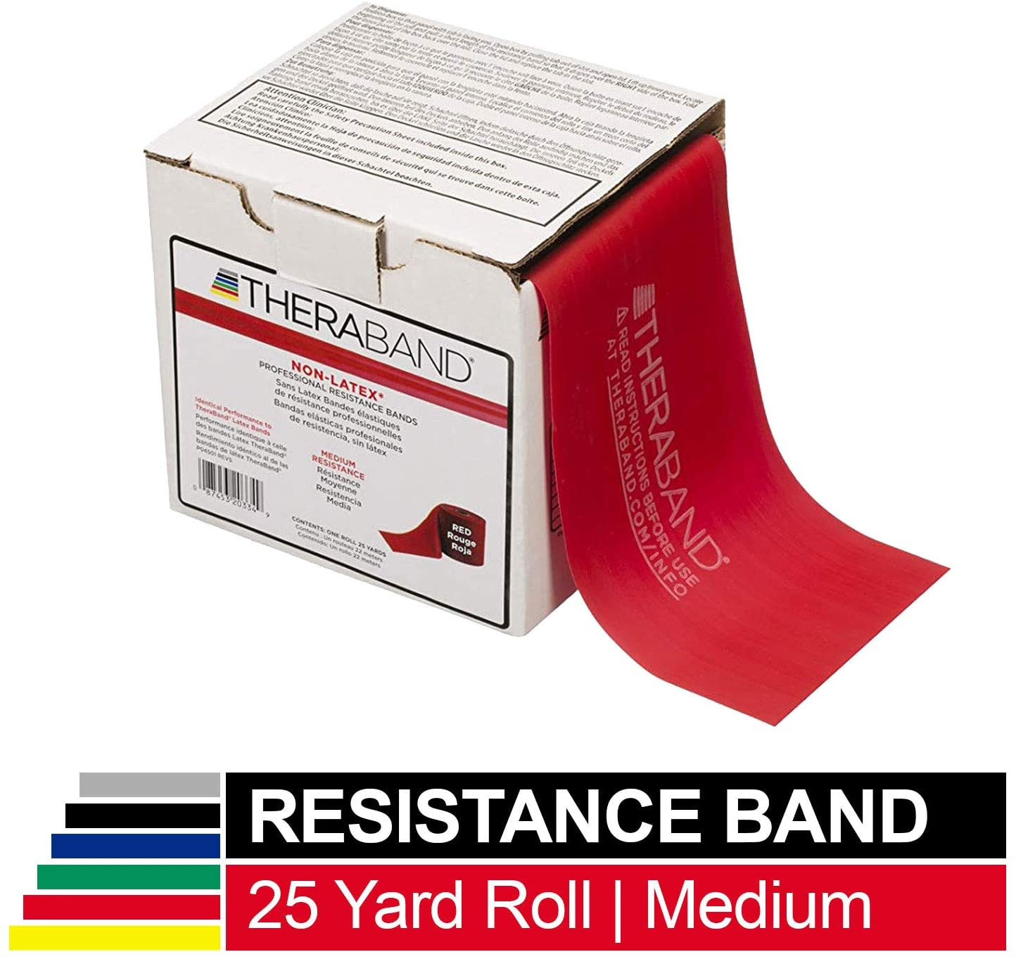
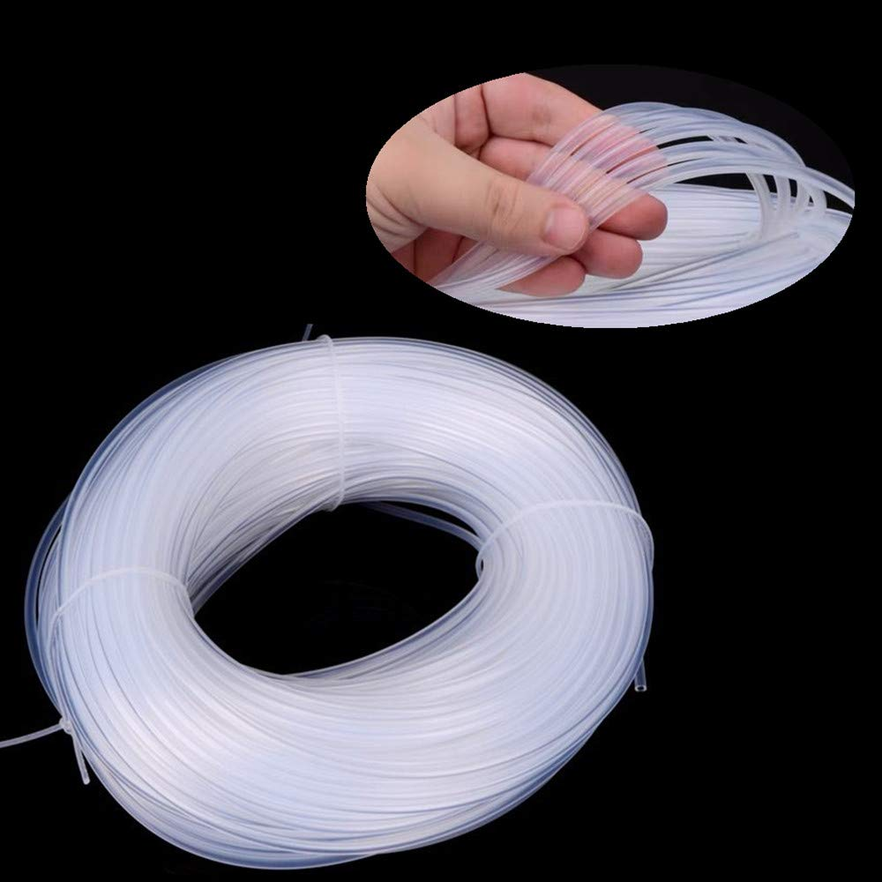
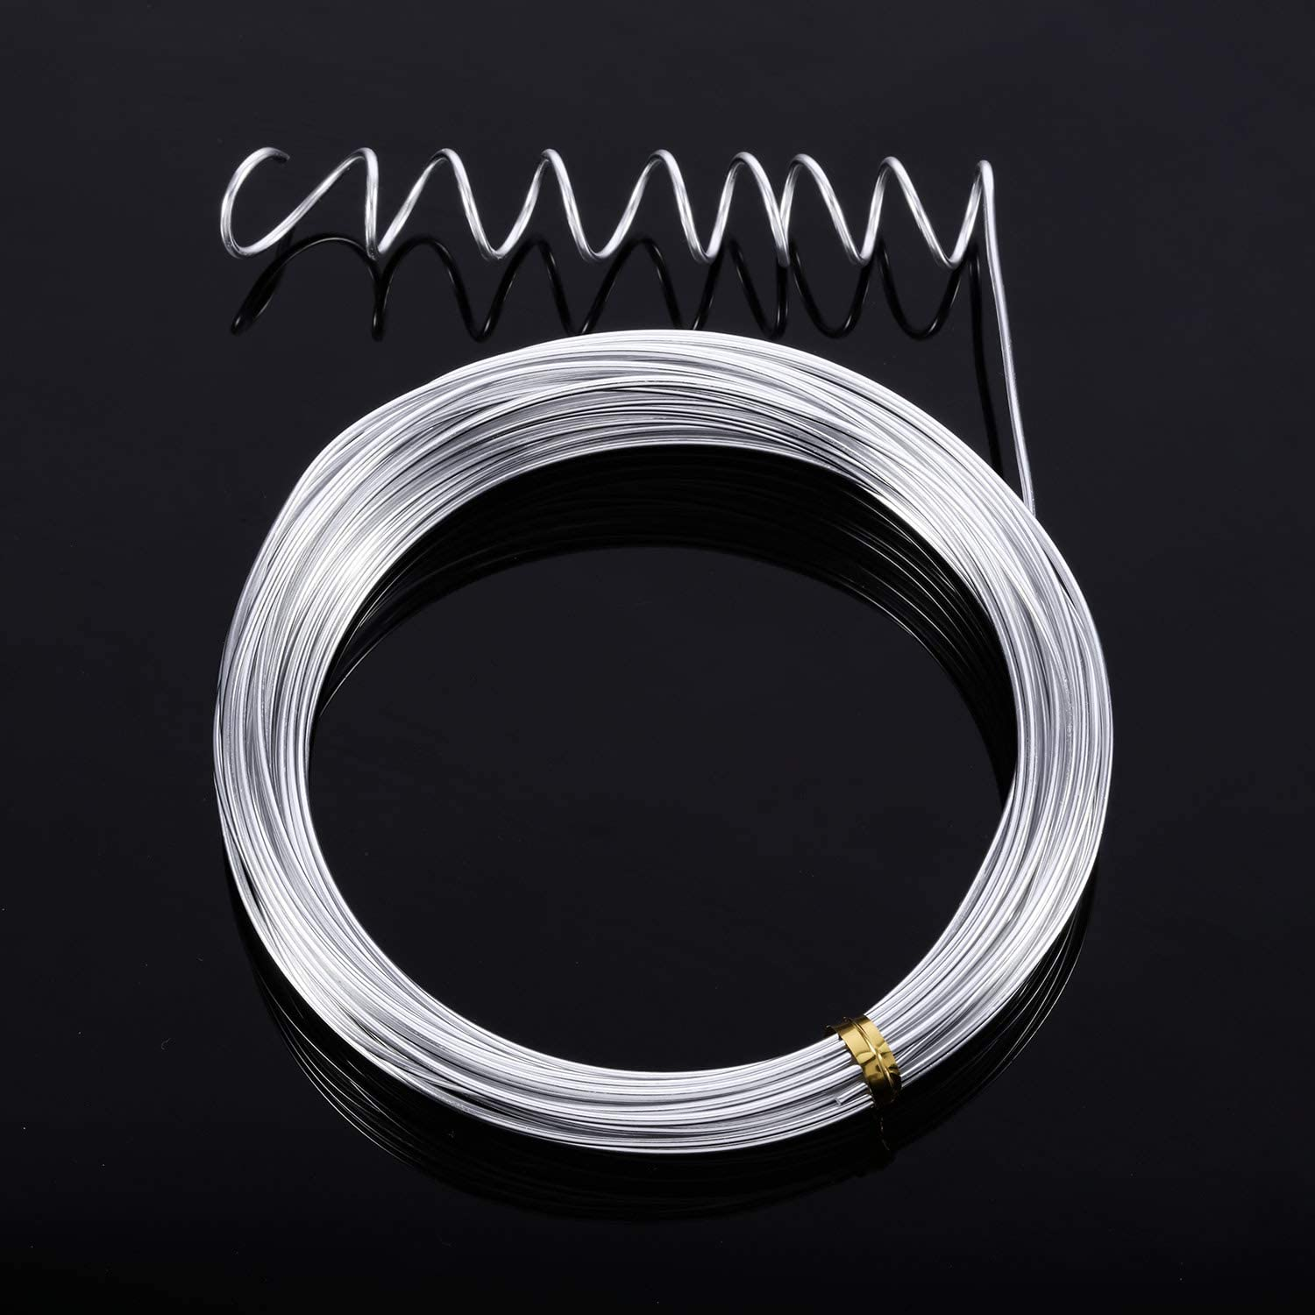
Bill of Materials
TPU95 flexible filament
540 mm of 1.5mm aluminum armature wire
Straps (examples listed below)
4mm ID x 6mm OD Silicone rubber tube
Non-latex resistance band
Other strap materials are feasible, but only the two above have been tested

Slide 4
Cost of Goods Sold (COGS)
Item | Supplier | Category | Price | Link
1.5mm x 550mm Armature wire | Animation Toolkit | Armature | $0.17 | https://tinyurl.com/yx7r4c38
Elastic cord 1/8” x 30” | Amazon | Strap | $0.04 | https://tinyurl.com/tf4ujzb
Polymaker PolyFlex 750 gram roll | Polymaker | Base | $1.80 | https://tinyurl.com/uvtl5es
Filter | ??? | Filter | ??? | ???

Slide 5
3D Printing

Slide 6
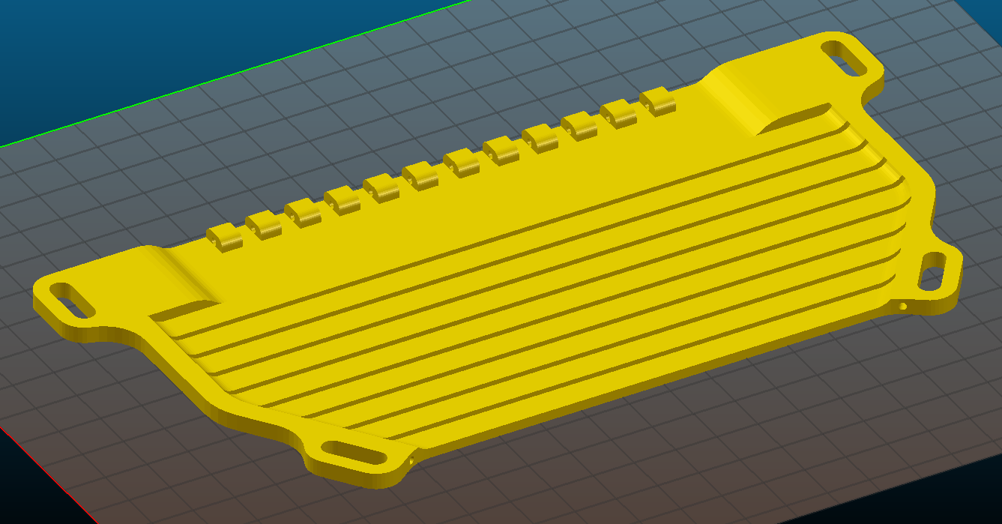
Slicing Settings
Material: Polymaker PolyFlex
Extruder: 250°C
Bed: 60°C
Layers and perimeters
Layer height: 0.3mm
# Perimeters: 2
Solid layers: 3 top and bottom
Infill
Density: 25%
Pattern: Rectilinear
Speed
20mm/s for all speed settings
Print time: ≈3 hours
Material Used: 34 grams
Print Orientation

Slide 7
Assembly

