Slide 1

Insights through Transactional Data
22 December 2023
Analytics Case

Slide 2
Executive summary
The Billing amount across the three months indicate downward trend
Key Influencing Factors:
Decrease in monthly transaction count
Consistent average monthly transaction values
Product Differentiation: transaction volumes for tech products have significantly declined
Top popular merchants: Beauty Bliss > Tech Touch > Home Harmony
The daily billing trend fluctuates between 700 million and 740 million, reaching its highest point in January and hitting a minimum in March.
Transaction Funnel Analysis: Failed transactions account for 50.01% of the total, while missing information and successful transactions contribute 33.23% and 16.77%, respectively

Slide 3
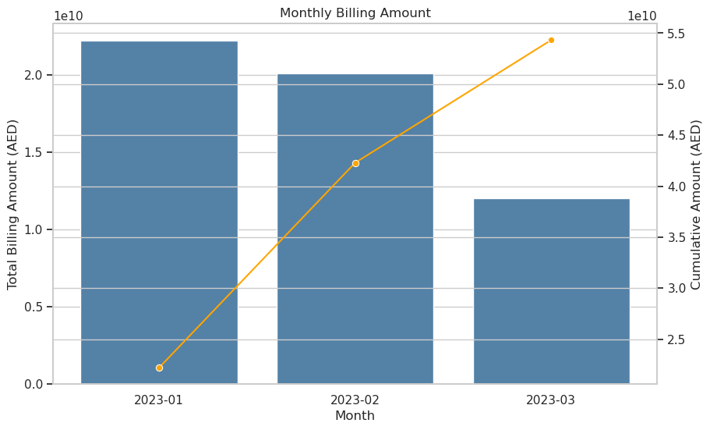

Slide 4
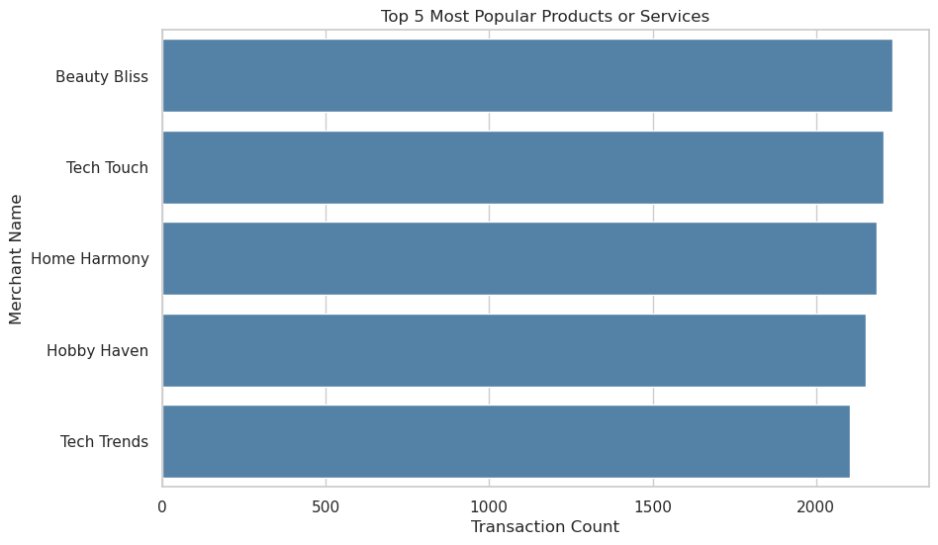

Slide 5
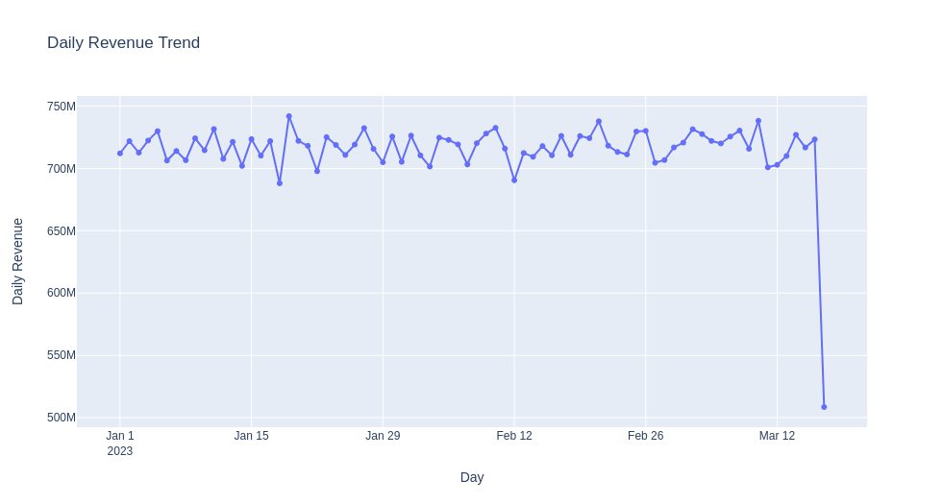
peak

Slide 6
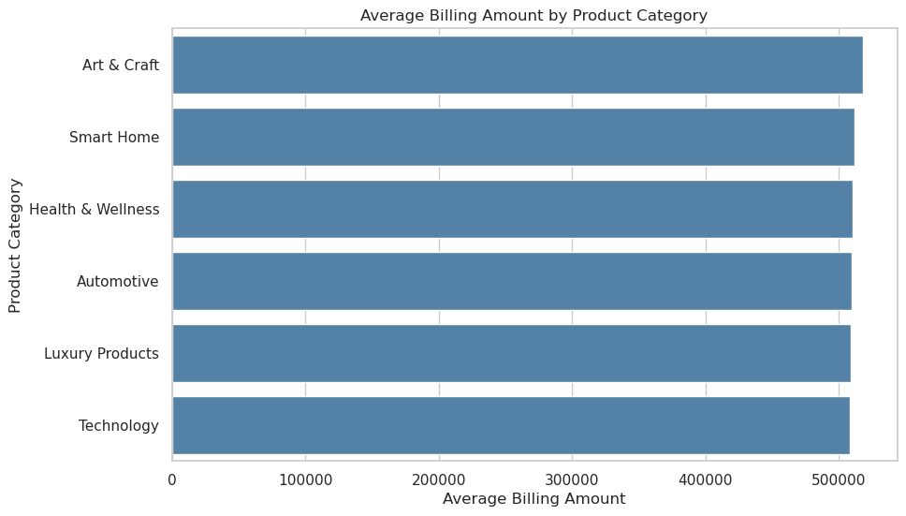

Slide 7
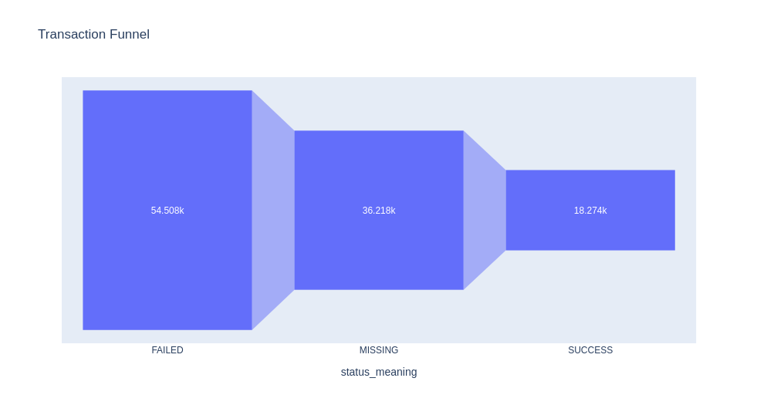

Slide 8
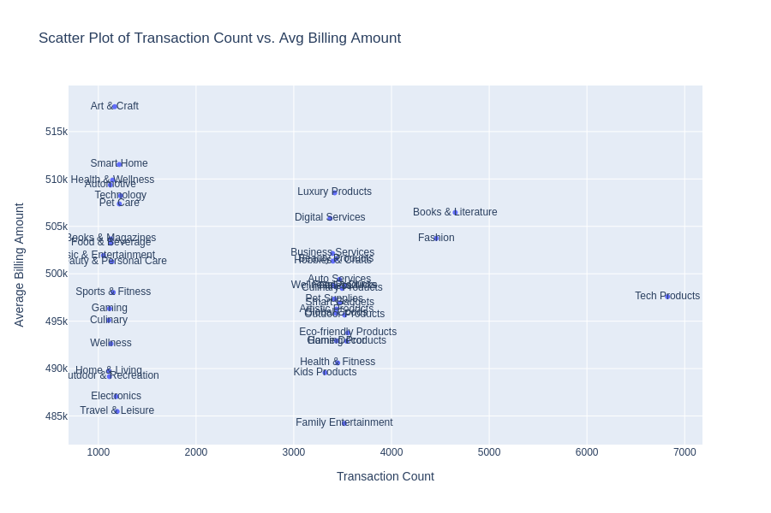
Three distinctive segments
Age group under 18?

Slide 9
Recommendations:
To increase monthly transaction counts: focus on targeted marketing campaigns, improving user engagement, expanding product offerings etc.
To analyze failed transactions (> 50%), categorize and investigate failure reasons, perform root cause analysis, map error codes, seek customer feedback and monitor transaction flow
Combine and present services with low transaction counts and average billing amounts as bundled offerings to boost overall revenue.

