Slide 1

Insights through Transactional Data
22 December 2023
Understanding Trends and Influincing Factors
Notes:
Good [morning/afternoon/evening], everyone. I am abhinav, and today we are going to dive into the billing trends and transaction dynamics analysis that has shaped over the three months from jan 2023- march 2023. Lets begin

Slide 2
Overview:
The Billing amount across the three months indicate downward trend
Key Influencing Factors:
Decrease in monthly transaction count
Consistent average monthly transaction values
Product Differentiation: transaction volumes for tech products have significantly declined
Top popular merchants: Beauty Bliss > Tech Touch > Home Harmony
The daily billing trend fluctuates between 700 million and 740 million, reaching its highest point in January and hitting a minimum in March.
Transaction Funnel Analysis: Failed transactions account for 50.01% of the total, while missing information and successful transactions contribute 33.23% and 16.77%, respectively
Notes:
So, this is a high level overview, First, lets take a look at the billing trends.
we have identified a downward trend in the billing amount. And there are several factors that influence these trends: 1. Transaction count 2. Transaction Value 3. Changing Customer preferences. There is a lot to explore in the coming slides: Lets begin with the billing trends

Slide 3
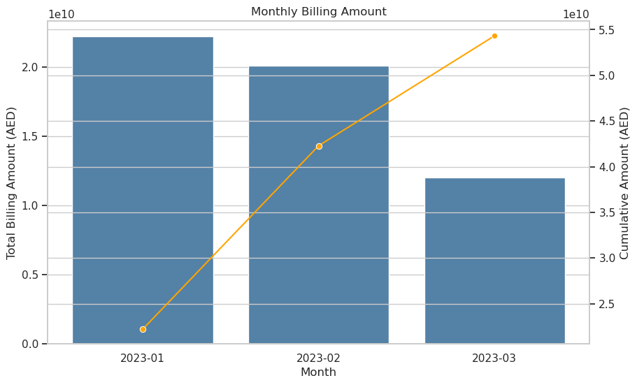
Billing Trend Analysis
Notes:
Here, you can see a visual representation of our billing amounts across the last three months. The downward trend is evident, and it's crucial for us to understand why. Let's explore this further.

Slide 4
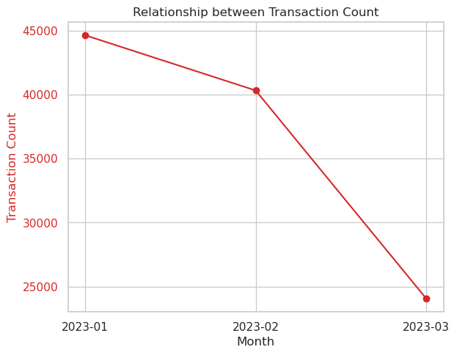
Transaction Count is reducing
The Average billing amount shows least deviation
Billing Trend Analysis
Notes:
The decrease in transaction count and the consistent average monthly transaction values are pivotal components. Each month tells a story,

Slide 5
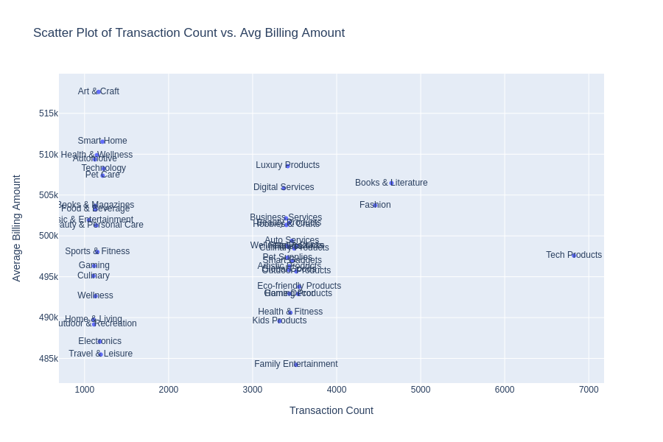
Three distinctive segments
Age group under 18?
Segmentation
Notes:
clustered in Three specific region.
top merchants on the plot.

Slide 6
Overview:
The Billing amount across the three months indicate downward trend
Key Influencing Factors:
Decrease in monthly transaction count
Consistent average monthly transaction values
Product Differentiation: transaction volumes for tech products have significantly declined
Top popular merchants: Beauty Bliss > Tech Touch > Home Harmony
The daily billing trend fluctuates between 700 million and 740 million, reaching its highest point in January and hitting a minimum in March.
Transaction Funnel Analysis: Failed transactions account for 50.01% of the total, while missing information and successful transactions contribute 33.23% and 16.77%, respectively

Slide 7
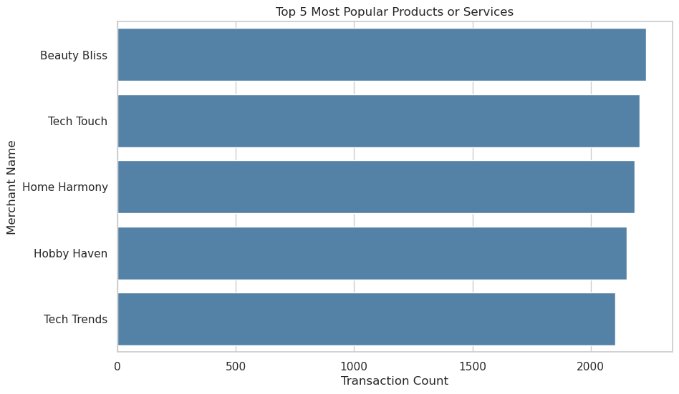
Top Popular Merchants
Notes:
Our top merchants, Beauty Bliss, Tech Touch, and Home Harmony, play a vital role in our transaction landscape. Understanding their dynamics is key to navigating our market.

Slide 8
Overview:
The Billing amount across the three months indicate downward trend
Key Influencing Factors:
Decrease in monthly transaction count
Consistent average monthly transaction values
Product Differentiation: transaction volumes for tech products have significantly declined
Top popular merchants: Beauty Bliss > Tech Touch > Home Harmony
The daily billing trend fluctuates between 700 million and 740 million, reaching its highest point in January and hitting a minimum in March.
Transaction Funnel Analysis: Failed transactions account for 50.01% of the total, while missing information and successful transactions contribute 33.23% and 16.77%, respectively

Slide 9
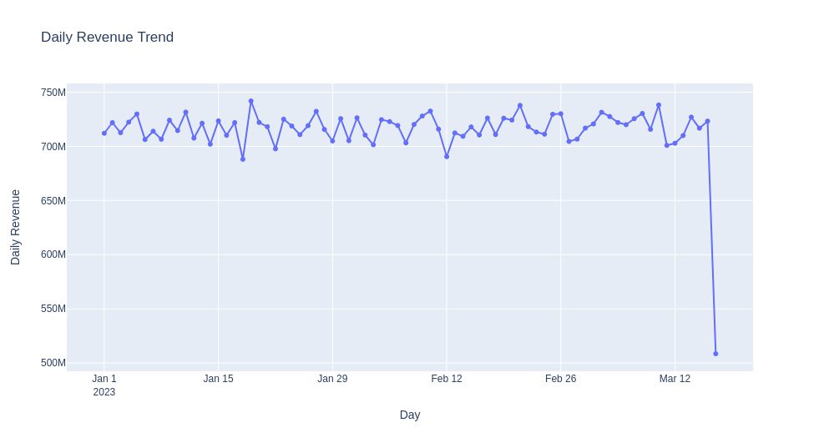
peak
Daily Billing Trend
Notes:
Our daily billing trends showcase interesting patterns. From the highest point in January to the minimum in March, these fluctuations hold valuable insights

Slide 10
Overview:
The Billing amount across the three months indicate downward trend
Key Influencing Factors:
Decrease in monthly transaction count
Consistent average monthly transaction values
Product Differentiation: transaction volumes for tech products have significantly declined
Top popular merchants: Beauty Bliss > Tech Touch > Home Harmony
The daily billing trend fluctuates between 700 million and 740 million, reaching its highest point in January and hitting a minimum in March.
Transaction Funnel Analysis: Failed transactions account for 50.01% of the total, while missing information and successful transactions contribute 33.23% and 16.77%, respectively

Slide 11
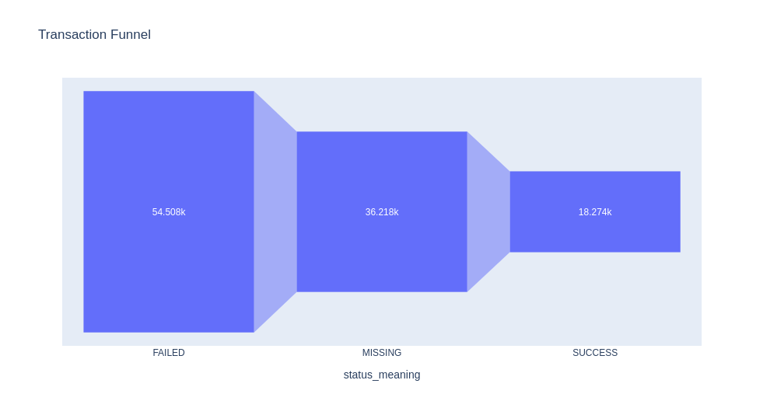
Transaction Funnel
Notes:
Examining our transaction funnel, we see that failed transactions account for 50.01%, missing information for 33.23%, and successful transactions for 16.77%. This breakdown provides a clear picture of our customer interactions.

Slide 12
Recommendations:
To increase monthly transaction counts: focus on targeted marketing campaigns, improving user engagement, expanding product offerings etc.
To analyze failed transactions (> 50%), categorize and investigate failure reasons, perform root cause analysis, map error codes, seek customer feedback and monitor transaction flow
Combine and present services with low transaction counts and average billing amounts as bundled offerings to boost overall revenue.

