Slide 1
Fourier-Wavelet Regularized Deconvolution (ForWaRD)
Seminar: Embedded Image Processing
Supervisor: Yousef Baroud Prof: Simon

Slide 2
Outline
Deblurring Algorithms
R.Neelamani, SP 2004
J.Dysart, HPEC 2014
Forward
Forward on GPU
Results & Conclusion
Notes:
Explain what u gonna cover In brief, Example in forward and in forward on gpu.

Slide 3
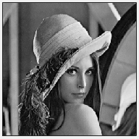
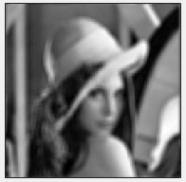
Introduction & Motivation
Original Image
Blurred Image
PSF
AWGN
PSF- Point Spread Function
AWGN - Additive White Gaussian Noise

Slide 4
Introduction & Motivation
Operator Inversion
Naive Deconvolution(Inverse fourier trans)
f (x,y)*g(x,y) + n(x,y) = h(x,y)
Limitation: Large Mean Square error
How to estimate the original image?
Deblurring Algorithms
Notes:
Explain f(x,y) and all terms

Slide 5
Deblurring Algorithms
Wiener Estimation
Deblurring in Fourier Domain
FoRWaRD Algorithm
Deblurring in Fourier & Wavelet Domains

Slide 6
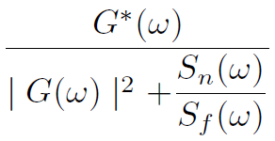
Wiener Estimation
Wiener Filter
Image
Image
Fourier Transform
Filtering
Inverse Fourier Transform
Strength: Colored Noise - Sharp images
Limitation: Singularities - unclear edges
Ref[3]: Digital Image Processing, C. Gonzalez

Slide 7
FoRWaRD Idea
Observation
Inversion
Fourier
Domain
Wavelet
Domain
o/p
Input : Sample image
Step1 : Operator Inversion
Step 2: Fourier Transformations
Step 3: Wavelet Transformations
Output: Estimated Image

Slide 8
Wavelet Domain
HF
2
HF
2
LF
2
HF
2
Image
2
Level 3
LF
Level 2
LF
2
Level 1 coefficients
HF - High pass Filter
LF - Low pass Filter
2
Down sampling

Slide 9
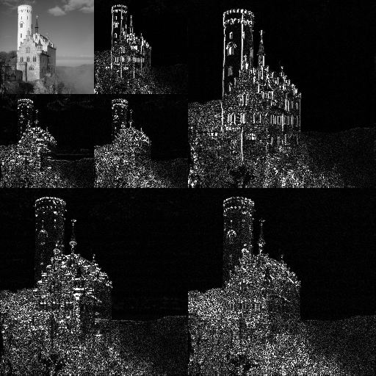
Wavelet Domain
Ref: https://en.wikipedia.org/wiki/DWT
Notes:
Read Wikipedia and get expert knowledge on this picture.
Dabauschies 30 40 …..what the other guy told ? Listen to his audio u took on july 1st , (Important)

Slide 10
FoRWaRD Algorithm
Fourier Shrinkage -
Wavelet Shrinkage - Coefficients Threshold
Smoothens regions, edges well preserved
Observation
Inversion
Fourier
Shrinkage
Wavelet
Shrinkage
o/p

Slide 11
FoRWaRD Choices
Fourier shrinkage
Wiener / Tikhonov filter
Wavelet Shrinkage
WT1 Daubechies transform(6 levels)
WT2 Daubechies transform(2 levels)
Wavelet Domain Wiener Filter(WDWF)
Ref[1]: Fourier wavelet regularized deconvolution
for ill-conditioned systems, R.Neelamani

Slide 12
FoRWaRD Implementation
Blurred Image
Precompute
PSF
Threshold Update
FFT
WT1
PSF - Point Spread Function
Fourier Filter
MAD Noise Estimate
FFT - Forward Fourier
Transform
IFFT
IFFT - Inverse FFT
Compute Threshold
WT1
WT2
Wavelet Transforms
WT2
WT1
MAD - Median Absolute
Deviation
Estimate Noise

Slide 13
FoRWaRD Implementation
Deblurring
FFT
Filter in Frequency Domain
IWT1 - Inverse WT of WT1
IWT2 - Inverse WT of WT2
WDWF – Wavelet Domain
Wiener Filter
IFFT
WT2
WT1
Hard Threshold
WDWF
IWT1
WT2

Slide 14
FoRWaRD Implementation
PSF
Blurred Image
FFT
WT1
FFT
Filter in Frequency Domain
Fourier Filter
MAD Noise Estimate
IFFT
IFFT
WT2
WT1
Compute
Threshold
WT2
WT1
Hard Threshold
WT2
IWT1
WDWF
Estimate Noise
Deblurred Image
IWT2

Slide 15
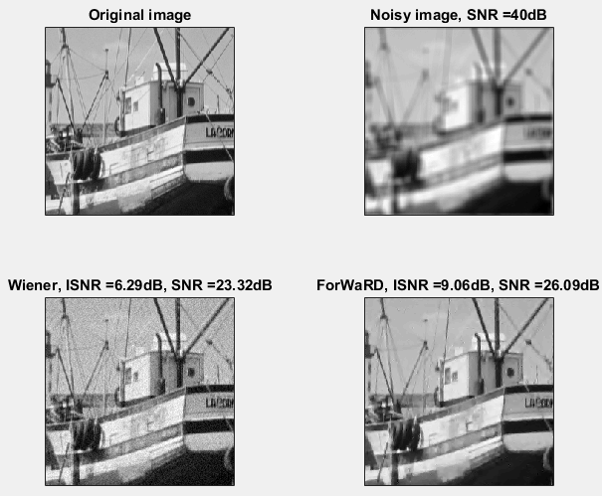
Results Comparison
Ref[8]: http://dsp.rice.edu/software/forward
Notes:
Imporant : Mention this is the output u gor from matlab code implementation
If possible, add the other image of 1d signal result too.

Slide 16
FoRWaRD Implementation on GPU
Goal: Real time HD video deblurring (30 f/s)
2 Algorithms to reach goal
Limitation: Bandwidth
DDGPU library (Demosaic & Deblur on GPU)
Modify Forward
Remove WDWF, Subframes for Thresh.
Demosaicing
Deblurring

Slide 17
FoRWaRD Implementation on GPU
Implement DDGPU
Gpu cards - GTX 580, GTX 670, GTX 780
Performance Improvements
Reduced memory transfers
Reduced unnecessary data movements
Notes:
Insert if u have time and understood the table contett presented in this ieee paper , here.

Slide 18
Forward Implementation Comparison
FoRWaRD | FoRWaRD on GPU
Huge computations | Parallel Computations (Multi core)
High Memory bandwidth | Minimizing bandwidth
Grayscale images | Colored images (1080x1920 24-bit pixel )
Ref[2]: Embedded Real time HD Video Deblurring, J.Dysart
Notes:
How memoer bandwidth minimized ? Get clear on this point.

Slide 19
Conclusion
Deconvolution in any single domain is inadequate
Forward Combines Fourier & wavelet Domains
Forward achieves good visual quality
Code open source
Future: Gpu cards → Fpga’s

Slide 20
References
[1] R. Neelamani, H. Choi, and R. Baraniuk, ‘Forward: Fourierwavelet regularized deconvolution for ill-conditioned systems
[2] J. Dysart, B. Brockman, S. Johnes, F. Bacon “Embedded Realtime HD Video Deblurring
[3] C. Gonzalez, E.Woods, “Digital Signal Processing,” ,Pearson,
[4] T. Young,J. Gerbrands,J. van Vliet, “Fundamentals of Image
Processing,” Delft University of Technology.
[5] Y. Nievergelt, “Wavelets Made Easy,” Birkhaeuser, 1999.
[6] J. Kalifa and S. Mallat, “Thresholding estimators for linear inverse problems,’Ann. Statist.,’, vol. 31,no. 1, Feb 2003.
[7] S. Mallat, A Wavelet Tour of Signal Processing. New York:
Academic, 1998.
[8] http://dsp.rice.edu/software/forward

Slide 21

తెలుగు
Telugu

