Slide 1
Fourier-Wavelet Regularized Deconvolution (ForWaRD)
Seminar: Embedded Image Processing
Professor: Simon Supervisor: Yousef Baroud

Slide 2
Outline
Deblurring Algorithms
R.Neelamani, SP 2004
J.Dysart, HPEC 2014
ForWaRD
ForWaRD on GPU
Results & Conclusion

Slide 3
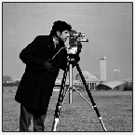
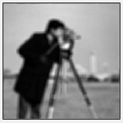
Introduction
Original Image
Blurred Image
PSF
AWGN
PSF- Point Spread Function
AWGN - Additive White Gaussian Noise

Slide 4
Motivation
Image blur Model: f (x,y)*g(x,y) + n(x,y) = h(x,y)
Naive Deconvolution (Inverse fourier transform)
1/G(w)
Limitation: Large Mean Square error
How to estimate the original image?
Deblurring Algorithms

Slide 5
Deblurring Algorithms
Image Deblurring Techniques
Non Blind Deconvolution
Blind Deconvolution
Wiener Filter
ForWaRD
Regularized
Filter
Haar

Slide 6
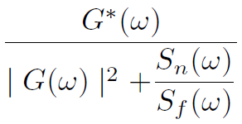
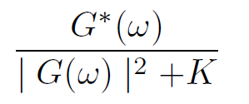
Wiener Deconvolution
Wiener Filter
J = deconvwnr(I,PSF,NSR)
Image
Image
Fourier Transform
Filtering
Inverse Fourier Transform
Ref[3]: Digital Image Processing, C. Gonzalez

Slide 7
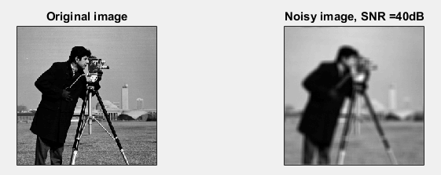
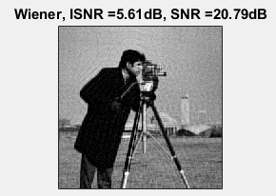
Wiener Filter Result
+ Sharp images
- Singularities

Slide 8
Wavelet Domain
LF
2
LF
2
HF
2
LF
2
HF
2
Level 3
Image
Level 2
HF
2
Level 1 coefficients
HF - High pass Filter
LF - Low pass Filter
2
Down sampling

Slide 9
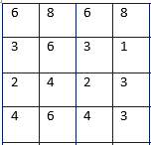
Haar Wavelet Transform
Forward Transform
At each level
Scaling coefficients
Avg. of adjacent samples
Wavelet coefficients
Sub. of adjacent samples
[ca,ch,cv,cd]=Dwt2(X, ‘wname’)

Slide 10
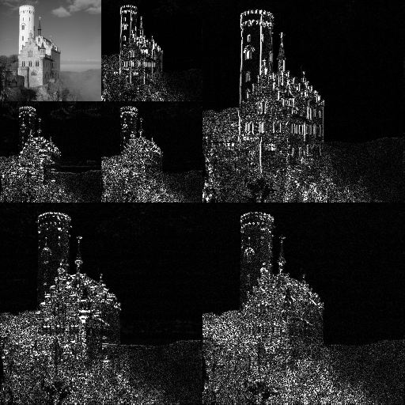
Wavelet Transform Result
+ Smooth regions
- Noise

Slide 11
ForWaRD Algorithm
Fourier Shrinkage
Tikhonov filter, K= 3.4*10⁻⁴
Wavelet Shrinkage
Coefficients Threshold : Y = wthresh(X,SORH,T)
Wavelet domain wiener filter
Observation
Inversion
Fourier Shrinkage
Wavelet Shrinkage
o/p
Wavelet
Shrinkage
Ref[1]: R. Neelamani, ‘Forward for ill conditioned systems’

Slide 12
ForWaRD Implementation
Blurred Image
Precompute
PSF
Threshold Update
FFT
WT1
PSF - Point Spread Function
Regularized Fourier Filter
MAD Noise Estimate
FFT - Forward Fourier
Transform
IFFT
IFFT - Inverse FFT
Compute Threshold
WT1
WT2
Daubechies6, 2
Wavelet Transforms
WT2
WT1
MAD - Median Absolute
Deviation
Estimate Noise

Slide 13
ForWaRD Implementation
Blurred Image
Deblurring
FFT
Filter in Frequency Domain
IWT1 - Inverse WT of WT1
WDWF – Wavelet Domain
Wiener Filter
IFFT
WT2
WT1
Hard Threshold
WDWF
WT2
IWT1

Slide 14
ForWaRD Implementation
PSF
Blurred Image
FFT
WT1
FFT
Regularized Fourier Filter
Filter in Frequency Domain
MAD Noise Estimate
IFFT
IFFT
WT2
WT1
Compute
Threshold
WT2
WT1
Hard Threshold
WT2
IWT1
WDWF
Estimate Noise
Deblurred Image
IWT2

Slide 15
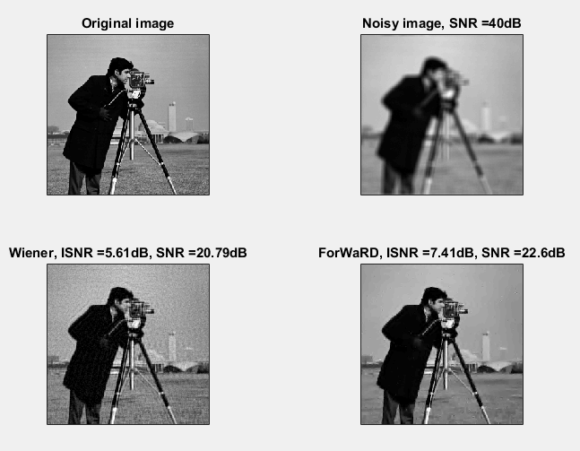
Results Comparison
Ref[8]: http://dsp.rice.edu/software/forward

Slide 16
ForWaRD Implementation on GPU
Real time HD video deblurring (30 f/s)
Camera + Processor + GPU
DDGPU library (Demosaic & Deblur on GPU)
Reduced ForWaRD
Remove WDWF, Subframes for Thresholding
Performance Improvements
Reduced memory transfers
Reduced unnecessary data movements
Ref[2]: J. Dysart “Embedded Realtime HD Video Deblurring

Slide 17
ForWaRD Performance Results
Implement DDGPU on GPU cards
Time/frame (ms) | Color | GPU | Improvements
55 | Gray | GTX 580 | Removed device transfers
100 | Color | GTX 580 | Reduced Computations
37.5 | Color | GTX 670 | Full Reduced Algorithm
23 | Color | GTX 780 | Upgraded Hardware

Slide 18
ForWaRD Implementation Comparison
ForWaRD | ForWaRD on GPU
Huge computations | Parallel Computations (Multi core)
High Memory bandwidth | Minimized bandwidth
Grayscale images | Colored images

Slide 19
Conclusion
Deconvolution in any single domain is inadequate
Forward combines fourier & wavelet domains
Better Estimate than traditional filters
Improved MSE → Good visual quality
Space variant applications
Future: Gpu cards → Fpga’s
Notes:
Code open source
Smoothens regions, edges well preserved
Applications of forward ranges from satellite imaging to seismic deconvolution. Can be used in all Space variant systems

Slide 20
References
[1] R. Neelamani, H. Choi, and R. Baraniuk, ‘Forward:
Fourierwavelet regularized deconvolution for ill-conditioned
systems
[2] J. Dysart, B. Brockman, S. Johnes, F. Bacon “Embedded
Realtime HD Video Deblurring
[3] C. Gonzalez, E.Woods, “Digital Signal Processing,” ,Pearson,
[4] T. Young,J. Gerbrands,J. van Vliet, “Fundamentals of Image
Processing,” Delft University of Technology.
[5] Y. Nievergelt, “Wavelets Made Easy,” Birkhaeuser, 1999.
[6] J. Kalifa and S. Mallat, “Thresholding estimators for linear
inverse problems,’Ann. Statist.,’, vol. 31,no. 1, Feb 2003.
[7] S. Mallat, A Wavelet Tour of Signal Processing. New York:
Academic, 1998.
[8] http://dsp.rice.edu/software/forward

Slide 21
DANKE Thank you

