Slide 1
DEPARTMENT OF COMPUTER SCIENCE AND ENGINEERING (IOT)
Next-Gen Intelligent Vehicle System for Enhanced Safety and Secure Access
BY
PINJARI APSAR (23AT5A3507)
SHAIK YAHIYA AHAMMED (22AT1A3539)
KATIKA NASEER (23AT5A3504)
KATIKA JAYAPRAKASH (22AT1A3516)
Under the Supervision of P.VISHNU KUMAR M.Tech, (Ph.D).
G PULLAIAH COLLEGE OF ENGINEERING AND TECHNOLOGY
(An Autonomous Institute affiliated to JNTUA, Ananthapuramu)

Slide 2
CONTENTS
Problem Statement
Motivation
Objectives
Abstract
Introduction
Existing system
Proposed System Block Diagram
Explanation of Block Diagram
Software Tools Used
Hardware Tools Used
Advantages and Applications

Slide 3
Problem Statement
Existing vehicle security systems are vulnerable to theft and unauthorized access
Lack of authentication in traditional vehicle access methods
Absence of real-time driver monitoring to detect fatigue or unsafe behavior
Limited integration of safety features such as alcohol and accident detection
Delayed emergency response due to lack of automatic alert systems
Need for an integrated, intelligent, and cost-effective vehicle safety solution

Slide 4
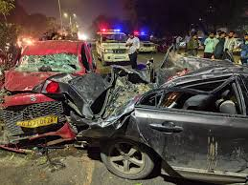
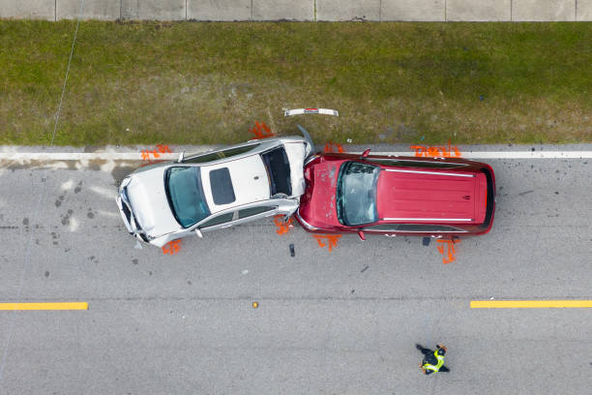
Motivation
Rapid growth in smart vehicles but lack of advanced security integration
Unauthorized vehicle access due to weak authentication methods
Dependence on manual driving without intelligent monitoring systems
Increasing accidents caused by distracted or drowsy drivers
Absence of real-time driver health and behavior analysis
Lack of automated alert systems during emergencies

Slide 5
Objectives
To design and develop an intelligent vehicle system that enhances safety and security using modern IoT and embedded technologies.
To implement authentication using face recognition and smartphone-based fingerprint access to prevent unauthorized vehicle use.
To monitor driver behavior in real time through vision-based drowsiness detection to reduce fatigue-related accidents.
To integrate alcohol detection and accident detection mechanisms for proactive safety control.

Slide 6
ABSTRACT
The development of intelligent vehicle systems plays a vital role in enhancing road safety, vehicle security, and driving comfort. This project presents an Enhanced Intelligent Vehicle System (E-IVS) that integrates biometric authentication and real-time driver monitoring to ensure secure vehicle access and safe driving conditions.
The system employs face recognition using Python to authenticate the driver before engine ignition, effectively preventing unauthorized access and vehicle theft.
In place of conventional hardware-based eye blink sensors, a software-based drowsiness detection system is implemented using computer vision techniques to continuously monitor the driver’s eye movements and accurately identify signs of fatigue, triggering timely alerts to prevent accidents. Additionally, safety-critical modules such as alcohol detection and accident detection are incorporated to monitor driver behavior and collision events.
In emergency situations, GSM and GPS technologies are used to transmit real-time alerts and location information to predefined contacts for rapid assistance.
By combining biometric security, intelligent driver monitoring, and automated emergency response mechanisms, the proposed system provides a reliable, cost-effective, and efficient solution to significantly enhance vehicle security and driver safety in modern transportation systems.

Slide 7
INTRODUCTION
Implements authentication using Python-based face recognition to allow access only to authorized drivers
Reduces vehicle theft and unauthorized usage through secure authentication
Integrates embedded systems and software-based control for efficient and user-friendly operation
Incorporates alcohol and accident detection for enhanced safety
Uses GSM and GPS to send automatic emergency alerts with location details
Provides a reliable and cost-effective solution for improving road safety

Slide 8
EXISTING SYSTEM
Based on Internet of Things (IoT) technology for vehicle monitoring
Uses multiple sensors to detect drunk driving, accidents, and driver fatigue
Employs microcontrollers such as ESP32 to process sensor data and control actuators
Provides real-time vehicle tracking and basic safety alerts
Faces challenges such as sensor calibration and data accuracy
Limited integration of advanced security features like biometric authentication

Slide 9
PROPOSED SYSTEM
Verifies driver identity using biometric authentication before allowing vehicle operation
Uses Python-based face recognition to prevent vehicle theft and unauthorized access
Enhances security while maintaining ease of use for authorized drivers
Generates instant alerts when driver fatigue is detected to reduce accident risk
Includes alcohol detection to prevent drunk driving
Uses GPS and GSM modules for accident detection and automatic emergency notifications
Provides a cost-effective, reliable, and integrated system compared to standalone solutions

Slide 10
Methodology
Collect sensor data using ESP32 as the central processing unit
Verify seat belt usage before vehicle operation
Detect alcohol presence using the alcohol sensor
Identify accidents using the vibration sensor
Acquire real-time vehicle location using the GPS module
Send emergency alerts through the GSM module
Control vehicle using a relay based on system decisionsignition.

Slide 11
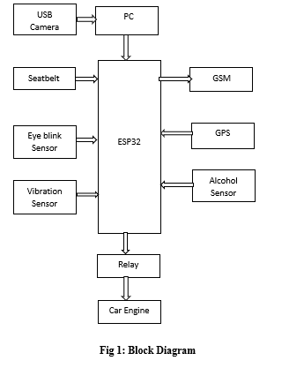
Block Diagram

Slide 12
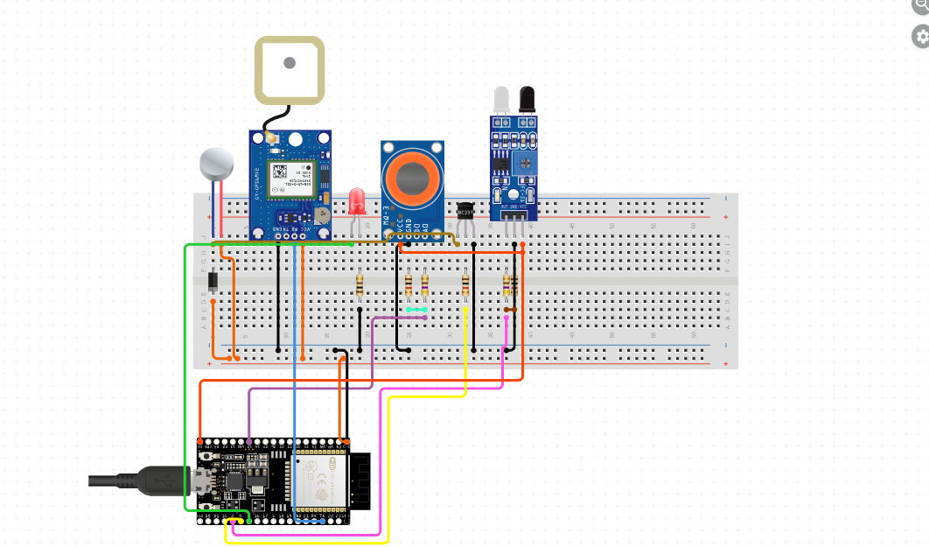
Wiring Diagram

Slide 13
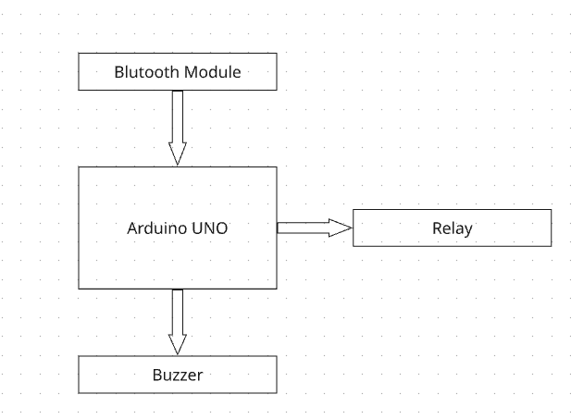
Block of DOOR LOCK

Slide 14
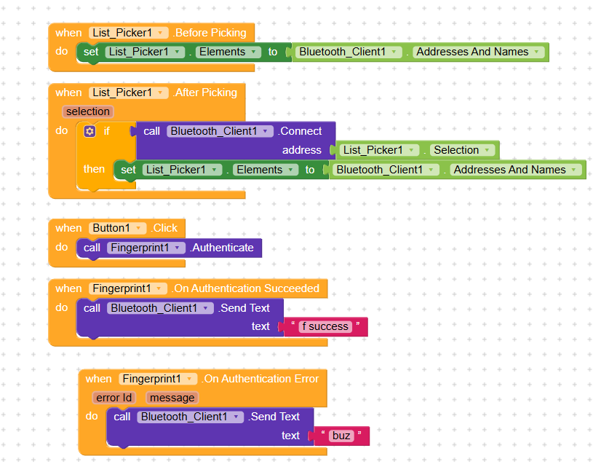
CODE of DOOR LOCK

Slide 15


SOFTWARE TOOL USED
Arduino IDE: Used to write and upload programs to the Arduino UNO and ESP32. It helps control sensors, relays, and communication modules.
Python: Used to implement face recognition and driver drowsiness detection through real-time image processing. It enables accurate monitoring and decision-making using computer vision techniques.

Slide 16
Algorithms USED
🪟 Tkinter (GUI Module)
Tkinter is Python’s built-in graphical interface library.
It creates the project window, buttons, labels, and input fields.
Allows users to capture images, train the model, and start recognition through a simple interface.

Slide 17

Hardware TOOL USED
ESP32: Acts as the main processing and communication unit with built-in Wi-Fi and Bluetooth
Relay Module: Safely switches high-voltage devices using low-voltage control signals
MQ-3 Alcohol Sensor: Detects alcohol presence in the driver’s breath
GPS Module: Provides real-time vehicle location information
GSM Module: Sends alert messages using the mobile network
Vibration Sensor: Detects shocks or impacts to identify accidents

Slide 18
ADVANTAGES AND APPLICATION
Applications
Smart and intelligent vehicle safety systems
Personal and commercial vehicle security
Accident detection and emergency alert systems
Driver monitoring and fatigue detection systems
Fleet management and vehicle tracking
IoT-based transportation and smart mobility solutions
Advantages
Enhanced Vehicle Security
Real-Time Driver Monitoring
Integrated Safety Features
Cost-Effective Solution
Scalable and Upgradable

Slide 19
QUERIES?

Slide 20
THANK YOU

