Slide 1
Big Data Analysis of the Board Game Community using Spark
Adam CarteR
CS 5540
Fall 2016

Slide 2
Introduction to Topic
Board Game Hobbyists on Twitter
Started by identifying several key user groups: Designers, Publishers, Reviewers/Podcasters, Convention Feeds
From that list, gather all followers, and cross-reference
Fifth User Group: Community Members
Must be followers of at least 10 of the above entities
Total Data: 21,467 Users & 1,670,856 Tweets

Slide 3
System Architecture
Hadoop/HDFS using Spark
REST API – Java using Spring REST Framework
Server initialization launches SparkSession
REST Handlers run Spark Queries to Retreive Results
Visualization Done in HTML5/JavaScript/Bootstrap
Multiple Google Chart APIs used, as well as vis.js
Data loaded through asynchronous AJAX calls

Slide 4
Query Caching
All REST requests run against live data in Spark
Search Results are Cached using subfolder structure similar to HDFS partitioning approach
Example:
Query2 accepts and start and end date range to bound query
Stored in HDFS under /proj3/query2/<startDate>/<endDate>
REST calls check for cached path
If found, read in data from cache and return results
If not found, run full Spark Job, cache the results as indicated, return results

Slide 5
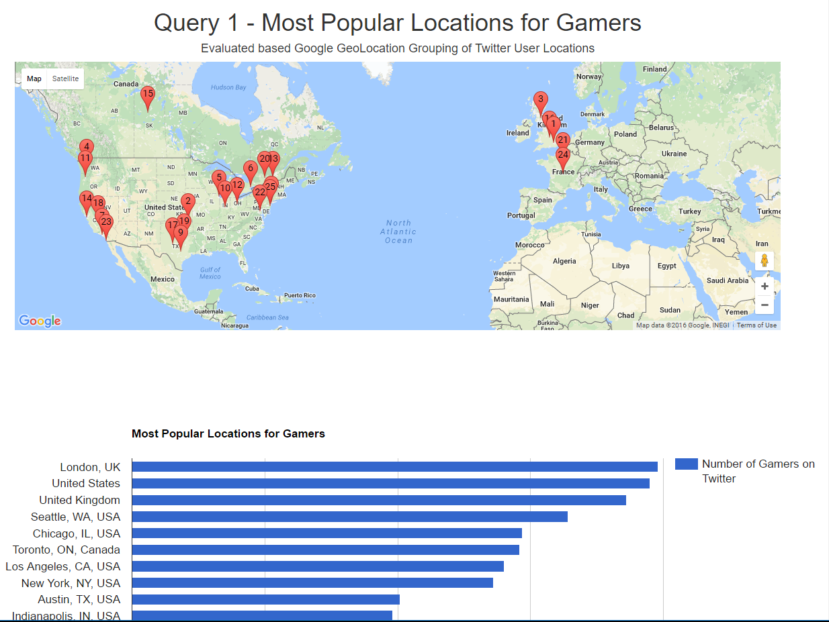
Query 1 -

Slide 6
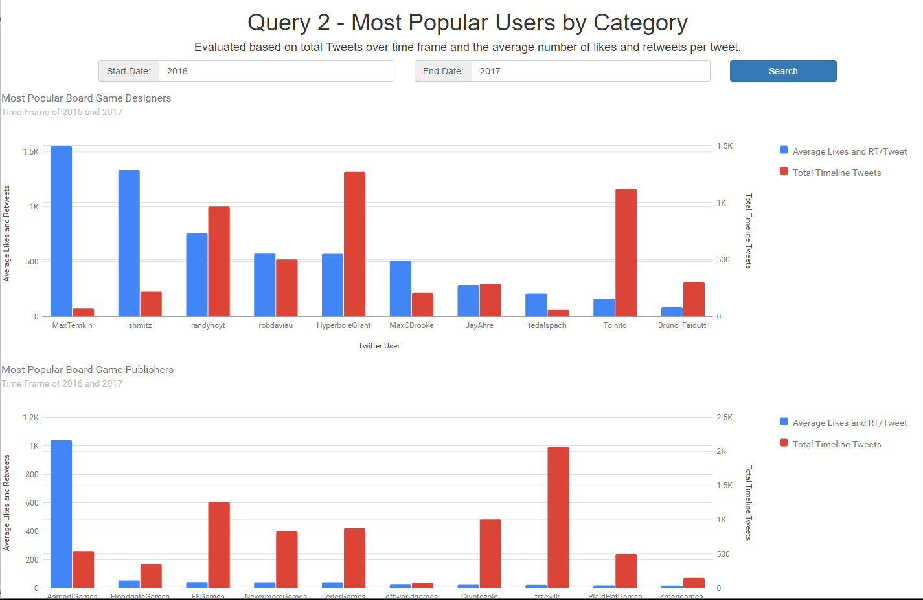
Query 2 –

Slide 7
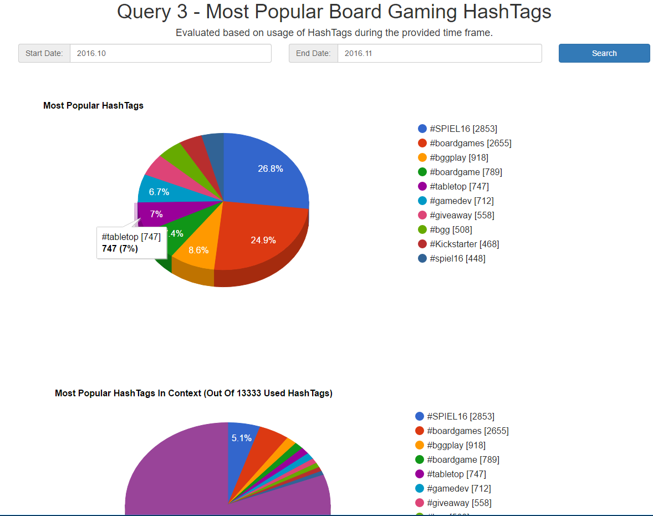
Query 3 -

Slide 8
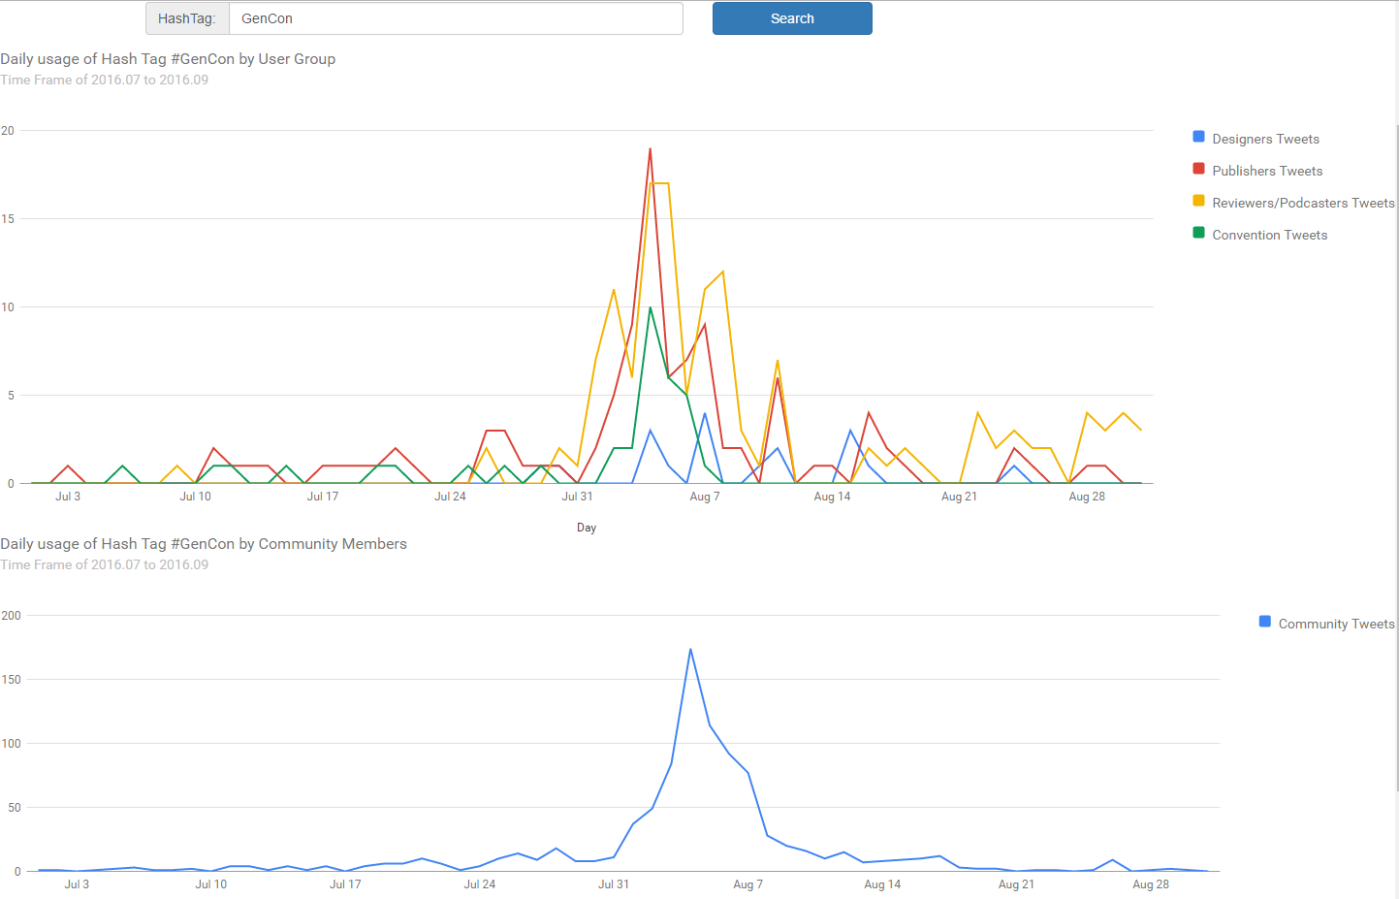
Query 4 -

Slide 9
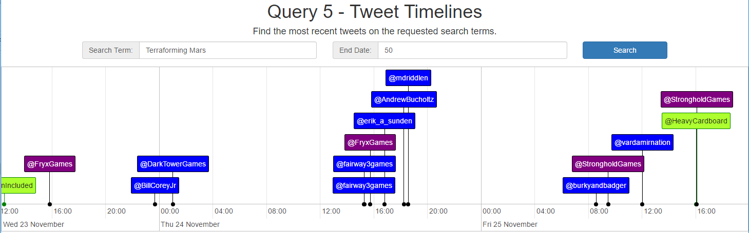
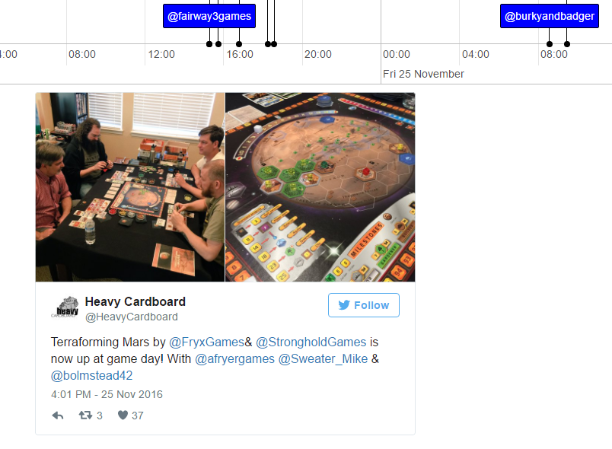
Query 5 -

Slide 10
Thank You
YouTube Demo Video: https://youtu.be/Oor6PsdXJXQ
Code Repositories:
https://github.com/apshaiTerp/ac-twitter-pull
https://github.com/apshaiTerp/ac-hdfs-writer
https://github.com/apshaiTerp/ac-spark-project2
https://github.com/apshaiTerp/ac-spark-rest-service
https://github.com/apshaiTerp/ac-spark-site

