Slide 1

Species Invasion in a Network Population Model
Ryan Yan
Dr. Leah Shaw

Slide 2
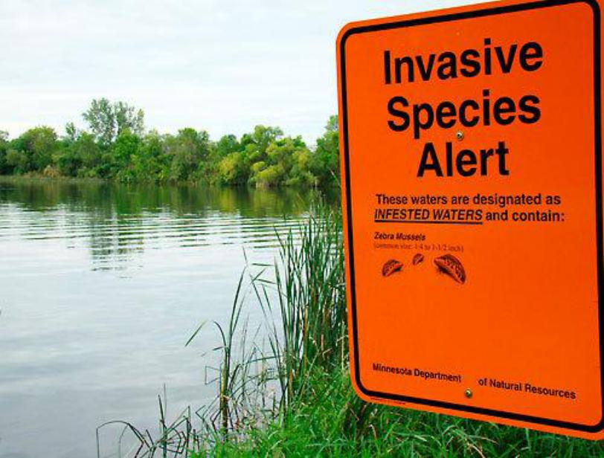
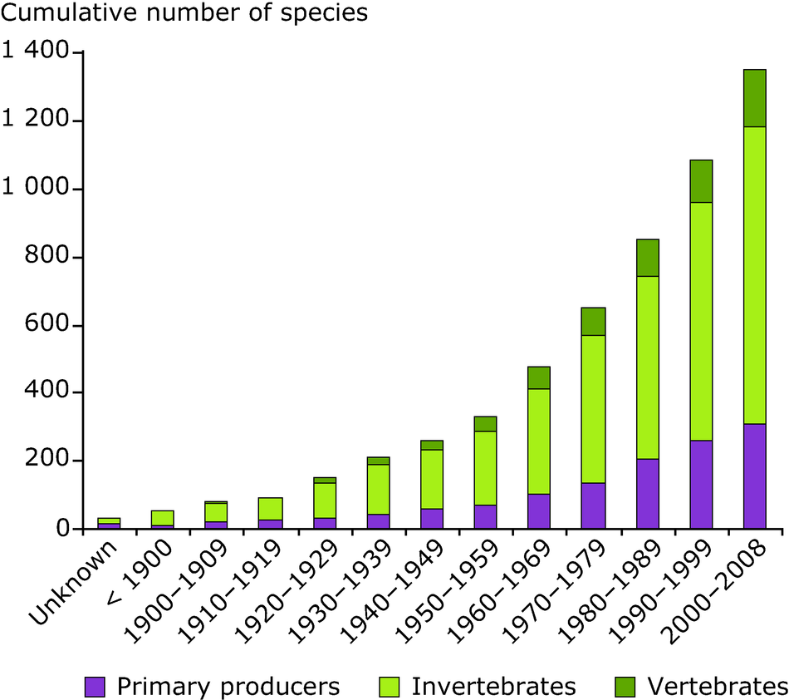
The Problem with Invasive Species
Notes:
So what is the problem with invasive species? It’s not new. In fact it’s been creeping up quietly in the background over the years and decades, and now its effects are in full swing. It’s one of the leading causes of species extinction around the world. Invasive species have contributed directly to the decline of 42% of endangered species in the US. There is an economic cost, to the tune of about $120 billion per year. A land area the size of California is experiencing native invasivion I want to start by giving a definition of invasive species. Simply put, these are organisms which have become established outside of their native environment.
What are invasives Why are they harmful, How do they spread? “In this talk, we will be focusing in on how invasive species proliferate and spread to new areas”. Image of zebra mussels attached to boat propeller (human transport is main vector of spread for many nuisance species). (zebra mussels known to have been mostly spread within the united states attached to personal motoboats)
Why we choose a network model with within node logistic growth: stages of invasion - introduction, establishment, spread. Modeling this on a network model (internode movement = introduction into empty nodes, establishment = intra-node logistic growth, spread is subsequent transfers from newly infected nodes.)

Slide 3
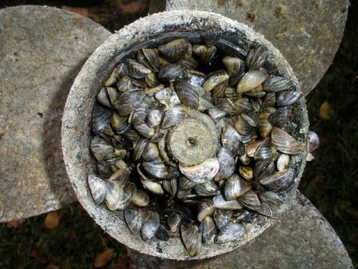


The Problem with Invasive Species
Notes:
What are invasives – no doubt you’ve
Why are they harmful, How do they spread? “In this talk, we will be focusing in on how invasive species proliferate and spread to new areas”. Image of zebra mussels attached to boat propeller (human transport is main vector of spread for many nuisance species). (zebra mussels known to have been mostly spread within the united states attached to personal motoboats)
Why we choose a network model with within node logistic growth: stages of invasion - introduction, establishment, spread. Modeling this on a network model (internode movement = introduction into empty nodes, establishment = intra-node logistic growth, spread is subsequent transfers from newly infected nodes.)

Slide 4
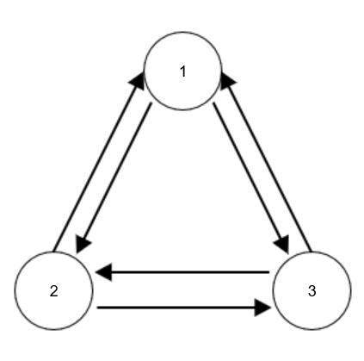






Model Framework
Nodes – Ecological patches
Edges – Migration routes between patches
Notes:
So what does this model look like? Nodes represent distinct environments that the species can reside in. Pathways of movement lie along edges connected each node.
One year time step, directed weighted network model. A simple network to the right – 3 interconnected nodes.

Slide 5

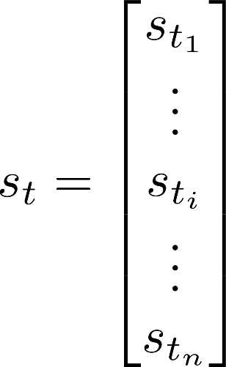
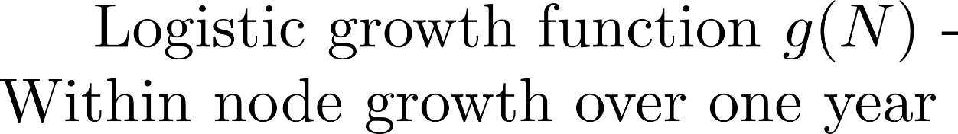
Model Framework
state vector
Notes:
To put it more concretely…
State vector – Each node is represented in the state vector. Elements keep track of populations at a particular time. Time step = one year
Logistic growth – intra-node growth
Transition Matrix – inter-node movement
(I didn’t show the equations for the logistic growth because I thought it might be confusing if I show either the unfamiliar discrete map form or the continuous function, since that would be inconsistent. Also didn’t put in the transition matrix since I didn’t think people would remember and it’s on the next slide anyway)

Slide 6

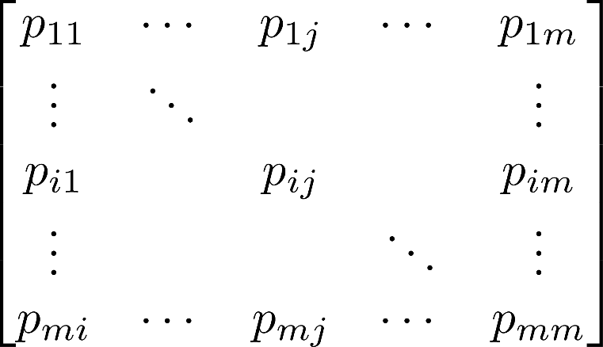





Introduction and Spread
1
Transition matrix
2
3
Notes:
“Now we’re thinking in terms of species moving across a network of patches…”
We model this using a weighted directed network model – simply meaning connections between nodes have a direction and a magnitude associated with them.
(talk about figure on the right) – Weights along the directed edges equate to elements in the transition matrix – how we determine the proportion of individuals moved from one patch to another each year.
When we start a simulation, we generate a corresponding transition matrix (via movement data, or, artificially)
Network geometry – symmetry, conservation, tie in to real networks (e.g. shipping)

Slide 7
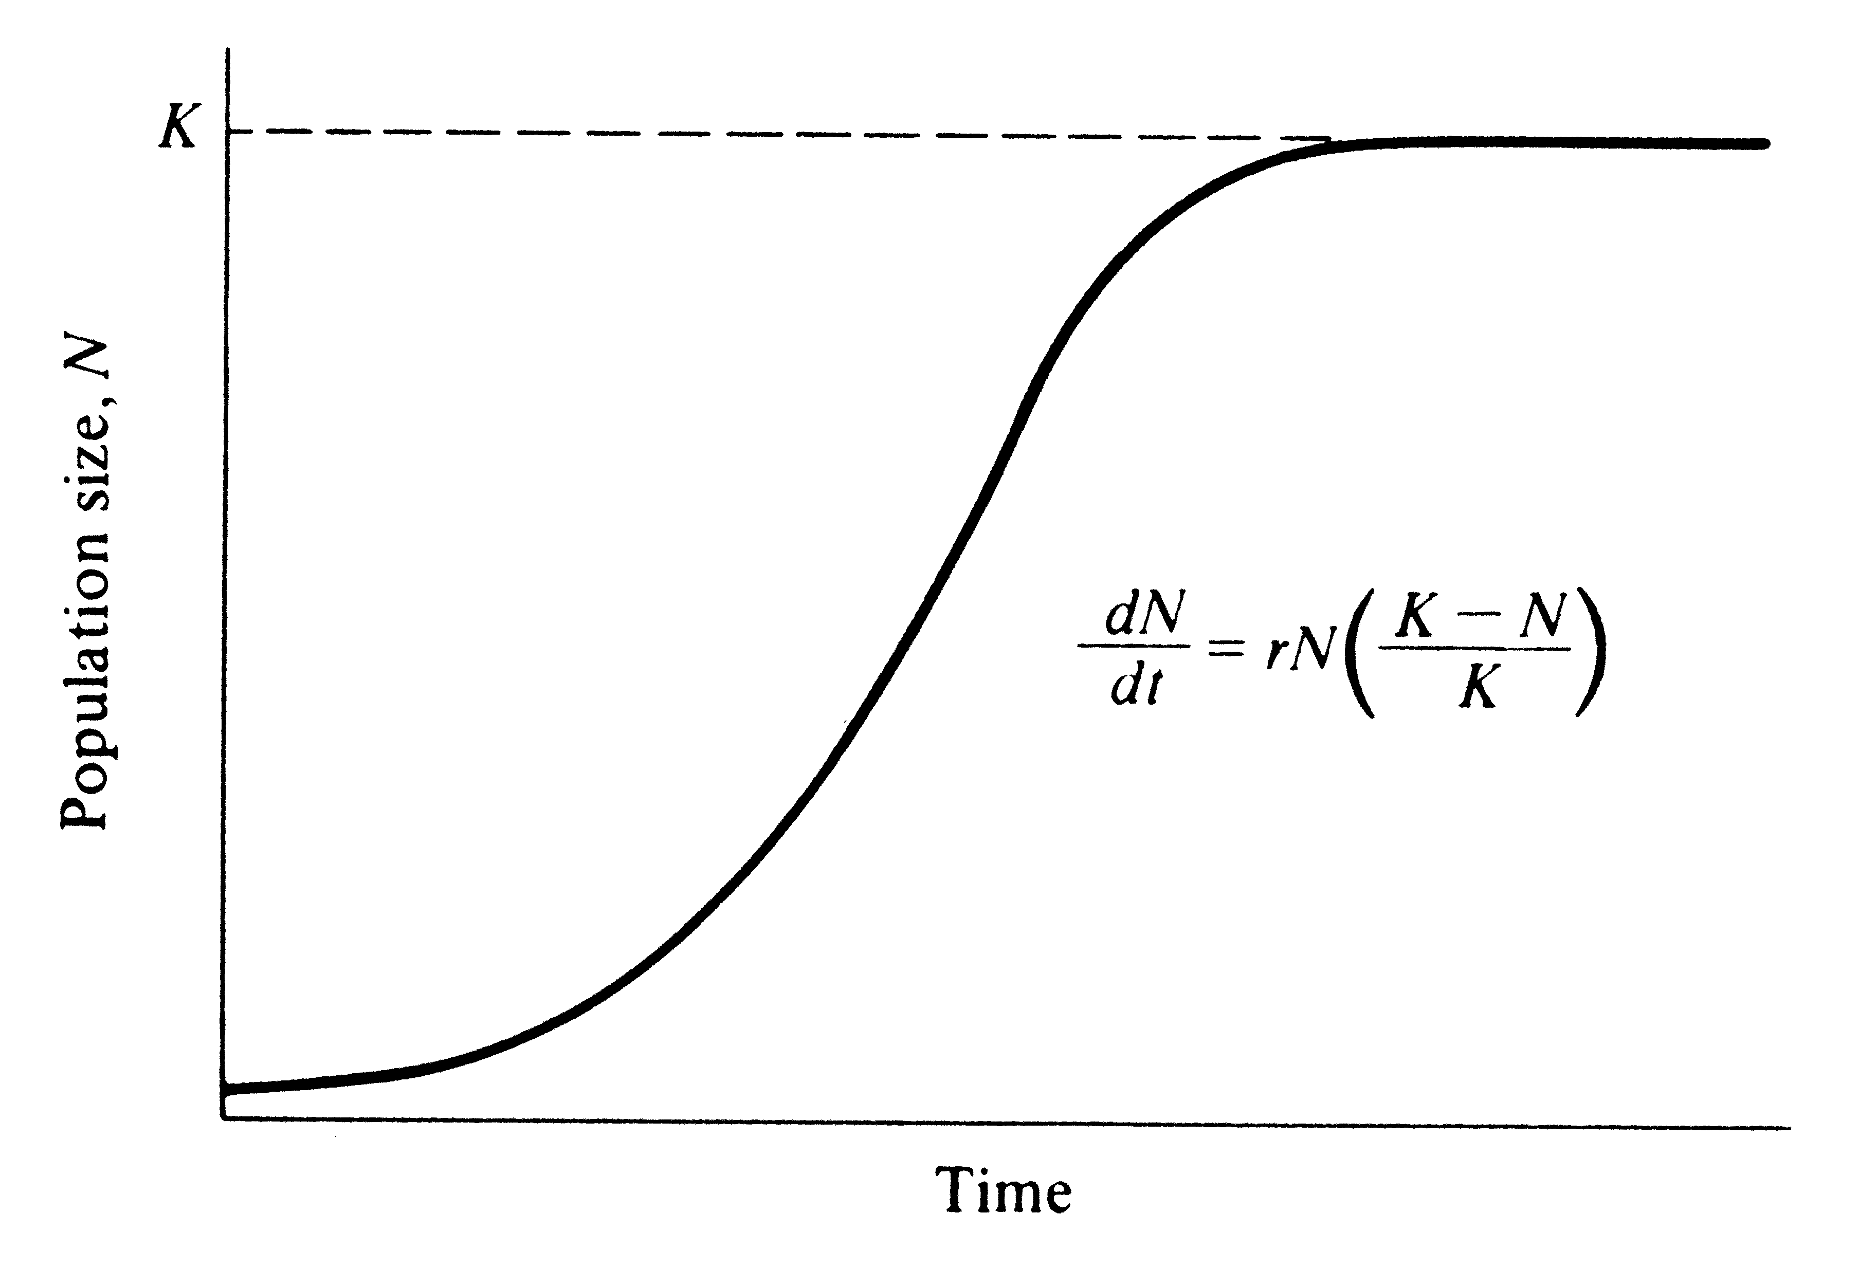

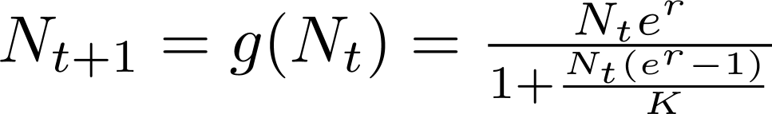
Establishment
continuous time logistic function
discrete map of the logistic function
Notes:
Establishment - How do we model the growth of a species in a single node? We start with the well-known continuous logistic equation. Through integration, we develop a discrete map analog of the continuous equation. (Explain variables) This equation maps the population within one node from one year to the next. This is very useful in large-scale simulations which will come in later.
Plot - time series of population undergoing logistic growth. The sigmoidal curve should be familiar to biologists, and is highly relevant to the establishment of invasive species. (lag time after initial introduction, accelerated growth period, slowdown, seen in individual patches and in the invasion as a whole)
Fixed points – points in time at which the system is unchanging. To predict what state a system will end up in, we look at the study the steady states. In a biological sense, we are looking for states in which the population is neither increasing or decreasing. (-carrying capacity). We solve the discrete map for N* s.t. N_t+1 = N_t = N*. Find N* = 0, K.

Slide 8
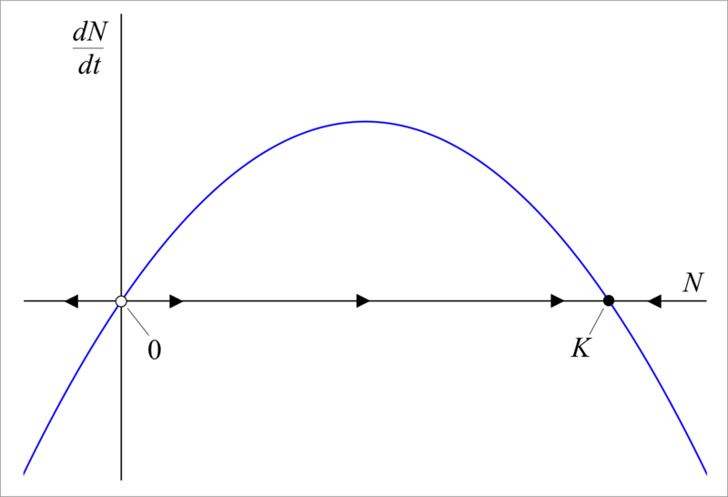
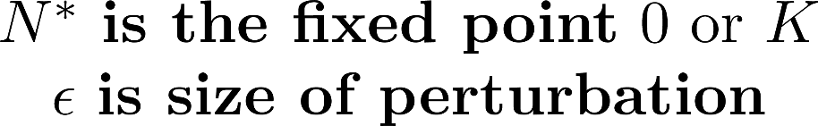

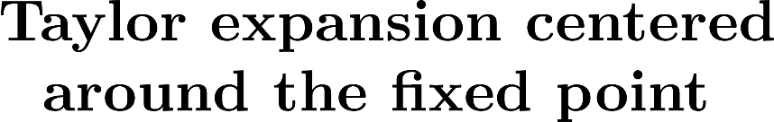
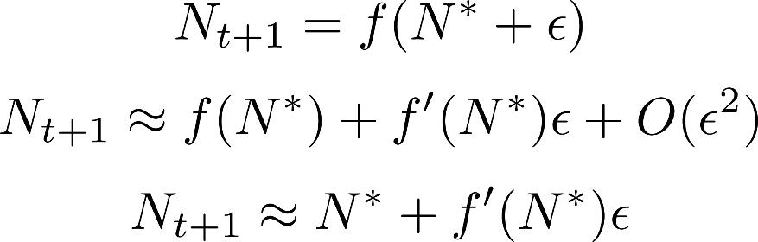
Stability Analysis
Notes:
(Talk about 1-d analysis) What happens to a steady state system when it is perturbed? In stability analysis we answer this question by looking at a small neighborhood around the fixed point
Linearization – Taylor series expansion centered at N*, when epsilon is small, higher order terms are negligible
Stability – What does the last equation mean? The population at the next time step will be approximately equal to the population now + the first derivative of the growth function at N* times epsilon. When the magnitude of f’(N*) < 1, the fixed point is stable.
Interpretation? As it turns out, there is a reliance on r, the intrinsic rate of growth. When r > 0, K is stable and 0 is unstable. The repercussions? Once an introduction is made into an environment, the population will surely rise to the carrying capacity within that patch.
(In higher dimensions, the process is similar but more complicated. We also have to deal with transfer coefficients in between node transfers, so the carrying capacity is no longer exactly the fixed point unless there is symmetry)

Slide 9
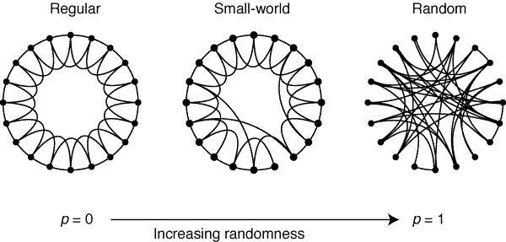
Small-world Networks
Notes:
(Transition) We talked about a simple network geometry of 3 interconnected nodes. In the real world, the networks are more complicated. But as it turns out, many types of networks in real life are small-world networks… some degree of regular connectivity with several long-distance connections.
How does this network get generated? Start with m nodes and n neighbors, go through rewiring process with probability from regularity 0 < p < 1 randomness.
Invasive species – So why is this helpful to us? We can think of the network that invasive species spread across as a small connections between neighbors: movement via slow diffusive processes over small distances. Long-distance “shortcuts” via human or otherwise long-distance secondary dispersal methods.

Slide 10
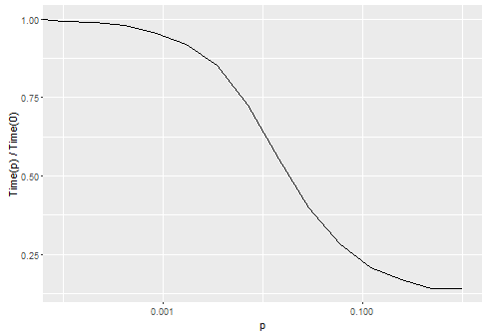
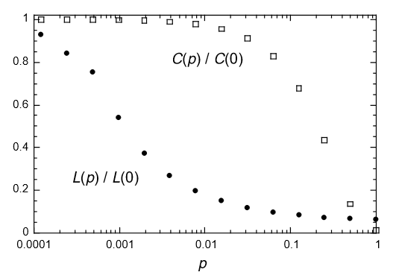
Small-world Simulations
Notes:
Discrete map small world simulations – Graph on the right from Watts-Strogatz paper. L(p) / L(0) is normalized characteristic path length, shares the same functional form as our measure – time to infection (passing a certain population threshold on the opposite side of the world as where the invasive species was first introduced)
Plot on the left is of our simulation ran using the adjacency matrix generated by a watts-strogatz generated network varying p. This is with low migration rate and r = 0.01 growth rate.
We are investigating the roles of growth and spread rate in the small world network.
(*Can put other graphs here, maybe on the same plot would be good)
I plotted some and they looked only different in terms of the above plot – so same functional form, but different timings (high spread rate simulations are faster), but I also need to go back and possibly change how the adjacency matrix is fit into the simulation since it’s showing odd behavior at times I think.

Slide 11
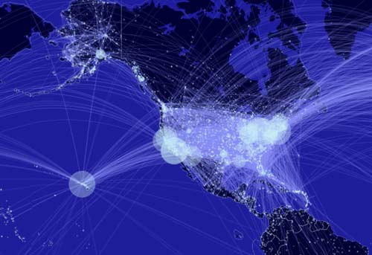
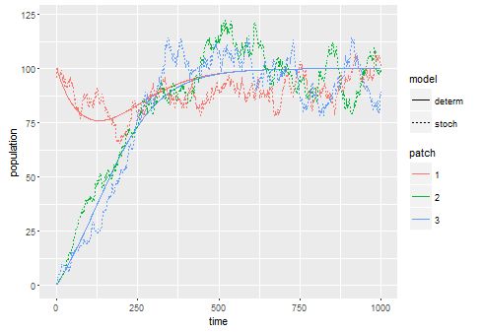
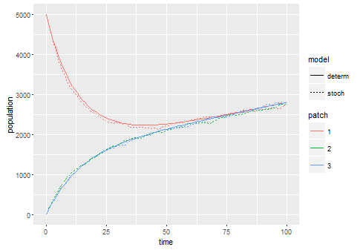
Future Work
Low population and migration rate
High population and migration rate
Network Effects – role of large hubs and long-distance dispersal
Stochasticity in long-run aggregate simulations
Notes:
FUTURE WORK:
Continuing thesis work… divided into two fields
Allee Effects / stochasticity: Graphs – for large populations with fairly high migration rates, stochastic simulations and deterministic simulations do not differ much. However in the case of invasive species, we perceive introductions as rare events, most of which fail to establish a stable colony due to chance. Recall the idea of fixed points – population at 0 moving inexorably towards carrying capacity. Very low migration rates for invasive species – stochasticity with low population numbers can have a large impact. Allee effects – positive growth impacts from many individuals (e.g. mate searching) creates threshold for invasion, requiring repeated / large volumes of introductions within a short period.
Network effects – small world exploration, by and large respective roles of growth and long-distance dispersal. Investigation into role of large hubs. Idea of human transport networks – reasonable that a few nodes with high connectivity would source a large proportion of initial introductions. What is their impact and does this have any implications for management? Would simply controlling traffic through these hubs have any effect to slow down the spread of the invasion?

Slide 12
1
2
3

Slide 13
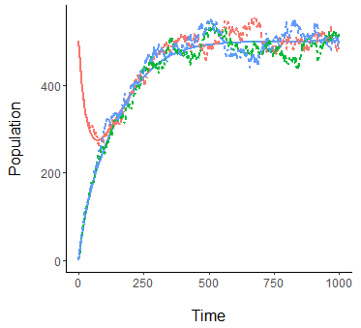
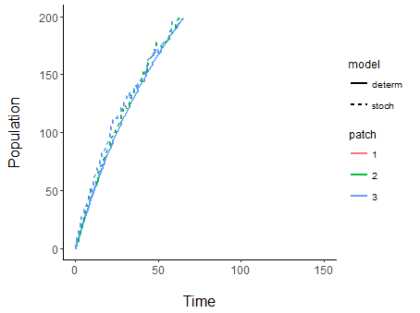
(a)
(b)

Slide 14
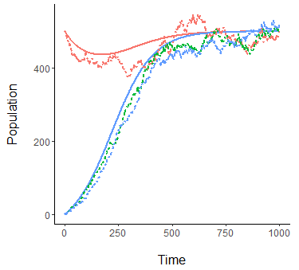
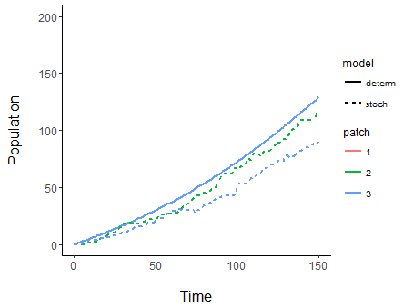
(a)
(b)

Slide 15
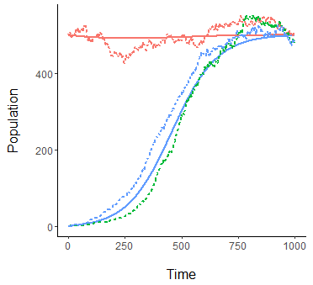
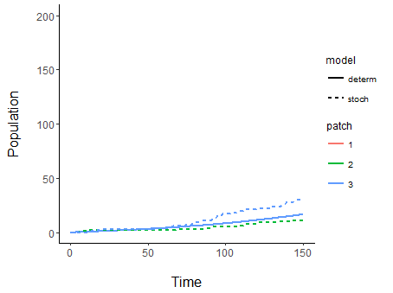
(a)
(b)

Slide 16
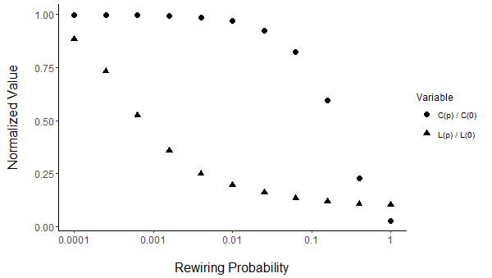
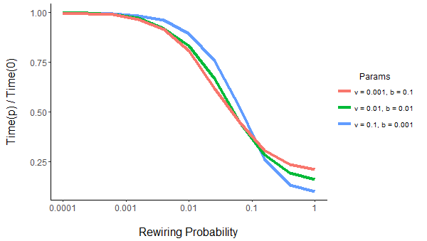
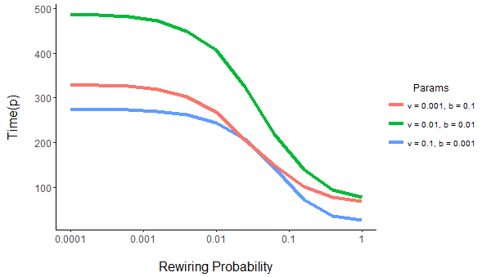
(a)
(b)
(c)

