Slide 1

Species Invasion in a Network Population Model
Ryan Yan
Dr. Leah Shaw

Slide 2
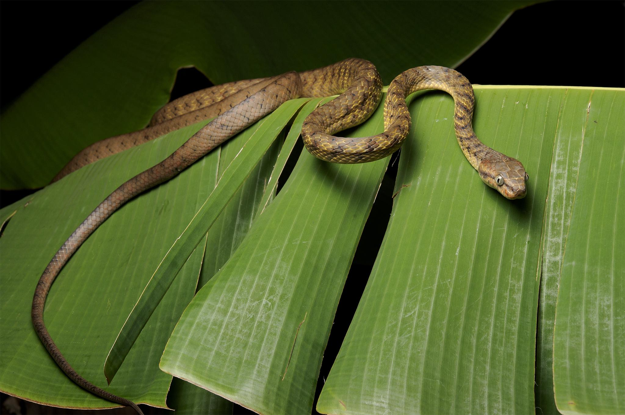
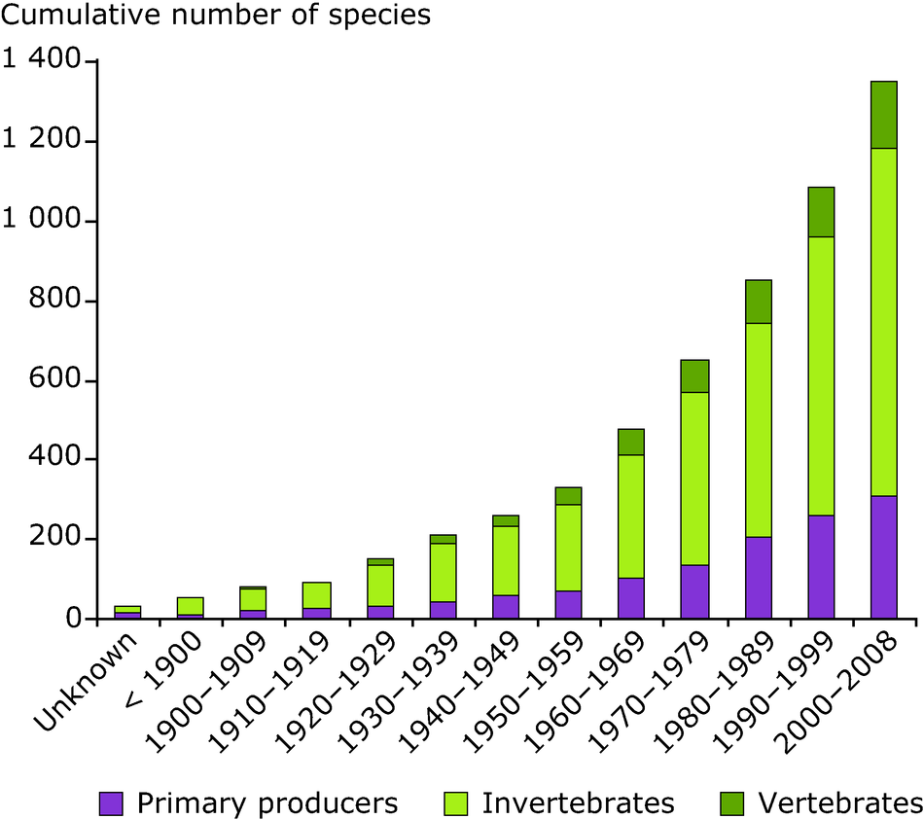
The Problem with Invasive Species
[1] http://voices.nationalgeographic.com/files/2014/05/ww-invasive-species-havoc-brown-tree-snake-02.jpg
[2] http://wwws2.eea.europa.eu/data-and-maps/figures/alien-species-in-european-marine-estuarine-waters-october-2008/image_xlarge
Notes:
So what is the problem with invasive species? It’s not new. In fact it’s been creeping up quietly in the background over the years and decades, and now its effects are in full swing. It’s one of the leading causes of species extinction around the world. Invasive species have contributed directly to the decline of 42% of endangered species in the US. There is an economic cost, to the tune of about $120 billion per year. A land area the size of California is experiencing native invasivion I want to start by giving a definition of invasive species. Simply put, these are organisms which have become established outside of their native environment.
What are invasives Why are they harmful, How do they spread? “In this talk, we will be focusing in on how invasive species proliferate and spread to new areas”. Image of zebra mussels attached to boat propeller (human transport is main vector of spread for many nuisance species). (zebra mussels known to have been mostly spread within the united states attached to personal motoboats)
Why we choose a network model with within node logistic growth: stages of invasion - introduction, establishment, spread. Modeling this on a network model (internode movement = introduction into empty nodes, establishment = intra-node logistic growth, spread is subsequent transfers from newly infected nodes.)

Slide 3
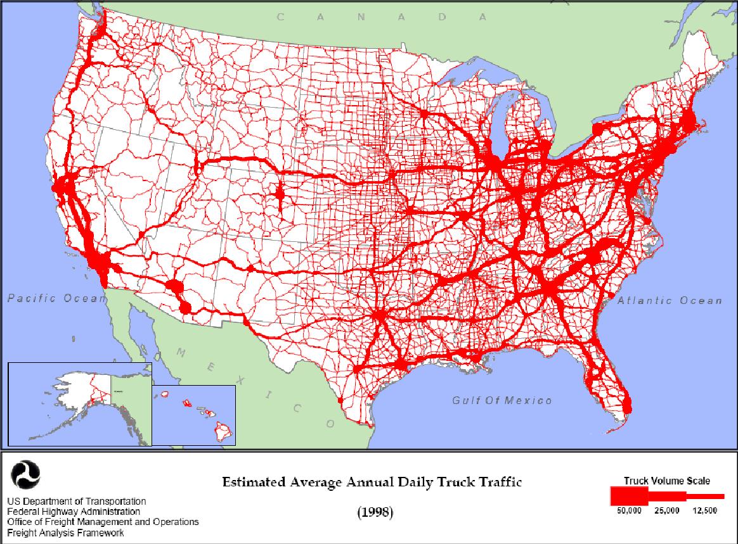
Modeling Background
Diffusion - reaction
Integro-differential
Environmental niche models
Network models
[3] https://upload.wikimedia.org/wikipedia/commons/5/5c/Estimated_Average_Annual_Daily_Truck_Traffic_%281998%29.PNG
Notes:
There is plenty of research to draw upon in invasive species modeling. Varies in terms of spatial and environmental complexity taken into account. In general, the growth terms in these models assume logistic growth
Diffusion – reaction: Simple model, combines growth term with diffusive spread to generate solid expanding fronts.
Integro-differential: Main advantage is in greater spatial complexity – expansion kernel allows for different distributions along the spatial axes.
Environmental niche models: Main advantage is takes into account environmental variables. More computational / data driven approach to modeling. Uses presence / absence data to run a regression against various environmental variables to generate a mathematically defined “niche” for the species. Can be used for predictive purposes
Network models: More recent in the literature. Advantages in that they can take into account spatial complexity like long-distance dispersal terms, and seems like an intuitive fit for the phenomena of invasive species dispersal. There is a longstanding literature behind network analysis.
(image for transportation networks) (talk about transport networks motivation)

Slide 4

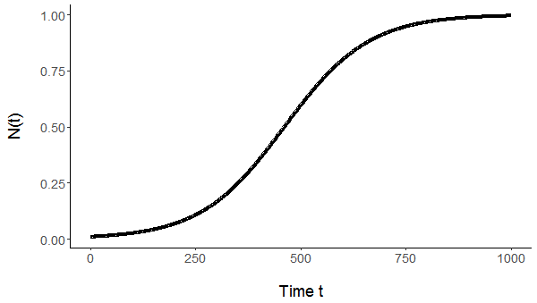
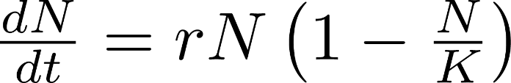
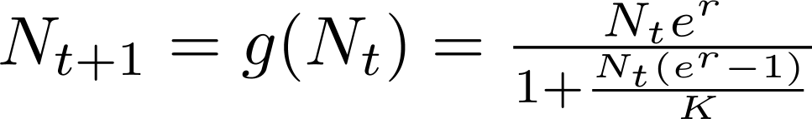
Single Patch Model
continuous time logistic function
discrete map of the logistic function
Time series of population using discrete map
Notes:
N(t) vs. t time series dot at 0 vs 1 Figure

Slide 5
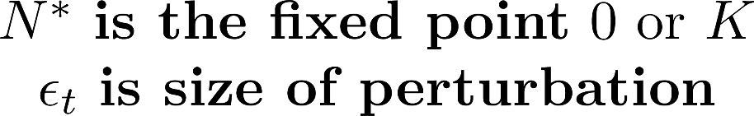
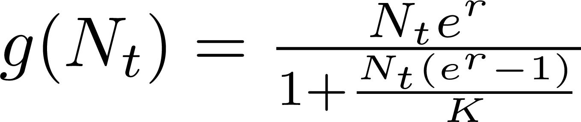
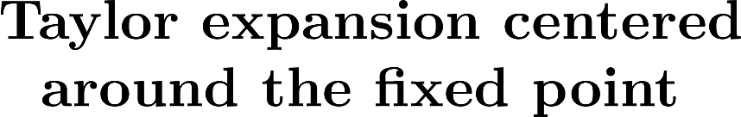
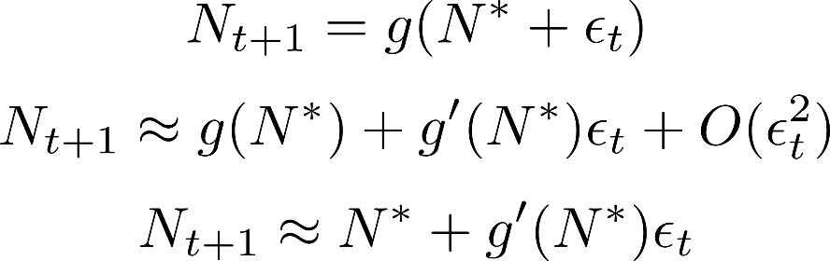
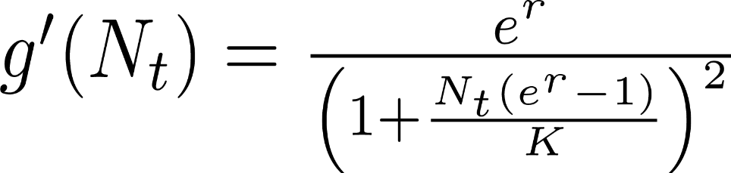

Single Patch Stability Analysis
Notes:
(Talk about 1-d analysis) What happens to a steady state system when it is perturbed? In stability analysis we answer this question by looking at a small neighborhood around the fixed point
Linearization – Taylor series expansion centered at N*, when epsilon is small, higher order terms are negligible
Stability – What does the last equation mean? The population at the next time step will be approximately equal to the population now + the first derivative of the growth function at N* times epsilon. When the magnitude of f’(N*) < 1, the fixed point is stable.
Interpretation? As it turns out, there is a reliance on r, the intrinsic rate of growth. When r > 0, K is stable and 0 is unstable. The repercussions? Once an introduction is made into an environment, the population will surely rise to the carrying capacity within that patch.
(In higher dimensions, the process is similar but more complicated.
(Put derivative down)

Slide 6

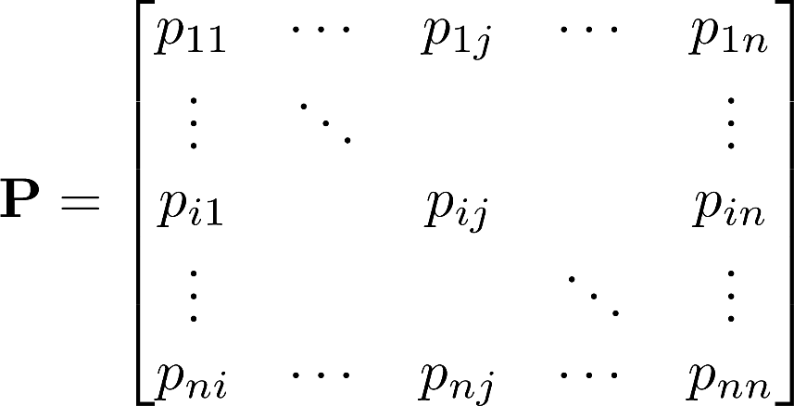
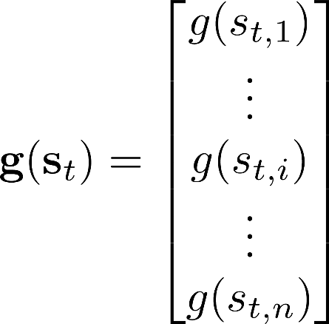
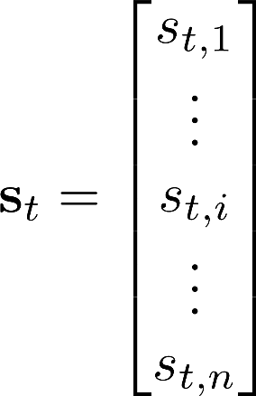
Multidimensional Model
Transition Matrix
Vector Growth Function
State Vector

Slide 7



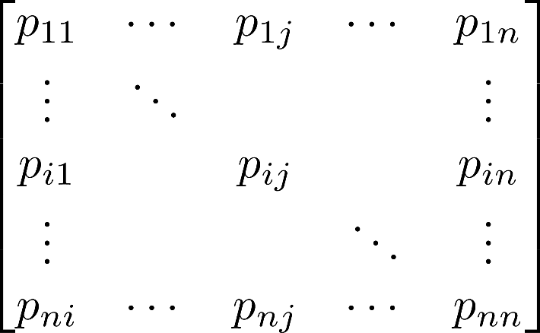








Multidimensional Model
1
Transition matrix
2
3
Notes:
A more visual look at the component we’re adding – movement along edges is weighted by the elements in the transition matrixPathways of movement lie along edges connected each node.
One year time step, directed weighted network model. A simple network to the right – 3 interconnected nodes.

Slide 8
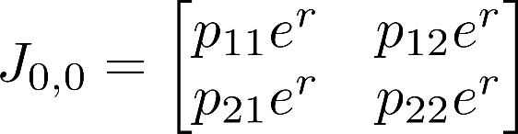
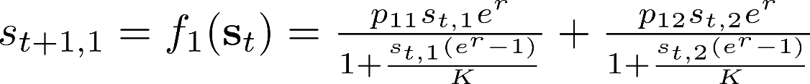
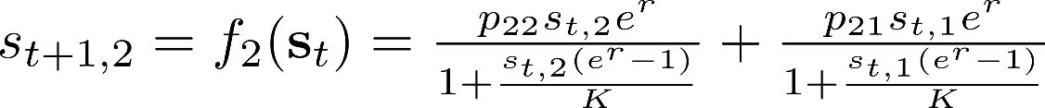


Two Patch Stability Analysis
Jacobian Matrix
General Two-Patch System
Characteristic equation
Eigenvalues
Notes:
(Not pos / neg, just two eigenvalues)

Slide 9
Numerical Simulations Background
___________________
General Approach
Deterministic Models
___________________
Initialize state vector - set one node to carrying capacity, others to 0
Generate network connections (i.e. transition matrix)
Use specific model to map population forward and record yearly populations
Discrete Map
Directly implemented in R
ODE integration
Uses ODE solver package
Continuous-time Monte Carlo
Implements Gillespie algorithm
Stochastic Model
___________________
Notes:
We don’t attempt analysis of the map beyond 2 dimensions. Instead we rely on numerical simulations. This slide just tries to paint a picture of how we’re doing the simulations.

Slide 10

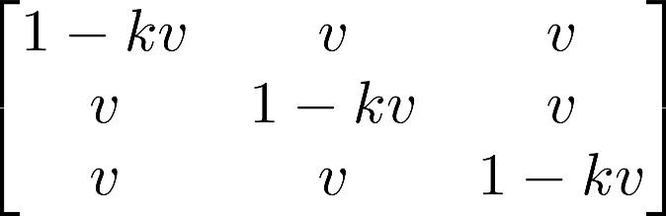


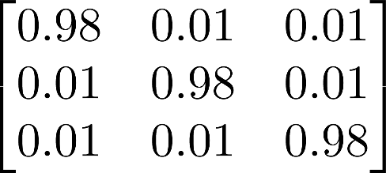
Choosing Migration Rate
k is the outdegree of a node
v is the migration rate set by the user
The transition matrix of the symmetric 3-D system, parameters:
Let k = 2
Let v = 0.01
1
2
3

Slide 11
Continuous-time Monte Carlo (CTMC)
1) Initialize the state vector
2) Generate random numbers to decide which transition step occurs as well as the size of the (exponentially drawn) time step
3) Update the corresponding elements of the state vector
4) Repeat steps 2 and 3 until the desired amount of time has passed

Slide 12
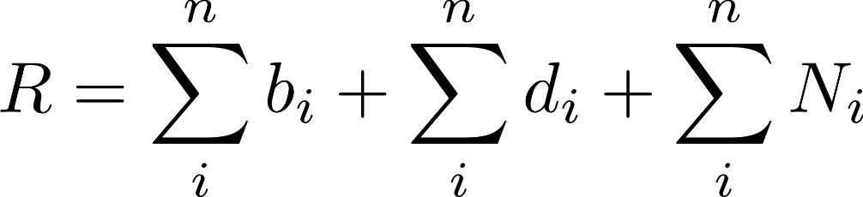



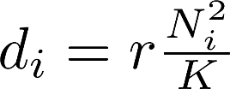
CTMC Continued
Total rate R
Assume transitions are dependent only on current state
Treat transitions as a Poisson process, with mean rate R
Time steps are exponentially distributed with mean 1/R
Birth rate
Death rate
Movement rate
Notes:
Total rate = R
Treat transition as Poisson process
Draw from exponential distribution
Then decide what nodes are involved.
Add networks of 3 patches, 1 – v, v…

Slide 13
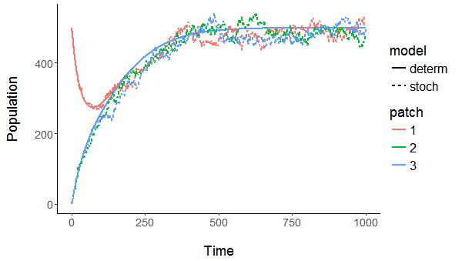
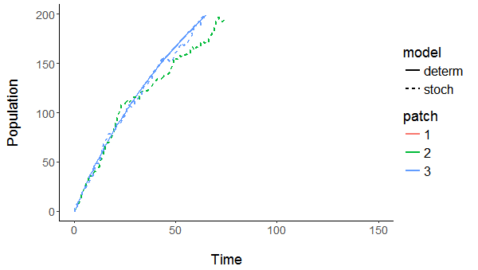
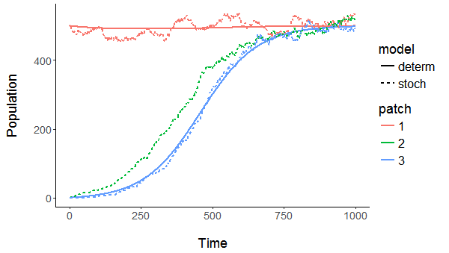
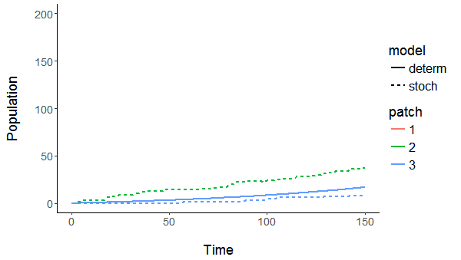
(a)
(b)
v = 0.01, b = 0.01 – (Higher Migration Rate)
(c)
(d)
v = 0.0001, b = 0.01 – ( Lower Migration Rate)
Notes:
(need text?) (Top is faster, lower is lower migration)
(increase text size)

Slide 14
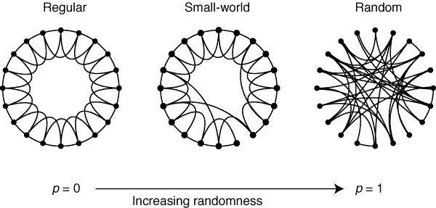

Small-World Network Background
Random graphs show low characteristic path lengths but low clustering
Regular graphs show high characteristic path lengths but high clustering
The rewiring of a regular graph generates a small-world network that has characteristics of both
^{[4]}Duncan J Watts and Steven H Strogatz. Collective dynamics of small-world networks. Nature, 393(6684):440-442, 1998.
Notes:
(Transition) We talked about a simple network geometry of 3 interconnected nodes. In the real world, the networks are more complicated. But as it turns out, many types of networks in real life are small-world networks… some degree of regular connectivity with several long-distance connections.
How does this network get generated? Start with m nodes and n neighbors, go through rewiring process with probability from regularity 0 < p < 1 randomness.
Invasive species – So why is this helpful to us? We can think of the network that invasive species spread across as a small connections between neighbors: movement via slow diffusive processes over small distances. Long-distance “shortcuts” via human or otherwise long-distance secondary dispersal methods.
(Define clustering, and change p to Q or something)

Slide 15
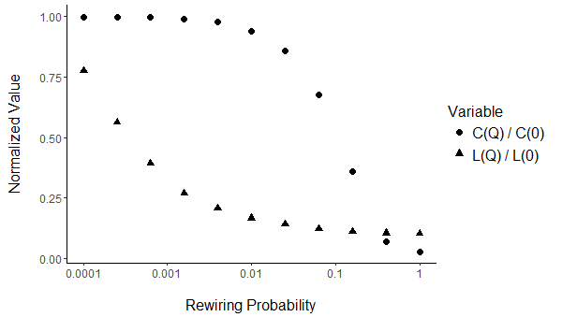
Small-world Network Background
Characteristic path length relates to the number of long-distance dispersal pathways in a network
Long-distance dispersal events are thought to be significant in invasive species spread dynamics
C is the clustering coefficient
L is the characteristic path length

Slide 16
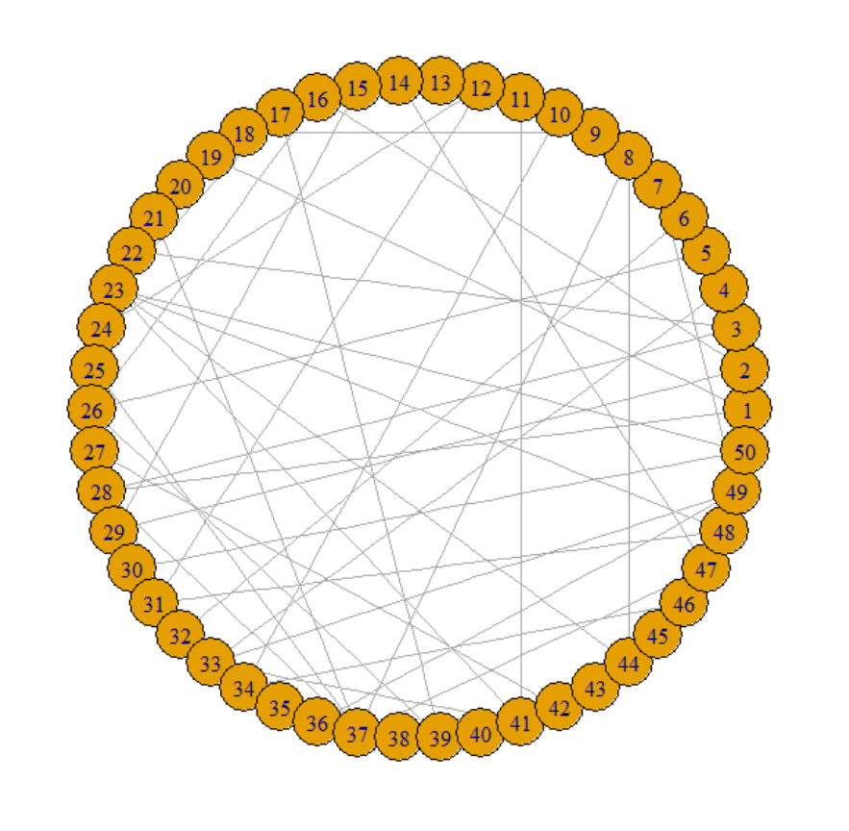
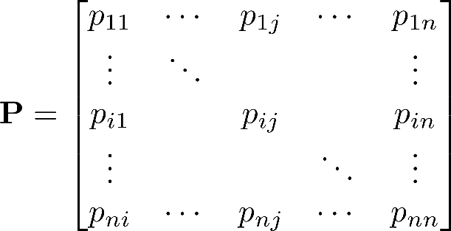
Small-World Simulations Method
1) Generate small-world network
2) Transform adjacency matrix into transition matrix
3) Run simulation of invasive spread on discrete map

Slide 17
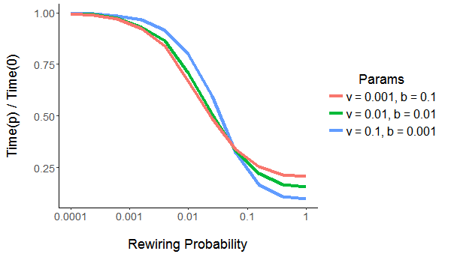
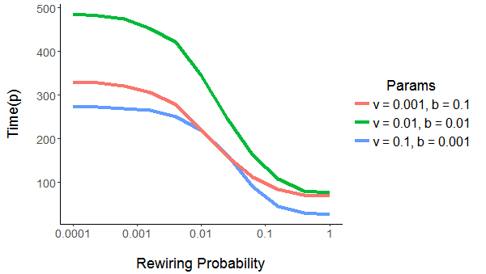
Small-World Simulations Results
Plot of absolute time to establishment vs. rewiring probability
Plot of normalized time to establishment vs. rewiring probability
Notes:
(increase text size)

Slide 18
Conclusions
Stability Analysis:
If growth rate is positive, any small introduction will grow to carrying capacity
Small-World Network:
Time to establishment drops with characteristic path length
Normalized time to establishment vs. absolute time to
Stochastic Modeling:
Order of introduction at low populations can influence the relative growth of different patches
Overall growth trajectory deterministically reaches carrying capacity
Notes:
(Don’t oversell the small world

Slide 19
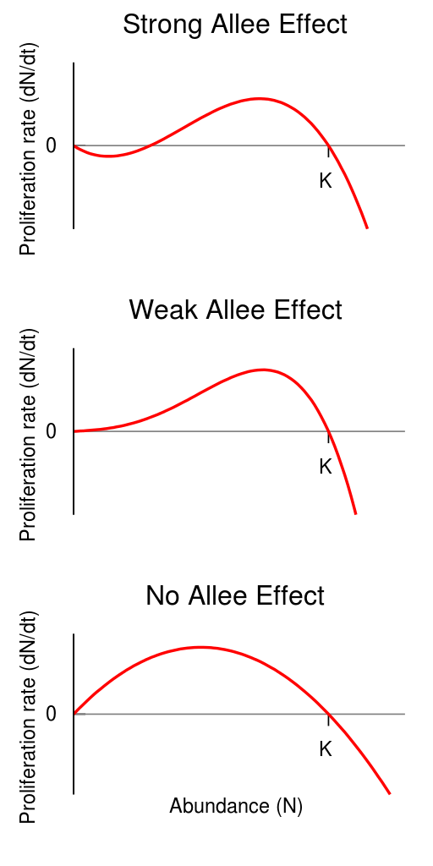
Future Work
Allee Effect
New fixed point at the allee threshold
Extinct state is stable
[5] https://upload.wikimedia.org/wikipedia/en/thumb/7/7f/A_graph_showing_the_difference_between_strong_and_weak_Allee_effects.svg/512px-A_graph_showing_the_difference_between_strong_and_weak_Allee_effects.svg.png
Notes:
(talk about how this extends to the stochastic modeling section)

Slide 20
Future Work
Network Effects
Are there relevant network properties besides characteristic path length?
Hubs
Effect of nodes with large volume of inbound and outbound traffic
Notes:
FUTURE WORK:
Continuing thesis work… divided into two fields
Allee Effects / stochasticity: Graphs – for large populations with fairly high migration rates, stochastic simulations and deterministic simulations do not differ much. However in the case of invasive species, we perceive introductions as rare events, most of which fail to establish a stable colony due to chance. Recall the idea of fixed points – population at 0 moving inexorably towards carrying capacity. Very low migration rates for invasive species – stochasticity with low population numbers can have a large impact. Allee effects – positive growth impacts from many individuals (e.g. mate searching) creates threshold for invasion, requiring repeated / large volumes of introductions within a short period.
Network effects – small world exploration, by and large respective roles of growth and long-distance dispersal. Investigation into role of large hubs. Idea of human transport networks – reasonable that a few nodes with high connectivity would source a large proportion of initial introductions. What is their impact and does this have any implications for management? Would simply controlling traffic through these hubs have any effect to slow down the spread of the invasion?
(Characteristic path length does not fully determine stuff)
(Network hubs)

Slide 21
Questions?

Slide 22
Acknowledgements
Thank you to my incredible advisor Dr. Leah Shaw, without whom I could never have taken this project this far. Thank you for not only for demystifying mathematical analysis but for always being ready to teach me something new.
And thank you to my committee and those in the audience for listening to my presentation

