Slide 1
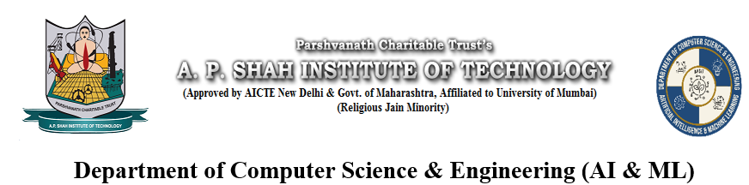
VEHICLE SERVICE MANAGEMENT SYSTEM USING DJANGO
GROUP MEMBERS
Atharva Patil – 22106039
Brahmjot Singh- 22106004
Shraavani Salunkhe- 22106031
Sujal Yadav- 22106083
Project Guide
Mr. Viki Patil

Slide 2
Outline
Introduction
Literature Survey of the existing systems
Limitations of the existing systems
Problem statement
System Design
Technology used
Implementation
Conclusion
References

Slide 3
Introduction
Modern society relies heavily on vehicles for transportation needs.
Current vehicle service management systems face challenges like manual record-keeping and fragmented communication.
The development of a comprehensive Vehicle Service Management System (VSMS) using Django framework is necessary to address these challenges.

Slide 4
Objective
Implement a centralized platform for efficient data management, including vehicle data, maintenance records, and customer information.
Facilitate seamless communication channels between stakeholders, such as administrators, mechanics, and customers.
Optimize resource allocation through automated service scheduling and real-time insights into workforce utilization.
Design a modular and extensible system architecture to accommodate future growth and customization needs.

Slide 5
Literature Survey of the Existing System
Survey of existing solutions:-
IVMS for Unihomes: Centralizes vehicle and renting details, streamlining operations with Agile Unified Process methodology.
Web-Based Service System for MAS Motors LLC: Enhances service division efficiency through centralized, tested solution.
Struts2-based Auto Maintenance System: Standardizes processes, improves customer experience with modular design.

Slide 6
Limitations of Existing System
Analysis of issues:
Fragmented Communication: Existing systems suffer from disjointed communication channels among stakeholders, causing delays in service updates and issue resolution.
Data Disorganization and Limited Scalability: Manual data entry and disparate systems lead to data silos, hindering access and analysis, while limited scalability restricts adaptability and future growth.
General Overall Observations:
Centralized Data Management: highlights the need to consolidate vehicle data for efficient operations and informed decision-making, enabling easy access and analysis of crucial information.
User Experience and Scalability: emphasizes the importance of user-friendly interfaces to boost satisfaction and productivity, while also addressing the necessity for system scalability to accommodate organizational growth and evolving needs.

Slide 7
Problem Statement
Conventional vehicle service management systems suffer from inefficiencies and lack of real-time updates.
Challenges include delays, suboptimal resource utilization, and poor customer satisfaction.
Existing systems overlook sudden incidents and dynamically changing conditions, leading to unreliable route suggestions and increased operational costs.
To address these issues, there's a need for a modern, dynamic, and context-aware Vehicle Service Management System (VSMS) using the Django framework.

Slide 8
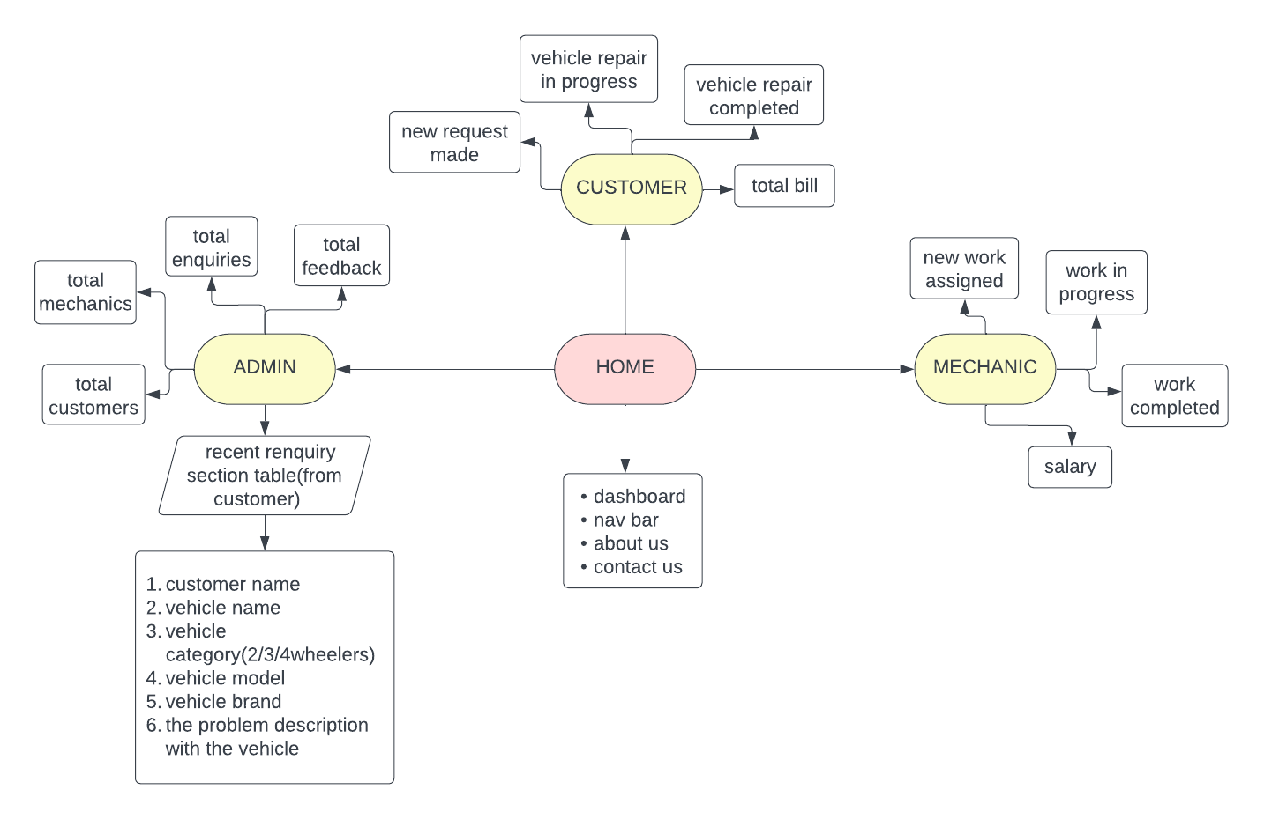
System Design

Slide 9






Technology Used
VISUAL STUDIO
PYTHON
DJANGO
SQL
JAVASCRIPT
CSS
HTML

Slide 10
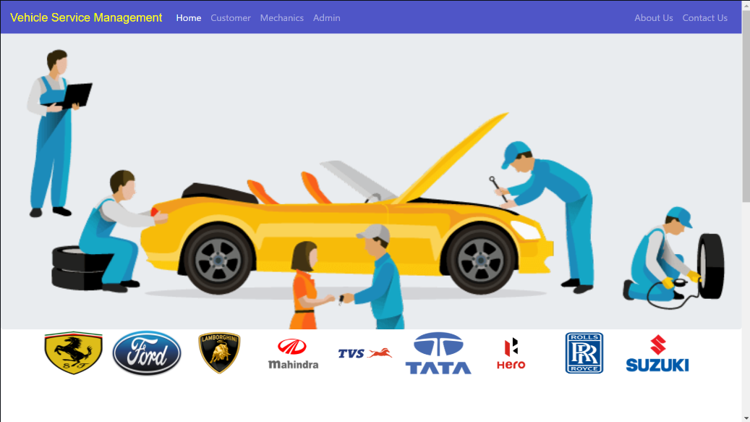
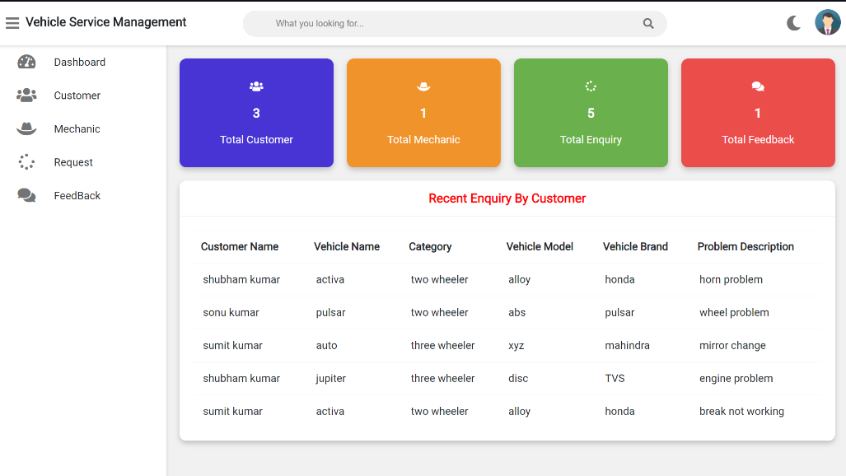
Implementation

Slide 11
Conclusion
Enhanced Efficiency: The Vehicle Service Management System enhances operational efficiency by automating crucial processes and providing insights for informed decision-making.
Customer Satisfaction: Improved service quality and streamlined communication contribute to increased customer satisfaction and retention.
Cost Savings: By optimizing maintenance schedules and preventing unexpected breakdowns, the system contributes to long-term cost savings and resource utilization.

Slide 12
THANK YOU!!!

