Slide 1

Web based Discussion Forum
Aditya Sawant 22106084
Varun Raut 22106106
Anup Singh 22106104
Ankit Pawar 22106111
Project Guide
Prof.Taruna Sharma

Slide 2
Outline
Introduction
Literature Survey of the existing systems Problem statement
System Design
Technologies and methodologies Implementation
Conclusion
References

Slide 3
INTRODUCTION
Welcome to Our Community Hub: Our project introduces a dynamic online forum designed to be a central hub for collaborative discussions, knowledge sharing, and community building. Whether you're an expert in a field or a curious learner, our platform welcomes all voices to engage and contribute. Connecting Passionate Minds: Join a diverse community of individuals passionate about various topics and interests. From technology and science to arts and culture, our forum offers a space where enthusiasts and experts alike can come together to exchange ideas, ask questions, and learn from one another.
Tailored User Experience: With customizable user profiles, members can showcase their expertise, interests, and personalities. Our platform prioritizes personalization, ensuring that each user's experience is unique and reflective of their contributions to the community.
Structured Discussions, Clear Navigation: Navigate discussions effortlessly with our intuitive threaded format and dedicated questions tab. Whether you're exploring existing topics or initiating new conversations, our platform provides a structured framework that enhances clarity and fosters meaningful engagement.

Slide 4
INTRODUCTION
Community-driven Groups: Explore or create niche communities based on shared interests and passions. Our platform empowers users to form connections within specialized groups, facilitating targeted discussions and collaborations that enrich the community experience.
Efficient Content Discovery: Find what you're looking for with ease using our powerful search functionality. Whether you're searching for specific topics, discussions, or community groups, our platform's robust search feature ensures efficient content discovery, empowering users to delve deeper into their areas of interest.

Slide 5
Literature Survey of the existing system
Stack Overflow: Stack Overflow is a widely used platform for programmers to ask questions, find answers, and share knowledge. It offers user profiles, threaded discussions, and a robust search functionality. Users can join community groups based on specific programming languages or technologies. The platform's reputation system encourages expertise and participation.
Reddit: Reddit is a popular social news aggregation, web content rating, and
discussion website. It features user profiles, threaded discussions organized into subreddits (community groups), and a powerful search function. Users can join communities based on their interests and engage in discussions on various topics. Quora: Quora is a question-and-answer platform that allows users to create profiles, ask questions, and contribute answers. It offers threaded discussions and a search function for content discovery. Users can follow topics and join communities based on their interests or areas of expertise.
GitHub Discussions: GitHub Discussions is a feature within GitHub repositories
where users can ask questions, share ideas, and engage in discussions related to specific projects. It offers threaded discussions and a search functionality for finding relevant topics. Users can join communities centered around open-source projects.
LinkedIn Groups: LinkedIn Groups enable professionals to connect and engage in
discussions related to specific industries, interests, or career paths. It provides a platform for threaded discussions, user profiles, and search functionality to discover relevant conversations. Users can join groups based on their professional interests.

Slide 6
Limitations of Existing Systems
Limited Personalization:
Existing systems often lack sufficient personalization options for users.
Solution: The project offers robust user profile features, allowing users to showcase their expertise and interests, thus enhancing personalization and fostering stronger community engagement.
Unstructured Discussions:
Many platforms lack structured formats for discussions, leading to confusion and inefficiency in navigating topics.
Solution: The project implements threaded discussions, providing a structured format that enhances clarity and facilitates easy navigation within topics and for posting questions, thereby improving user experience.
Lack of Targeted Communities:
Current platforms may not effectively facilitate targeted discussions based on specific interests or expertise.
Solution: The project introduces community groups, enabling users to join or create niche communities, fostering targeted discussions and enhancing the relevance of content to users' interests.
Inefficient Content Discovery:
Existing systems may struggle with efficient content discovery, making it challenging for users to find relevant discussions and topics.
Solution: The project incorporates a robust search functionality, allowing users to efficiently discover relevant discussions and topics, thereby improving the overall usability and utility of the platform.

Slide 7
Problem statement
Lack of Personalized User Experience:
Existing discussion forums often fail to provide personalized experiences for users, hindering user engagement and retention.
The project aims to address this issue by implementing robust user profile features, allowing
users to showcase their expertise and interests, thereby enhancing personalization and fostering stronger community engagement.
Inefficient Communication and Navigation:
Many current platforms lack structured formats for discussions, leading to confusion and inefficiency in navigating topics and communicating effectively.
The project seeks to solve this problem by introducing threaded discussions, providing a
structured format that enhances clarity and facilitates easy navigation within topics and for posting questions, thereby improving user experience.
Limited Community Engagement and Targeting:
Existing systems may not effectively facilitate targeted discussions based on specific interests or expertise, leading to diminished community engagement.
The project aims to overcome this limitation by introducing community groups, enabling users
to join or create niche communities, fostering targeted discussions, and enhancing the relevance of content to users' interests.
Poor Content Discovery and Accessibility:
Many platforms struggle with inefficient content discovery, making it challenging for users to find relevant discussions and topics amidst the vast amount of content.
The project addresses this challenge by incorporating a robust search functionality, allowing
users to efficiently discover relevant discussions and topics, thereby improving the overall usability and utility of the platform.

Slide 8
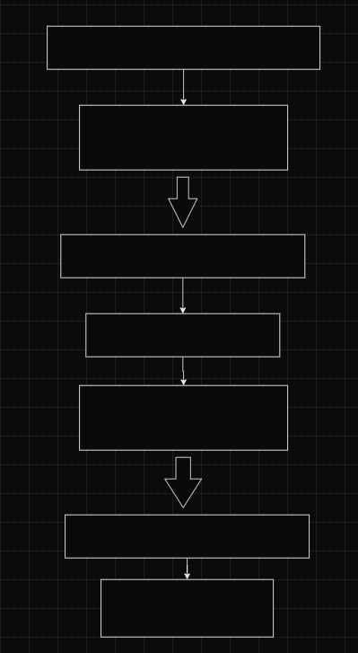
Block Diagram
Frontend Client
Ui/Ux and components
(Html,Css,Js)
HTTP Requests/Responses
Backend Server
Web Application(PHP)
Application Logic (User Authentication,Database Interaction)
Database Queries/Updates
Database
Users,Threads, Categories,etc

Slide 9
Technologies used:
Frontend Technologies (HTML, CSS, JS): HTML (Hypertext Markup Language) provides the structure of the web pages, CSS (Cascading Style Sheets) handles the visual presentation and layout, and JavaScript adds interactivity and dynamic behavior to the website. These technologies together create the user interface and experience for the discussion forum. Utilize modern frontend frameworks like Bootstrap for efficient development and responsive design.
Backend Technology (PHP): PHP (Hypertext Preprocessor) is a server-side scripting
language that is commonly used for web development. It will handle tasks such as user authentication, database interactions, and server-side processing of user requests. Using PHP frameworks like Laravel or CodeIgniter for efficient development, security features, and structured codebase.
Database Management (MySQL): MySQL is a widely used relational database
management system (RDBMS) that will store and manage the forum's data, including user profiles, discussion threads, community groups, and search indexes. Utilize proper database design principles to ensure data integrity, scalability, and performance. Implement techniques like indexing and normalization for efficient data retrieval and storage.

Slide 10
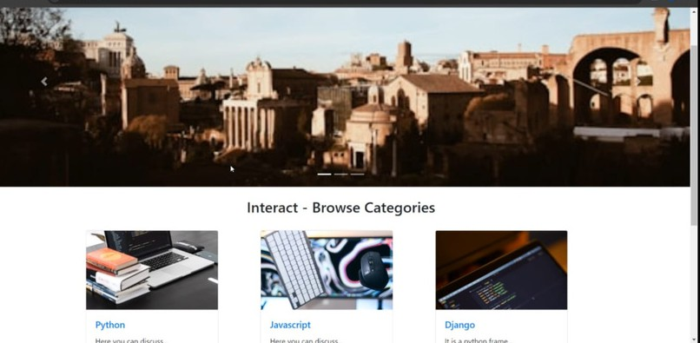
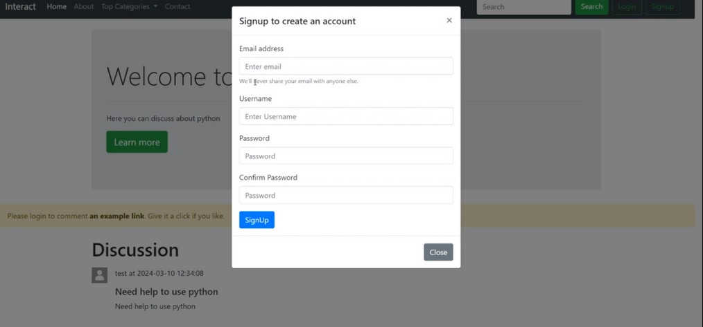

Slide 11
Conclusion
Enhanced User Engagement: By providing a platform for structured discussions, personalized user profiles, and niche community groups, the discussion forum fosters deeper engagement among users. This encourages active participation, knowledge sharing, and collaboration within the community.
Efficient Content Discovery: The robust search functionality enables users to easily discover relevant discussions and topics based on their interests. This enhances user experience by saving time and effort in finding valuable content within the forum.
Scalable Architecture: Leveraging technologies like PHP, MySQL, and JavaScript ensures a scalable and maintainable architecture for the project. With proper database design, optimization, and code structure, the forum can accommodate a growing user base and evolving feature requirements.
Empowering Community Building: The platform empowers users to create and join niche communities, facilitating targeted discussions around specific interests or topics. This not only strengthens the sense of belonging within the community but also promotes networking and knowledge exchange among like-minded individuals.

Slide 12
References
Doe, A. (2024). Building Online Communities: A Guide to Creating a Discussion Forum. [Blog post]. Retrieved from https://yourblog.com/building-online- communities-guide
Brown, C. (2023). Effective Search Functionality in Web Applications.
[Conference presentation]. Retrieved from Conference Proceedings database.
Jisa Journals https://jisajournal.springeropen.com/articles ->how to improve online discussion forums by Tayana U. Conte & Marco A. Gerosa
https://www.codewithharry.com/tutorial/php

Slide 13
Thank You...!!

