Slide 1

Department of Computer Science &Engineering Artificial Intelligence & Machine Learning A.P. Shah Institute of Technology G.B.Road,Kasarvadavli, Thane(W), Mumbai-400615 UNIVERSITY OF MUMBAI Academic Year 2023-2024

Slide 2
Synopsis on “AI Chat-bot” Submitted in partial fulfillment of the degree of Bachelor of Engineering(Sem V)
in Computer Science & Engineering
Artificial Intelligence and Machine Learning By Sahil Shaikh(22206004) Milind Chavan(22206007)
Harshal Deshmukh(22206008)
Aryan Bane(22206009)
Under the Guidance of
Prof. Sayali Badhan

Slide 3
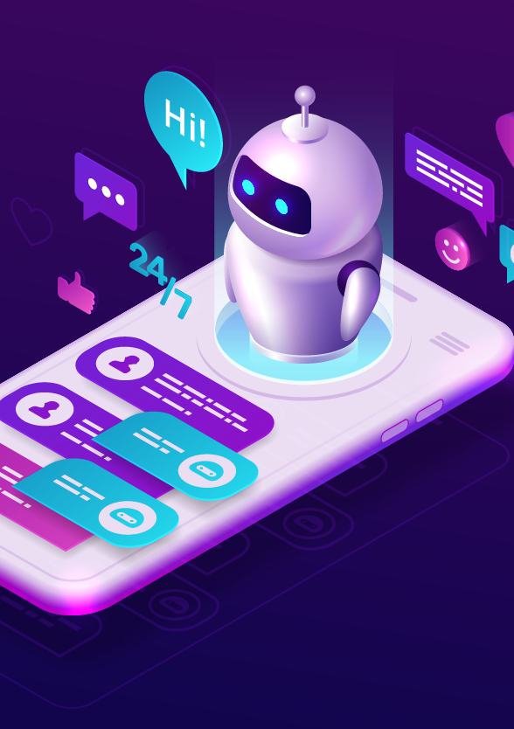
Abstract
AI chatbots have emerged as transformative tools in the realm of human-computer interaction.
It finds applications across various domains, including customer support, healthcare, education, e-commerce and more.
Enhance user experiences by providing real-time assistance, answering inquiries and automating routine tasks.

Slide 4
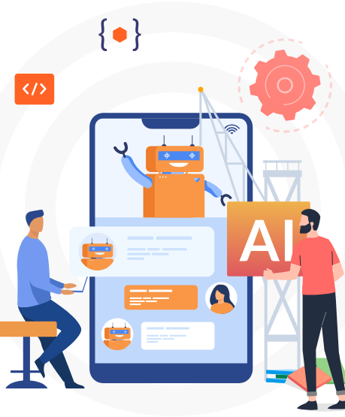
Problem Definition
Limited User Engagement
Inaccuracy and Lack of Personalization
Complexity in Obtaining Weather Updates
User-Centric Needs
Data Integration Challenges

Slide 5
Objectives
Objective of Our Chat-Bot are:-
To show text based result based on the input provided by the user
To display weather report of a place searched by the user
It will generate the youtube link of the videos that is searched by the user

Slide 6
Literature Survey
Sr. No | Title | Author Name | Description
1. | Conversational AI: Chatbots (IEEE EXPLORE 2021) [1] | Siddhant Meshram, Namit Naik, Megha VR | The growth of technologies like Artificial Intelligence (AI), Big Data & Internet of Things (IoT), etc. has marked many advancements in the technological world since the last decade. These technologies have a wide range of applications. One such application is “Chatterbot or “Chatbot”. Chatbots are conversational AIs, which mimics the human while conversing.
2. | An overview of artificial intelligence based chatbots and an example chatbot application(IEEE EXPLORE 2018) [2] | Naz Albayrak, Aydeniz Özdemir, Engin Zeydan | In this paper, we present the general working principle and the basic concepts of artificial intelligence based chatbots and related concepts as well as their applications in various sectors such as telecommunication, banking, health, customer call centers and e-commerce. Additionally, the results of an example chabbot for donation service developed for telecommunication service provider are presented using the proposed architecture.

Slide 7
Literature Survey
3. | Chatbot: An automated conversation system for the educational domain(IEEE EXPLORE 2019) [3] | Anupam Mondal, Monalisa Dey, Dipankar Das, Sachit Nagpal | Speech and textual information play a crucial role in communicating between humans. An article in “The New York Times” published that now-a-days the adults are spending more than 8 hours a day on screens of computers or mobiles. So the major communication between humans is conducted through web applications such as WhatsApp, Facebook, and Twitter etc as a form of speech and textual conversation. In the present paper, we have focused on designing a textual communication application namely chat-bot in the educational domain.
4. | A Survey on Chatbots Using Artificial Intelligence(IEEE EXPLORE 2020) [4] | M. Ganesan, Deepika C, Harievashini B, Krithikha A.S, Lokhratchana B | This paper provides a survey based on the different platforms used to build a chatbot for providing various kind of services to different kind of users. The design techniques for building the chatbot depends on the services meant to provide for the users. The chatbot will get the experience by learning through the past experience using various algorithms. The data can be trained to the chatbot which will enable it to check with the knowledge base for providing accurate results to the query of the user through client side applications.

Slide 8
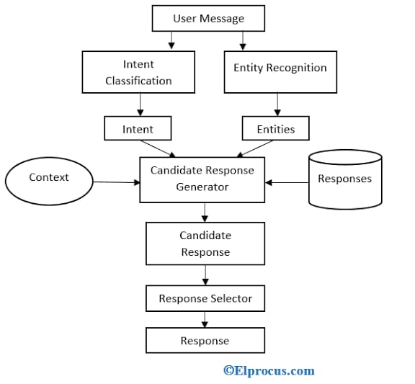
Block Diagram
Intent: An intent is defined as a user’s intention.
Entity: An entity in the Chat-bot is used to modifies an intent.
Candidate Response Generator: It is used the calculations using different algorithms to process the user request.
Response Selector: It is used to select the word or text according to the user queries to give a response to the users which should work better.

Slide 9
Future scope
The future scope of chatbots is vast and varied, as they are already becoming increasingly popular and are being adopted by various industries. Here are some potential areas where chatbots may be used in the future:
Customer service: Chatbots can provide instant assistance to customers, which can help reduce wait times and improve customer satisfaction.
Healthcare: Chatbots have the potential to help patients manage their health by providing guidance on medication, answering questions about symptoms, and providing support for mental health issues.
Education: Chatbots can be used to provide personalized learning experiences, answering student questions and helping them progress through their studies.
Financial services: Chatbots can provide assistance with financial planning, help with banking tasks, etc.

Slide 10
Existing System
ELIZA: The first chat bot developed was ELIZA. It was developed by Joseph Weizenbaum using a keyword matching technique. The idea was to read the user input and search for certain keywords, if a keyword was found then the answer was retrieved.
A.L.I.C.E : ALICE was implemented by Richard Wallace in 1995. It uses pattern matching and stores the information in Artificial Intelligence Mark-up Language, or else known as AIML, files. An AIML file is similar to an XML file that was developed to store pattern knowledge for chatbots.

Slide 11





Technology Stack
Html
Css
JavaScript
Python
Django

Slide 12
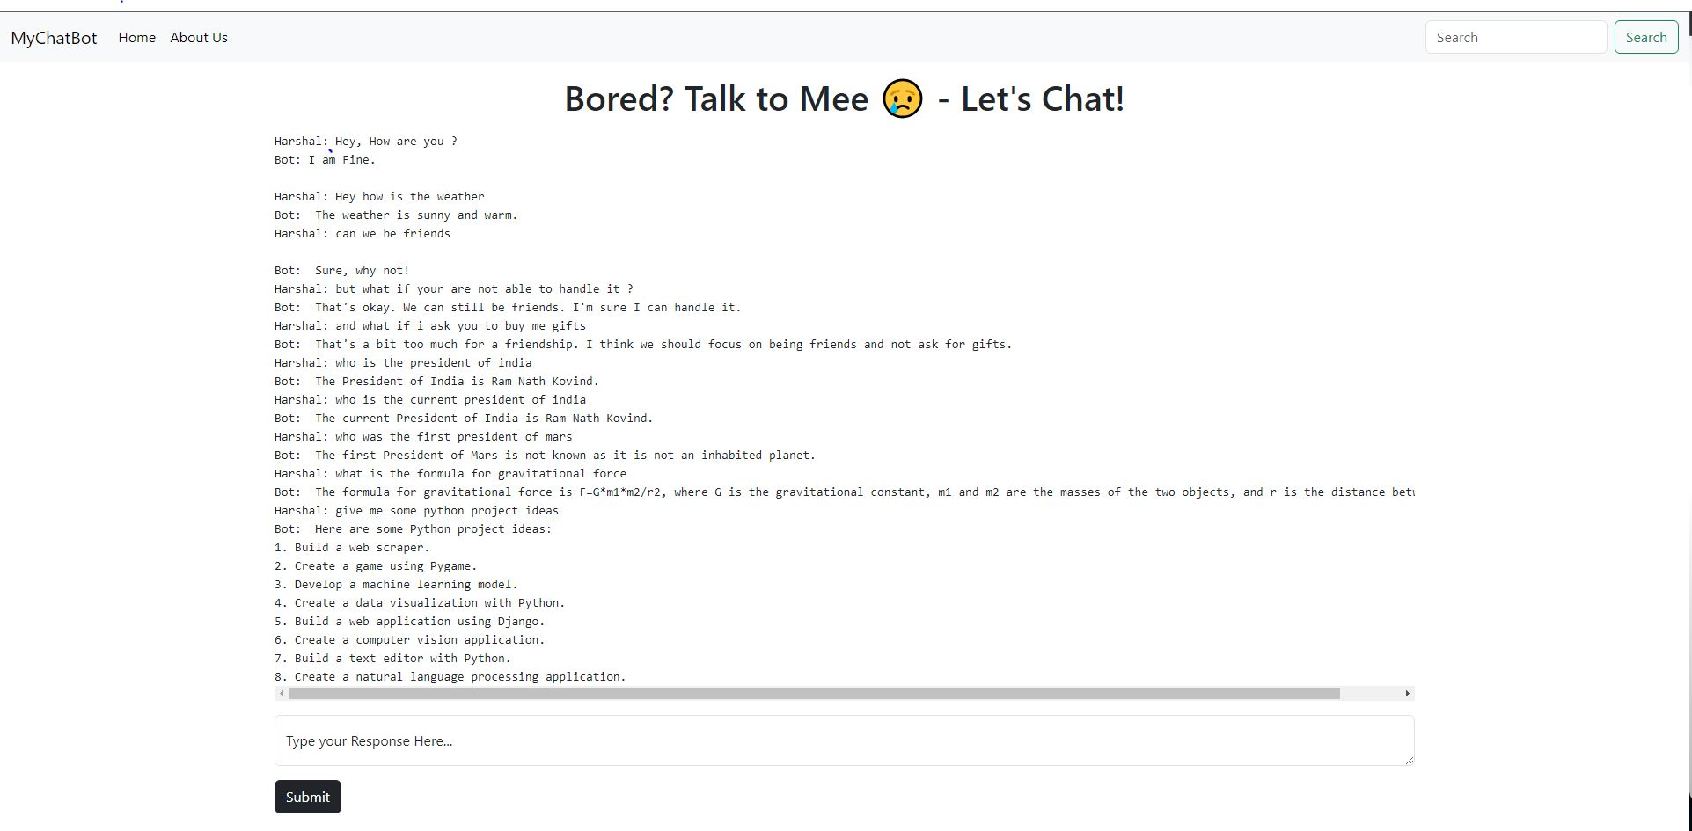
Implementation

Slide 13
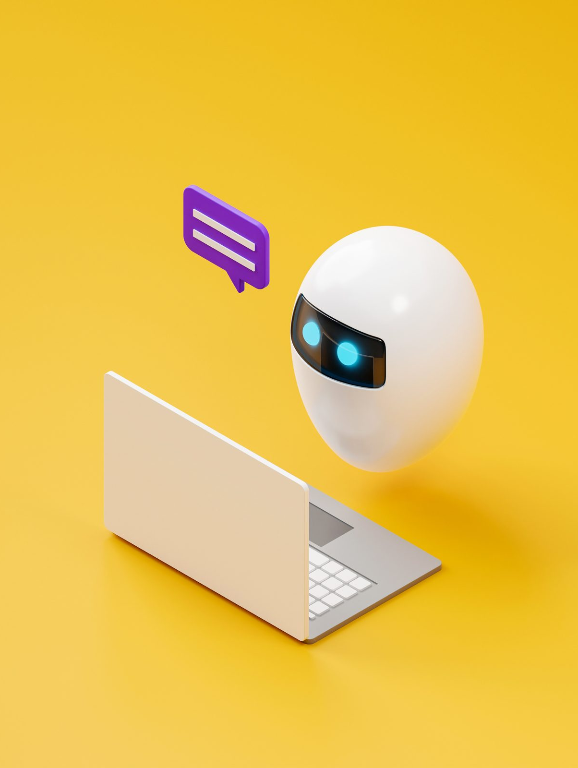
Benefits for Society
Provide fast, 24/7 customer service
Offer more personalized experiences
Deliver multilingual support
Ensure consistent support
Offer convenient self-service options
Provide proactive customer service
Deliver Omni channel support

Slide 14
Applications
Social media messaging apps
Standalone messaging platforms
Proprietary websites and apps
Even on phone calls (where they are also known as integrated voice response, or IVR)
And many more...

Slide 15
Conclusion
Created Sign-in & Sign-up page
Created Dashboard
Created sidebar
Created About us page
Added Weather forecast feature
For future, we will create a completed chatbot with features like weather forecast in the bot UI, can search information about something across the web, can generate YouTube link based on search.

Slide 16
References
Journal Papers
[1] S. Meshram, N. Naik, M. VR, T. More and S. Kharche, "Conversational AI: Chatbots," 2021 International Conference on Intelligent Technologies (CONIT), Hubli, India, 2021, pp. 1-6, doi: 10.1109/CONIT51480.2021.9498508.
[2] N. Albayrak, A. Özdemir and E. Zeydan, "An overview of artificial intelligence based chatbots and an example chatbot application," 2018 26th Signal Processing and Communications Applications Conference (SIU), Izmir, Turkey, 2018, pp. 1-4, doi: 10.1109/SIU.2018.8404430.
[3] A. Mondal, M. Dey, D. Das, S. Nagpal and K. Garda, "Chatbot: An automated conversation system for the educational domain," 2018 International Joint Symposium on Artificial Intelligence and Natural Language Processing (iSAI-NLP), Pattaya, Thailand, 2018, pp. 1-5, doi: 10.1109/iSAI-NLP.2018.8692927.
[4] M. Ganesan, D. C., H. B., K. A.S. and L. B., "A Survey on Chatbots Using Artificial Intelligence," 2020 International Conference on System, Computation, Automation and Networking (ICSCAN), Pondicherry, India, 2020, pp. 1-5, doi: 10.1109/ICSCAN49426.2020.9262366.
Useful Links
[5]https://www.ibm.com/topics/chatbots#:~:text=AI%20chatbots%20are%20commonly%20used,service%20or%20human%20resources%20issues

Slide 17
Thank You

