Slide 1

Radiology Clinic Management System
Tejas Kalokhe (22106049)
Ranjit Kadam (22106034)
Sahil Govardhane (22106097)
Sanket Kudale (22106059)
Project Guide
Mrs. Sayali Sonje

Slide 2
Outline
Introduction
Literature Survey of the Existing Systems
Limitations of the Existing Systems
Problem Statement
Proposed System Design
Framework/Algorithm
Technologies Stack for Proposed System
Details of Database / Input to the System
Implementation
Conclusion
References

Slide 3
Introduction
Importance of Efficient Management in Radiology Clinics :
Radiology clinics provide diagnostic imaging services such as X-rays, MRIs, CT scans, Ultrasounds (Sonography), and 2D Echo.
Efficient management is crucial for smooth operations and quality patient care.
Traditional paper-based and fragmented digital systems often lead to inefficiencies, data loss, and errors.
Need for a Radiology Clinic Management System (RCMS):
Existing challenges include data loss, scheduling issues, administrative inefficiencies, and report mismanagement.
A centralized system can streamline workflow, reduce errors, and enhance patient experience.
Purpose of the System:
To develop a comprehensive and user-friendly digital platform for radiology clinic operations.
To integrate functionalities such as patient registration, appointment scheduling, diagnostic report generation, and billing in one system.
To ensure secure data storage and retrieval while maintaining healthcare data privacy standards.

Slide 4
Introduction
To support the management of multiple imaging services, including Sonography, 2D Echo, X-rays, MRIs, and CT scans.
Patient reports will be stored digitally for future reference, reducing paperwork and ensuring long-term record-keeping.
Patients will have the option to download their reports whenever needed, enhancing accessibility and convenience.
Scope of the Project:
Automates administrative tasks and reduces paperwork.
Enhances coordination between radiologists, technicians, and administrative staff.
Ensures efficient report generation and record-keeping for different imaging procedures.
Enables secure and easy access to patient reports for both doctors and patients.
Improves accuracy, accessibility, and efficiency in clinic management.
Project Report Overview:
The report will cover objectives, system architecture, features, implementation, and benefits of the system.
The project contributes to the digitization of healthcare services for improved patient care and clinic efficiency.

Slide 5
Literature Survey of the existing system
1. Traditional Paper-Based Systems
Many radiology clinics still use manual paper records for patient registration, appointment scheduling, and report management.
These systems lead to data loss, mismanagement, duplication, and difficulty in retrieval.
Compliance with healthcare regulations like HIPAA (Health Insurance Portability and Accountability Act) is challenging due to the risk of unauthorized access to patient records.
2. Existing Digital Healthcare Systems
Various Hospital Management Systems (HMS) and Electronic Medical Records (EMR) solutions exist but often lack dedicated features for radiology clinic management.
Some hospitals use Picture Archiving and Communication Systems (PACS) for storing radiology images, but these systems do not efficiently manage appointments, billing, and patient interactions.

Slide 6
Literature Survey of the existing system
3. Challenges in Current Radiology Information Systems (RIS)
Some radiology clinics implement Radiology Information Systems (RIS) for managing patient records and imaging data.
However, many RIS platforms are expensive and require technical expertise, making them inaccessible for small and medium-sized clinics.
4. Need for a Comprehensive Radiology Clinic Management System (RCMS)
Research suggests that an integrated, cloud-based RCMS can improve workflow efficiency by automating appointments, report generation, and billing.
Secure digital storage allows patients and doctors to access and download reports anytime, improving patient experience.
AI-powered automation in radiology clinics can enhance diagnostic accuracy and speed.
5. Advantages of Implementing RCMS
Increased Efficiency – Automates processes, reducing administrative workload.
Improved Data Security – Ensures compliance with data privacy regulations.
Better Patient Experience – Enables quick access to medical reports.
Cost-Effective for Clinics – Provides an affordable solution compared to high-end RIS and PACS systems.

Slide 7
Limitations of Existing Systems
High Initial Costs – Implementation requires investment in software, hardware, and staff training.
Data Security Concerns – Digital storage must comply with HIPAA/GDPR to prevent data breaches.
Integration Issues – Compatibility challenges with existing HMS, PACS, or third-party systems.
Internet Dependency – Cloud-based systems require a stable internet connection for seamless access.
Training & Adoption – Staff may need technical training, and some may resist the transition from manual processes.
Limited AI Integration – Lack of automated diagnostics and AI-driven scan analysis.
Customization Challenges – Some systems may not be flexible enough to meet unique clinic requirements.

Slide 8
Problem statement
Radiology clinics provide essential diagnostic services like X-rays, MRIs, CT scans, Ultrasounds (Sonography), and 2D Echo, but many still rely on manual record-keeping and fragmented digital systems, leading to inefficiencies, data loss, and workflow disruptions. Appointment scheduling issues, delayed report generation, and administrative burdens further impact clinic operations and patient care. Additionally, the lack of centralized access to reports makes it difficult for doctors and patients to retrieve past medical records, while traditional storage methods pose security and compliance risks.
To overcome these challenges, a Radiology Clinic Management System (RCMS) is needed to digitize and streamline operations. This system will provide a centralized platform for patient records, appointments, and reports, ensuring seamless coordination between radiologists, technicians, and staff. Automated scheduling will reduce errors, and secure digital storage will allow easy access and downloading of reports. Implementing RCMS will enhance efficiency, accuracy, data security, and patient experience while reducing administrative workload.

Slide 9
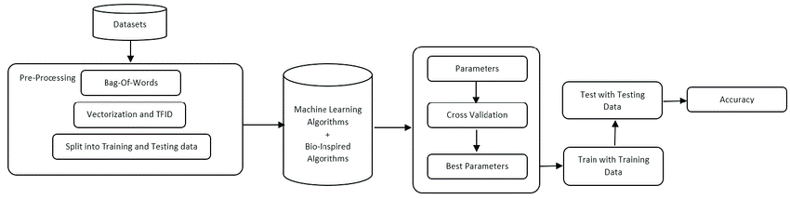
Proposed System Design
Fig.1 Workflow to build and test the model

Slide 10
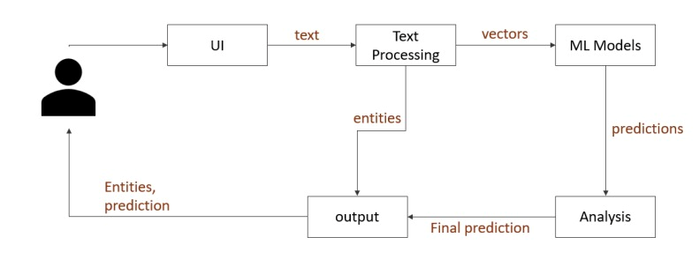
Proposed System Design
Fig.2 Working of the web app.

Slide 11
Algorithm
SVC (Support Vector Classifier):
Separates classes with a hyperplane, maximizing margin for spam detection.
KNN (K-Nearest Neighbors):
Classifies based on the similarity (distance) to neighboring examples.
NB (Naive Bayes):
Probabilistic classifier assuming feature independence, effective for spam detection.
DT (Decision Tree):
Creates rule-based classification using feature-based decisions at each node.
LR (Logistic Regression):
Predicts the probability of spam using a logistic function for binary classification.

Slide 12
RF (Random Forest):
Combines multiple decision trees to improve classification accuracy.
AdaBoost:
Iteratively improves weak learners for enhanced classification.
BGC (Bayesian Generalized Linear Models):
Models spam probability with prior knowledge and complex feature relationships.
ETC (Extremely Randomized Trees):
Uses highly randomized trees for efficient large-scale classification.
GBDT (Gradient Boosting Decision Trees):
Boosts performance by sequentially improving decision trees for better accuracy.
XGB (eXtreme Gradient Boosting):
An efficient and scalable gradient boosting method for large datasets.

Slide 13
Technologies Stack for Proposed System
Streamlit
NLTK(Natural Language Toolkit)
Pandas
Matplotlib & Seaborn
Scikit-Learn
WordCloud

Slide 14
Details of Dataset
Traning data is aquired from the following Kaggle dataset
Link :
SMS Spam Collection Dataset (kaggle.com)

Slide 15
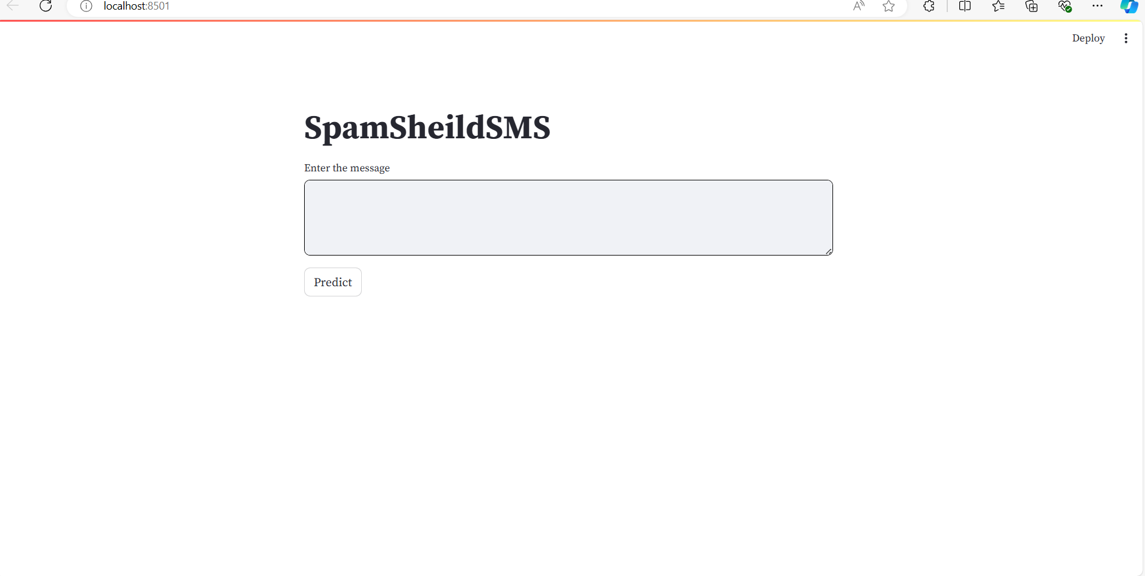
Implementation
Fig.User Interference

Slide 16
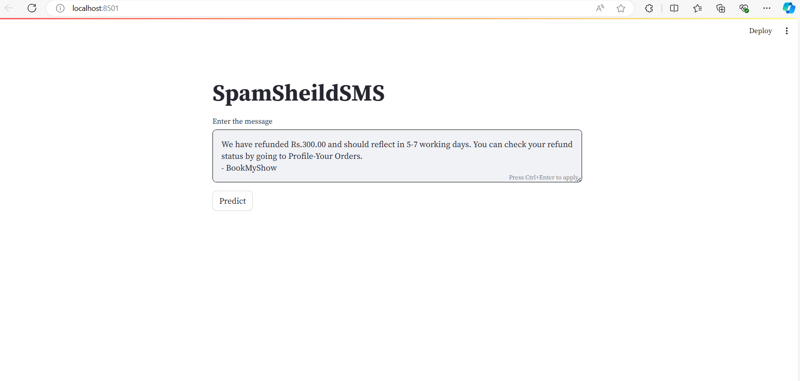
Implementation
Fig.Entering Message

Slide 17
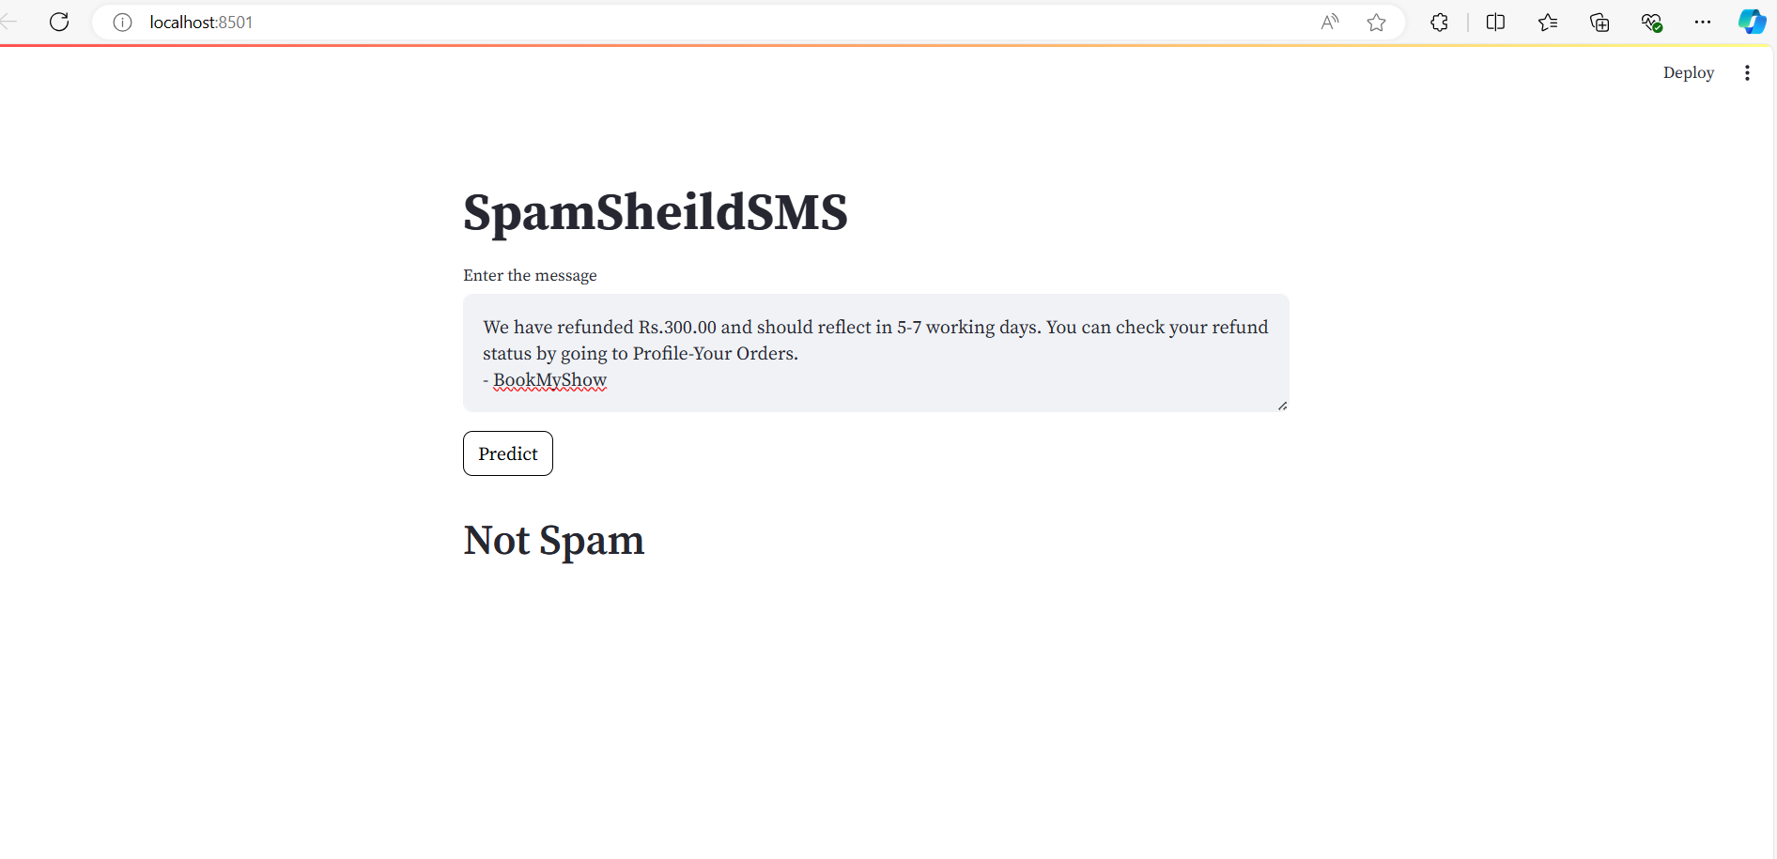
Implementation
Fig.Prediction

Slide 18
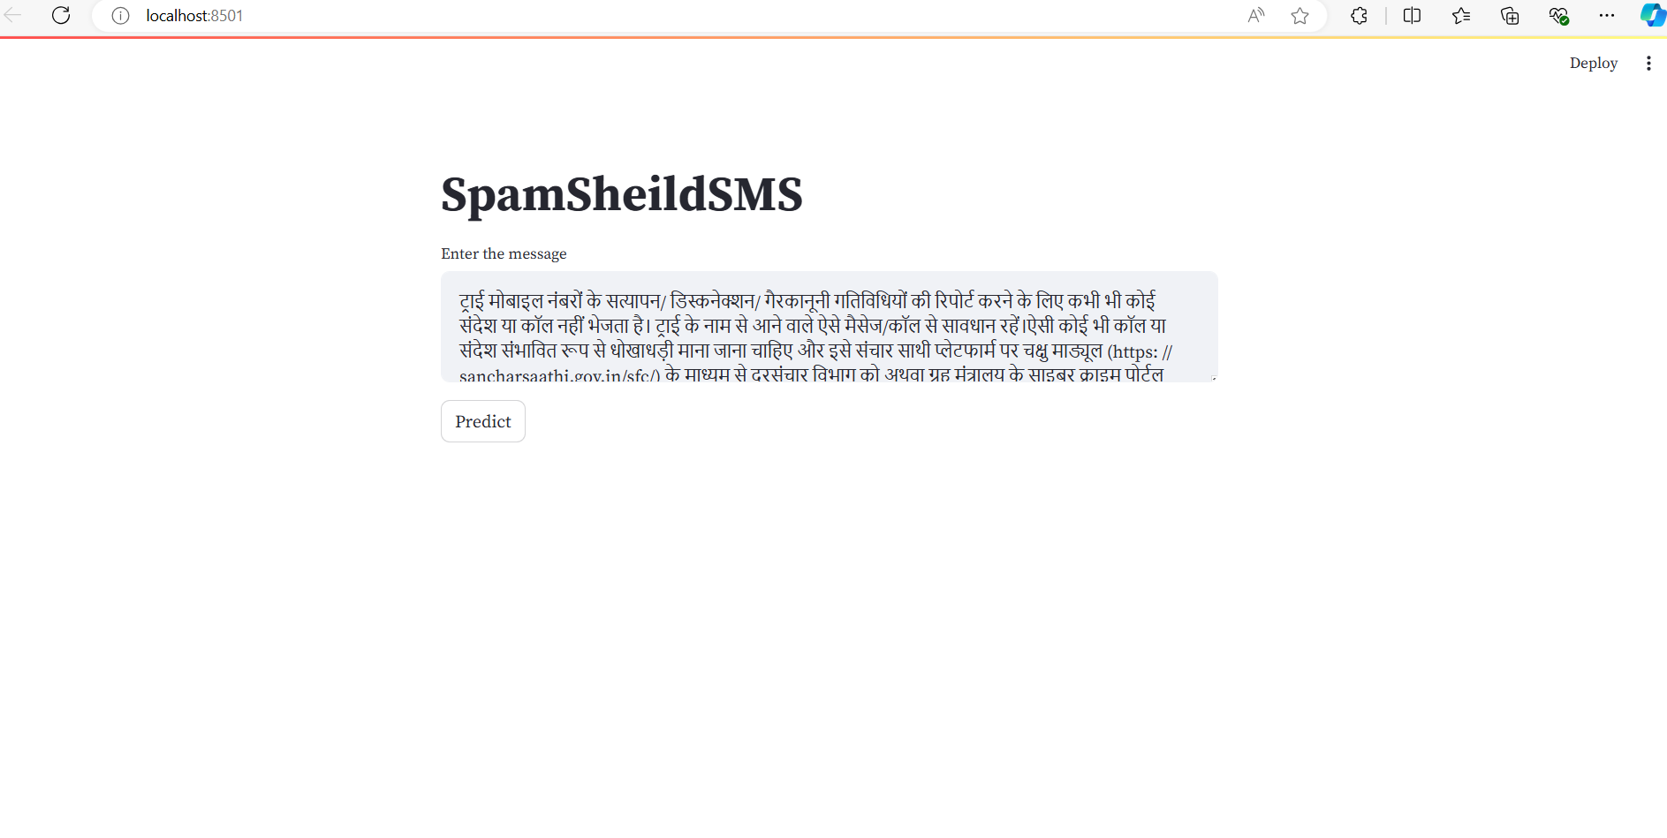
Implementation
Fig.Entering Another Message

Slide 19
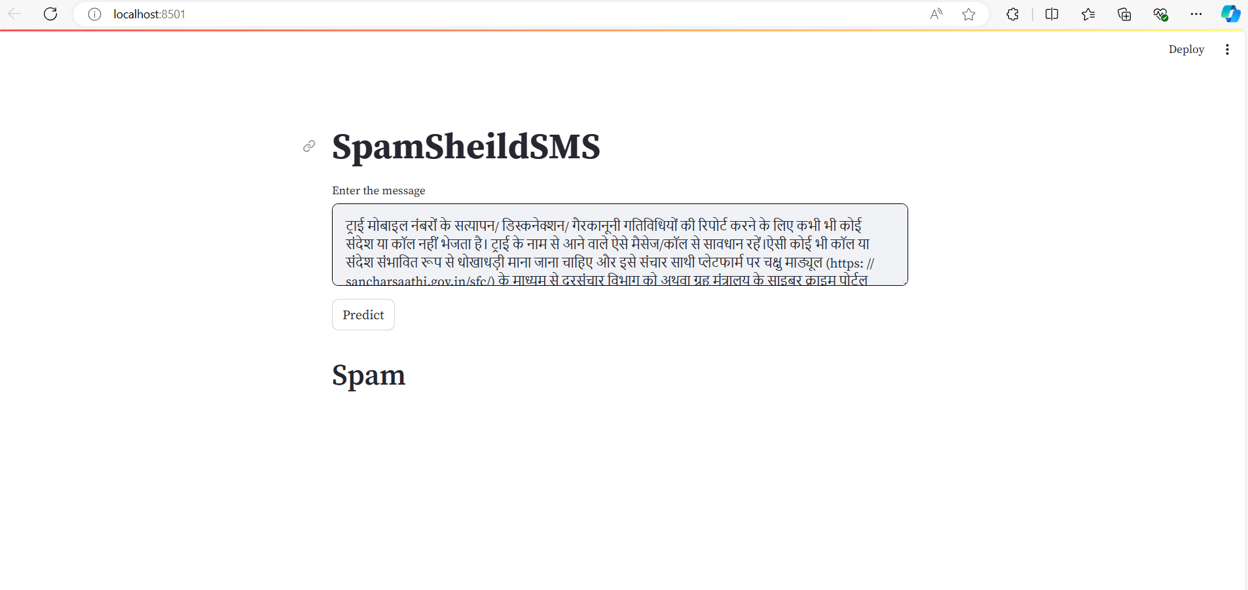
Implementation
Fig.Prediction

Slide 20
Conclusion
In conclusion, this spam SMS protection project has successfully addressed a pressing issue and provides a valuable tool for safeguarding individuals and organizations from the negative consequences of unwanted messages.

Slide 21
References
[1] J. Mythili, B. Deebeshkumar, T. Eshwaramoorthy, and J. N. Ajay, "Enhancing Email Spam Detection with Temporal Naive Bayes Classifier," IEEE Xplore, vol. 11, June 2024. Enhancing Email Spam Detection with Temporal Naive Bayes Classifier | IEEE Conference Publication | IEEE Xplore
[2] P. Thakur, K. Joshi, P. Thakral, and S. Jain, "Detection of Email Spam using Machine Learning Algorithms: A Comparative Study," IEEE Xplore, vol. 12, Jan. 2023 Detection of Email Spam using Machine Learning Algorithms: A Comparative Study | IEEE Conference Publication | IEEE Xplore
[3] K. Debnath and N. Kar, "Email Spam Detection using Deep Learning Approach," IEEE Xplore, vol. 15, Aug. 2022. Email Spam Detection using Deep Learning Approach | IEEE Conference Publication | IEEE Xplore
[4] M. Raza, N. D. Jayasinghe, and M. Magboul, "A Comprehensive Review on Email Spam Classification using Machine Learning Algorithms," IEEE Xplore, vol. 02, Feb. 2021. A Comprehensive Review on Email Spam Classification using Machine Learning Algorithms | IEEE Conference Publication | IEEE Xplore
[5] S. Suryawanshi, A. Goswami, and P. Patil, "Email Spam Detection: An Empirical Comparative Study of Different ML and Ensemble Classifiers," IEEE Xplore, vol. 30, Jan. 2020. Email Spam Detection : An Empirical Comparative Study of Different ML and Ensemble Classifiers | IEEE Conference Publication | IEEE Xplore

Slide 22
Thank You...!!

