Slide 1
General Guidelines for Presentation
General Guidelines for writing PPT and project Report: Both should have same content. Report being the detailed explanation of the PPT points that you explain orally while presenting.
PPT :
The content should be only the important points in the form of bullet list with meaningful short sentences and phrases. Running texts and big paragraphs are not accepted.
It should have proper citations.
Diagrams should be original and should be visible clearly.
Use minimum font size of 17
Put mathematical models and algorithms / methods explanations where ever necessary.
Emphasize on your original thinking, original work and contribution and highlight them in the slide.
Project Report:
The PPT content and the project report content should match.
All the points of PPT should be well explained and where needed they should be justified by using citations and /or by proper analysis and proofs.
Emphasize on your original thinking, original work and contribution and highlight them in the appropriate places in the report.
The diagrams / figures and tables should be numbered and tilted and should be refereed in the text with their numbers mentioning the purpose of the same. Also explain them in your own words w.r.t. the purpose, the contents, relation of various entities in them, etc.
All references should be used as citations at the appropriate places.
The following chapter slides will give general information of the points to be considered and the sequence in which they need to be explained to give a proper flow to the report and to the presentation.
Nevertheless, you are free to modify, add or delete few points as per your problem needs.

Slide 2

Department of Computer Science & Engineering Artificial Intelligence & Machine Learning A.P. Shah Institute of Technology G. B. Road, Kasarvadavli, Thane(W), Mumbai - 400615 UNIVERSITY OF MUMBAI
Academic Year 2024-2025

Slide 3

Python based Age and Gender Detector
By
Ritesh Singh (22106037)
Sameer Singh (22106116)
Manasi Patil (22106042)
Pratiksha Pathak (22106127)
Project Guide
Mr. Vijesh Nair

Slide 4
OUTLINE
Introduction
Literature Survey of the Existing Systems
Limitations of the Existing Systems
Problem Statement
Proposed System Design
Framework/Algorithm
Technologies Stack for Proposed System
Input to the System
Implementation
Applications
Future Advancement
Conclusion
References

Slide 5
INTRODUCTION
Demographic data (age, gender) is crucial in various applications.
Traditional methods: time-consuming, labor-intensive, error-prone.
Need for an automated, accurate, and efficient system.
Uses machine learning.
Uses deep learning for facial analysis: detection and classification.
User-friendly interface built with Tkinter and PIL.
Ensures accurate and efficient demographic analysis.

Slide 6
MOTIVATION:
Apply machine learning in real-world scenarios
Create a user-friendly Python interface with OpenCV.
Automate age and gender detection from facial images.
OBJECTIVE:
Build and evaluate a Python system for age and gender detection.
Implement face detection and classification.
Explore applications in marketing, security, and healthcare.

Slide 7
LITERATURE SURVEY OF THE EXISTING SYSTEM

Slide 8
Research Paper | Summary | Limitation | Adaptation
Age and Gender Detection [2023] | Develops a CNN-based age and gender detection system with high accuracy (92% for age, 96% for gender) from facial images. | Accuracy decreases with variations in lighting, expressions, poses, or underrepresented features in the training dataset. | Improving accuracy by expanding the dataset, using multi-task learning, and fine-tuning pre-trained models.
Gender and Age detection using Deep Learning [2021] | Develops a CNN-based age and gender detection system with high accuracy using a Kaggle dataset. | cosmetics, lighting conditions, obstructions, and facial expressions, make it difficult to achieve precise predictions. | Model treats age prediction as a classification problem instead of regression.
Age and Gender Prediction using Deep CNNs and Transfer Learning [2021] | Facial image processing: 76.3% age, 86.6% gender accuracy. | Small and imbalanced dataset reduces accuracy, especially for ages above 70. | SENet50_f pre-trained model improves performance via transfer learning.
Human Age and Gender Estimation using Facial Image Processing [2020] | Facial image processing method achieves 76.3% age accuracy and 86.6% gender accuracy. | Lighting conditions impact age and gender accuracy. | Combining edge detection and wrinkle density maintains accuracy across facial databases.
Notes:
https://www.doi.org/10.56726/IRJMETS39260

Slide 9
LIMITATIONS OF EXISTING SYSTEMS
Limited generalizability across cultures and ethnicities.
Sensitive to lighting and image quality.
Difficulty with similar facial features and ages.
Vulnerable to spoofing (e.g., mask, spectacles, sunglasses).
Privacy Issues, data collection raises privacy concerns.
Environmental Lights can interfere with clarity.

Slide 10
PROBLEM STATEMENT
In the contemporary digital landscape, there is an increasing demand for advanced technologies that can analyze and interpret human characteristics from visual data. One such application is age and gender detection, which has significant implications across various sectors, including security, marketing, and personalized user experiences. The challenge lies in developing an accurate, efficient, and scalable system capable of detecting age and gender from facial images in real-time.

Slide 11
PROPOSED SYSTEM DESIGN
1. System Architecture:
Data Collection:
Webcam/video feed
Image database
Face Detection:
OpenCV
Age and Gender Classification:
Deep learning models (CNN)
User Interface:
Tkinter
System Integration:
Python scripts
2. System Components:
Face Detection Module:
using OpenCV
Age and Gender Classification Module:
using deep learning models
User Interface Module:
using Tkinter
Main System Module:
Integrating all components

Slide 12
3. System Flow:
User interacts with the GUI
Webcam/video feed is captured and preprocessed
Face detection is performed using OpenCV
Detected face is passed to age and gender classification module
Age and gender are predicted using deep learning models
Results are displayed on the GUI
4. System Requirements:
Python 3.12.0
OpenCV
TensorFlow/Keras for deep learning models
Tkinter for GUI development
Webcam/video feed for face detection

Slide 13
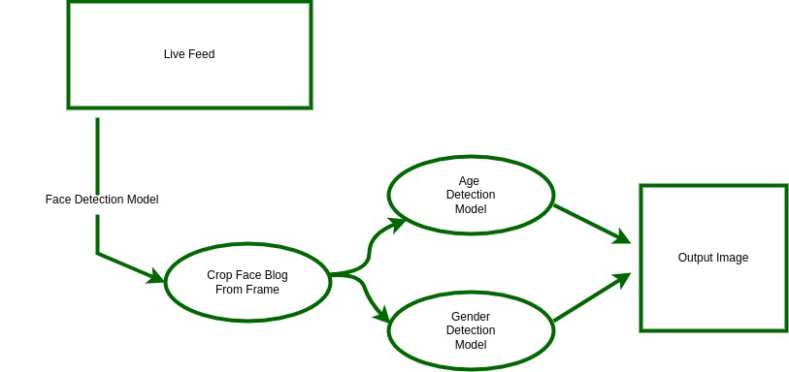
BLOCK DIAGRAM
Diagram representing stages of our Age and Gender Detector System

Slide 14
FRAMEWORK / ALGORITHM
Step 1: Face Detection
Uses OpenCV's deep learning-based face detection algorithm.
Identifies faces in real-time video streams using a pre-trained model.
Returns bounding box coordinates (x, y, w, h) of detected faces.
Step 2: Face Preprocessing
Resizes the detected face to 227x227.
Normalizes to zero mean and unit variance.
Step 3: Age Classification
Uses age classification model (age_net.caffemodel).
Employs CNN architecture to predict age.
Maps predicted age to predefined age ranges.

Slide 15
Step 4: Gender Classification
Uses gender classification model (gender_net.caffemodel).
Employs CNN architecture to predict gender.
Maps predicted gender to Male or Female.
Step 5: Display Results
Displays predicted age and gender on video stream in real-time.
Uses OpenCV's putText function to overlay text on video stream.
Technical Details:
The system uses OpenCV's DNN module to load and run the pre-trained models.
The system uses Python as the programming language and Tkinter for the GUI.
The system uses a webcam to capture real-time video streams.

Slide 16
Customizations/Modifications:
The system uses a multi-modal approach, combining computer vision and machine learning techniques to analyze facial features and vocal characteristics.
The system uses pre-trained models for face detection, age classification, and gender classification, which are fine-tuned for the specific task.
The system uses a user-friendly interface, allowing users to initiate face with a single button click.

Slide 17
TECHNOLOGY STACK
Programming Language:-
- Python
Libraries and Frameworks:-
- Tkinter (for GUI)
- OpenCV (for face detection and image processing)
- PIL (for image processing)
- CV2 (for video capture and processing)
- DNN (for deep neural network-based face detection and prediction)
Deep Learning Models:-
- Face detection: OpenCV's face detector (opencv_face_detector.pbtxt and opencv_face_detector_uint8.pb)
- Age prediction: Age Net (age_deploy.prototxt and age_net.caffemodel)
- Gender prediction: Gender Net (gender_deploy.prototxt and gender_net.caffemodel)

Slide 18
INPUT TO THE SYSTEM
The deploy files used are:-
opencv_face_detector.pbtxt: Face detection model configuration file.
opencv_face_detector_uint8.pb: Face detection model weights file.
age_deploy.prototxt: Age classification model architecture file.
age_net.caffemodel: Age classification model weights file.
gender_deploy.prototxt: Gender classification model architecture file.
gender_net.caffemodel: Gender classification model weights file.
These files are used to deploy the face detection, age classification, and gender classification models in the application.

Slide 19
IMPLEMENTATION

Slide 20
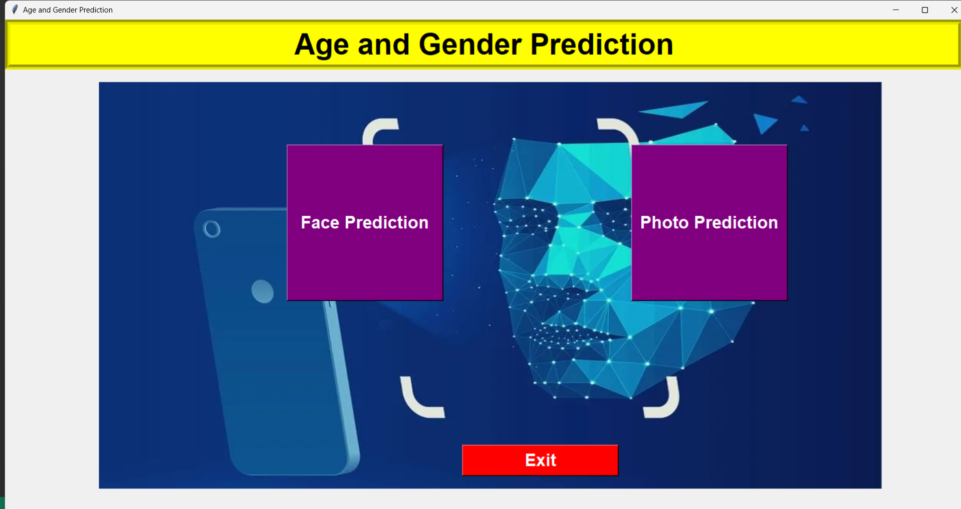

Slide 21
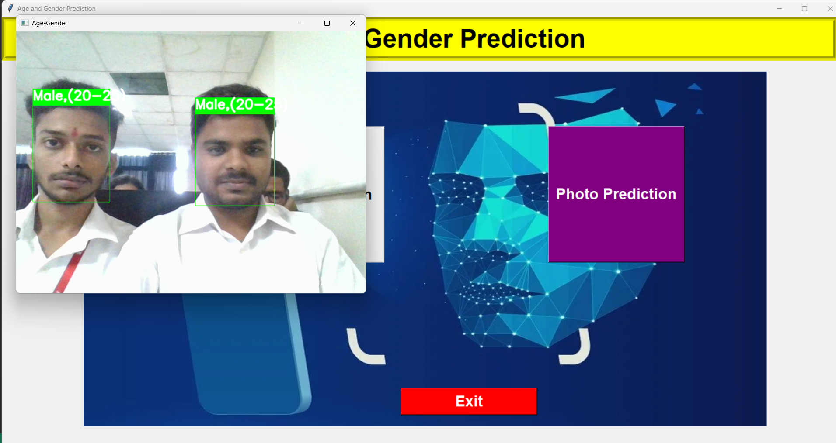

Slide 22
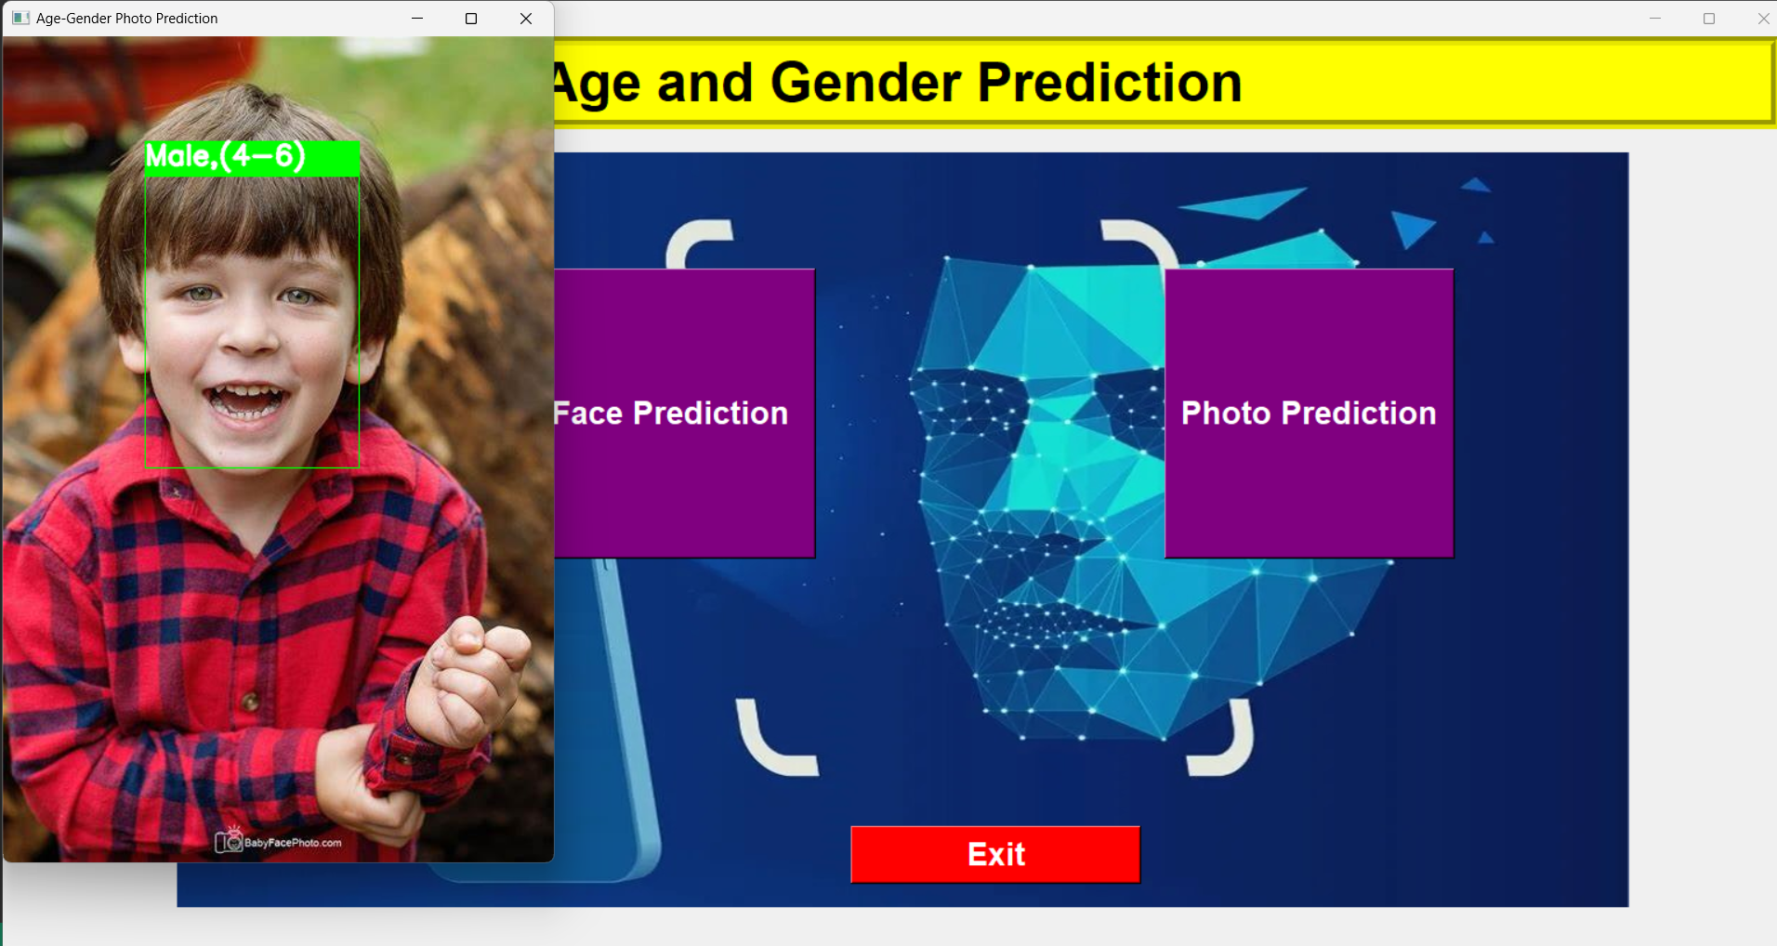

Slide 23
APPLICATIONS
Marketing and Advertising:
Targeted advertising based on age and gender.
Personalized product recommendations.
Demographic analysis for market research.
Security and Surveillance:
Age and gender-based access control.
Surveillance monitoring and alerts.
Identity verification.
Healthcare:
Patient demographic analysis.
Age and gender-specific diagnosis and treatment.
Healthcare marketing and outreach.
Social Media and Online Platforms:
Age and gender-based content filtering.
Personalized user experiences.
Demographic analysis for social media marketing.

Slide 24
Output Display: Shows predicted age and gender alongside transcriptions in real-time.
Integration: Visual age and gender detection for comprehensive analysis.
Applications: Useful in marketing, customer service, and interactive systems

Slide 25
CONCLUSION
Accurate age and gender detection using facial images
Successful implementation of face detection, age, and gender classification
Utilized deep learning and OpenCV for efficient processing

Slide 26
REFERENCES
[1] Fahimeh Alaei1 and Alireza Alaei1, “Review of age and gender detection methods based on handwriting analysis,” Published on 8 September 2023.
[2] Syed Mohammed Afnan, Shreyas NK, Prajwal KC, Gagan Kumar N, Dr. Swarnalatha K, “Age and Gender Detection,” Maharaja Institute Of Technology Thandvpura, India. Volume:05/Issue:05/May- 2023.
[3] Aryan Saxena, Prabhangad Singh and Shailendra Narayan Singh, “Gender and Age detection using Deep Learning,” Amity University, Noida, Uttar Pradesh, India, Published by IEEE, 2021.
[4] Vikas Sheoran,Shreyansh Joshi and Tanisha R. Bhayani, “Age and Gender Prediction using Deep CNNs and Transfer Learning,” Birla Institute of Technology & Science, Pilani, Hyderabad, India, 2021.
[5] Syed Taskeen Rahman, Asiful Arefeen*, Shashoto Sharif Mridul, Asir Intisar Khan and Samia Subrina, “Human Age and Gender Estimation using Facial Image Processing,” 2020 IEEE Region 10 Symposium (TENSYMP), Bangladesh University of Engineering and Technology, Dhaka, June 2020.

Slide 27
THANK YOU

