Slide 1
Polygonal Mesh Data Structure (YsShellExt) Tutorial

Slide 2
Session 1

Slide 3
Prerequisite
Sub-Version (svn) Client Version 1.8.x or 1.9.x. Pick one client and install on your computer. Make sure to install terminal (command-line) support.
https://tortoisesvn.net/
http://www.smartsvn.com/
https://subversion.apache.org/
CMake 3.7 or higher. Make sure the command cmake is accessible from the terminal.
https://cmake.org/
Visual Studio 2013 or higher with C++ and Win32 in Windows
XCode 6.x or higher in macOS

Slide 4
Checking out the source code
Create a directory called 'src'.
In terminal (or Visual Studio Command Prompt), cd to the directory you created in step 1.
Type:
svn checkout https://ramennoodle.me.cmu.edu/svn/public/public
(Needs to be in the CMU network. If you work from home, VPN to the CMU network and then type the command.)
Please do:
svn update public
occasionally to download the latest updates of the libraries.

Slide 5
Setting up build
Write a file called CMakeLists.txt in 'src' directory as:
cmake_minimum_required(VERSION 3.7)
set_property(GLOBAL PROPERTY USE_FOLDERS ON)
include(public/src/CMakeInclude.txt)
include_directories(${CMAKE_SOURCE_DIR}/public/src/imported/include)
add_subdirectory(public/src)
Create a directory called build at the same directory where you created 'src'.
The directory structure must look like:
(A directory to put your source files.)
src
CMakeLists.txt
public
build
In terminal, cd to 'build' directory.
Type:
cmake ../src

Slide 6
For 64-bit build with Visual C++
By default, CMake sets up build for 32-bit binary for Visual C++.
Instead of typing 'cmake ../src' you need to type:
cmake -G "Visual Studio 14 2015 Win64" ../src

Slide 7
Testing the Build Setup
In Windows:
Open 'build' directory in the Explorer.
Double-click Project.sln
Build
In macOS:
In Terminal type:
make
If everything goes well, you may see some warnings, but zero error (or "0 failed").

Slide 8
Tutorial 1: Adding your own program
Goal: Add your program and use polygonal-mesh libraries.
In Terminal, cd to 'src' directory you created in Checking out the source code.
It is a good idea to make a directory where all of your programs. Type: mkdir myproj (If you have an account in the ramennoodle SVN server, check out your working directory instead of creating a new directory.)
Then create a directory for a program. Type: cd myproj mkdir tutorial01

Slide 9
In tutorial01, create a source file called main.cpp as:
#include <ysshellext.h> int main(int argc,char *argv[]) { YsShellExt shl; return 0; }
In tutorial01, add CMakeLists.txt as:
add_executable(shellext_tutorial01 main.cpp) target_link_libraries(shellext_tutorial01 geblkernel geblutil)
Open top-level CMakeLists.txt (the file in 'src' directory) and ADD the following line IN THE END: add_subdirectory(myproj/tutorial01)
Cd to the 'build' directory and type: cmake ../src
Then type: make shellext_tutorial01 in macOS or open Project.sln and build a project called shellext_tutorial01 in Visual Studio.

Slide 10
The executable file is in the sub-directory of build:
myproj/tutoria01/Debug or myproj/tutoria01/Release (depending on which configuration you chose).
myproj/tutorial01 in macOS and Linux.
The file name of the executable is:
shellext_tutorial01.exe in Windows
shellext_tutorial01 in macOS and Linux.
By compiling it you confirm that:
You can include header for the polygonal-mesh kernel (ysshellext.h), and
You can link the polygonal-mesh library (geblkernel)

Slide 11
Data structure for a mesh
A polygonal mesh consists of vertices (or nodes) and faces (or elements).
v0 {f0}
v1 {f0, f1}
v2 {f1, f3}
v3 {f0, f2}
v4 {f0, f1, f2, f3, f4}
v5 {f3, f4, f5}
:
e(v0,v1) {f0}
e(v1,v2) {f1}
e(v1,v4) {f0, f1} e(v3,v4) {f0, f2}
e(v5,v7) {f4, f5}
:
v0
v1
v2
f0
f1
v3
f3
f2
v4
v5
f4
v6
f5
v8
f6
v7
v9

Slide 12
Creating a mesh with one quadrilateral element.
2-Steps
Add four vertices, then
Add a polygon.
Saving to a file
Data format supported by YsShellExt class:
.SRF (Native format of YsShellExt)
.STL (ASCII and Binary)
.OFF
.OBJ

Slide 13
#include <ysshellext.h>
#include <ysshellextio.h>
int main(void)
{
YsShellExt shl;
YsVec3 corner[4];
corner[0].Set(0.0,0.0,0.0);
corner[1].Set(1.0,0.0,0.0);
corner[2].Set(1.0,1.0,0.0);
corner[3].Set(0.0,1.0,0.0);
YsShell::VertexHandle vtHd[4];
vtHd[0]=shl.AddVertex(corner[0]);
vtHd[1]=shl.AddVertex(corner[1]);
vtHd[2]=shl.AddVertex(corner[2]);
vtHd[3]=shl.AddVertex(corner[3]);
YsShell::PolygonHandle plHd=shl.AddPolygon(4,vtHd);
shl.SetPolygonColor(plHd,YsWhite());
// YsShellExt_SaveGeneral chooses the file format
// based on the file extension.
YsShellExt_SaveGeneral("sample.srf",shl);
return 0;
}

Slide 14
Open in PolygonCrest Polygon Editor
When you build entire public projects, PolygonCrest editor is included in the build.
From 'build' directory, in Windows type:
.\public\src\ysgebl\src\main\Debug\ysgebl64.exe sample.srf (Or can be in Release if you built in the Release mode.)
Or in Linux type:
./public/src/ysgebl/src/main/ysgebl64 sample.srf
Or in macOS type:
./public/src/ysgebl/src/main/ysgebl64.app/Contents/MacOS/ysgebl64 sample.srf
Polygon Crest is a fully-functional polygon modeler.
Also good for visualization.

Slide 15
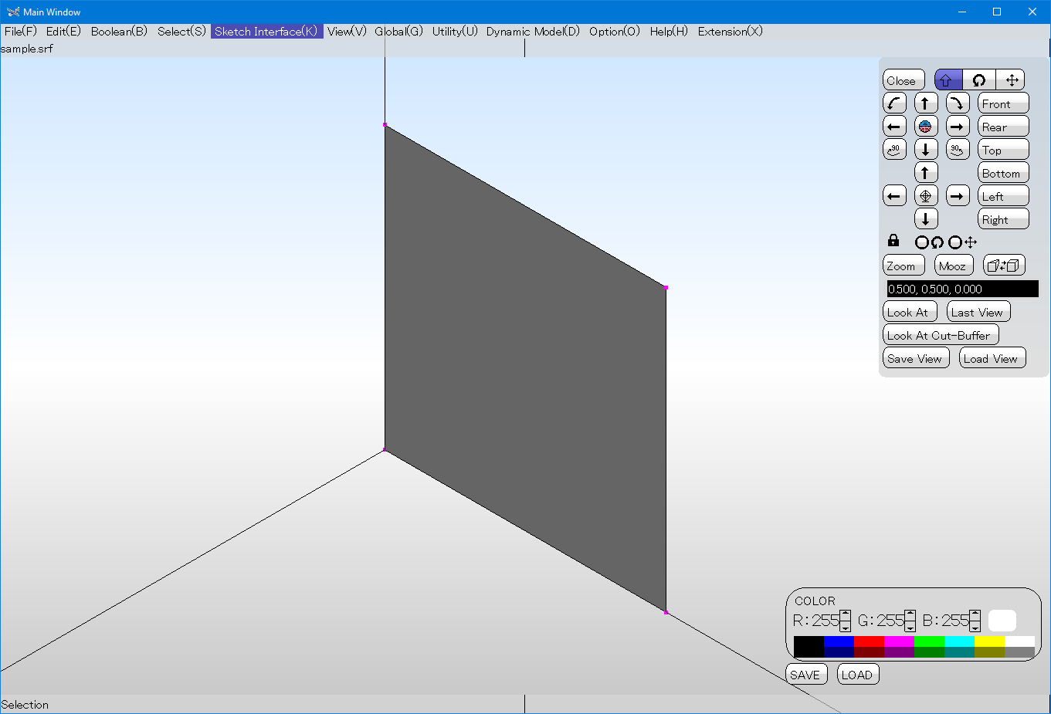

Slide 16
Basic usage of Polygon Crest
Rotation:
Shift Key + Right Button drag, or
Three-finger touch in touch-enabled environment, or
Buttons on the view-control dialog.
Scroll:
Shift Key + Left Button drag, or
Two-finger touch in touch-enabled environment, or
Buttons on the view-control dialog.
Zoom/Unzoom
Shift Key + Left and Right button drag, or
Pinch gesture in touch-enabled environment, or
Zoom and Mooz buttons on the view-control dialog.
Looking at a Vertex
Place the mouse cursor on the vertex and press 'R' key.

Slide 17
Cross-Section and Viewport
Enabling/Disabling the Cross-Section
[View]->[Cross Section]->[Enable]
Resetting the Cross-Section
[View]->[Cross Section]->[Reset]
Enabling/Disabling the Viewport
[View]->[View Port]->[Enable]
Resetting the Viewport (Show all)
[View]->[View Port]->[Reset]
Moving the Viewport
[View]->[Viwe Port]->[Move]
Click and drag green handles

Slide 18
Making a mesh of z=sin(2*PI/5)*cos(2*PI/5)
#include <math.h>
#include <ysshellext.h>
#include <ysshellextio.h>
void MakeMesh(YsShellExt &shl)
{
// YsArray works just like std::vector
YsArray <YsShell::VertexHandle> vtHdMatrix;
for(int j=0; j<=100; ++j)
{
double y=(double)j/20;
for(int i=0; i<=100; ++i)
{
double x=(double)i/20;
double z=sin(x*2.0*YsPi/5.0)*cos(y*2.0*YsPi/5.0);
vtHdMatrix.push_back(shl.AddVertex(YsVec3(x,y,z)));
}
}
for(int j=0; j<100; ++j)
{
for(int i=0; i<100; ++i)
{
YsShell::VertexHandle quadVtHd[4]=
{
vtHdMatrix[ j*101 +i],
vtHdMatrix[ j*101 +i+1],
vtHdMatrix[(j+1)*101+i+1],
vtHdMatrix[(j+1)*101+i],
};
auto plHd=shl.AddPolygon(4,quadVtHd);
shl.SetPolygonColor(plHd,YsBlue());
}
}
}
int main(void)
{
YsShellExt shl;
MakeMesh(shl);
YsShellExt_SaveGeneral("sample.srf",shl);
return 0;
}
Making 101x101 matrix of vertices.
Making 100x100 quad elements.

Slide 19
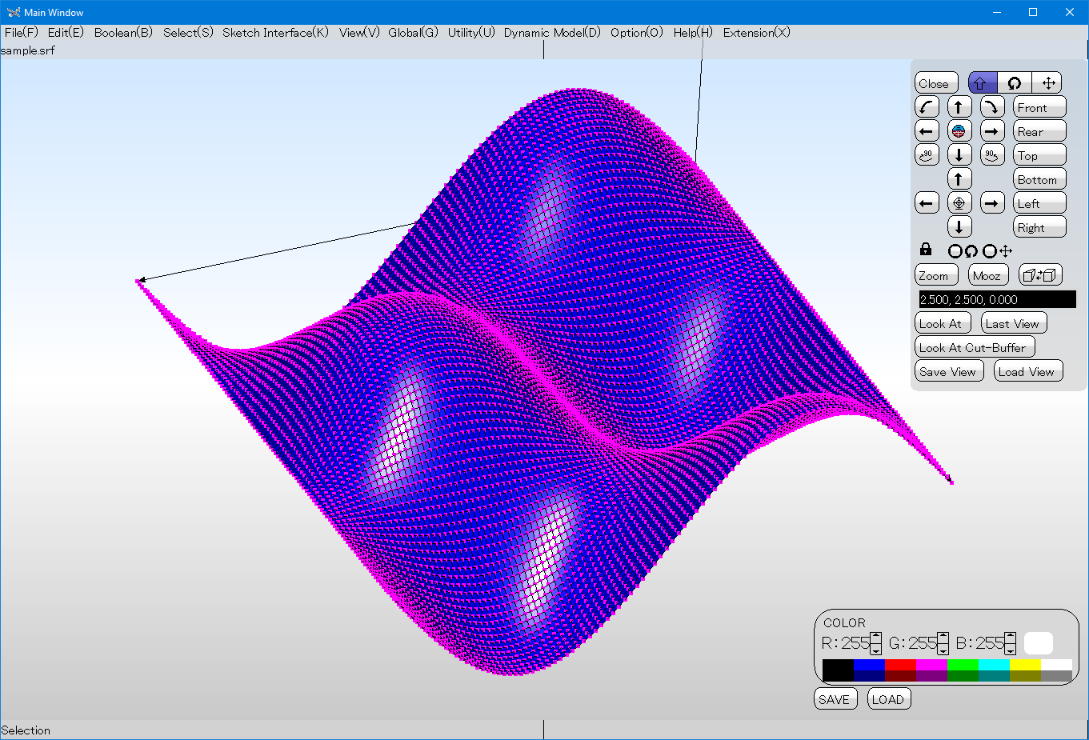

Slide 20
Assigning normal vectors to the polygons.
Input tessellation may be broken in many ways.
One possible way is having incorrect orientation, normal vector, or both.
In the last example, we haven't assigned normal vector, but the normal vectors can be pre-calculated based on the orientation.
You can do it by using a built-in utility class called YsShellExt_OrientationUtil.

Slide 21
Changes from the previous sample
No change in MakeMesh function.
#include <ysshellext_orientationutil.h>
int main(void)
{
YsShellExt shl;
MakeMesh(shl);
YsShellExt_OrientationUtil util;
util.RecalculateNormalFromCurrentOrientation(shl.Conv());
util.Commit(shl);
YsShellExt_SaveGeneral("sample.srf",shl);
return 0;
}

Slide 22
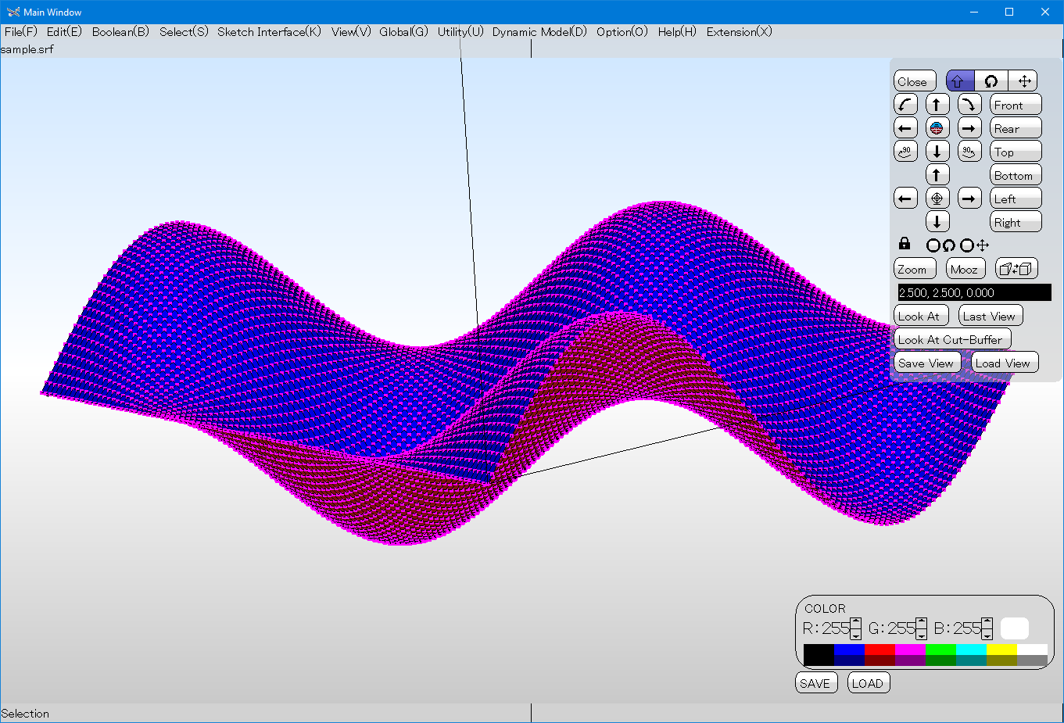
After normal vectors are assigned, Polygon Crest identifies back face and draws in a different color.

Slide 23
Tutorial 2: Re-sampling (Down-sampling) a mesh
The goal of this example is to uniformly reduce resolution of the mesh created in the previous example.
The program takes two command-line arguments (1) input mesh file name, and (2) output mesh file name.
The input mesh consists of 101x101 vertices and 100x100 quadrilaterals.
The output mesh must consists of 21x21 vertices and 20x20 quadrilaterals.
First do it with no supporting data structure, and then with supporting data structure (YsShellLattice).
Shoot columns of rays from (x,y,10.0) to the direction (0,0,-1) and use intersection points as vertices for the down sampling.

Slide 24
Creating a new project
Cd to src/myproj directory and type:
mkdir tutorial02 (If you checked out your working directory, then use svn mkdir tutorial02)
In tutorial02, make CMakeLists.txt as:
add_executable(shellext_tutorial02 main.cpp) target_link_libraries(shellext_tutorial02 geblkernel geblutil)
In CMakeLists.txt directly under 'src', add the following
add_subdirectory(myproj/tutorial02)

Slide 25
Write main.cpp in tutorial02
First let's make a skeleton.
#include <ysshellext.h>
#include <ysshellextio.h>
void ResampleMesh(YsShellExt &outShl,const YsShellExt &inShl)
{
}
int main(int argc,char *argv[])
{
if(3<=argc)
{
YsShellExt inShl,outShl;
if(YSOK!=YsShellExt_LoadGeneral(inShl,argv[1]))
{
fprintf(stderr,"Failed to read the input.\n");
return 1;
}
ResampleMesh(outShl,inShl);
YsShellExt_SaveGeneral(argv[2],outShl);
}
return 0;
}

Slide 26
Test Build
Cd to the 'build' directory.
Type:
cmake ../src
Then build in Visual Studio or XCode.
This program does nothing at this time.

Slide 27
Then fill Resample function.
void ResampleMesh(YsShellExt &outShl,const YsShellExt &inShl)
{
YsArray <YsShell::VertexHandle> vtHdMatrix;
for(int j=0; j<=20; ++j)
{
printf("%d\n",j);
double y=5.0*(double)j/20.0;
for(int i=0; i<=20; ++i)
{
double x=5.0*(double)i/20.0;
YsVec3 from(x,y,10.0);
YsVec3 dir(0.0,0.0,-1.0);
auto res=inShl.FindFirstIntersection(from,dir);
// res has two members:
// plHd intersecting polygon handle.
// nullptr if no intersection.
// pos position of intersection.
if(nullptr!=res.plHd)
{
vtHdMatrix.push_back(outShl.AddVertex(res.pos));
}
else
{
vtHdMatrix.push_back(nullptr);
}
}
}
for(int j=0; j<20; ++j)
{
for(int i=0; i<20; ++i)
{
YsShell::VertexHandle quadVtHd[4]=
{
vtHdMatrix[ j*21 +i],
vtHdMatrix[ j*21 +i+1],
vtHdMatrix[(j+1)*21+i+1],
vtHdMatrix[(j+1)*21+i],
};
if(nullptr!=quadVtHd[0] && nullptr!=quadVtHd[1] &&
nullptr!=quadVtHd[2] && nullptr!=quadVtHd[3])
{
auto plHd=outShl.AddPolygon(4,quadVtHd);
outShl.SetPolygonColor(plHd,YsGreen());
}
}
}
}

Slide 28
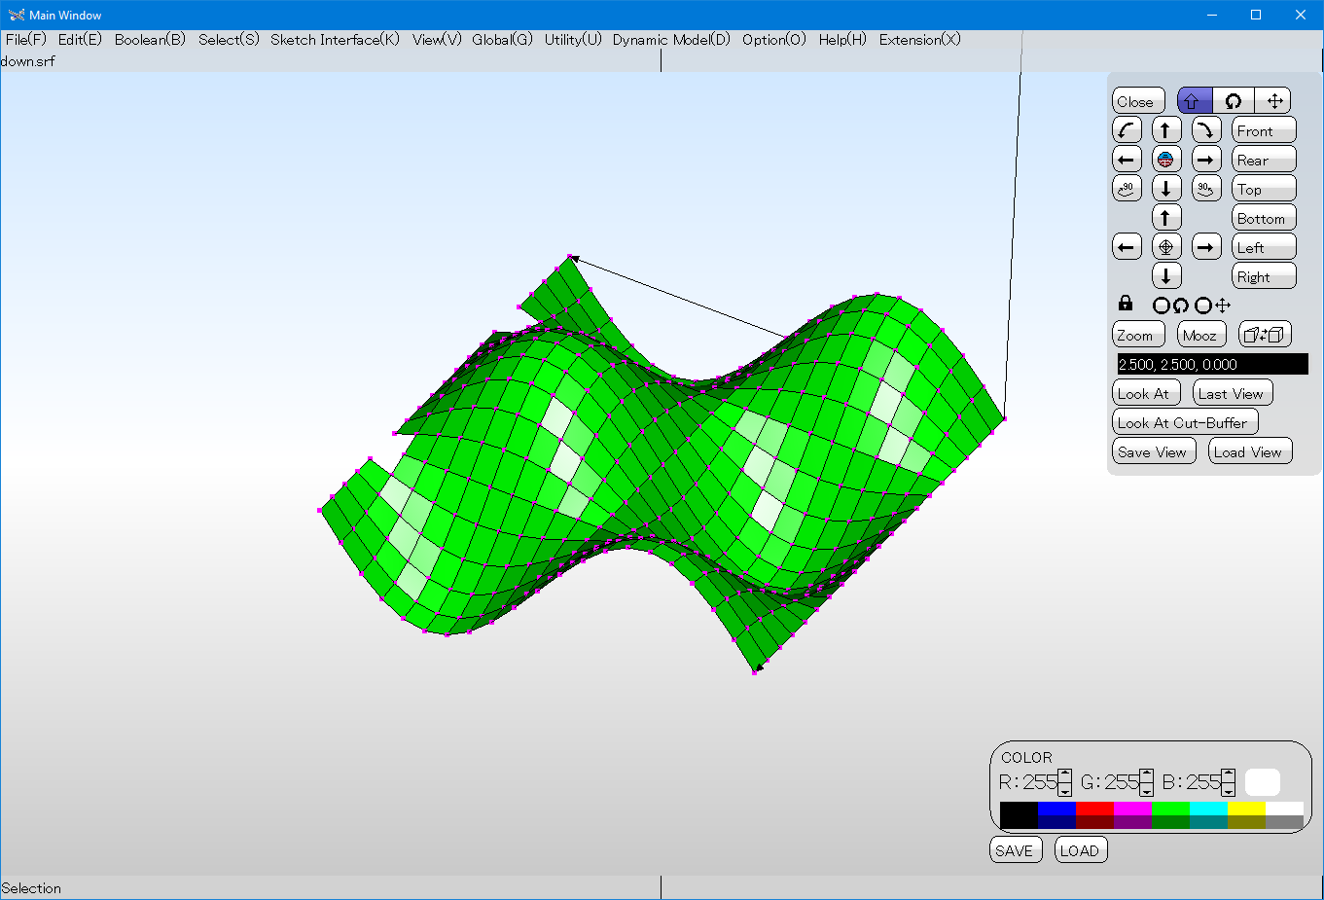
It does work. But, quite slow.

Slide 29
Use YsShellLattice class to accelerate intersection checks.
Modify the first for-loop in Resample function as:
YsShellLattice ltc;
ltc.SetDomain(inShl.Conv(),1+inShl.GetNumPolygon());
for(int j=0; j<=20; ++j)
{
double y=5.0*(double)j/20.0;
for(int i=0; i<=20; ++i)
{
double x=5.0*(double)i/20.0;
YsVec3 from(x,y,10.0);
YsVec3 dir(0.0,0.0,-1.0);
YsShell::PolygonHandle itscPlHd;
YsVec3 itscPos;
if(YSOK==ltc.FindFirstIntersection(itscPlHd,itscPos,from,dir) && nullptr!=itscPlHd)
{
vtHdMatrix.push_back(outShl.AddVertex(itscPos));
}
else
{
vtHdMatrix.push_back(nullptr);
}
}
}

Slide 30
Session 2

Slide 31
Tutorial 3: Polygon-Polygon Intersection Detection
Highlight polygons of the surface that intersects with a discretized sphere.
Make a copy of tutorial02 to make tutorial03.
Then rename project name in CMakeLists.txt
You have two locations to change CMakeLists.txt in tutorial03:
add_executable(shellext_tutorial03 main.cpp)
target_link_libraries(shellext_tutorial03 geblkernel geblutil)
Add new directory in the top-level CMakeLists.txt

Slide 32
If it were in an assignment, I let you write your own function to discretize a sphere into a polygonal mesh, but it is not.
Let's use a utility function that creates a set of polygons by discretizing a sphere.
Also use a utility class called YsCollisionOfPolygon to detect polygon-vs-polygon intersection.

Slide 33
Data type is YsArray <YsVec3,4>.
You can use it like std::vector <YsVec3>
#include <ysshellext.h>
#include <ysshellextio.h>
#include <ysshellext_primitiveshapeutil.h>
void HighlightIntersection(YsShellExt &inOutShl,const YsShellExt &toolShl)
{
YsShellLattice ltc;
ltc.SetDomain(inOutShl.Conv(),1+inOutShl.GetNumPolygon());
for(auto toolPlHd : toolShl.AllPolygon())
{
auto toolPlVtPos=toolShl.GetPolygonVertexPosition(toolPlHd);
auto itscCheckCandidate=
ltc.GetPolygonIntersectionCandidate(toolPlVtPos.size(),toolPlVtPos.data());
for(auto checkPlHd : itscCheckCandidate)
{
auto checkPlVtPos=inOutShl.GetPolygonVertexPosition(checkPlHd);
YsCollisionOfPolygon coll;
coll.SetPolygon1(toolPlVtPos.size(),toolPlVtPos.data());
coll.SetPolygon2(checkPlVtPos.size(),checkPlVtPos.data());
if(YSTRUE==coll.CheckCollision())
{
inOutShl.SetPolygonColor(checkPlHd,YsRed());
}
}
}
}

Slide 34
int main(int argc,char *argv[])
{
if(3<=argc)
{
YsShellExt inOutShl;
if(YSOK!=YsShellExt_LoadGeneral(inOutShl,argv[1]))
{
fprintf(stderr,"Failed to read the input.\n");
return 1;
}
YsShellExt toolShl;
YsShellExt_SphereGeneratorUtil util;
util.SetUp(YsVec3::Origin(),4.0,16,32);
util.Generate(toolShl);
HighlightIntersection(inOutShl,toolShl);
YsShellExt_SaveGeneral(argv[2],inOutShl);
}
return 0;
}

Slide 35
Tutorial 4: Self-Intersection Check
One of the common defects of an STL is self-intersection, in which an element intersects with another element in the mesh.
For each polygon in the mesh, check if the polygon is intersecting with another polygon other than immediate neighbor that shares at least one vertex. (Note: Immediate neighbor polygon is always intersecting.)
This function is included in PolygonCrest GUI, but you can write the same functionality.

Slide 36
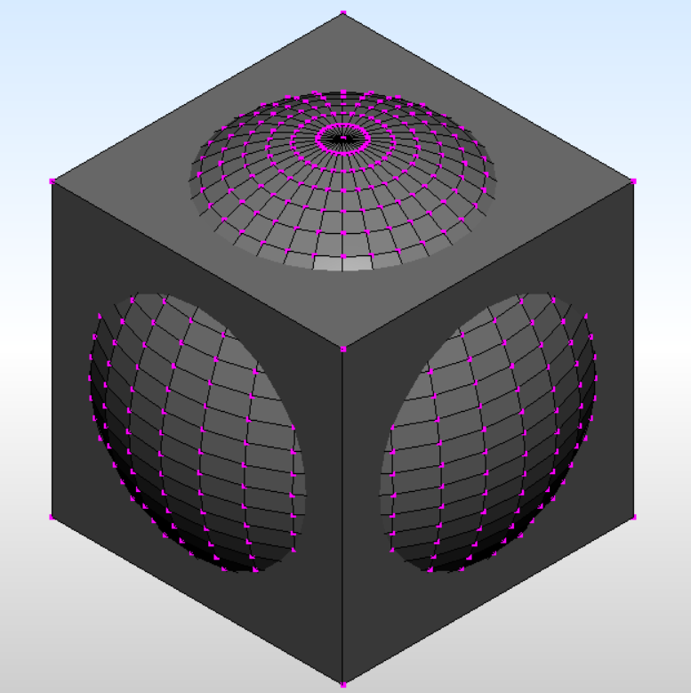
First, let’s make a test model.
Generate a mesh with:
A sphere with radius of 5.0 centered at origin.
A cube with an edge length of 4.0 centered at origin.
The code:
#include <ysshellext.h>
#include <ysshellextio.h>
#include <ysshellext_primitiveshapeutil.h>
int main(void)
{
YsShellExt shl;
YsShellExt_SphereGeneratorUtil sphereUtil;
sphereUtil.SetUp(YsVec3::Origin(),5.0,32,32);
sphereUtil.Generate(shl);
YsShellExt_BoxGeneratorUtil boxUtil;
boxUtil.SetUp(YsVec3(-4.0,-4.0,-4.0),YsVec3(4.0,4.0,4.0));
boxUtil.Generate(shl);
YsShellExt_SaveGeneral("selfitsc.srf",shl);
return 0;
}

Slide 37
Then write the self-intersection checker.
The algorithm is:
For each polygon P0, find potentially intersecting polygons.
For each potentially intersecting polygon Q,
If Q shares at least one vertex with P0, ignore it.
If Q does not share any vertex with P0, check if P0 and Q1 intersects.
If they do intersect, mark them as self-intersecting.
The program takes an input file as the first argument, then paint self-intersecting polygons red, other polygons white, then write to the file specified as the second argument.
The program looks very similar to tutorial03

Slide 38
#include <ysshellext.h>
#include <ysshellextio.h>
void HighlightIntersection(YsShellExt &shl)
{
YsShellLattice ltc;
ltc.SetDomain(shl.Conv(),1+shl.GetNumPolygon());
for(auto toolPlHd : shl.AllPolygon())
{
shl.SetPolygonColor(toolPlHd,YsWhite());
}
for(auto toolPlHd : shl.AllPolygon())
{
auto toolPlVtHd=shl.GetPolygonVertex(toolPlHd);
auto toolPlVtPos=shl.GetPolygonVertexPosition(toolPlHd);
auto itscCheckCandidate=
ltc.GetPolygonIntersectionCandidate(toolPlVtPos.size(),toolPlVtPos.data());
for(auto checkPlHd : itscCheckCandidate)
{
auto checkPlVtHd=shl.GetPolygonVertex(checkPlHd);
if(YSTRUE==toolPlVtHd.HasCommonItem(checkPlVtHd))
{
continue;
}
auto checkPlVtPos=shl.GetPolygonVertexPosition(checkPlHd);
YsCollisionOfPolygon coll;
coll.SetPolygon1(toolPlVtPos.size(),toolPlVtPos.data());
coll.SetPolygon2(checkPlVtPos.size(),checkPlVtPos.data());
if(YSTRUE==coll.CheckCollision())
{
shl.SetPolygonColor(checkPlHd,YsRed());
shl.SetPolygonColor(toolPlHd,YsRed());
}
}
}
}
Tentatively paint everything white.
Ignore immediate neighbor.

Slide 39
int main(int argc,char *argv[])
{
if(3<=argc)
{
YsShellExt shl;
if(YSOK!=YsShellExt_LoadGeneral(shl,argv[1]))
{
fprintf(stderr,"Failed to read the input.\n");
return 1;
}
HighlightIntersection(shl);
YsShellExt_SaveGeneral(argv[2],shl);
}
return 0;
}

Slide 40
Tutorial 5: Triangulation
STL data format is the worst possible data format for a triangular mesh.
Maybe that’s why it is standard.
Everything in STL needs to be a triangle.
Non-triangular polygons in a polygonal mesh needs to be split into triangles before exported to an STL file.
Write a command that reads a polygonal mesh file specified as the first parameter, triangulate, and then save to a file specified as the second parameter.

Slide 41
#include <ysshellext.h>
#include <ysshellextio.h>
#include <ysshellext_triangulationutil.h>
int main(int argc,char *argv[])
{
if(3<=argc)
{
YsShellExt shl;
if(YSOK!=YsShellExt_LoadGeneral(shl,argv[1]))
{
fprintf(stderr,"Failed to read the input.\n");
return 1;
}
YsShellExt_TriangulationInfo util;
util.MakeInfo(shl);
util.Commit(shl);
YsShellExt_SaveGeneral(argv[2],shl);
}
return 0;
}

Slide 42
Session 3

Slide 43
Tutorial 6: Statistics
Open a mesh file and print:
Number of vertices
Number of polygons
Min, Max, and Average valence (Number of polygons using a vertex)
Is open, closed, or non-manifold
Manifold: A mesh is homeomorphic to a disk at every point on the mesh.
Non-Manifold: A mesh that includes a point connection, an edge not used by two polygons.
Open: A mesh that has an edge that is used by only one polygon.
Openness is a kind of non-manifoldness. But, often are distinguished. Don’t be surprised when someone say “open manifold mesh”, which probably means it is open, but no edge is used by more than two polygons.
Volume if it is closed
Total area
For topological inquiry, you need to call:
shl.EnableSearch();

Slide 44
Tutorial 07: Finding a point connection
It is easy to catch a non-manifold edge.
What about a point connection?
Find all polygons using the vertex V0.
Pick one of the polygons using V0, and make a chain of polygons by traversing to the neighboring polygon by an edge that one of the edge-vertices is V0. The traversal should stop when it cannot move any further (either cannot find a unique neighboring polygon or no neighboring polygon), or it made a loop (when it comes back to the polygon where the traversal started.)
If the number of polygons in the chain is different from the number of polygons using V0, V0 is a point connection.

Slide 45
#include <ysshellext.h>
#include <ysshellextio.h>
#include <ysshellext_trackingutil.h>
void PrintNumVertexNumPolygon(const YsShellExt &shl)
{
printf("Number of Vertices: %d\n",(int)shl.GetNumVertex());
printf("Number of Polygons: %d\n",(int)shl.GetNumPolygon());
}
void PrintMinMaxAverageValence(const YsShellExt &shl)
{
YSSIZE_T min,max,avg=0,nSample=0;
for(auto vtHd : shl.AllVertex())
{
// You can also use GetNumPoygonUsingVertex
auto vtPlHd=shl.FindPolygonFromVertex(vtHd);
if(0==nSample)
{
min=vtPlHd.size();
max=vtPlHd.size();
}
else
{
YsMakeSmaller(min,vtPlHd.size());
YsMakeGreater(max,vtPlHd.size());
}
avg+=vtPlHd.size();
++nSample;
}
if(0<nSample)
{
avg/=nSample;
}
printf("Valence Min:%lld Max:%lld Avg:%lld\n",min,max,avg);
}

Slide 46
void PrintMeshType(const YsShellExt &shl)
{
bool isOpen=false,isNonManifold=false;
YsShellEdgeEnumHandle edHd=nullptr;
while(YSOK==shl.MoveToNextEdge(edHd))
{
// You can shortcut by GetNumPolygonUsingEdge
// or you can also directly give edHd to FindPolygonFromEdge
auto edgePiece=shl.GetEdge(edHd);
auto edPlHd=shl.FindPolygonFromEdgePiece(edgePiece);
if(2!=edPlHd.size())
{
isNonManifold=true;
}
if(1==edPlHd.size())
{
isOpen=true;
}
}
// In fact, the following loop also captures an edge used by more than
// two polygons.
for(auto vtHd : shl.AllVertex())
{
YsShellExt::PassAll cond; // <- Consider all polygons.
auto vtPlHd=shl.FindPolygonFromVertex(vtHd);
if(0<vtPlHd.size())
{
auto plgFan=
YsShellExt_TrackingUtil::MakePolygonFanAroundVertex(
shl,vtHd,vtPlHd[0],cond);
if(plgFan.size()!=vtPlHd.size())
{
isNonManifold=true;
}
}
}

Slide 47
if(true==isNonManifold)
{
printf("Is a non-manifold mesh.\n");
}
if(true==isOpen)
{
printf("Is an open mesh.\n");
}
if(true!=isNonManifold && true!=isOpen)
{
printf("Is a closed mesh.\n");
}
}
void PrintVolume(const YsShellExt &shl)
{
printf("Volume is inaccurate if it is not a closed manifold mesh.\n");
printf("Volume: %lf\n",shl.ComputeVolume());
}
void PrintTotalArea(const YsShellExt &shl)
{
double area=0.0;
for(auto plHd : shl.AllPolygon())
{
area+=shl.GetPolygonArea(plHd);
}
printf("Total Area: %lf\n",area);
}

Slide 48
int main(int argc,char *argv[])
{
if(2<=argc)
{
YsShellExt shl;
if(YSOK!=YsShellExt_LoadGeneral(shl,argv[1]))
{
fprintf(stderr,"Failed to read the input.\n");
return 1;
}
shl.EnableSearch();
PrintNumVertexNumPolygon(shl);
PrintMinMaxAverageValence(shl);
PrintMeshType(shl);
PrintVolume(shl);
PrintTotalArea(shl);
}
return 0;
}
Don’t forget this!

Slide 49
Tutorial 08: Smoothing
Example: Laplacian smoothing
In each iteration, vertices are moved to the average of neighboring vertices.
Only vertices away from the boundary should move.
Also vertices must be constrained on the original polygonal mesh.

Slide 50
Laplacian with no constraint.
#include <ysshellext.h>
#include <ysshellextio.h>
void LaplacianSmoothing(YsShellExt &shl)
{
for(auto vtHd : shl.AllVertex())
{
auto avg=YsVec3::Origin();
YSSIZE_T nSample=0;
for(auto connVtHd : shl.GetConnectedVertex(vtHd))
{
avg+=shl.GetVertexPosition(connVtHd);
++nSample;
}
if(0<nSample)
{
avg/=(double)nSample;
shl.SetVertexPosition(vtHd,avg);
}
}
}
int main(int argc,char *argv[])
{
if(3<=argc)
{
YsShellExt shl;
if(YSOK!=YsShellExt_LoadGeneral(shl,argv[1]))
{
fprintf(stderr,"Failed to read the input.\n");
return 1;
}
shl.EnableSearch();
for(int i=0; i<100; ++i)
{
LaplacianSmoothing(shl);
}
YsShellExt_SaveGeneral(argv[2],shl);
}
return 0;
}

Slide 51
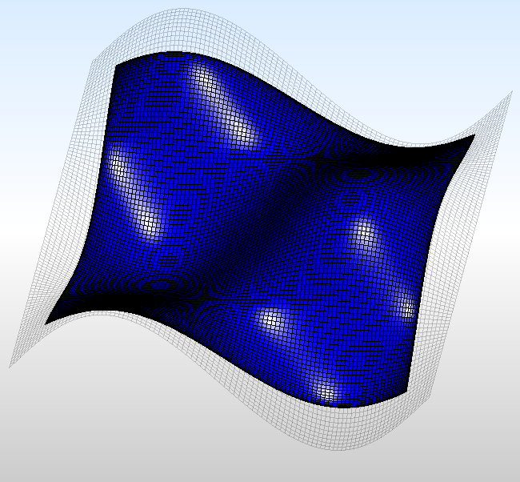
The surface shrinks.

Slide 52
Constraining boundary vertices
void LaplacianSmoothing(YsShellExt &shl)
{
for(auto vtHd : shl.AllVertex())
{
bool isOnNonManifoldEdge=false;
for(auto connVtHd : shl.GetConnectedVertex(vtHd))
{
if(2!=shl.GetNumPolygonUsingEdge(vtHd,connVtHd))
{
isOnNonManifoldEdge=true;
break;
}
}
if(true==isOnNonManifoldEdge)
{
continue;
}
auto avg=YsVec3::Origin();
YSSIZE_T nSample=0;
for(auto connVtHd : shl.GetConnectedVertex(vtHd))
{
avg+=shl.GetVertexPosition(connVtHd);
++nSample;
}
if(0<nSample)
{
avg/=(double)nSample;
shl.SetVertexPosition(vtHd,avg);
}
}
}

Slide 53
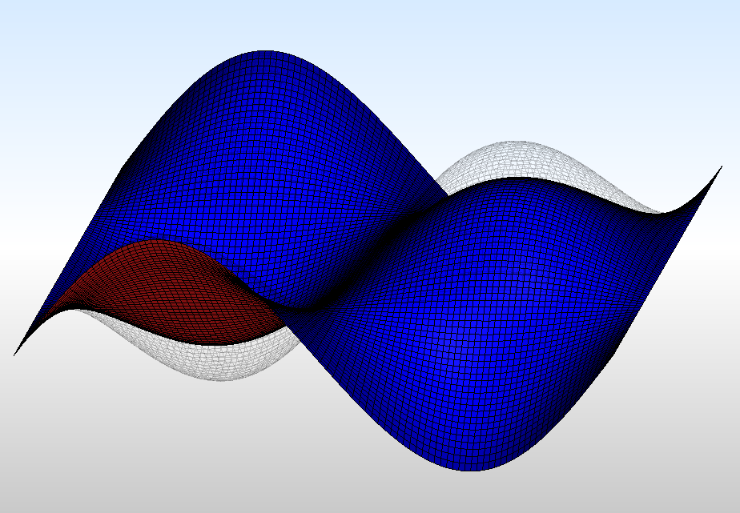
Boundary of the mesh is preserved. Still the surface deviates too much from the input mesh (gray wireframe).

Slide 54
Constraining vertices on the input mesh
Using Face-Group Smoother (YsShellExt_FaceGroupSmoothingUtil) defined in ysshellext_smoothingutil.h
Steps to follow:
Create a face group (In this case make entire mesh a one face group)
Smooth only inside vertices of the face group
Commit the changes to the mesh

Slide 55
Change in the LaplacianSmoothing function
#include <ysshellext.h>
#include <ysshellextio.h>
#include <ysshellext_smoothingutil.h>
#include <ysshellext_triangulationutil.h>
void LaplacianSmoothing(
YsShellExt &shl,
YsShellExt::FaceGroupHandle fgHd,
YsShellExt_FaceGroupSmoothingUtil &smoother)
{
for(auto vtHd : shl.GetFaceGroupInsideVertex(fgHd))
{
auto avg=YsVec3::Origin();
YSSIZE_T nSample=0;
for(auto connVtHd : shl.GetConnectedVertex(vtHd))
{
avg+=smoother.GetVertexPosition(connVtHd);
++nSample;
}
if(0<nSample)
{
avg/=(double)nSample;
smoother.SetVertexPosition(vtHd,avg);
}
}
}

Slide 56
MakeSingleFaceGroup function
YsShellExt::FaceGroupHandle MakeSingleFaceGroup(YsShellExt &shl)
{
std::vector <YsShellExt::PolygonHandle> fgPlHd;
for(auto plHd : shl.AllPolygon())
{
fgPlHd.push_back(plHd);
}
return shl.AddFaceGroup(fgPlHd);
}

Slide 57
Changes in the main function
int main(int argc,char *argv[])
{
if(3<=argc)
{
YsShellExt shl;
if(YSOK!=YsShellExt_LoadGeneral(shl,argv[1]))
{
fprintf(stderr,"Failed to read the input.\n");
return 1;
}
shl.EnableSearch();
auto fgHd=MakeSingleFaceGroup(shl);
YsShellExt_FaceGroupSmoothingUtil smoother;
smoother.Begin(shl.Conv());
for(int i=0; i<100; ++i)
{
printf("%d\n",i);
LaplacianSmoothing(shl,fgHd,smoother);
}
smoother.Commit(shl);
YsShellExt_SaveGeneral(argv[2],shl);
}
return 0;
}

Slide 58
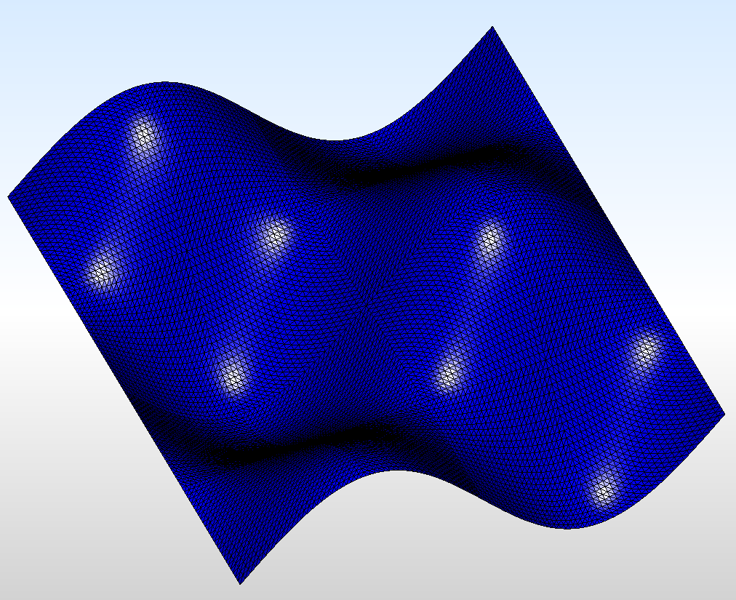
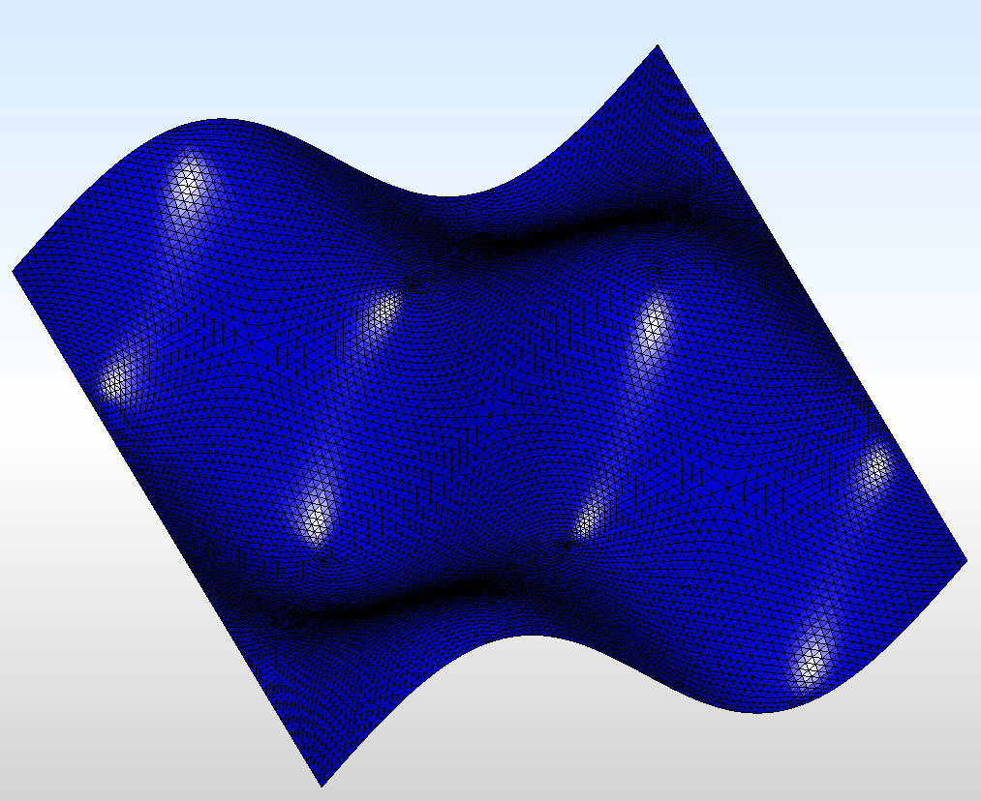
Before
After

Slide 59
Tutorial 09: Writing a Plug-In for PolygonCrest
Using a program from command is good, but sometimes it is nicer to have a visual feedback.

Slide 60
Preparation
Copy a directory: public/src/ysgebl/src/main
Rename it to tutorial09
Open CMakeLists.txt and modify: set(TARGET_NAME "ysgebl${BITNESS}") to set(TARGET_NAME “shellext_tutorial09")
Find the following lines: set(SRCS ${platform_SRCS} ysgebl_gui_extension.cpp ) and add: myfunc.cpp
Create an empty (tentatively) file called: myfunc.cpp
Add tutorial09 directory in the top-level CMakeLists.txt

Slide 61
Run CMake and try Building. (In Visual Studio, the new project will be in the PolygonCrest group.)

Slide 62
Add your menu call-back function
In GeblGuiExtension class in ysgebl_gui_extension.h, add the following function declaration: void MyCallBack(FsGuiPopUpMenuItem *);
In myfunc.cpp, write the following
Modify the function AddMenu in ysgebl_gui_extension.cpp as:
Compile and run, select your menu to see the console output.
#include <stdio.h>
#include "ysgebl_gui_extension.h"
void GeblGuiExtension::MyCallBack(FsGuiPopUpMenuItem *)
{
printf("Checking function binding.\n");
}
void GeblGuiExtension::AddMenu(class GeblGuiEditorMainMenu *mainMenu)
{
auto extMenu=mainMenu->AddTextItem(0,FSKEY_X,L"Extension")->GetSubMenu();
extMenu->AddTextItem(0,FSKEY_S,L"Sample")->BindCallBack(&GeblGuiExtension::SampleMenuCallBack,this);
extMenu->AddTextItem(0,FSKEY_NULL,L"My function")->BindCallBack(&GeblGuiExtension::MyCallBack,this);
}

Slide 63
Accessing the YsShellExtEdit class in the call-back function.
The member variable canvasPtr gives a pointer to the GUI window.
canvasPtr->Slhd() gives a pointer to YsShellExtEdit object.
The following example will create a sphere.
If the created geometry is too large for the view port ((-5,-5,-5)-(5,5,5) default), select [View]->[Reset View Range]
#include <stdio.h>
#include <ysshellext_primitiveshapeutil.h>
#include <ysgebl_gui_editor_base.h>
#include "ysgebl_gui_extension.h"
void GeblGuiExtension::MyCallBack(FsGuiPopUpMenuItem *)
{
auto &canvas=*(this->canvasPtr);
if(NULL!=canvas.Slhd())
{
auto &shl=*canvas.Slhd();
YsShellExt_SphereGeneratorUtil sphereUtil;
sphereUtil.SetUp(YsVec3::Origin(),5.0,32,32);
sphereUtil.Generate(shl);
canvas.needRemakeDrawingBuffer|=canvas.NEED_REMAKE_DRAWING_ALL;
canvas.SetNeedRedraw(YSTRUE);
}
}

Slide 64
Conversion Object
canvasPtr->Slhd() is a pointer to YsShellExtEdit, which is a sub-class of YsShellExt.
When a function needs to take const YsShellExt & or const YsShell &, pass: canvasPtr->Slhd()->Conv()
Conv() returns a conversion object, which will convert YsShellExtEdit to const YsShellExt & or const YsShell & appropriately.

Slide 65
Example of use of the conversion object
#include <stdio.h>
#include <ysshellext_primitiveshapeutil.h>
#include <ysshellext_triangulationutil.h>
#include <ysgebl_gui_editor_base.h>
#include "ysgebl_gui_extension.h"
void GeblGuiExtension::MyCallBack(FsGuiPopUpMenuItem *)
{
auto &canvas=*(this->canvasPtr);
if(NULL!=canvas.Slhd())
{
auto &shl=*canvas.Slhd();
YsShellExt_SphereGeneratorUtil sphereUtil;
sphereUtil.SetUp(YsVec3::Origin(),5.0,32,32);
sphereUtil.Generate(shl);
YsShellExt_TriangulationInfo util;
util.MakeInfo(shl.Conv());
util.Commit(shl);
canvas.needRemakeDrawingBuffer|=canvas.NEED_REMAKE_DRAWING_ALL;
canvas.SetNeedRedraw(YSTRUE);
}
}
Using Conv()

Slide 66
Accessing selected vertices and polygons
Use: auto selVtHd=shl.GetSelectedVertex(); auto selPlHd=shl.GetSelectedPolygon();
These functions returns an array of selected vertices/polygons.

Slide 67
Example
#include <ysgebl_gui_editor_base.h>
#include "ysgebl_gui_extension.h"
void GeblGuiExtension::MyCallBack(FsGuiPopUpMenuItem *)
{
auto &canvas=*(this->canvasPtr);
if(NULL!=canvas.Slhd())
{
auto &shl=*canvas.Slhd();
for(auto plHd : shl.GetSelectedPolygon())
{
shl.SetPolygonColor(plHd,YsRed());
}
for(auto vtHd : shl.GetSelectedVertex())
{
for(auto plHd : shl.FindPolygonFromVertex(vtHd))
{
shl.SetPolygonColor(plHd,YsGreen());
}
}
canvas.needRemakeDrawingBuffer|=canvas.NEED_REMAKE_DRAWING_ALL;
canvas.SetNeedRedraw(YSTRUE);
}
}

Slide 68
To cover
Boolean operation (Mesh vs. Simple shape) Mesh vs Mesh virtually never succeeds
Offsetting
Trussnization
Face Groups and Constraint Edges

