Slide 1
OpenSHS: Open Smart Home Simulator
March, 2021
By Alshammari et al.
Published in MDPI, 2017
Notes:
All images are taken from the paper

Slide 2
Outline
Background
Architecture
Implementation
Analysis
Limitations
Summary

Slide 3
Related work (1)
Datasets generated by:
Real Smart Home Test Beds
Need a lot of equipment
Takes a lot of time
Smart Home Simulation Tools
Model-Based approach
Interactive approach
Most of these models are not available in the public domain

Slide 4
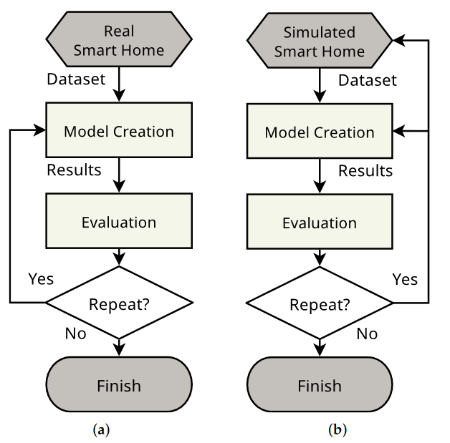
Related work (2)
If the results revealed the need to change something, this is usually a costly and infeasible choice to make
The researcher can only be able to tweak the model parameters
With a simulated smart home, this can be easily done, and the researcher can go back and modify the smart home design

Slide 5
Related work (3)
Model-Based Approach
Uses pre-defined models of activities to generate synthetic data.
These models specify the order of events, the probability of their occurrence and the duration of each activity.
Facilitates the generation of large datasets in a short period
BUT!
Sacrifices the granularity of capturing realistic interactions
It cannot capture unexpected accidents that are common in real homes

Slide 6
Related work (4)
Interactive Approach
Can capture more interesting interactions and fine details
This approach relies on having an avatar that can be controlled by a researcher, human participant or simulated participant.
The avatar moves and interacts with the virtual environment, which has virtual sensors and/or actuators.
The interactions could be done passively or actively.
BUT!
It is a time-consuming approach since all interactions must be captured in real time.

Slide 7
Motivation
The cost to build real smart homes and the collection of datasets for such scenarios is expensive/infeasible
Finding the optimal placement of the sensors, the appropriate participants and privacy and ethical issues
The majority of the existing tools are not available in the public domain as an open-source project
Most of the publicly-available simulation tools lack the flexibility to add and customise new sensors or devices

Slide 8
Challenges
Having a continuous capturing mechanism for the sensors’ data.
An appropriate annotation method for the inhabitants’ activities.
Can they offer:
Flexibility and scalability to add new/customised types of smart devices
Change their generated output(s), change their positions within the smart home
Fast dataset generation
The ability to pause and fast-forward the simulation to enable more accurate activity annotation.

Slide 9
Contribution
OpenSHS is a new hybrid, open-source, cross-platform 3D smart home simulator for dataset generation
Based on Blender and Python
OpenSHS combines advantages from both interactive and model-based approaches.
This approach reduces the time and efforts required to generate simulated smart home datasets
OpenSHS includes a library of smart devices that facilitates the simulation

Slide 10
Architecture
Follows a hybrid approach
Three main phases:
Design
Simulation
Aggregation
Model based approach
Interactive approach

Slide 11
Experiment
A virtual smart home environment consisting of:
a bedroom
a living room
a bathroom
a kitchen
an office
Each room is equipped with several sensors
Totalling 29 sensors of different types.
Sample rate: 1 second by default
The sensors are binary, and they are either on or off at any given time

Slide 12
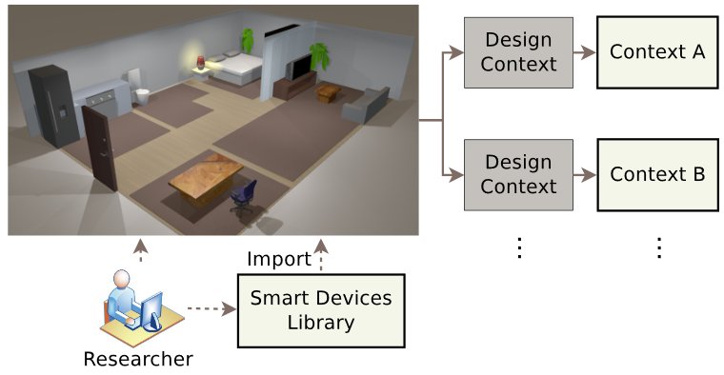
Design phase

Slide 13
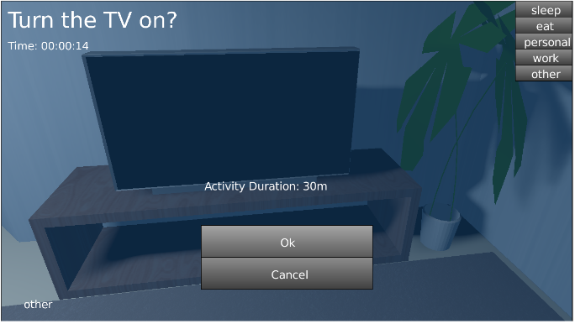
Assigning Activity Labels
Researchers can define unlimited number of activity labels
This list represents a sample of activities

Slide 14
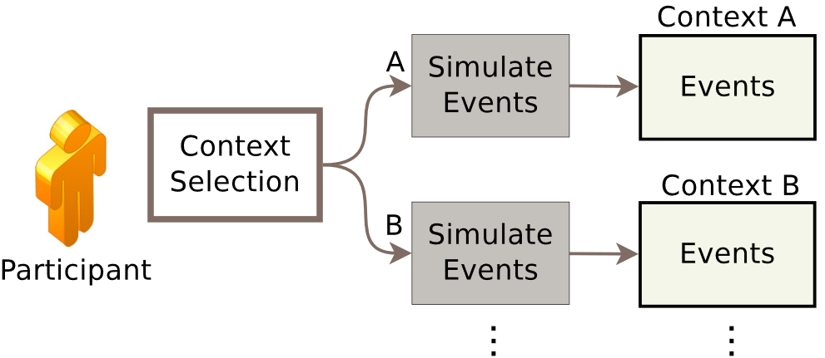
Simulation phase

Slide 15
Fast forward mode
OpenSHS allows the participant to control the time span of a certain activity
The participant wants to watch the TV for a period of time and does not want to perform the whole activity in real time
The participant can initiate that activity and specify how long this activity lasts.
The tool will simply copy and repeat the existing state of all sensors and devices during the specified time period.

Slide 16
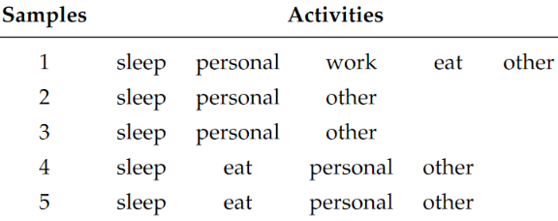
Example
A set of five samples with their activity labels for a certain context.
The first sample has five activities and so on
When the researcher aggregates the final dataset, the samples of every context are grouped by the number of activities in each sample.
Sample 1 will be in one group and so on

Slide 17
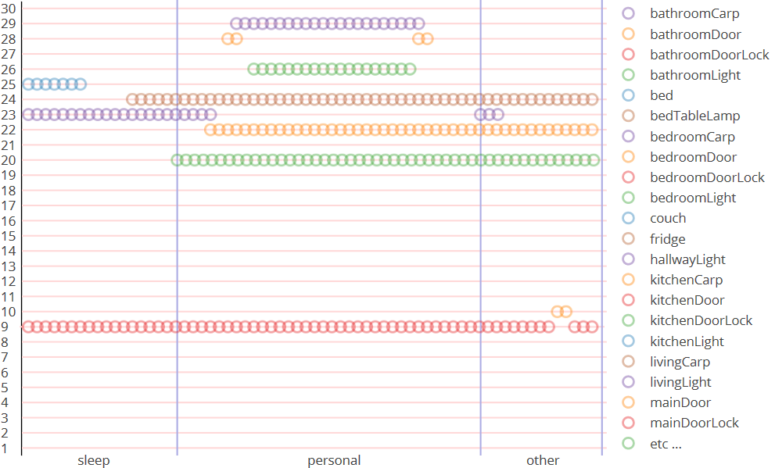
Activities Labelling
During a simulation and before transitioning from one activity to another, the participant will choose the new activity from the available list.
The sample consists of three activity labels
‘sleep’, ‘personal’ and ‘other ’.
Each activity label corresponds to a set of sensors’ readings.
The small circles correspond to an ‘ON-state’ of that sensor.

Slide 18
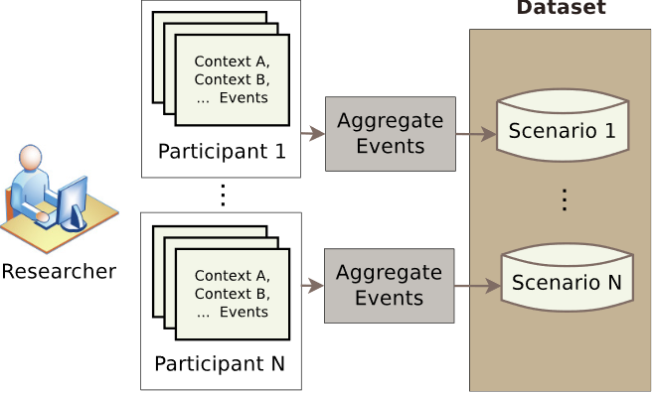
Aggregation Phase
Provides a solution for the generation of large datasets in short simulation time.
Aggregates the participants’ generated sample activities to produce the final dataset.
The results form a pool of sample activities for each context.
An algorithm is developed to replicate the output of the simulation phase by drawing appropriate samples for each designated context.
This feature encapsulates the model-based approach’s advantage with the interactive approach adapted by the simulation phase,
OpenSHS combines the benefits of both approaches

Slide 19
Event replication
Instead of having the user simulating the activities for extended periods of time, the user simulates only a particular context in real time.
Assume we are interested in an ‘early morning’ context, and we want to capture the activities that the inhabitant is doing in this time frame,
What is usually done in the weekdays compared to the weekends in the same context (the ‘early morning’ context).
The user will only perform sample simulations of different events in real time.
The greater the number of samples simulated, the richer the generated dataset will be.

Slide 20
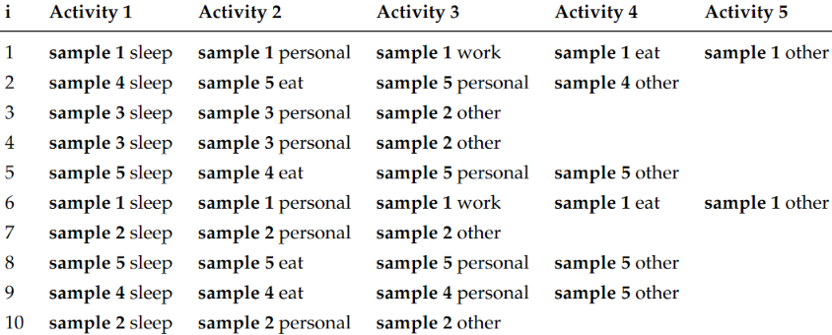
Replicated copies
Then a random group will be chosen, and from that group, a sample will be made for each activity.

Slide 21

Replication Algorithm
It is not realistic to aggregate the final dataset by trivially duplicating the contexts samples
There is a need for an algorithm that can replicate the recorded samples to generate a larger dataset
The number of unique replicated copies for a single context is calculated by:
G denotes the number of the groups of unique length of activities
Sg denotes the number of samples for the group g;
A denotes the number of activities within a sample Sg. The total number of unique replicated copies R is:

Slide 22
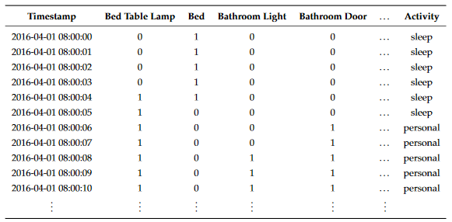
Dataset generation
After running the aggregation algorithm, the researcher can combine all of the scenarios, generated by different participants

Slide 23
Future work
Include multiple inhabitants support in real time
More sensors
Add a floor plan editor
The labelling of activities is performed by the participant during the simulation phase
OpenSHS does not perform automatic recognition of these activities
Plan to investigate the possibility of adding automatic recognition of the participants’ activities

Slide 24
Summary
OpenSHS, a novel smart home simulation tool
Uses the ability of model-based tools to generate large datasets in a reasonable time
Keeps the fine-grained interactions that are exhibited by interactive tools
It can generate seeds of events rapidly
A replication algorithm that can extend the simulated events to generate multiple unique large datasets.
OpenSHS offers partial support for multiple inhabitants.

Slide 25
Thank you!
Questions?

