Slide 1
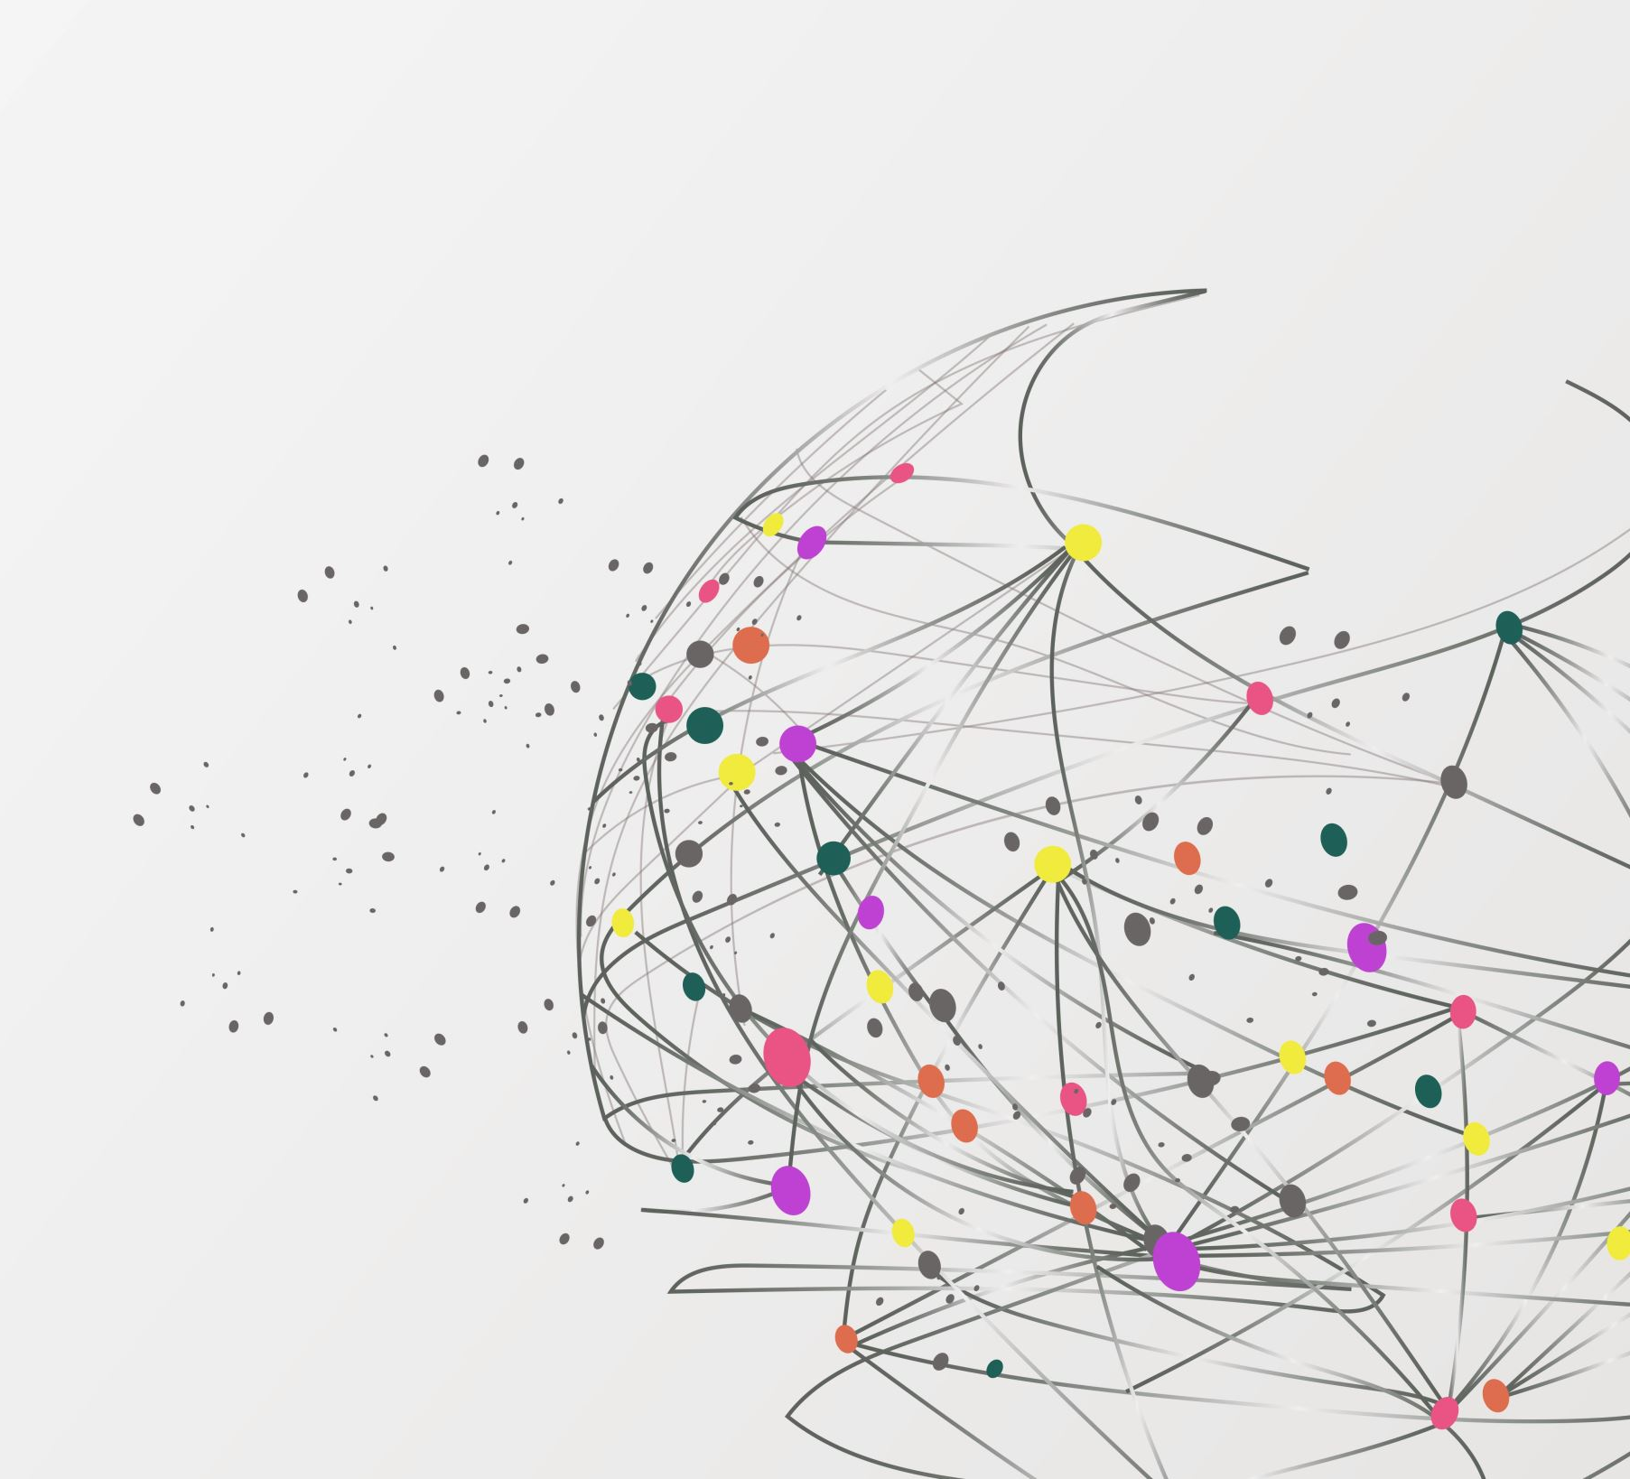
Decentralized Action Integrity for Trigger-Action IoT Platforms
Published in NDSS, 2018
By Fernandes et al.
January 2020

Slide 2
Outline
Background
Trigger-Action platforms
Problems - Mitigations
DTAP design
Limitations
Summary

Slide 3
Background
Many researchers have focused on the different trigger and action channels used by IFTTT users
IFTTT → If-This-Then-That
Other works tried to determine the risks that users face due to errors in rule creation
Studies have shown that the majority of deployments of OAuth in Android apps are vulnerable
The notion of XTokens is inspired by Kerberos’s single sign-on protocol
“Ticket granting tickets” are used to acquire “service tickets” to prove the user’s identity to services

Slide 4
Motivation
How an incorrect deployment of OAuth protocol can affect the security properties of trigger-action platforms.
What will happen if these tokens are overprivileged?
Prevent attackers from stealing OAuth tokens and executing actions at will
Independently of user rules

Slide 5
Contribution
A security principle that prevents an untrusted trigger-action platform from misusing compromised OAuth tokens
Designed and implemented the Decentralized Action Integrity
Based on rule-specific OAuth tokens with decentralized verifiable triggers
Uses the XToken, a way to gain the power of fine-grained tokens without losing the usability benefits of coarse-grained tokens
Backwards-compatible with OAuth protocol
DTAP is the first decoupled trigger action platform supporting Decentralized Action Integrity

Slide 6
What is a Trigger-Action platform?
A class of web-based systems that stitch together a number of online services
Provide users the ability to set up automation rules
E.g., “If I post a picture to Facebook, save this picture to my OneDrive account”
Such platforms have added automation support for physical devices
E.g., “If there is an alarm, turn on the lights

Slide 7
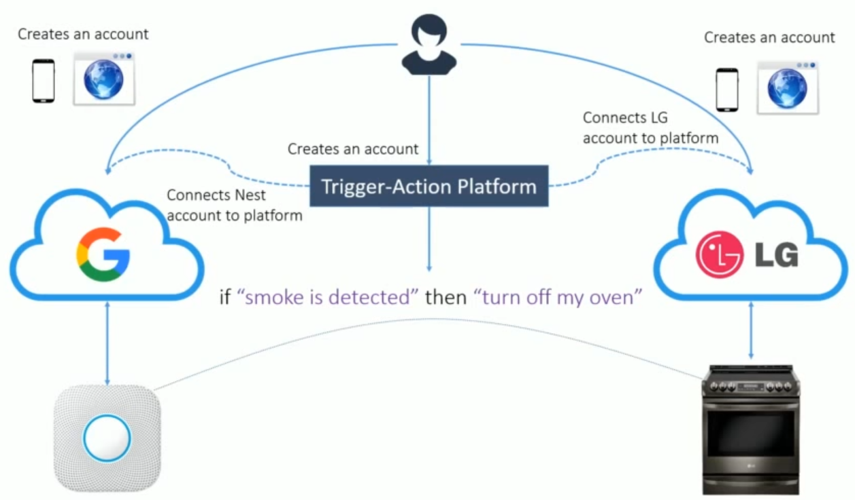

Slide 8
Trigger-Action platforms are targets
Trigger-Action platforms support a wide variety of business and IoT use-cases, using a logically monolithic design
If attackers compromise the platform, they will be able to leak OAuth tokens for all users
These platforms have privileged access to users’ online services and physical devices
If they get compromised, attackers can arbitrarily manipulate data and devices belonging to a lot of user

Slide 9
Research Question
How can we guarantee that actions
are executed according to user rules in
an untrusted trigger-action platform?

Slide 10
Initial research
A survey of 7 trigger-action platforms with over 11 million users
Cloud services are still not immune to persistent and sophisticated attacks
Τhe overprivilege in the OAuth tokens enable the attacker to invoke API calls that are outside the abilities of the trigger-action platform itself.

Slide 11
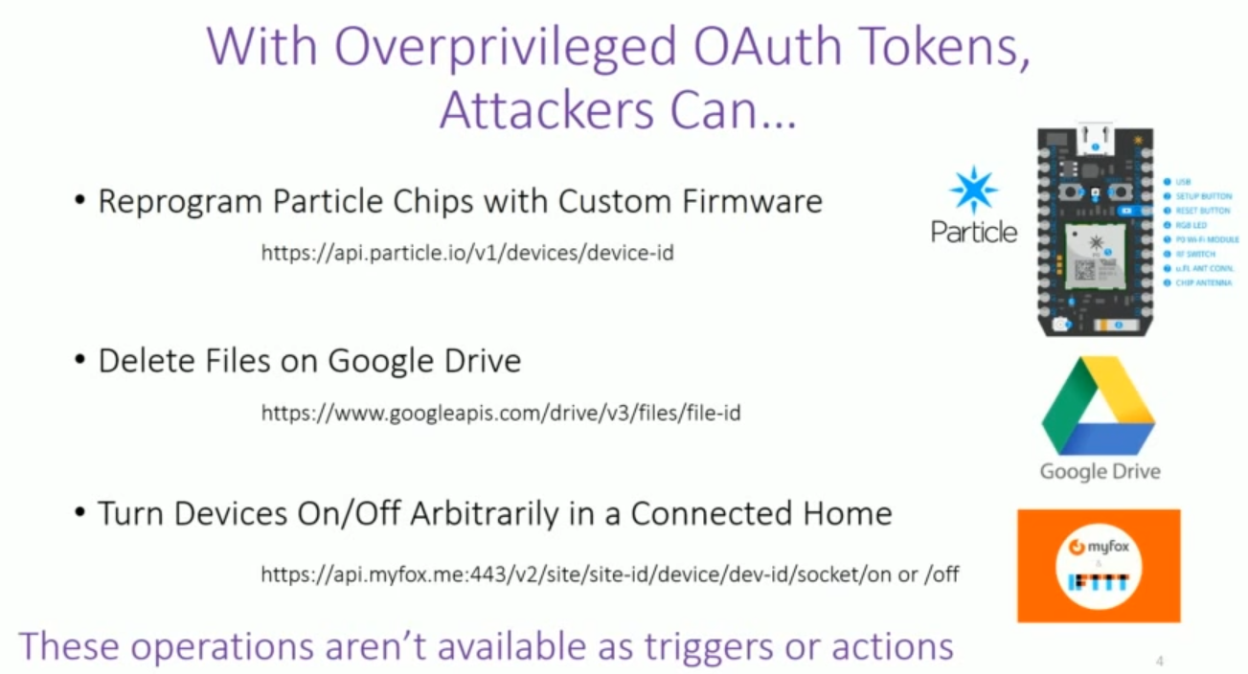

Slide 12
Threat model
Assume that the platform is not trusted, and can be compromised
Assume that online services are not compromised
An attacker can leak OAuth tokens and attempt to invoke actions arbitrarily
An attacker can manipulate any triggering data passing through the platform
The model DO NOT prevent:
DoS attacks
Leakage of sensitive data

Slide 13
They could try …
Short – lived OAuth tokens?
Require many refresh calls
Depends on the existence of a separate signaling mechanism
Rule Analytics/Anomaly Detection?
After-the-fact, damage is done
Does not address root cause
Fully Decentralised Platform?
Provides functionalities to each user through a client that executes rules on their own machine
Finely – Grained Tokens?
Reduces the useful attack window
Platforms request tokens when users program rules
The platform only has the amount of privilege necessary to execute rules
Increases the number of permissions prompts for users
Trigger-action platform is not a single valuable target anymore
It does not provide the benefits of a cloud services (e.g., availability, fault tolerance)
Usability problems
BUT non of the designs prevent a compromised platform from arbitrarily manipulating data and devices

Slide 14
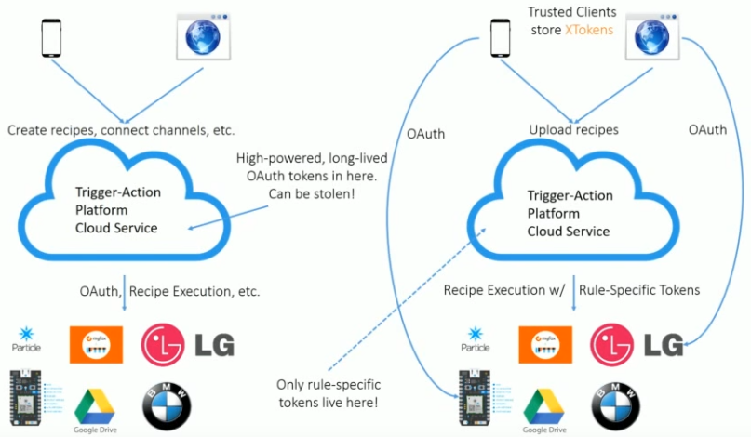
Insecure Platforms vs DTAP
Storing overprivileged tokes in the cloud,
Each user uses a DTAP client to secure his token
Trusted clients negotiate OAuth tokens, recipes, XTokens
DTAP guarantees that no other action other than the specified in the recipes can be performed using the recipe-specific token
A compromise of DTAP cloud does not affect the clients
DTAP clients are not created/managed by the DTAP cloud

Slide 15
The principle of Decentralized Action Integrity
The concept must comply with the following elements:
Rule-specific OAuth tokens
“IF smoke is detected THEN turn off oven.
The platform needs two different OAuth tokens.
Timely and verifiably triggers
Execute an action function if it can prove that the corresponding triggering event was true within a reasonable time period
Data integrity
IF new NASA Instagram post, THEN save the picture to my Dropbox
A compromised cloud service of the platform should not be able to replace the Instagram image with malware
Decentralized tokens
The compromisation of the platform does not mean that the all the tokens are leaked

Slide 16
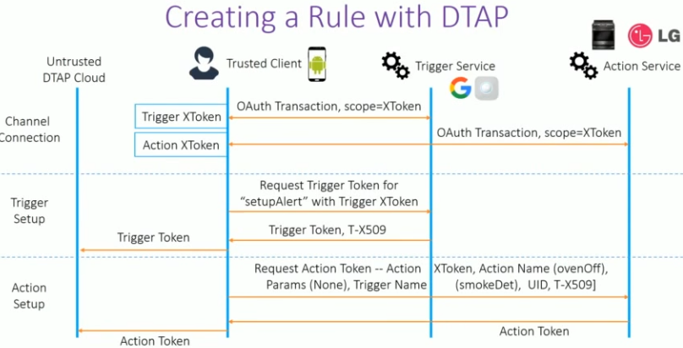
DTAP authorisation
The client obtains scope-to-function maps for every online service
Then they setup up triggering events (e.g. If there is smoke..)
These tokes are used to request rule-specific tokens

Slide 17
Decentralized Action Integrity
Attackers who control a compromised trigger-action platform :
Can only invoke actions and triggers needed for the rules that users have created
They should prove to an action service that the corresponding triggered occurred in the past
To provide a proof that tokens were not misused, the principle places verification checks for misuse of OAuth tokens at the endpoints (e.g., online services) of the system
A compromise of the platform does not leak tokens of all the users

Slide 18
Limitations
DTAP only allows a user to use a single trusted client at a time
The protocol itself does not preclude multiple clients
XToken is a high-powered credential. A malicious client can still leak this credential
But this will affect only one user and not the whole system
An attacker can gain access to sensitive data simply by passively recording rule execution
Data passing through the DTAP-cloud need encryption

Slide 19
Results
DTAP enables fine-grained control and good descriptiveness of the permissions used
Storage overhead:
Each DTAP rule creates a 3.5 KB overhead in addition to the 0.8 KB required to store the XToken
Transmission overhead:
DTAP created 6 – 11% overhead (even when using 10 parameters). This overhead does not exceed 7.5 KB
End-to-End latency:
Excluding the network latency, the maximum verification overhead is less than 15ms.
DTAP protocol has not been formally verified yet

Slide 20
Summary
Trigger-Action platforms work by gaining privilege to access user data and devices in the form of OAuth tokens
DTAP, the first trigger action platform supporting Decentralized Action Integrity
Provides guarantee that even if the OAuth tokens of a trigger-action platform are stolen, the attack cannot misuse the tokes.
Only if they can prove that the triggering condition was true for a given rule
The design introduces the notion of an XToken coupled with rule-specific tokens and a cryptographic extension to the OAauth 2.0 protocol

Slide 21
Thank you!
Questions?

