Slide 1
APSS Seminar -Thursday 21/01/2021
Privacy-preserving Voice Analysis via Disentangled Representations
Ranya Aloufi, Hamed Haddadi and David Boyle
CCSW'20: Proceedings of the 2020 ACM SIGSAC Conference on Cloud Computing Security Workshop, November 2020
APSS | DOMINIKA WOSZCZYK

Slide 2



Voice Privacy Issues
Emotion
Health conditions
Age, gender, accent
APSS | DOMINIKA WOSZCZYK

Slide 3
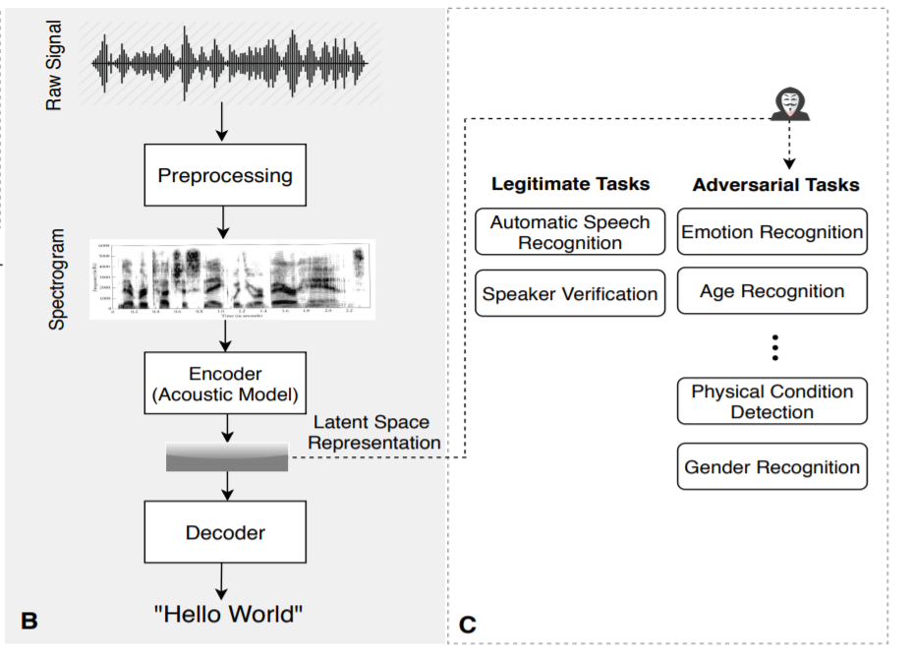
Deep Learning Latent Representations
(Aloufi et al., 2020, Figure 1)
APSS | DOMINIKA WOSZCZYK

Slide 4
Paper’s Contributions
Show inference attacks of emotion, identity and gender on commonly used acoustic models
Propose a privacy-aware framework with different levels of privacy. The framework is based on a quantized variational autoencoder model and disentanglement learning.
Evaluate their framework on 5 different datasets
APSS | DOMINIKA WOSZCZYK

Slide 5
Scenario and Threat Model
User shares voice recordings with cloud service providers to accomplish a certain task but do not wish to share additional attributes..
Attacker (service provider, surveillance agency, advertiser) wants to infer sensitive attributes to track the user, advertise to them or sell their data.
APSS | DOMINIKA WOSZCZYK

Slide 6
Research Questions
To what extent can an attacker infer sensitive attributes?
Can we build a effective defense?
APSS | DOMINIKA WOSZCZYK

Slide 7
Background : Disentanglement
Learning technique to separate representations
Computer vision: body pose or shape, face shape, make up
NLP: syntax and semantics
Speech : content, accent, prosody, emotion, language, environment
APSS | DOMINIKA WOSZCZYK

Slide 8
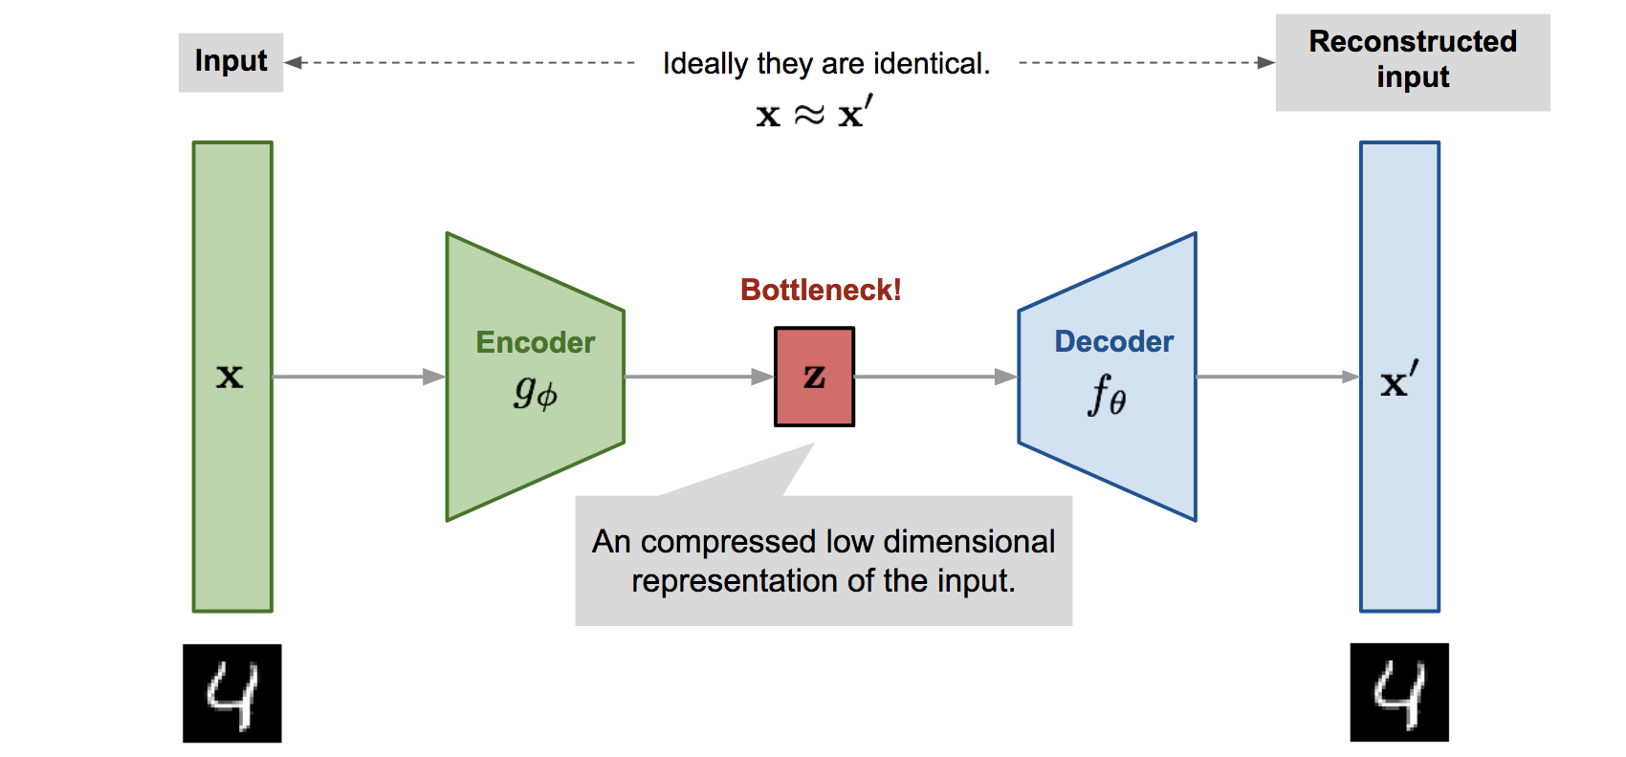
Background : Auto Encoder
https://lilianweng.github.io/lil-log/2018/08/12/from-autoencoder-to-beta-vae.html
APSS | DOMINIKA WOSZCZYK

Slide 9
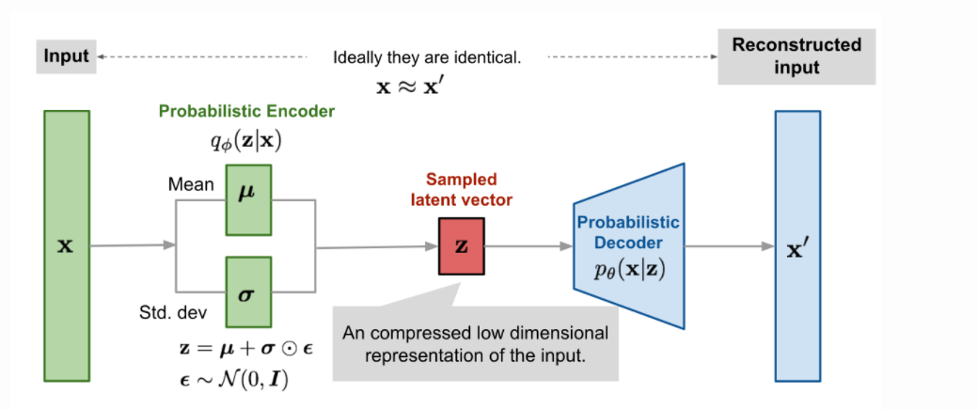
Background : Variational Auto Encoder
Introduces continuous latent space representations
Generative model
https://lilianweng.github.io/lil-log/2018/08/12/from-autoencoder-to-beta-vae.html
APSS | DOMINIKA WOSZCZYK

Slide 10
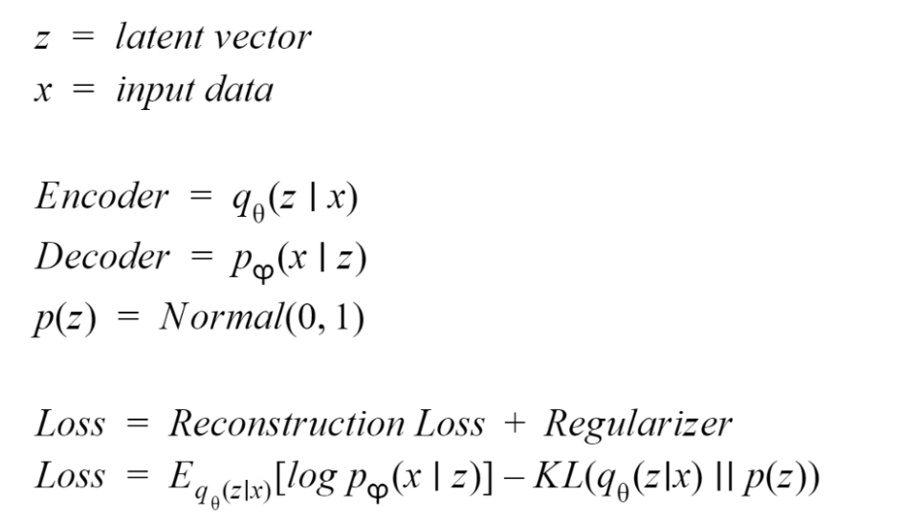
Background : Variational Autoencoder
https://medium.com/ai-deep-learning-tutorials/variational-autoencoders-an-intuitive-explanation-some-keras-code-bc0362bc8113
APSS | DOMINIKA WOSZCZYK

Slide 11
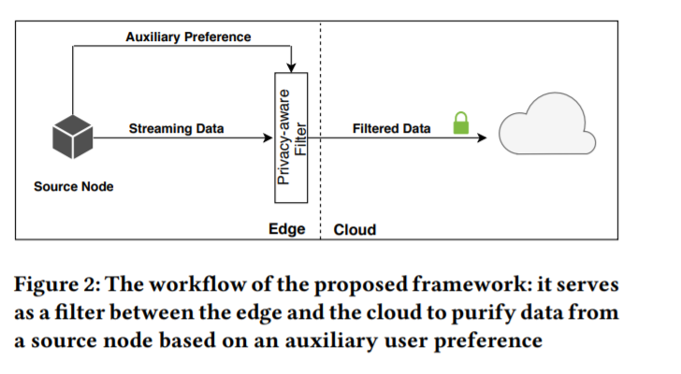
Framework
(Aloufi et al., 2020, Figure 2)
APSS | DOMINIKA WOSZCZYK

Slide 12
General Framework
Given user preference, map it into into n tasks
Models
For each task, build a specific encoder branch
Decoder: vocoder to concatenate features from each branch and reconstructs speech.
APSS | DOMINIKA WOSZCZYK

Slide 13
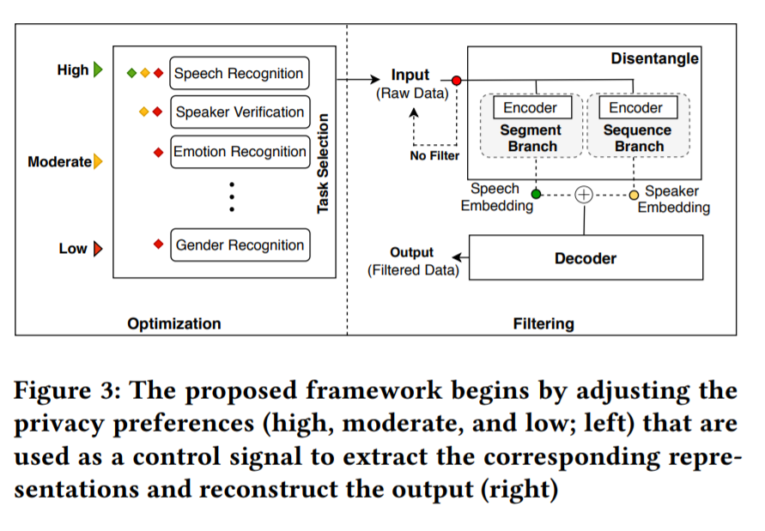
Proposed Framework
(Aloufi et al., 2020, Figure 3)
APSS | DOMINIKA WOSZCZYK

Slide 14

Proposed Framework: Disentanglement
Raw data
Speech Recognition
Speaker Identification
VQVAE
Thin Resnet-34
Content/ Speech embedding
Speaker embedding
Decoder: WaveRNN
Reconstructed speech
APSS | DOMINIKA WOSZCZYK

Slide 15
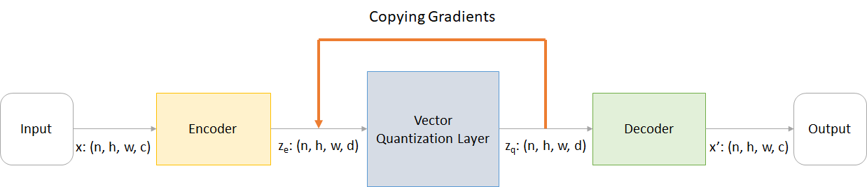
Speech Recognition Task: Vector Quantized Variational Autoencoder
Learns discrete latent representations by mapping the output of the encoder to the closest vector from a codebook of K vectors.
https://blog.usejournal.com/understanding-vector-quantized-variational-autoencoders-vq-vae-323d710a888a
APSS | DOMINIKA WOSZCZYK

Slide 16
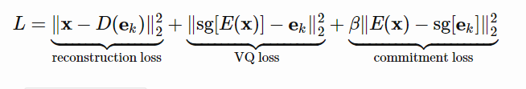
Speech Recognition Task: Vector Quantized Variational Autoencoder
Learns discrete latent representations by mapping the output of the encoder to the closest vector from a codebook of K code vectors.
VQ loss: The L2 error between the embedding space and the encoder outputs.
Commitment loss: A measure to encourage the encoder output to stay close to the embedding space and to prevent it from fluctuating too frequently from one code vector to another.
https://lilianweng.github.io/lil-log/2018/08/12/from-autoencoder-to-beta-vae.html
APSS | DOMINIKA WOSZCZYK

Slide 17
Speaker Verification Task: Thin Resnet-34
CNN model trained to learn speaker embeddings
Trained on Voxceleb, speaker identification task
APSS | DOMINIKA WOSZCZYK

Slide 18
Experiments
Attribute inference attack on representations extracted from pretrained acoustic models
Defense efficiency of the framework
APSS | DOMINIKA WOSZCZYK

Slide 19
Attributes Per Dataset
Emotion and gender: IEMOCAP (12h, 4 emotions), RAVDESS (1,440 recordings, 7 emotions)
Emotion: SAVEE (480 recordings, 7 emotions)
Gender: Librispeech (100 hours, audiobooks), VoxCeleb (1,251 celebrities, 1,200 recordings)
APSS | DOMINIKA WOSZCZYK

Slide 20
Experiment 1: Inference attacks
Extract representations from pre-trained wav2vec model and DeepSpeech2 as input features
Train Logistic regression, SVM, Random Forest, Multilayer perceptron to infer gender, emotion on both on all 5 datasets
APSS | DOMINIKA WOSZCZYK

Slide 21
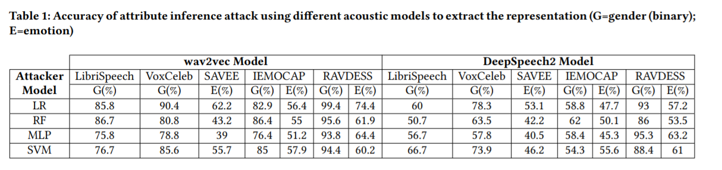
Results
(Aloufi et al., 2020, Table 1)
APSS | DOMINIKA WOSZCZYK

Slide 22
Experiment 2: Framework evaluation
Train the model branches and decoder for speech recognition and speaker identification, using Librispeech dataset
Evaluate inference accuracy on reconstructed speech
APSS | DOMINIKA WOSZCZYK

Slide 23
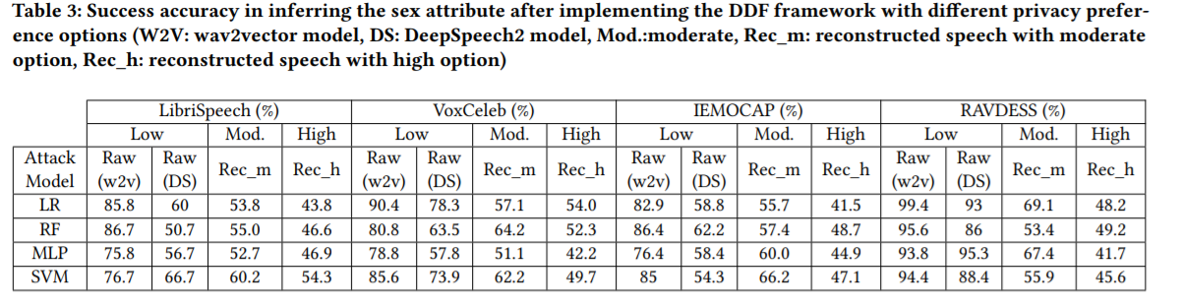
Results: Gender
(Aloufi et al., 2020, Table 3)
APSS | DOMINIKA WOSZCZYK

Slide 24
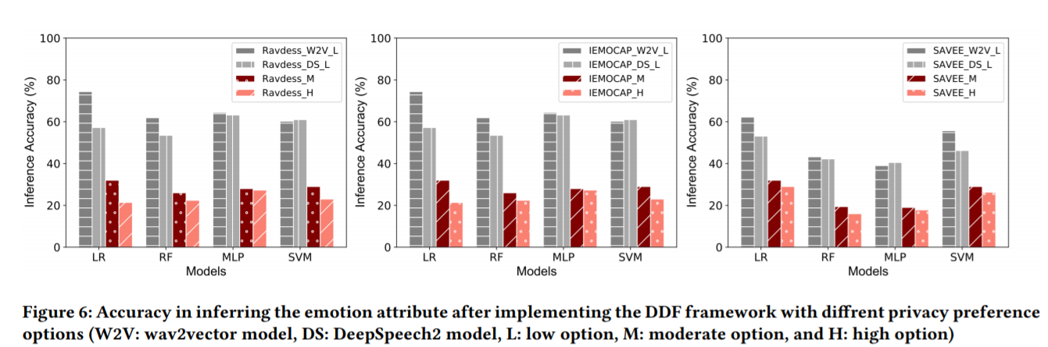
Results: Emotion
(Aloufi et al., 2020, Figure 6)
APSS | DOMINIKA WOSZCZYK

Slide 25
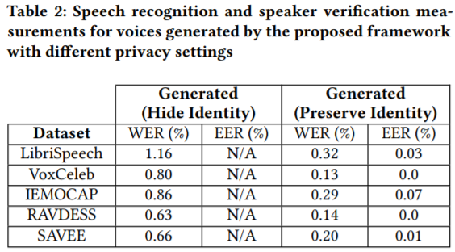
Results
(Aloufi et al., 2020, Table 2)
APSS | DOMINIKA WOSZCZYK

Slide 26

Examples
https://www.youtube.com/watch?v=hQAcK_Ynun0
APSS | DOMINIKA WOSZCZYK

Slide 27
Discussion
Shows plausibility of inference attacks for gender and emotion using models trained on other tasks
Low and medium reduces inference attacks to nearly random
Speech recognition performance suffers slightly
APSS | DOMINIKA WOSZCZYK

Slide 28
Limitations
Only acoustic features are considered
Requires a new model for each feature type
Does not evaluate their approach on other personal attributes (mental/physical abilities, age)
Quality of audio is altered
APSS | DOMINIKA WOSZCZYK

Slide 29
Related Work
Preech: A system for privacy-preserving speech transcription. S Ahmed, AR Chowdhury, K Fawaz, P Ramanathan - 29th USENIX Security …, 2020
Considers linguistic and acoustic feature.
Voice-Indistinguishability: Protecting Voiceprint In Privacy-Preserving Speech Data Release.Y. Han, S. Li, Y. Cao, Q. Ma and M. Yoshikawa -IEEE International Conference on Multimedia and Expo (ICME), London, United Kingdom, 2020.
Paralinguistic Privacy Protection at the Edge. Ranya Aloufi, Hamed Haddadi, David Boyle
Extension for edge
APSS | DOMINIKA WOSZCZYK

