Slide 1
Monday 10/05/2021
The Audio Auditor: User-Level Membership Inference in Internet of Things Voice Services
Yuantian Miao, Minhui Xue, Chao Chen, Lei Pan, Jun Zhang, Benjamin Zi Hao Zhao, Dali Kaafar, Yang Xiang
PETS 2021
APSS | DOMINIKA WOSZCZYK

Slide 2
Contents
User membership Inference
Audio Auditor
Efficacity, Efficiency, Transferability and robustness of attack
Discussion

Slide 3
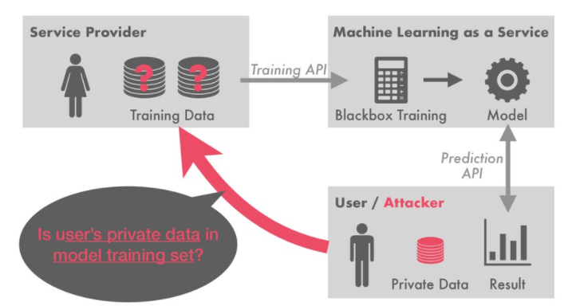
Record-level Membership inference
https://speakerdeck.com/sorami/acl2020-membership-inference-attacks-on-sequence-to-sequence-models-is-my-data-in-your-machine-translation-system?slide=13
APSS | DOMINIKA WOSZCZYK

Slide 4
Record-level Membership inference
Single record
Check if that specific record is in the training set
Works best for tabular data
APSS | DOMINIKA WOSZCZYK

Slide 5
User-level Membership inference
Multiple records per user
Check if any sample of user was part of training set
Speech recording, photos, texts...
APSS | DOMINIKA WOSZCZYK

Slide 6
Paper in a Nutshell
Proposed approach allow user to see if their data was used for the training of a voice assistant
Perform user membership inference on black box ASR systems
Build shadow models and auditor based on transcriptions and audio features
Demonstrate attack on Apple’s Siri
APSS | DOMINIKA WOSZCZYK

Slide 7
Previous work: Membership Inference Attacks Against Machine Learning Models
Paper trains shadows models on generated data labelled by target model to perform membership inference on blackbox models
Uses output probability
Shows that overfitting leads to data leakage
Most effective mitigation strategy is regularization
APSS | DOMINIKA WOSZCZYK

Slide 8
Threat model
Model trained on private data can be released and leak training samples
Commercial models trained on large training sets
Voice cloning
Some manufacturers might not respect privacy policies
Assumptions:
Black box models
Access to transcription only
Auditor queries black box models to identify membership of user in training set
APSS | DOMINIKA WOSZCZYK

Slide 9
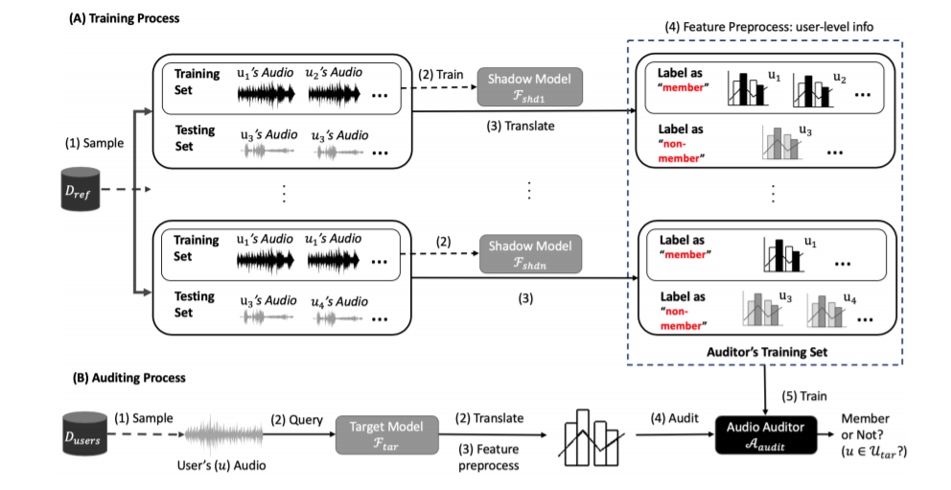
Attack
Figure 1
APSS | DOMINIKA WOSZCZYK

Slide 10
Methodology
Training phase
Train ASR shadow models
Auditor phase
Generate transcriptions with shadow model
Extract features
Train an auditor on the extracted features
APSS | DOMINIKA WOSZCZYK

Slide 11
Features
Extract speaker speed and frame length
Source transcription to compare with target transcription
Cosine similarity between transcription_src and transcription_target
Missing characters and insertions
Compute mean, std, median, max, min and variance per user
APSS | DOMINIKA WOSZCZYK

Slide 12
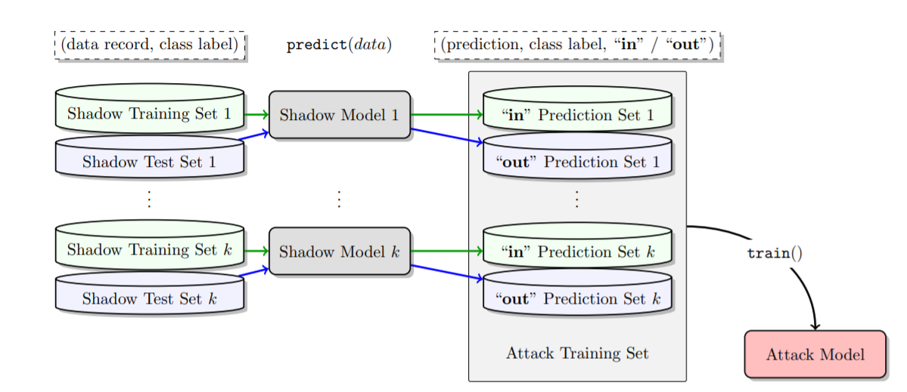
Phase 1: Shadow models
Train model with similar architectures as target model
Shadow model
Outputs transcription
Figure 1
APSS | DOMINIKA WOSZCZYK

Slide 13
Phase 2: Attacker model
Attacker takes transcription and extract features
Training set labelled as IN
Test set labeled as OUT
One attacker model
APSS | DOMINIKA WOSZCZYK

Slide 14
Experiments
RQ1: How performant is the auditor and how does it perform with different size of training sets?
RQ2: How many queries are necessary?
RQ3: Transferability across datasets
RQ4: Robustness to different blackbox models
Real-world implementation

Slide 15
Experiments setup
Split shadow sets for IN and OUT samples
Train ASR target model
Train ASR shadow model
Train auditor on shadow training set
Evaluate attacker model (Accuracy, Precision and Recall)
APSS | DOMINIKA WOSZCZYK

Slide 16
Experiments setup
Assumptions:
Target ASR and Shadow ASR have same pipeline (Hybrid ASR)
Target ASR: LSTM
Shadow ASR: GRU
Auditor model is a random forest
Train Target ASR and shadow ASR on Librispeech
APSS | DOMINIKA WOSZCZYK

Slide 17
RQ1: Auditor Performance (wr training size)
APSS | DOMINIKA WOSZCZYK

Slide 18
Experiment
Build a shadow set using N users.
Examine extreme cases:
Auditor’s testing set only contains member users querying with the unseen audios
Auditor’s testing set that only contains member users querying with the seen audios
Experiment with number of samples per user in the shadow set
APSS | DOMINIKA WOSZCZYK

Slide 19
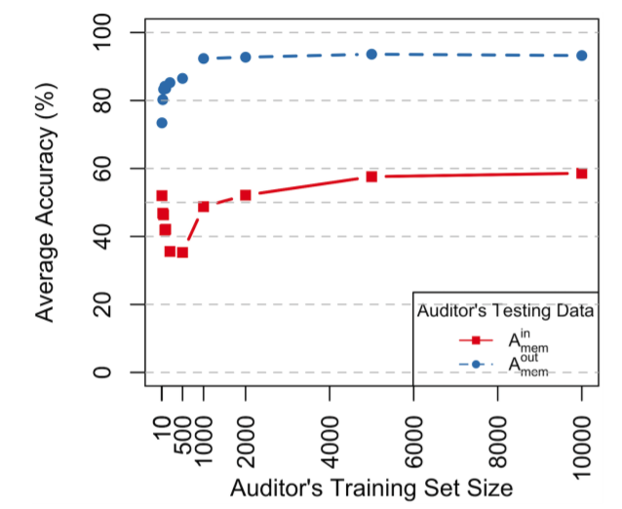
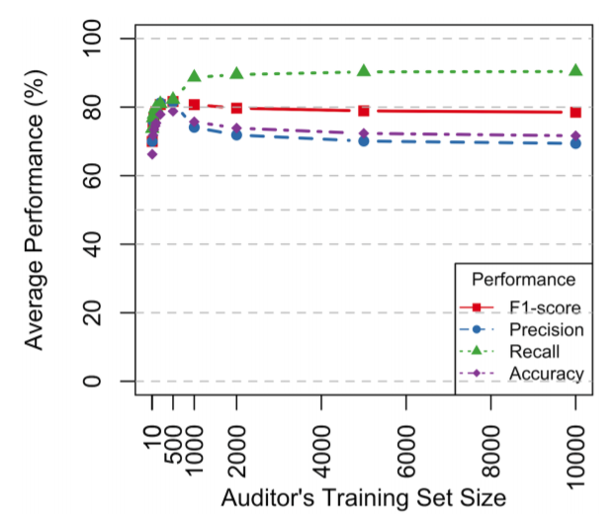
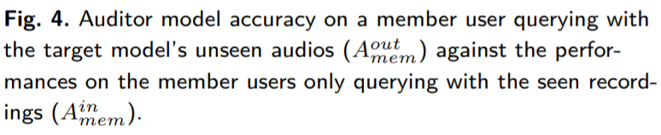
Average performance and extremes cases
APSS | DOMINIKA WOSZCZYK

Slide 20
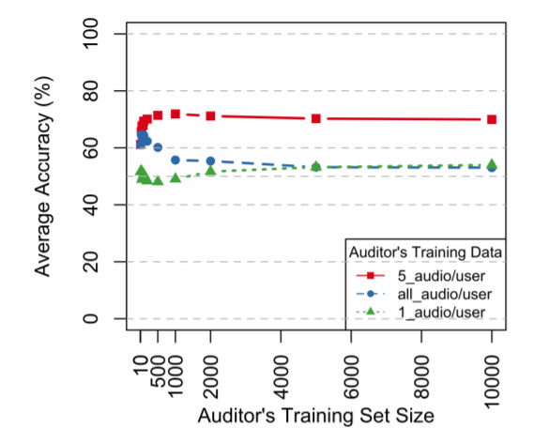
Impact of samples size per user
Fig.6. A comparison of average accuracy for one audio, five audios, and all audios per user when training the auditor model with a limited number of audios per user gained in the auditing phase.
APSS | DOMINIKA WOSZCZYK

Slide 21
Impact of number of users
The auditor performs best on samples seen during the target ASR training
Larger training size lower the precision
The performance peak around 5000 users
When training the auditor, 5 samples per users is optimal
APSS | DOMINIKA WOSZCZYK

Slide 22
RQ2: Number of queries
APSS | DOMINIKA WOSZCZYK

Slide 23
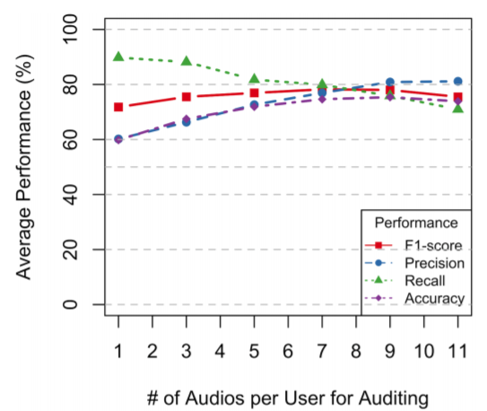
Query size
Fig.7. A varying number of audios used for each speaker when querying an auditor model trained with 5 audios per user
APSS | DOMINIKA WOSZCZYK

Slide 24
Query size
More queries results in a better precision
Recall and accuracy drops after a certain threshold
Model is “cautious”
9 queries seems to be the optimal spot
APSS | DOMINIKA WOSZCZYK

Slide 25
RQ3: Transferability
APSS | DOMINIKA WOSZCZYK

Slide 26
Different datasets distributions from black box
Train Target ASR on different datasets:
Librispeech (100 hours clean + 500h noisy)
Recordings of audiobooks
TIMIT (6,300 samples)
Telephone conversations
TED-LIUM (118 hours)
TED Talks recordings
Auditor is trained on Librispeech
APSS | DOMINIKA WOSZCZYK

Slide 27
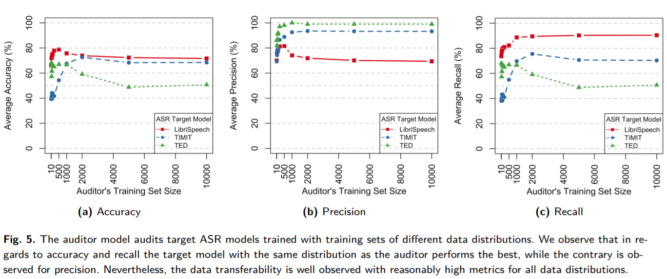
Different ASR training sets
APSS | DOMINIKA WOSZCZYK

Slide 28
Different ASR training sets
Training shadow ASR on the same dataset performs the best
Low precision: tends to classify non members as members
Auditor performs well even when trained with different datasets
APSS | DOMINIKA WOSZCZYK

Slide 29
Noisy queries
Train two target LSTM-HMM ASR
Trained with clean audios
Trained with noisy audios
Train shadows models and create sets for noisy and clean audios
Train Shadow Hybrid models with different DNN models
LSTM
GRU
RNN
APSS | DOMINIKA WOSZCZYK

Slide 30
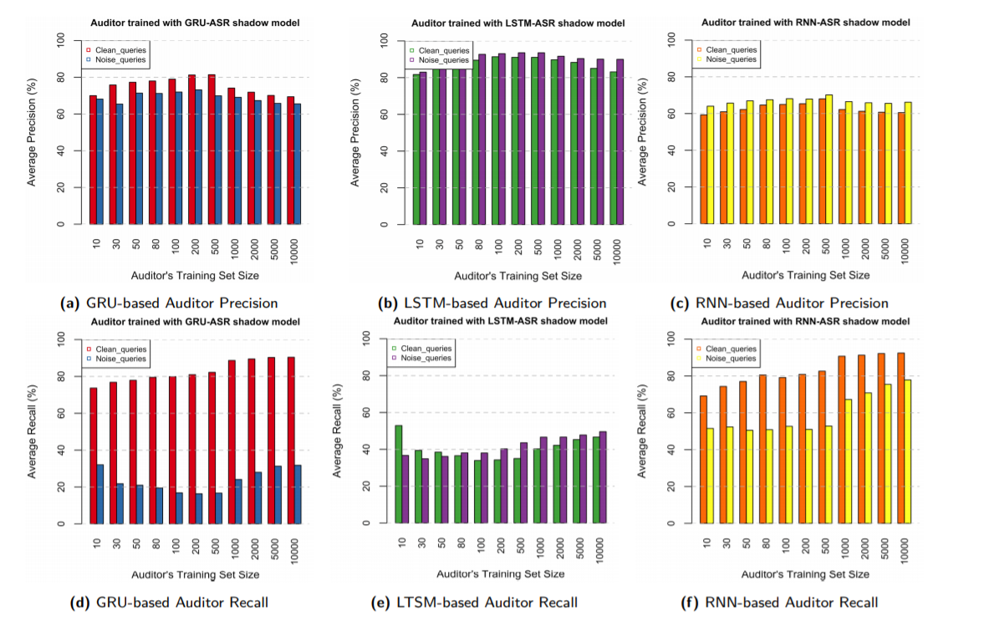

Slide 31
Noisy queries
Noisy training sets negatively impact the auditor’s recall
The auditor model is less impacted by noise when built with the same architecture as target asr
APSS | DOMINIKA WOSZCZYK

Slide 32
RQ4: Robustness to different blackbox models
APSS | DOMINIKA WOSZCZYK

Slide 33
Different target ASR architectures
Train Shadow Hybrid models with different models
LSTM
GRU
RNN
Combine multiple Shadow ASR
APSS | DOMINIKA WOSZCZYK

Slide 34
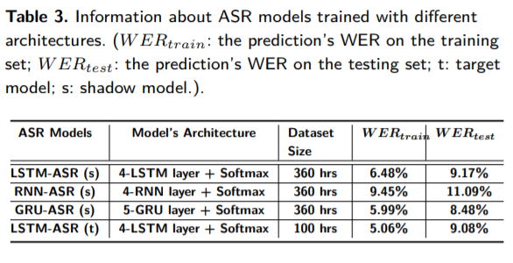
Different ASR Shadow architectures
APSS | DOMINIKA WOSZCZYK

Slide 35
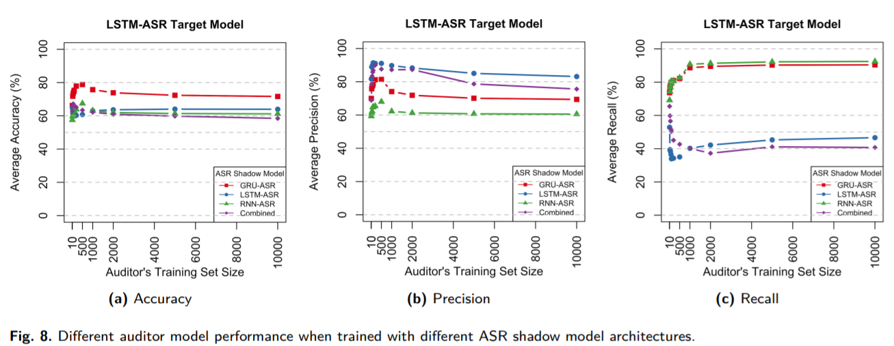
Different ASR Shadow architectures
APSS | DOMINIKA WOSZCZYK

Slide 36
Different target ASR pipeline
Evaluate Hybrid Shadow ASR and Auditor with different target ASR pipeline
Hybrid DNN-HMM
End-to-End
APSS | DOMINIKA WOSZCZYK

Slide 37
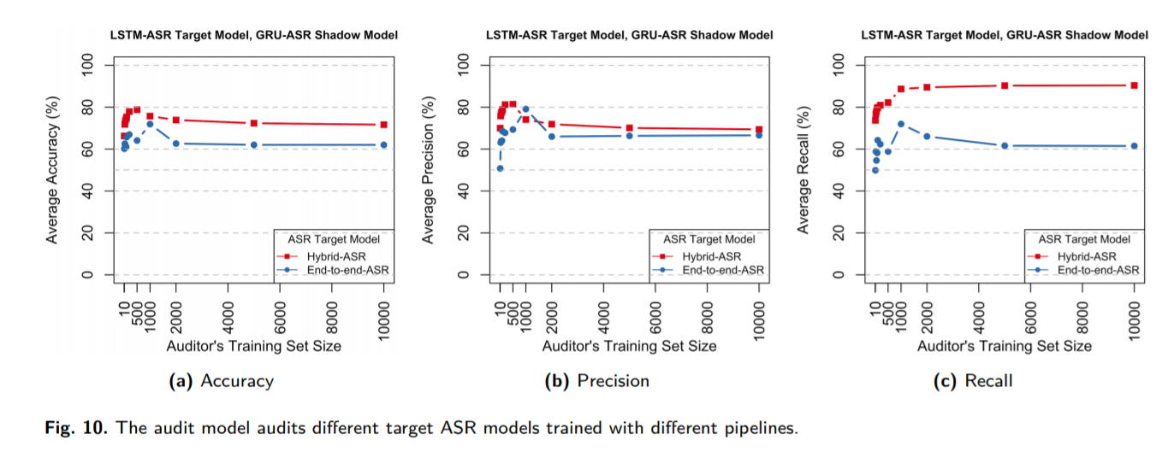
Different ASR pipelines
APSS | DOMINIKA WOSZCZYK

Slide 38
Different ASR pipelines
Overfitting = WER_{train}− WER_{test}
Target ASR Model | Overfitting value
Hybrid | 0.04
End-to-end | 0.14
APSS | DOMINIKA WOSZCZYK

Slide 39
Robustness to blackbox models
Differences in ASR pipelines between the target model and the shadow model negatively impact the performance of the auditor.
Different architectures still perform above random
Overfitting is not an indication of higher leakage
APSS | DOMINIKA WOSZCZYK

Slide 40
Real-world evaluation: SIRI
APSS | DOMINIKA WOSZCZYK

Slide 41
Set up
Shadow ASR: GRU shadow trained on Librispeech
Sample 5 samples per user with 1000 users
Samples played via bluetooth speaker
Samples:
Member: Iphone owner
Non-members: 52 speakers from Librispeech
6 members samples, 52 non member samples
APSS | DOMINIKA WOSZCZYK

Slide 42
Results
Overall accuracy is 89.76%
Member precision: 58.45%
Non-member precision: 92.61%
Precision for seen member samples: 100%
APSS | DOMINIKA WOSZCZYK

Slide 43
Discussion
The auditor performs best on seen audios
Training size impact the performance - sweet spot
Auditor is relatively robust to different datasets and architectures
Noisy training has a negative impact on the auditor’s performance
Previous mitigations strategies do not apply here
Overfitting is less indicative of the auditor’s performance
APSS | DOMINIKA WOSZCZYK

Slide 44
Mitigations
Voice conversion
Differential Privacy
Regularization might not be very effective here
APSS | DOMINIKA WOSZCZYK

Slide 45
Limitations
Performance relies on audio features
More feature exploration needed
Some doubts about ground truth for Siri evaluation
Limited testing on blackbox models
Few mitigations strategies are discussed
APSS | DOMINIKA WOSZCZYK

Slide 46
Conclusion
Work present a user-level membership inference attack on black box voice services
Approach it as a ‘tool’ to detect privacy violations
Show robustness to different environment, data distribution and model architectures
Successfully demonstrate the feasibility of the attack on a real-world bloack box model
APSS | DOMINIKA WOSZCZYK

Slide 47
Related Work
Sound masking
Exploiting Sound Masking for Audio Privacy in Smartphones, Tung, Yu-Chih, and Kang G. Shin., Asia CCS '19
Patronus: preventing unauthorized speech recordings with support for selective unscrambling, Li, Lingkun, et al., SenSys '20
Microphone Jamming:
"Alexa, stop spying on me!": speech privacy protection against voice assistants, Sun, Ke, Chen Chen, and Xinyu Zhang., Sensys 20’
APSS | DOMINIKA WOSZCZYK

Slide 48
Thank you!
APSS | DOMINIKA WOSZCZYK

