Slide 1
Monday 22/01/2021
Semi-supervised Knowledge Transfer for Deep Learning from Private Training Data
Nicolas Papernot, Martín Abadi, Úlfar Erlingsson, Ian Goodfellow, Kunal Talwar
ICLR 2017
APSS | DOMINIKA WOSZCZYK

Slide 2
Contents
Machine Learning & Differential Privacy
What is PATE?
Threat model
Framework
Experiments and Results
Refined PATE

Slide 3
Machine Learning & Privacy
ML models can retain information (overlearning) and some memorise training data.
e.g Model Inversion Attacks that Exploit Confidence Information and Basic Countermeasures(Fredrikson, Matt et al., 2015 )
Threats:
Model querying (blackbox)
Model inspection (white box)
APSS | DOMINIKA WOSZCZYK

Slide 4
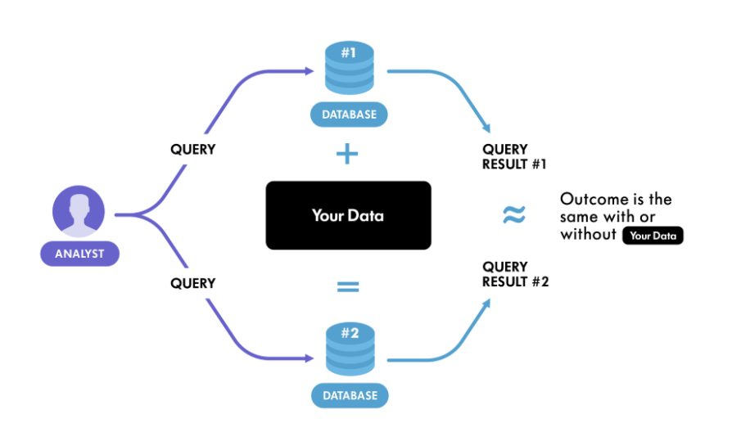
Differential Privacy
Differential Privacy
same inference from query, whether an individual was included in the input data or not.
https://www.winton.com/research/using-differential-privacy-to-protect-personal-data
APSS | DOMINIKA WOSZCZYK

Slide 5
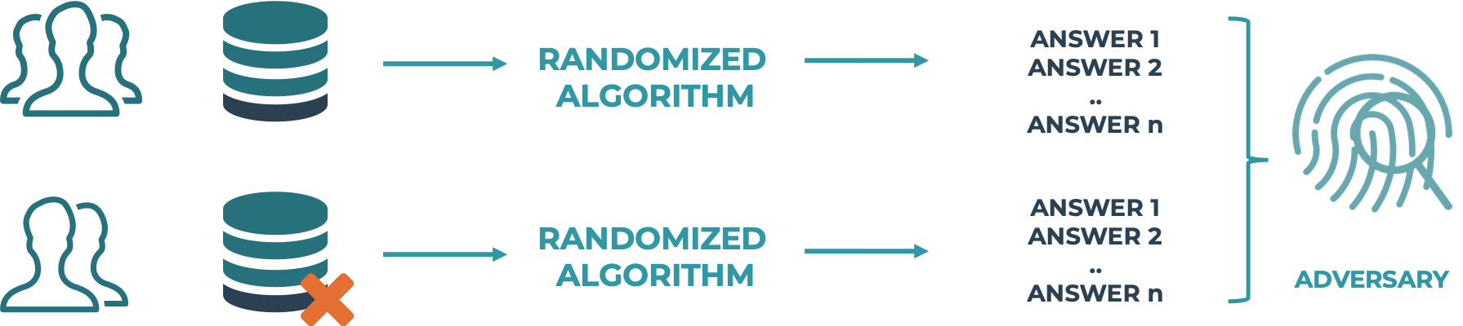
Differential Privacy in Machine Learning
https://2021.ai/machine-learning-differential-privacy-overview/
APSS | DOMINIKA WOSZCZYK

Slide 6
Differential Privacy
Definition 1: A randomized mechanism M with domain D and range R satisfies(ε,δ)-differential privacy if for any two adjacent inputs d, d’∈ D and for any subset of outputs S ⊆ R it holds that:
Pr[M(d) ∈ S] ≤ e^{ε} Pr[M(d’) ∈ S] + δ.
Smaller ε, stronger privacy guarantee and more noise.
δ is the tolerance bias.
APSS | DOMINIKA WOSZCZYK

Slide 7

Privacy Loss
Definition 2: . Let M: D → R be a randomized mechanism and d, d’ a pair of adjacent databases. Let aux denote an auxiliary input. For an outcome o ∈ R, the privacy loss at o is defined as:
APSS | DOMINIKA WOSZCZYK

Slide 8

Moments Accountant
Procedure that computes the privacy cost at each access to the training data, and accumulates this cost as the training progress
At each step, we use the aggregation mechanism with noise
Thus over T steps, we get
APSS | DOMINIKA WOSZCZYK

Slide 9
PATE
APSS | DOMINIKA WOSZCZYK

Slide 10
Paper in a Nutshell
Private Aggregation of Teacher Ensembles - PATE
Disjoint training sets and classifiers
Noisy aggregation
Semi supervised learning with PATE-G: teacher-student training of modified GAN model
APSS | DOMINIKA WOSZCZYK

Slide 11
Threat model
Trust ML service
Do no trust user
Adversaries:
Has access to model parameters
Unlimited number of queries
APSS | DOMINIKA WOSZCZYK

Slide 12
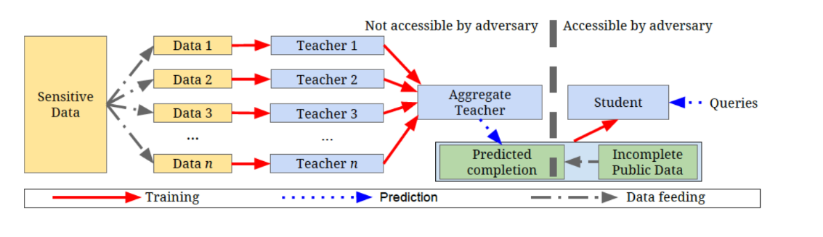
PATE
APSS | DOMINIKA WOSZCZYK

Slide 13
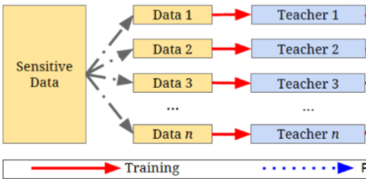
Teacher Ensemble
Divide dataset into n subsets
For each subsets, train a separate instance of a model (teacher)
At inference time, each teacher outputs its prediction
Count votes for each label, the one with the most counts is the predicted class
Users have access to predictions only (blackbox teachers models)
APSS | DOMINIKA WOSZCZYK

Slide 14

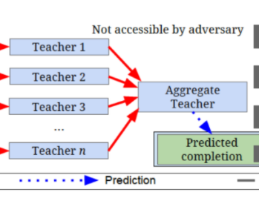

Aggregation Algorithm
Count prediction for class j from each teacher given input
Add Laplacian noise to each vote count n_{j ,} γ being privacy parameter
Return the prediction with the most votes
APSS | DOMINIKA WOSZCZYK

Slide 15
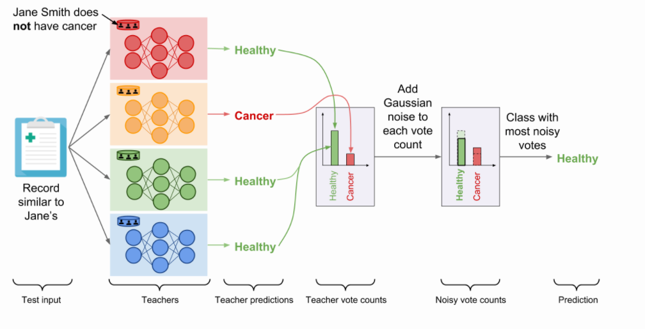
http://www.cleverhans.io/privacy/2018/04/29/privacy-and-machine-learning.html
APSS | DOMINIKA WOSZCZYK

Slide 16
Privacy guarantee?
Each query from the adversary increase the privacy costs
Teachers’ parameters could be discovered and consequently reveal the data they were trained
APSS | DOMINIKA WOSZCZYK

Slide 17
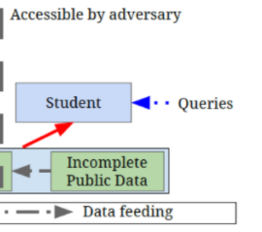
Student Model
Student model trained on data partly labeled by teacher ensemble
Available to users
Data must be non sensitive
Privacy loss is fixed to the number of queries allowed to the student model
Privacy loss does not grow with number of queries to the student model
APSS | DOMINIKA WOSZCZYK

Slide 18
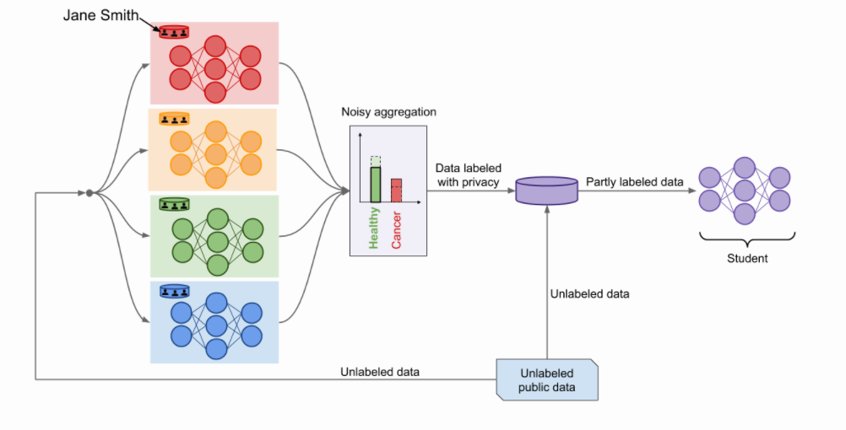
APSS | DOMINIKA WOSZCZYK

Slide 19
Experiments
Student model: PATE-G
Number of teachers
Privacy cost
Utility (Accuracy)
Experiments on MNIST and SVHN

Slide 20
PATE-G
APSS | DOMINIKA WOSZCZYK

Slide 21
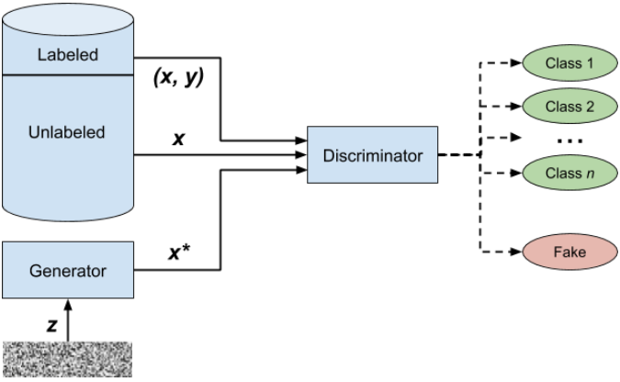
Student Model: Semi-supervised GAN
https://livebook.manning.com/book/gans-in-action/chapter-7/v-6/1
APSS | DOMINIKA WOSZCZYK

Slide 22
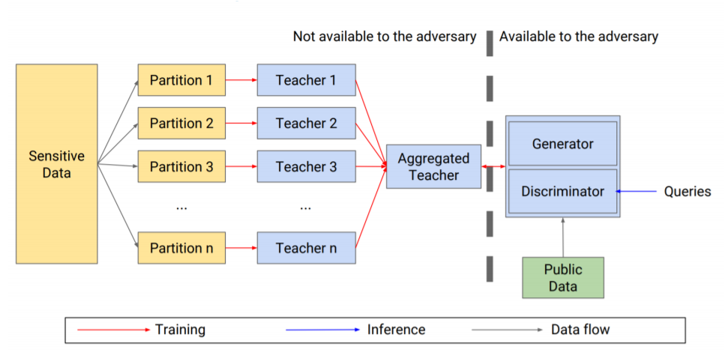
APSS | DOMINIKA WOSZCZYK

Slide 23
Experiments
APSS | DOMINIKA WOSZCZYK

Slide 24
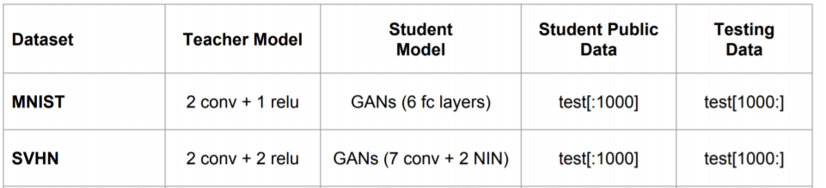
Experiment setup
APSS | DOMINIKA WOSZCZYK

Slide 25
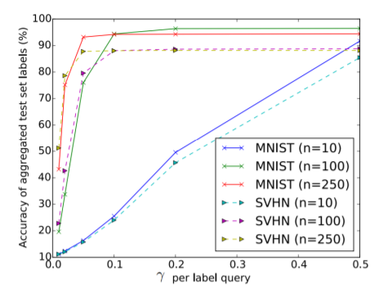
Accuracy per noise amplitude
APSS | DOMINIKA WOSZCZYK

Slide 26
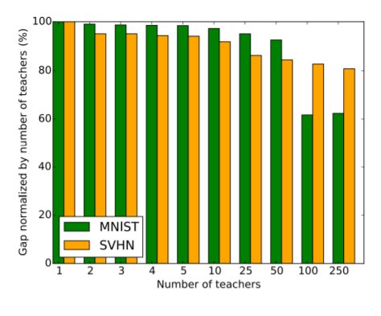
Number of teachers and privacy
APSS | DOMINIKA WOSZCZYK

Slide 27
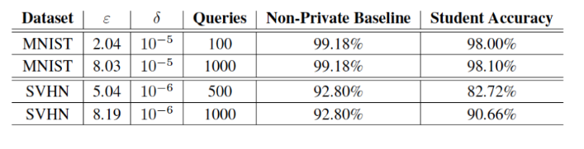
Results
APSS | DOMINIKA WOSZCZYK

Slide 28
Discussion
Requires ~250 of teacher models and data subsets for SVHN and MNIST
Number of teachers are a parameter to optimise for each dataset
Impact on accuracy is relatively low
APSS | DOMINIKA WOSZCZYK

Slide 29
Limitations
Evaluated only on MNIST and SVHN tasks (relatively simple )
Require many teachers as number of output classes and complexity of models increases
Datasets must have private and public sets available
APSS | DOMINIKA WOSZCZYK

Slide 30
Scalable Private Learning with PATE (2018)
Refined aggregation algorithm: Confident Aggregator
Smaller privacy loss
Better predictions performance
APSS | DOMINIKA WOSZCZYK

Slide 31
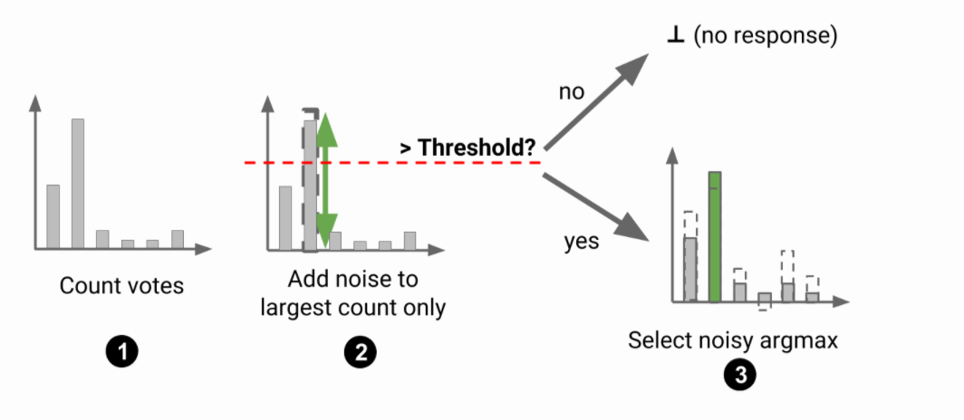
Confident Aggregator
APSS | DOMINIKA WOSZCZYK

Slide 32
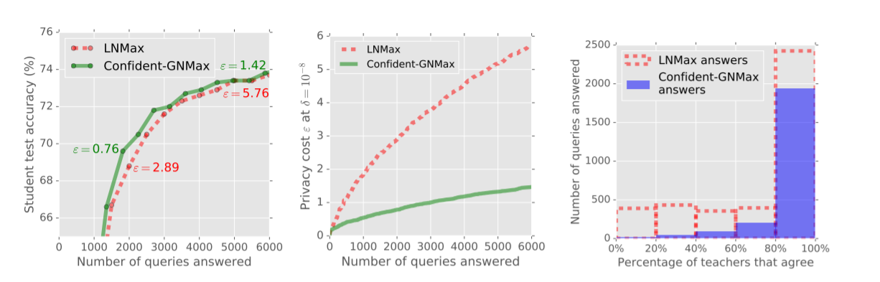
Scalable Private Learning with PATE (2018)
APSS | DOMINIKA WOSZCZYK

Slide 33
Conclusion
PATE is a general framework for privacy preserving machine learning training using a black box training strategy on sensitive data and noisy aggregation that provides differential privacy guarantee
Compared to previous work, make no assumption about models, parameters or student model. Student model is free and can only access top k votes.
PATE acts as a regularizer and can improve generability
Requires large datasets with private and public data available
APSS | DOMINIKA WOSZCZYK

Slide 34
Related Work
Differentially private stochastic gradient descent
Deep Learning with Differential Privacy (Abadi et al., 2016) [here]
Federated Learning
Federated Machine Learning: Concept and Applications (Yang, Qiang, et al, 2019) [here]
APSS | DOMINIKA WOSZCZYK

