Slide 1
Monday 22/03/2021
Membership Inference Attacks Against Machine Learning Models
Reza Shokri , Marco Stronati, Congzheng Song, Vitaly Shmatikov
S&P 2017
APSS | DOMINIKA WOSZCZYK

Slide 2
Contents
Membership Inference
Threat model
Proposed Attack
Experiments and Results
Discussion

Slide 3
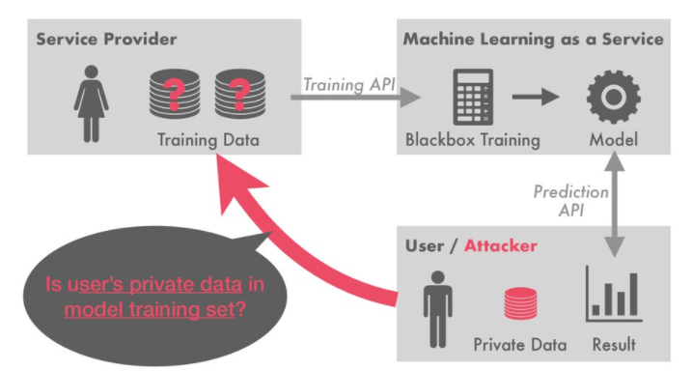
Membership inference
https://speakerdeck.com/sorami/acl2020-membership-inference-attacks-on-sequence-to-sequence-models-is-my-data-in-your-machine-translation-system?slide=13
APSS | DOMINIKA WOSZCZYK

Slide 4
Membership Inference: Consequences
Confidential records and their labels can be identified
Medical records( disease, past procedures, mental illness, ...)
Financial records
APSS | DOMINIKA WOSZCZYK

Slide 5
Paper in a Nutshell
Show that you can infer training data of machine learning models (even blackbox!)
Propose attack using shadow models trained on synthesized dataset using target model as an oracle
Proposed approach can be used to quantify leakage from a specific model
APSS | DOMINIKA WOSZCZYK

Slide 6
Threat model
Model trained on private data can be released and leak training samples
Commercial models trained on large training sets
Tailored models
Some datasets are sensitive
APSS | DOMINIKA WOSZCZYK

Slide 7
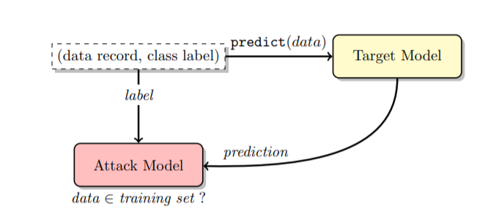
Proposed Attack
Figure 1
APSS | DOMINIKA WOSZCZYK

Slide 8
Attack
Generate data points that maximise target mode prediction confidence
Train shadow models on generated dataset
Given shadow models prediction output, create attack training dataset
Train attacker model on shadow dataset
APSS | DOMINIKA WOSZCZYK

Slide 9
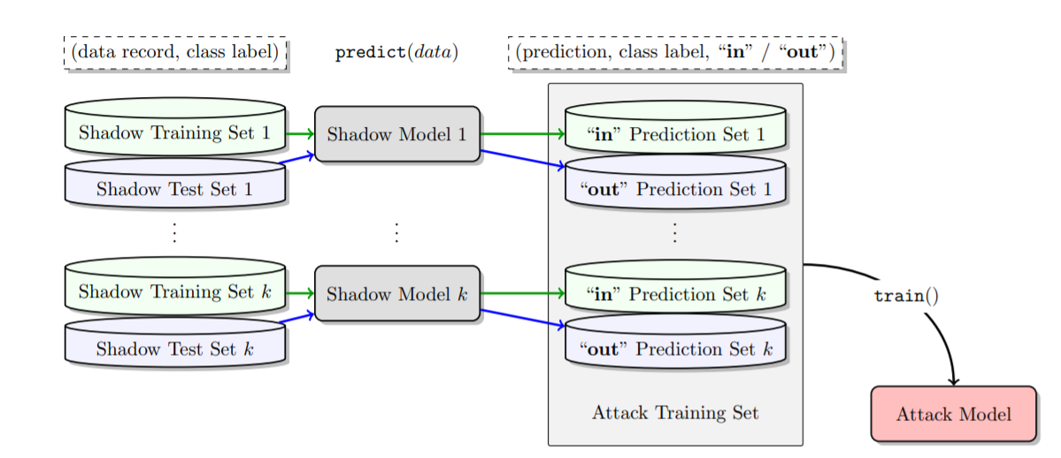
Attack
Figure 1
APSS | DOMINIKA WOSZCZYK

Slide 10
Shadow model dataset generation
Synthetic data
Generate synthetic data that is classified with high accuracy by target model (through queries)
Hill climbing
Doesn’t work on all type of inputs (high resolution pictures)
2. Noisy data
Replace some values with random values from original dataset
3. Statistic based:
Sample from marginal distribution over features
APSS | DOMINIKA WOSZCZYK

Slide 11
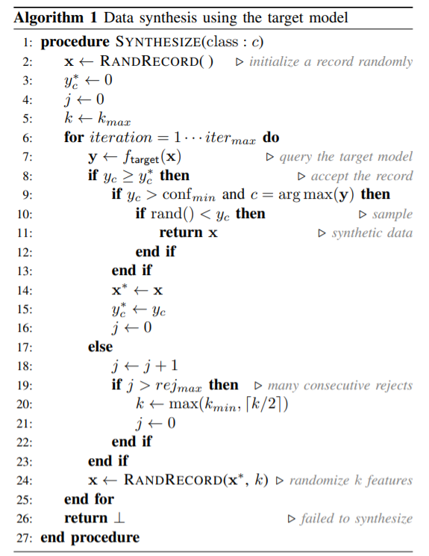

Slide 12
Phase 1: Shadow models
Train model with similar architectures as target model
Shadow model
Outputs probability and class
Figure 1
APSS | DOMINIKA WOSZCZYK

Slide 13
Phase 2: Attacker model
Attacker takes shadow models prediction probabilities over the classes
Training set labelled as IN
Test set labeled as OUT
For each class, train an attacker model
APSS | DOMINIKA WOSZCZYK

Slide 14
Experiments
Attack precision
Training set size
Number of classes
Different data sampling

Slide 15
Experiment setup
Split shadow sets for IN and OUT samples
Train cloud-based models
Train shadow models
Evaluate attacker model
APSS | DOMINIKA WOSZCZYK

Slide 16
Datasets and Tasks
CIFAR10 & CIFAR 100: image recognition
Purchases: Predict the purchase style (2, 10, 20, 50, 100 classes)
Locations: Predict the user’s geosocial type given their record (30 classes)
Texas hospital stays: Classify patient procedure (100 classes)
MNIST: handwritten digits recognition (10 classes)
UCI Adult: Census data for binary income classification using age, gender, education, marital status, occupation, working hours, native country.
APSS | DOMINIKA WOSZCZYK

Slide 17
Target models
Blackbox
Target:
Google Prediction API
Amazon ML :
Model with 10 max passes and L2 = 1e-6
Model with 100 max passes and L2 = 1e-4
Local: NN, CNN
Shadows :
NN
CNN
APSS | DOMINIKA WOSZCZYK

Slide 18
Training
Split dataset between target models and shadow models
Shadow models datasets can overlap
10 000 samples for all sets expect for Locations with 1,200 samples
Shadow models count:
CIFAR: 100
Purchase: 20
Texas hospital: 10
Location: 60
MNIST: 50
Census: 20
APSS | DOMINIKA WOSZCZYK

Slide 19
Results
APSS | DOMINIKA WOSZCZYK

Slide 20
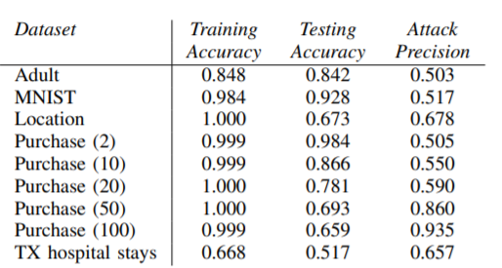
Attack Precision (Google)
APSS | DOMINIKA WOSZCZYK

Slide 21
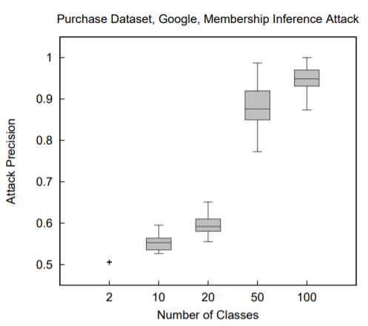
Number of classes (Google)
APSS | DOMINIKA WOSZCZYK

Slide 22
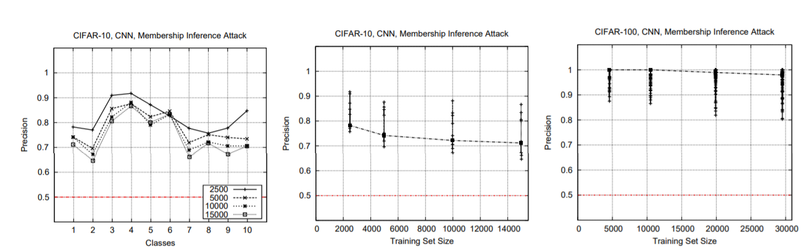
Effect of classes & training set size on CIFAR (Local)
APSS | DOMINIKA WOSZCZYK

Slide 23
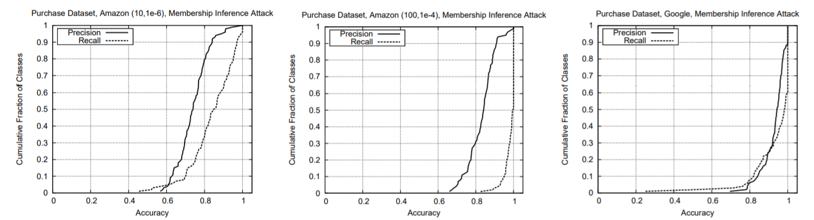
Precision and Recall over classes
Purchase dataset (30 classes)
APSS | DOMINIKA WOSZCZYK

Slide 24
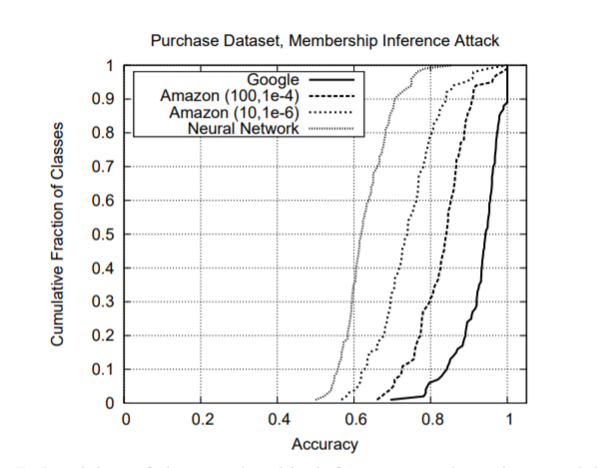
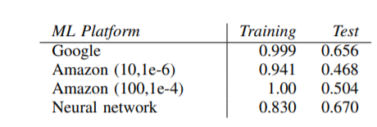
Results on Purchase dataset (30 classes)
APSS | DOMINIKA WOSZCZYK

Slide 25
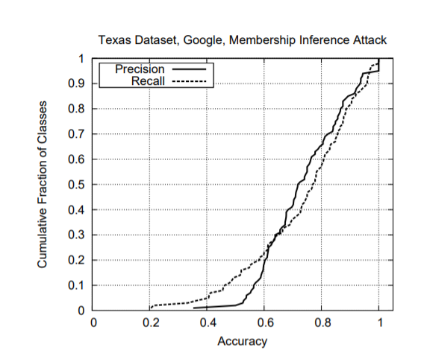
Results on Texas Hospital dataset (100 classes)
Training accuracy: 0.66
Test accuracy: 0.51
APSS | DOMINIKA WOSZCZYK

Slide 26
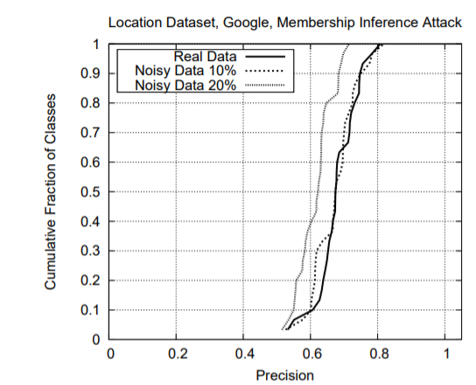
Noisy data
Location dataset
Precision of the attack over all classes is 0.678 (real data),
0.666 (data with 10% noise), and 0.613 (data with 20% noise).
The corresponding recall of the attack is 0.98, 0.99, and 1.00, respectively
The training accuracy of the target model is 1 and its test accuracy is 0.66.
APSS | DOMINIKA WOSZCZYK

Slide 27
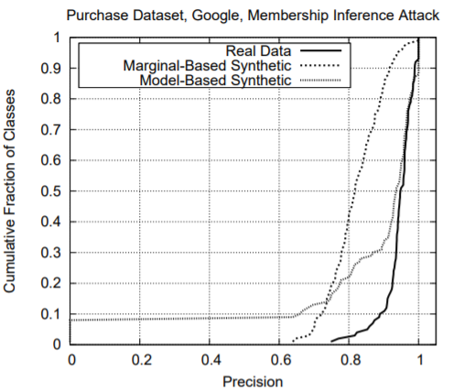
Marginal data
Precision of the attack over all classes is 0.935 (real data)
0.795 (marginal-based synthetic data)
0.896 (model-based synthetic data).
The corresponding recall of the attack is 0.994, 0.991, and 0.526, respectively.
APSS | DOMINIKA WOSZCZYK

Slide 28
Why?
Exploit the overfitting
Model outputs probability with high confidence on training data than on test set
APSS | DOMINIKA WOSZCZYK

Slide 29
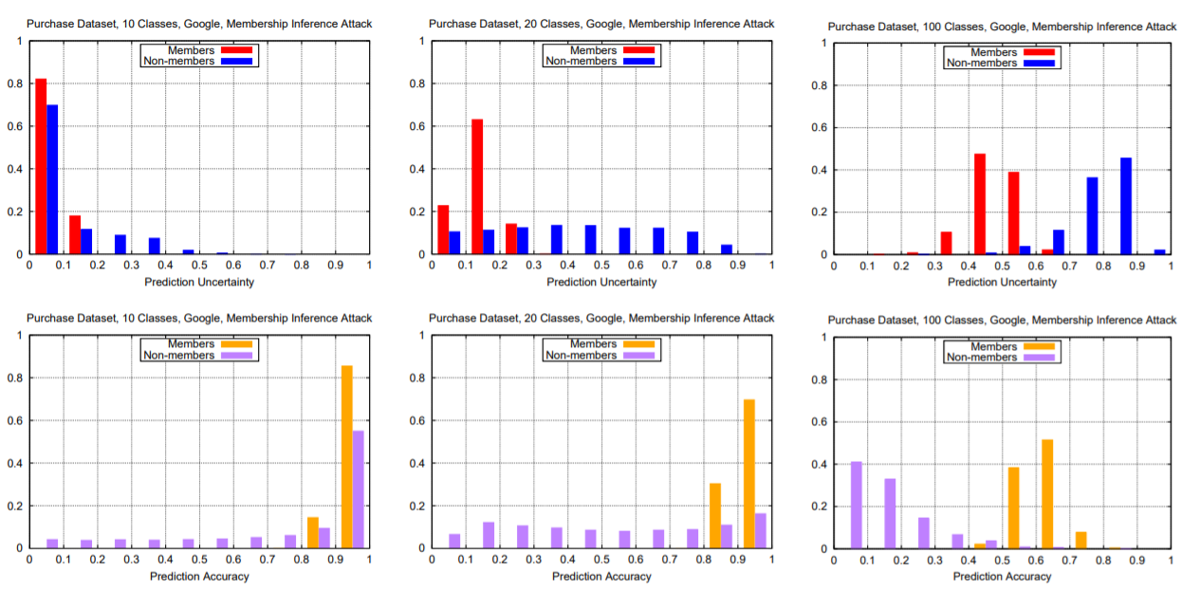
Results
APSS | DOMINIKA WOSZCZYK

Slide 30
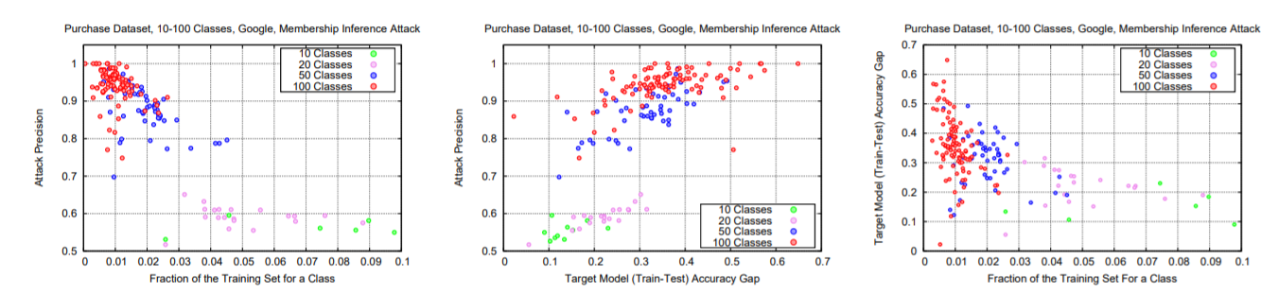
Overfitting
APSS | DOMINIKA WOSZCZYK

Slide 31
Discussion
Higher number of classes increases the attack accuracy
The attack accuracy is reduced
for classes with less samples
For larger training sets
Overfitting is the main cause of attack success
Other use cases:
License breach
Dataset for challenges
APSS | DOMINIKA WOSZCZYK

Slide 32
Mitigation
APSS | DOMINIKA WOSZCZYK

Slide 33
Mitigation Strategies
Return only top k classes probabilities
Round class probabilities
Increase entropy of the prediction vector
Increase normalizing temperature in softmax
Add regularization to loss function
APSS | DOMINIKA WOSZCZYK

Slide 34
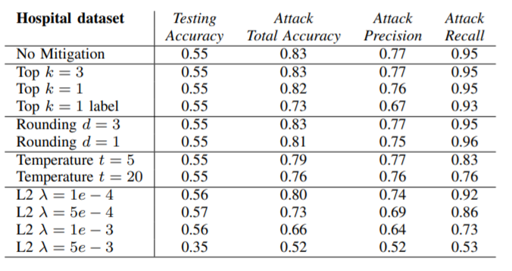
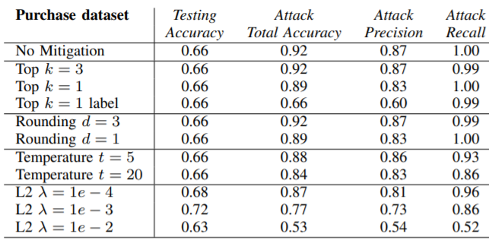
Mitigation Strategies: Evaluation
APSS | DOMINIKA WOSZCZYK

Slide 35
Mitigation Strategies: Evaluation
Even for restricting to one class is not enough
Attack can exploit the mislabeling behavior
Regularization is beneficial for model generalisability and defense against inference attack
Not all methods can be implemented in practice
High temperature reduces model accuracy
APSS | DOMINIKA WOSZCZYK

Slide 36
Mitigation
Reduce overfitting :
Dropout
Batch normalisation
Reduce model complexity
Differential private training
Avoid small datasets
Warn users about risks
APSS | DOMINIKA WOSZCZYK

Slide 37
Limitations
Assume target models outputs probability over classes
Sequence to sequence models?
ASR ?
How to choose optimal number of shadow models?
Inconsistent comparisons
Consequent work show that thresholding is sufficient [1]
[1] Samuel Yeom, Irene Giacomelli, Matt Fredrikson, and Somesh Jha. 2018. Privacy risk in machine learning: Analyzing the connection to overfitting. In IEEE Computer Security Foundations Symposium (CSF). 268–282.
APSS | DOMINIKA WOSZCZYK

Slide 38
Conclusion
Paper trains shadows models on generated data labelled by target model to perform membership inference on blackbox models
Shows that overfitting leads to data leakage
Most effective mitigation strategy is regularization
APSS | DOMINIKA WOSZCZYK

Slide 39
Related Work
Unintentional memorisation for generative text models
The Secret Sharer: Evaluating and Testing Unintended Memorization in Neural Networks, Carlini et al., Usenix 19’
Follow up Defense with Adversarial model:
Machine Learning with Membership Privacy using Adversarial Regularization, Milad et al., ACM SIGSAC Conference on Computer and Communications Security, 2018.
Speech:
The Audio Auditor: User-Level Membership Inference in Internet of Things Voice Services, Miao et al, 2019
APSS | DOMINIKA WOSZCZYK

Slide 40
Thank you!
APSS | DOMINIKA WOSZCZYK

