Slide 1
Indoor Occupancy Tracking in Smart Buildings Using Passive Sniffing of Probe Requests
April, 2021
Published in the IEEE ICC Workshop (2016)
By Vattapparamban et.al

Slide 2
Outline
Page 2
Related work
WiFi probe requests
Experiment
Results
Summary

Slide 3
Related work (1)
Page 3
Occupancy tracking can be implemented via:
Video processing and camera systems
Occupancy sensors throughout the building
These options require installation of new equipment,
Costly to deploy.
Alternatively, we can use wireless signals to uniquely match building’s occupants.
Many proposed solutions based on existing WiFi infrastructure,
They require a connection between user equipment and WiFi APs
No detailed studies that report building occupancy tracking using WiFi probe requests.

Slide 4
Motivation
Page 4
Buildings are among the largest consumers of electricity
An important portion of the electricity consumption of buildings is used for heating, ventilation, and air conditioning (HVAC).
Occupancy tracking can help in achieving significant energy savings in smart buildings
Dynamically scheduling HVAC activity based on real-time building occupancy levels at different areas

Slide 5
Related work (2) - Why Probe Requests?
Page 5
Location analytics
Search and Rescue
Privacy and Security

Slide 6
Location analytics
Page 6
To improve marketing, business teams use probe request information:
To learn how frequently and when shoppers visit a store.
For advertisement purposes.
To estimate required number of personnel for peak hours.
Cisco Meraki APs are used as sniffers to capture probe requests from users.
This data is then sent into a cloud server,
A database is generated that involves location analytics and patterns of shoppers.
To maintain privacy, only a hashed version of the MAC address is stored in the database

Slide 7
Search and Rescue
Page 7
Examples:
A WiFi-equipped drone actively broadcasts request-to-send (RTS) frames (100 per second) to trigger transmission of probe requests from a victim WiFi device.
This information is then used to coarsely estimate the location of the WiFi device
The proposed work differs because they capture the probe request for occupancy monitoring purposes.
Privacy is maintained in the sense that the addresses can be anonymized

Slide 8
Security and Privacy
Page 9
More probe requests are sent when devices are in active mode (screen on) and not connected to any network, which can be used for tracking individual users based on Received-Signal-Strength (RSS) information.
Other studies show that the maximum probing frequency is observed to happen when a device attempts to connect to a known network in its area.
For a commercially deployed MAC randomization mechanism, it is possible to re-identify anonymized probes
An attacker can automatically send beacon and probe response frames for every received probe request, to direct the clients to his own network.

Slide 9
Contribution
Page 10
WiFi probe requests are used for occupancy counting and tracking
WiFi Pineapple equipment are used for passively capturing ambient probe requests from WiFi devices
No connectivity to WiFi devices is required
This information is used to localise users within coarsely defined occupancy zones

Slide 10
WiFi Probe Requests (1)
Page 11
Probe requests are signals that are continuously broadcast from devices with WiFi technology (e.g., smartphones, laptops).
When a WiFi client wants to get connected to a WiFi network:
1. Scan for beacon frames, which are frames broadcast by WiFi routers to tell about their presence to WiFi clients
2. Send probe requests. A WiFi client itself can initiate a connection to a WiFi router instead of waiting for a beacon frame from the router.

Slide 11
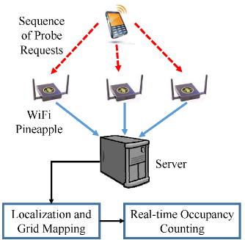
WiFi Probe Requests (2)
Page 12
Such requests contain the unique MAC address of the device, as well its type, brand, manufacturer, and model.
The probe requests are not encrypted, and can be passively captured and decoded with the help of wireless sniffers.

Slide 12
WiFi Probe Requests (3)
Page 13
Probe requests are bursty in nature as they are broadcasted in the air in search of WiFi networks
To get connected or
To get a list of available networks.
Frequent transmission of probe requests introduces an opportunity to:
Track occupancy of building by passively sniffing
Counting probe requests

Slide 13
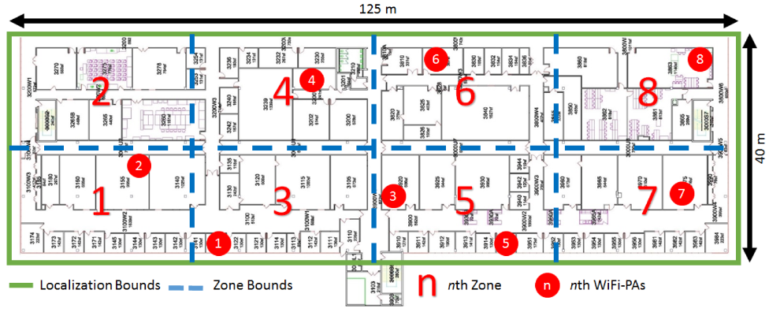
Experiment (1)
Page 14

Slide 14
Experiment (2) - Details
Page 15
Only WiFi probe requests are captured.
All the other packers were filtered out
The data captured include:
Time stamps providing the time at which the data were captured
MAC address of the WiFi enabled device
The signal strength of the WiFi device.
The bursty nature of probe requests requires pre-processing of the data to make it ready for wireless location estimation.

Slide 15
Pre-processing (1)
Page 16
The RSS data is resampled in time due to its bursty nature.
We can have several probe requests from the same user within few hundred milliseconds, followed by a silent period that may last several seconds.
To have uniformly sampled RSS captures, we average the received RSS values within one second intervals.

Slide 16
Pre-processing (2)
Page 17
The interpolation stage involves a sample-and-hold filter.
This keeps the probe requests RSS value at a certain WiFi-PA for a fixed time window.
If a new probe request is received, the RSS value is updated with the information obtained from that probe request.
If no probe request is received within 300 seconds, the value of the RSS from that particular MAC address is labelled as unavailable.

Slide 17
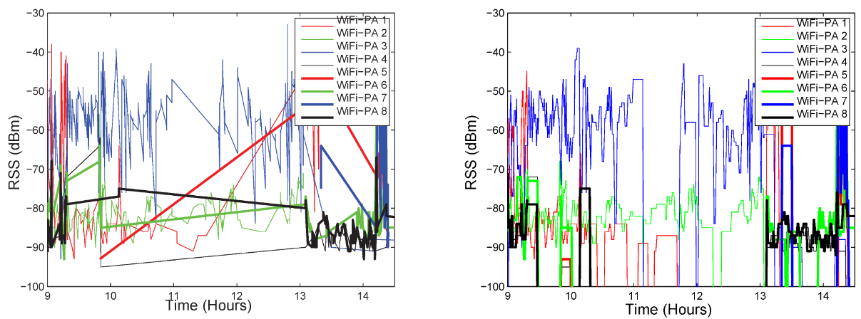
Raw measurement vs Processed data
Page 18
Raw measurements (left) vs processed data (right) of RSS.

Slide 18
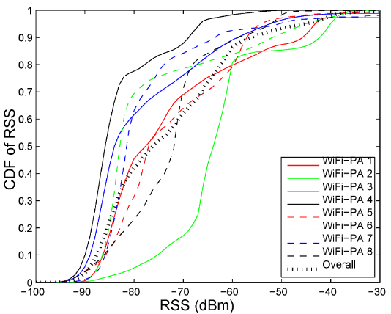
Cumulative distributions of RSS
Page 19
RSS values smaller than -100dBm or larger than -30dBm is regarded as outliers

Slide 19



Device Localization (1)
Page 20
True distance between the user and the ith reference node is given by:
The path-loss model for the RSS is given by:
The distance between transmitter and ith WiFi – PA is estimated as:

Slide 20
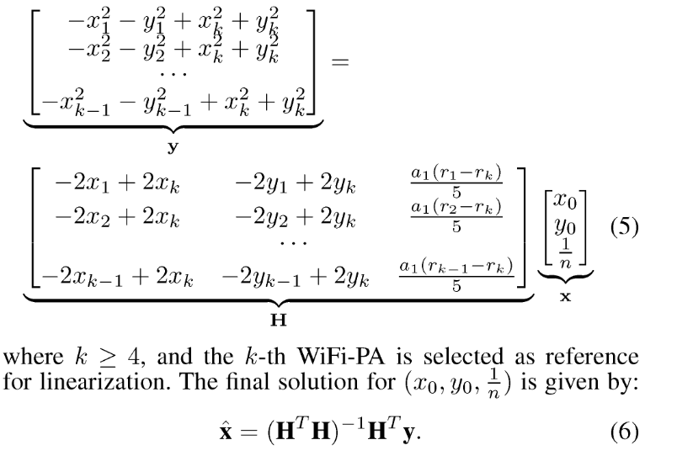
Device Localization (2)
Page 21
Subtracting all approximations of RSS from different WiFi – PAs, we obtain:

Slide 21
Real Time Occupancy Tracking
Page 22
Αt every second:
A linear least squares technique is used to obtain location estimates of each WiFi user.
They are further refined using a weighted k-nearest neighbour (WKNN) location tracking algorithm.
The final estimate is mapped to the nearest zone point with distance threshold.

Slide 22
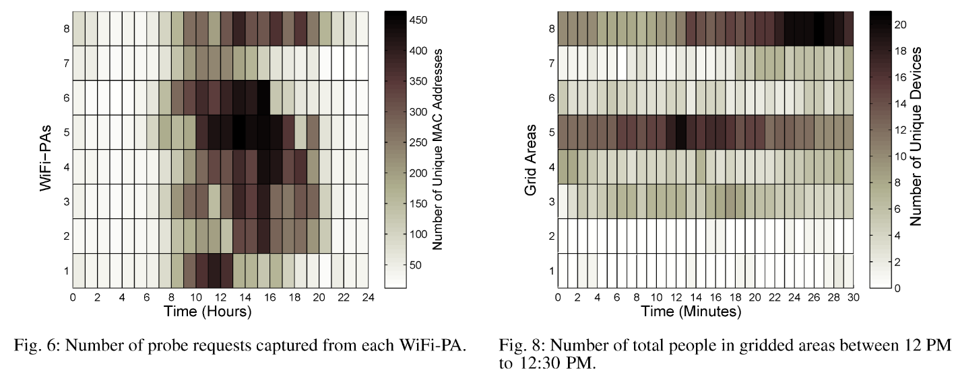
Occupancy Tracking – Results (1)
Page 23

Slide 23
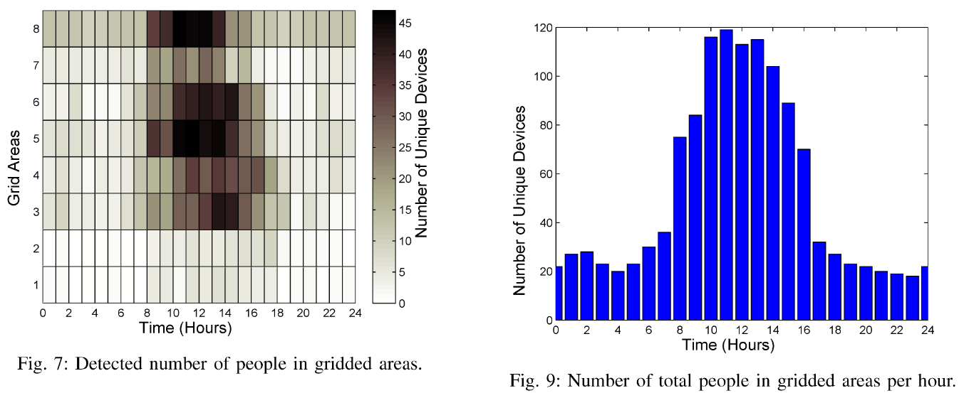
Occupancy Tracking – Results (2)
Page 24

Slide 24
Limitations
Page 25
MAC address randomization may result in over-estimating the number of building occupants
No accurate occupancy tracking if we have a limited number of WiFi - PAs

Slide 25
Summary
Page 26
By using probe requests, we can track the occupancy level information in different zones inside a building
WiFi-PA equipment can be used for passively capturing ambient probe requests from WiFi devices
No connectivity to a WiFi network is required.
This information is then used to localize users within coarsely defined occupancy zones
Obtain occupancy count within each zone at different time scales.

Slide 26
Thank you!
Question?

