Slide 1

Et Tu Alexa? When Commodity WiFi Devices Turn into Adversarial Motion Sensors
Published NDSS (2020)
By Zhu et al.
February 2021

Slide 2
Outline
Background
Attack Scenario
Adversarial Model
Attack Design
Evaluation
Defenses
Summary

Slide 3
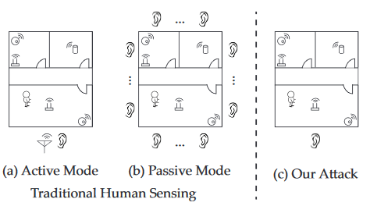
Background Work
Active sensing work (Device continuously transmits RF signals):
Most works appear on this area
Signals get reflected off the target body,
They are captured by the sensing device to infer the target status
Since the attacker device must continuously transmit signals, it is easy to detect
Passive sensing work (Devices only listen and do not transmit signals):
Multiple sniffers that listen to WiFi signals sent by multiple transmitters in the target area
A mechanism to detect the presence of a user when he disturbs the direct path between a WiFi AP and a sniffer
The attacker must obtain AP locations a priori and deploy multiple sniffers around the target area
All they use the signals to detect user location

Slide 4
Motivation
There are human sensing systems that can be turned into attacks but they impose a hefty cost and risk for the attacks
This limits the applicability of the attack
Can we simply reuse existing work on device-free human sensing systems to launch adversarial sensing attacks?
Can we find a passive human sensing attack that can be launched by a minimally equipped attacker and remain undetected?

Slide 5
Contribution
A silent attack that continuously detect, monitor/locate human motion behind walls
Uses a novel model on multipath signal dynamics to remove dependences on active transmissions
Remain undetectable
Low cost (cheap commodity hardware). ONLY a single WiFi receiver (with a single antenna)
No need to compromise devices or decode/decrypt the network traffic
The attack was validated in real-world settings.
A practical and effective defense using AP-based obfuscation

Slide 6
WiFi signal propagation
1) User movement near a WiFi transmitter changes its signal
propagation in a way that can be observed by nearby receivers
2) Walls and buildings today are not built insulated against WiFi
signals
Signals sent by devices inside a property can often be overheard by outside receivers

Slide 7
Motion Detection via multipath signal dynamics
The model links together
Human motion near WiFi transmitters
Variances of multipath signal propagation seen by a sniffer outside of the property
When a human moves near a WiFi device x, the motion changes the multipath signal propagation to the attacker sniffer S.
This model allows S to capture such signal dynamics and use them to pinpoint the target to a specific location
OF COURSE: The more WiFi devices inside the property, the more accurate tracking

Slide 8
Assumptions
No knowledge about the WiFi network and the devices inside the property (including their locations)
At least one WiFi device inside a room is needed for the attack to be effective
In case of relocating a sensor, the attack still works as accurate as before

Slide 9
Limitations
The model is unable to identify features like: speed, activity type and user identity or separate humans from large animals.
A passive sniffer with a single antenna cannot extract advanced signal features including phase of CSI, Time of Flight (ToF), Angle of Arrival (AoA) etc.

Slide 10
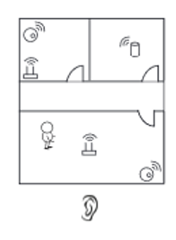
Attack Scenario
One sniffer and many anchors
The attack leverages the ubiquity of commodity WiFi devices (e.g.
routers, printers)
These devices are often spread over each room of a home and office
These WiFi devices will be referred as anchors in this presentation
The attack leverages the fact that WiFi signals are designed for significant coverage and can penetrate most walls
Attackers can place a sniffer outside the target property to passively listen to signals
Recall: WiFi protocols do not encrypt source/destination MAC addresses
Thus, the sniffer can isolate packets sent by each other

Slide 11
Adversarial Model
Adversary makes no assumptions about the number, location or movement speed of human targets being tracked
He does not have physical access to WiFi devices in the target property
He can physically move outside the target property, either outside exterior walls or along public corridors without attracting suspicion
To avoid detection, he only performs passive WiFi sniffing, without any specialized hardware. He needs a sniffer that has only a single built-in antenna
He divides the target property into “regions” around the anchors to detect user presence.

Slide 12
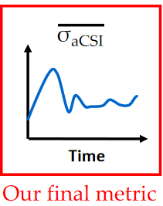
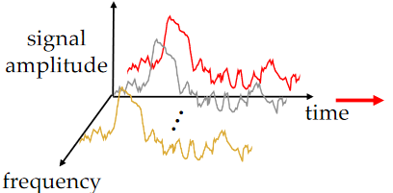

Measuring Signal Variation via CSI
This attack leverage the Channel State Information (CSI), which captures the signal strength under different carriers
To measure the variation, first gather the raw value of CSI
Compute the standard deviation for each sub-frequency
Average those standard deviations across
different sub-frequencies
Result: The average

Slide 13
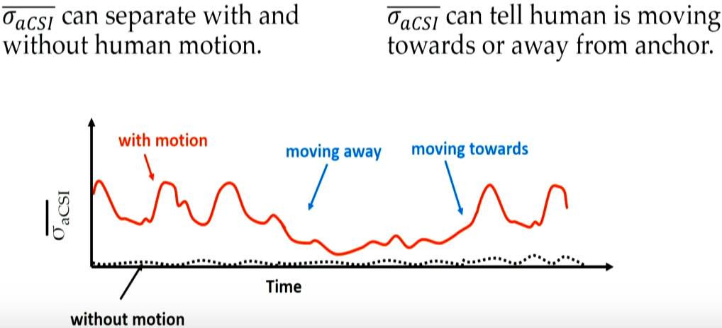
Observations (1)
User movement → aCSI variance
Humans are never completely stationary (e.g., playing games, walking)
Their natural movements will disturb the multipath signal propagation of nearby WiFi transmitters (i.e. anchors), creating variations in their aCSI values seen by the sniffer

Slide 14
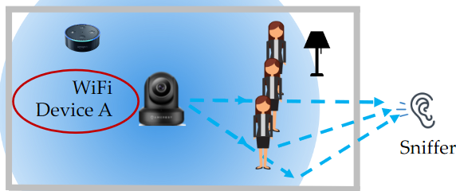
Observations (2)
As a target moves in the space between an anchor x and the sniffer, it blocks and diffracts some signal paths from x to the sniffer.
When close to x, it affects more paths than when it is far away from x
Thus, the received signals seen by the sniffer will display a larger temporal variation when the user is closer

Slide 15
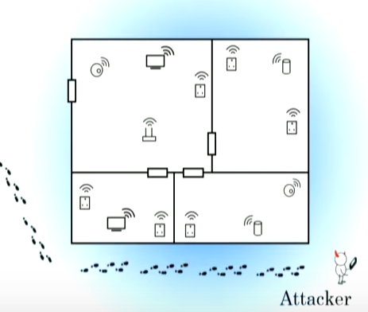
Attack Design (1)
Two steps:
Bootstrapping,
Continuous monitoring
Identify and locate anchors during “bootstrapping”
The attacker needs to identify and locate the anchors in the target area.
The unique feature of our motion detection is that is does not require precise location of anchors, only their individual room.
This is achieved by the attacker performing a brief passive WiFi measurement while walking outside the target property.

Slide 16
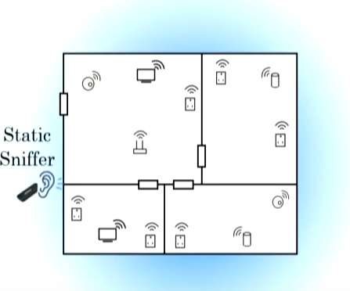
Attack Design (2)
Deploy the sniffer and perform “continuous human sensing.”
Τhe attacker hides the same sniffer at a fixed location outside the target area.
The sniffer continuously monitors WiFi signals, and uses them to locate human presence.
The sniffer monitors each detected anchor, and any relocation of an anchor will trigger its removal from the anchor list,
We need another bootstrapping phase to (re)locate the anchors

Slide 17
Evaluation (1)
Experiments
11 homes & offices with various floorplans
31 WiFi devices
These devices are naturally placed at locations where they are designed to be
A static sniffer outside of the target building within 2m to the target
Modified the WiFi firmware to passively collect CSI
The volunteers are aware of the attack goals but not the techniques

Slide 18
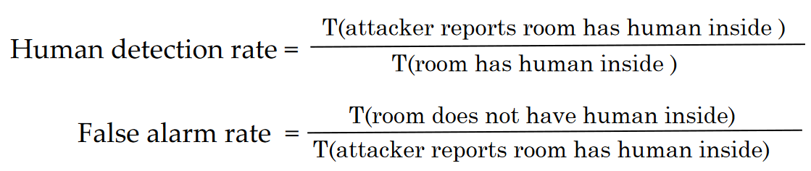
Evaluation (2)
•Detection rate(DR) measures the probability of the attack reporting a room as being occupied when it is actually occupied, across all the slots.
•False positive rate(FP) measures the probability of a room not being occupied when our attack reports that it is being occupied.
Having more anchors increases the chance that a user movement triggers at least one anchor.

Slide 19
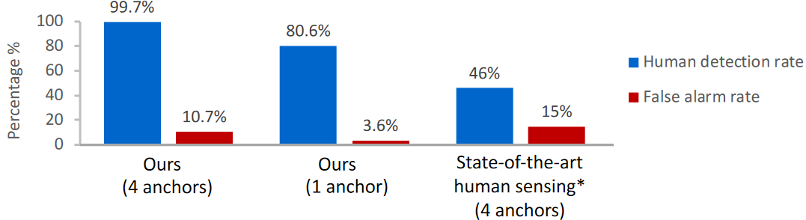
Is the attack effective?
LiFS requires each anchor’s precise physical location in the room (which is not available to our attacker), we use the room center as the input to LiFS, mapping to 1–2m localization error.
LiFS also requires knowledge of the aCSI value when no user is present,
* LiFS: Low human-effort, device-free localization with fine-grained subcarrier information. MobiCom’16.

Slide 20
Is the attack robust?
How effective is the attack at low-rate packet?
Human detection drops only 1.5% when anchors transmits at 2 packets per second, compared to full rate 11pps
How about non-human sources motions?
Human motion differs from equipment motion commonly seen in homes (e.g.an oscillating fan and a robot vacuum).
The latter either is too weak to produce any notable impact on aCSI or generates periodic signal patterns different from those of human motion

Slide 21
Existing Defenses (1)
The effectiveness of the attack depends heavily on the quantity and quality of the WiFi signals captured by the sniffer
MAC Randomization
Since the attack sniffer uses MAC address to isolate signals of anchors, MAC randomization can disrupt both bootstrapping and continuous sensing phases
This featured is disabled on most devices (according to recent work)
Android 9.0 switches to per-network MAC randomization, which does not apply any MAC randomization to static WiFi devices

Slide 22
Existing Defenses (2)
Geofencing
Bounds signal propagation to reduce WiFi signals accessible to the adversary
Geofencing is also difficult to deploy and configure:
Reduce the anchor’s transmit power, which is almost always undesirable since it degrades connectivity.
Equip WiFi devices with directional antennas, limiting signal spatial coverage.
Higher cost and larger form factor
WiFi rate limiting
Is undesirable for most network applications. Many WiFi devices, when idle, transmit at more than 2pps. It is hard to rate limit further, rendering the defense ineffective.

Slide 23
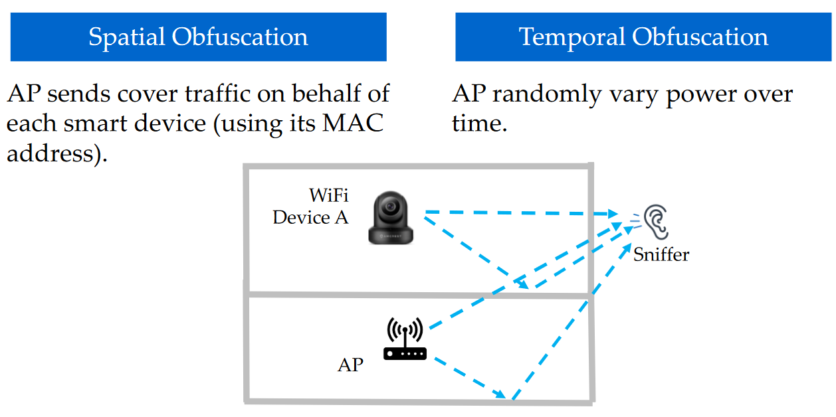
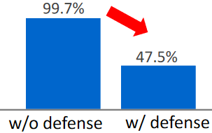
Proposed Defense (1)
Signal obfuscation by AP
Adds noise to WiFi signals
Adversaries cannot accurately localize anchors or detect user motion
Spatial obfuscation
The WiFi AP actively injects customized cover traffic for any of its associated WiFi devices w that is actively transmitting.
This produces large ambiguity to the attack
Temporal obfuscation
WiFi devices change transmit power randomly over time, injecting artificial noises to signals seen by the sniffer
It needs equipment with higher cost/energy consumption

Slide 24
Summary
An adversary can accurately detect and track movements of users
No compromisation of any device is needed
Only passive WiFi signal analysis
It seems to be effective under real conditions
Defense:
AP-based obfuscation is quite effective

Slide 25
Thank you!
Questions?

