Slide 1
Wi-Motion : A Robust Human Activity Recognition Using WiFi Signals
June, 2021
By Li et al.
Published in IEEE Access 7 (2019)
Notes:
All images are taken from the paper

Slide 2
Outline
Page 2
Background
Preliminary
System Overview
Data preprocessing method
Classification algorithm
Experiments
Summary

Slide 3
Motivation
Page 3
Existing techniques for activity recognition have limitations
Cameras require enough lighting and breach human privacy
Low-cost radars (60 GHz) have limited operation range
Wearables are inconvenient since the users must always care the sensors
Research have tried to develop a WiFi-based activity recognition system by analyzing the Chanel State Information (CSI).
BUT not of the prior work has combined both the amplitude and phase information together
Most of the works have utilized either:
The amplitude change in time domain
The phase shift in spatial and frequency domains of CSI values

Slide 4
Related work
Page 4
Received Signal Strength Indicator (RSSI) – Based Approaches
It provides coarse grained information about channel variations
Often affected by:
Multipath effects and noise
CSI – Based Approaches
It is a fine-grained value from the physical layer
Provides a channel estimation of each subcarrier for each transmission link
It describes the amplitude and phase on each subcarrier in the frequency domain

Slide 5
Contribution
Page 5
The utilization of both the amplitude and phase information in the CSI sequence
An activity extraction method combining a sliding window with a threshold-based image segmentation
After getting the results of each classifier, Wi-Motion generates prediction results based on the output posterior probability of the two classifiers

Slide 6
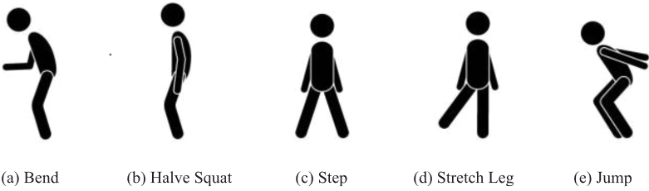
Human Activities
Page 6

Slide 7
Preliminary
Page 7
Different activities cause different multipath distortions in WiFi signals
The receiver can receive more than one pulse and each of them may have different transmission delay
Divide the multipaths into two groups:
Static p^{s}
The static paths (labeling by n) are not affected by the human activity and hence have constant delay λ_{n} and signal attenuation a_{n}
Dynamic p^{d}
Dynamic paths will experience a time-varying change if a person is moving

Slide 8
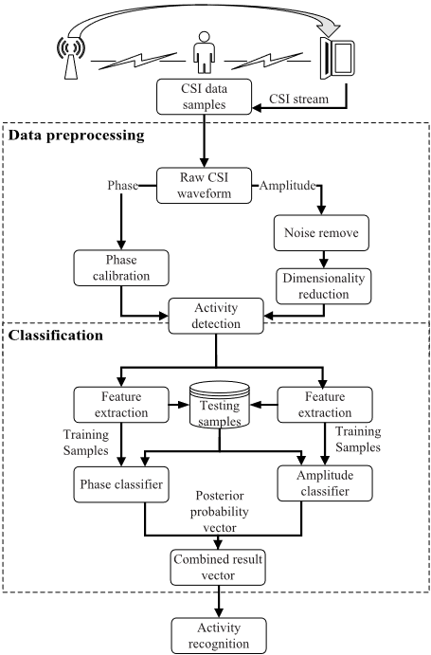
System overview
Page 8
Two stages
Data processing
Classification
Wi-Motion enables commercial
WiFi devices to identify user’s
activities using CSI measurements

Slide 9
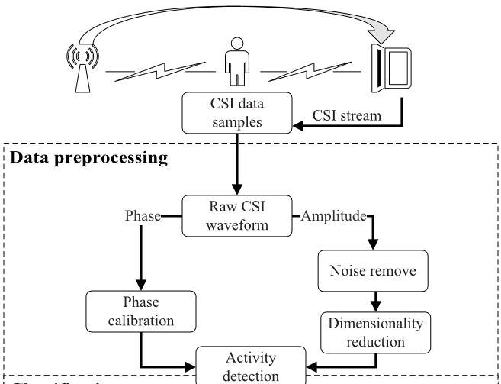
Data processing
Page 9

Slide 10
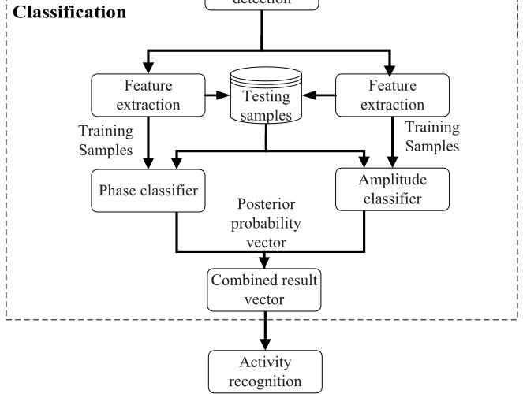
Classification
Page 10
Useful features which can represent the relationship between the time-series of CSI and human activities are extract, as a basis for classification

Slide 11


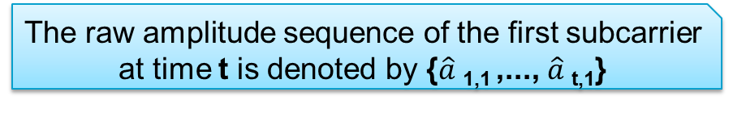
Noise Removal
Page 11
The raw amplitude sequence of the first subcarrier at time t is denoted by {$\hat{a}$_{1,1} ,..., $\hat{a}$_{t,1}}
The raw amplitude measurement obtained from raw CSI sequence is usually not reliable enough to be used for feature extraction
The noise, originates from environmental changes, radio signal interference
They utilize low-pass filtering to remove high-frequency noise and further introduce weighted moving average (WMA) method to process the raw amplitude waveform.
The most recent amplitude is assigned the highest weight.
In this paper, they empirically set m=10
m → being a window size and the largest weighting factor
$\tilde{a}$ → filter output

Slide 12
Dimensionality Reduction
Page 12
CSI information from different subcarriers will experience different changes
Each subcarrier has different sensitivity to human activities
Variance of the CSI sequence is used as an indicator of the sensitivity of the subcarrier
Principal Component Analysis (PCA) algorithm reduces the dimensions of the CSI sequence and eliminates redundant information remaining in the data sequence

Slide 13
Feature Extraction
Page 13
Discrete Wavelet Transform (DWT) analyses signals on multiple frequency scales
Amplitude Feature
Perform DWT on the extracted amplitude waveform (based on the first-order Daubechies wavelet)
Phase Feature
It sorts the subcarriers according to the variance of phase sequence in each subcarrier
Selects the top 20 (empirical value) subcarriers for PCA process
The obtained 1st component is chosen for constructing the classifier

Slide 14
Classifier Training
Page 14
The choice of kernel function plays a key role in the performance of classical SVM
The feature vectors of different human activities may not share the same length → not suitable for traditional SVM algorithm (which requires the dimension of the feature vector to be consistent)
Leverages Dynamic Time Wrapping (DTW) to calculate the distance among the feature vectors
DTW is resilient to signal distortion or shift
It compares two time-dependent series (which can be discrete signals)
DTW distance is used to construct a new kernel function

Slide 15
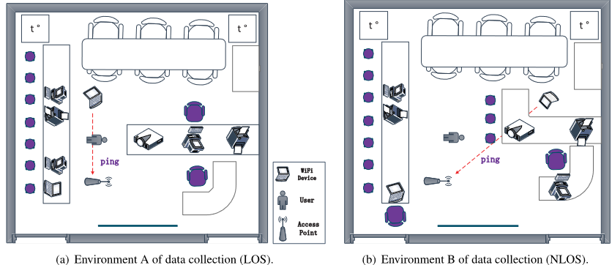
Experiment
Page 15
LOS environment → line-of-sight environment
NLOS environment → not line-of-sight environment
6 testers, 5 human activities

Slide 16
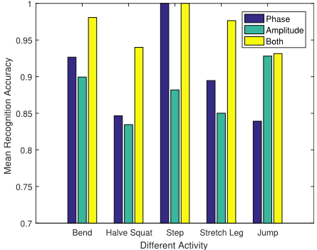
Results (1)
Page 16
Accuracy:
Halve squat: 94.7%
Step: 100%
Stretch leg: 97.8%
More accurate estimation by combining output posterior probability of two classifiers

Slide 17
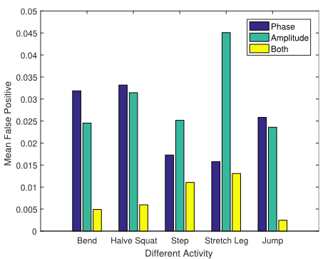
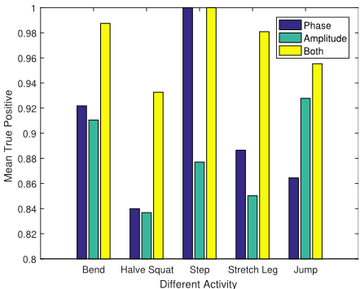
Results (2)
Page 17
False positives of different activities True positives of different activities
Accuracy:
FP : can be improved to about 0.75% & TP : 97.1%

Slide 18
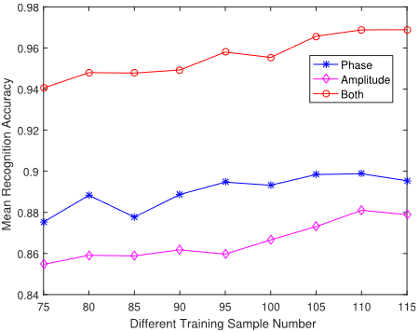
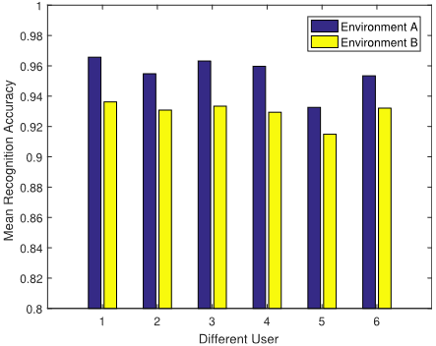
Results (3)
Page 18
Different number of training samples Different environments

Slide 19
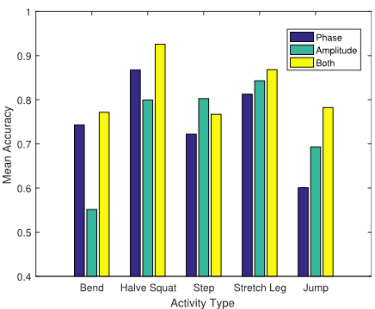
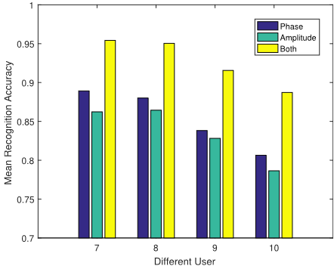
Results (4)
Page 19
Performance for two users Performance for users with different age

Slide 20
Limitations
Page 20
Both the receiver and the laptop are inside the same room with the tester
Most experiments were conducted with only one person each time
Under both LOS and NLOS environment
Considering the experiments that had more than one person, the accuracy of the system was (significantly) less, ≈ 68%

Slide 21
Summary
Page 21
A WiFi-based indoor activity recognition system
Both amplitude and phase information are being adopted
To construct classifiers for extra recognition performance
The recognition accuracy is 96.6% in the LOS environment
The accuracy drops
In the NLOS environment (92%)
As more people exist in the same room

Slide 22
Thank you!
Questions?

