Slide 1
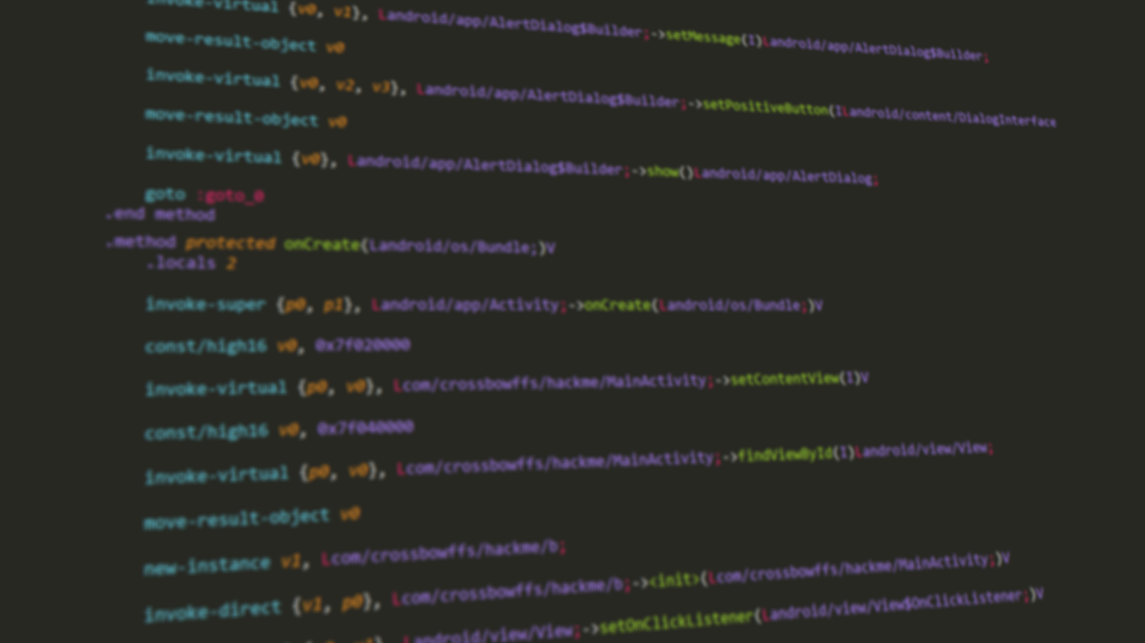
Intro to Android Reverse Engineering
Andrew Sun

Slide 2
Who am I?
Freshman @ UIUC!
Programming: 6 years
Android: 1.5 years
Xposed: 1 year
NekoSMS (text message blocker)
Tumblr AdAway (ad blocker for Tumblr)
SoundCloud AdAway (ad blocker for SoundCloud)
NoUsbNotification (USB notification blocker)
tl;dr: I hate a lot of things.

Slide 3
Why should you care?
Reverse engineering and using private APIs
System-level tweaks (Xposed)
Modifying app behavior (<cough> piracy </cough>)
Because it’s cool!

Slide 4
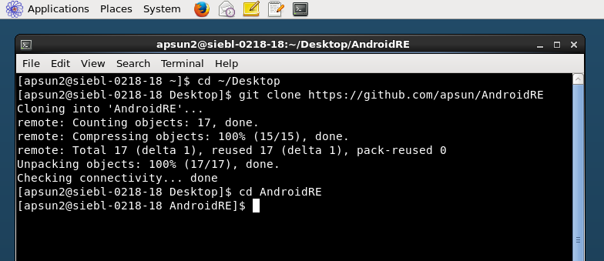
Setting up
Open up Terminal
Enter these following commands (in order):
cd ~/Desktop
git clone https://github.com/apsun/AndroidRE.git
cd AndroidRE
Keep this window open, you’ll need it later!

Slide 5
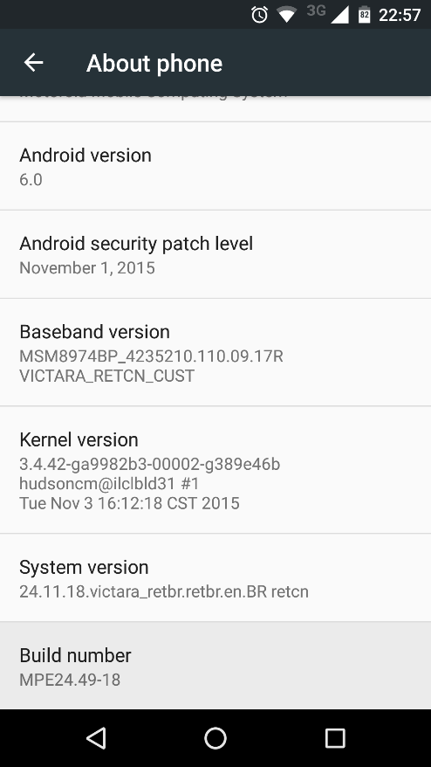
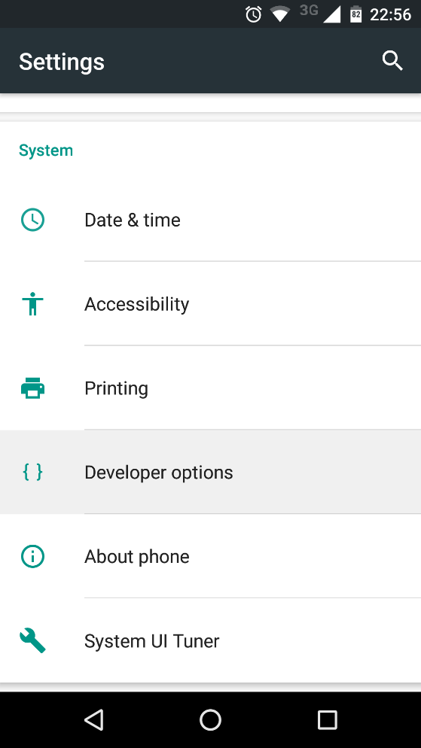
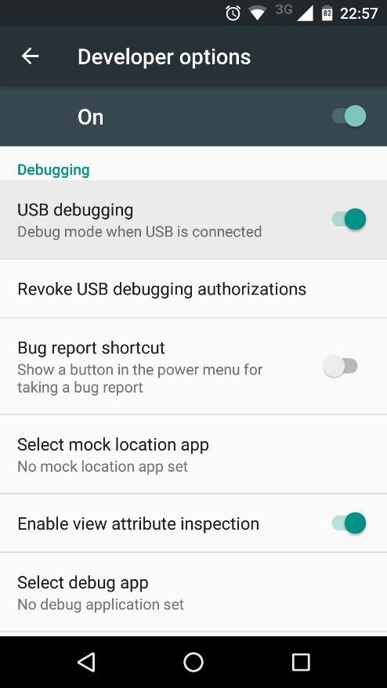
Enabling USB debugging
Enable me!
Tap 7 times

Slide 6
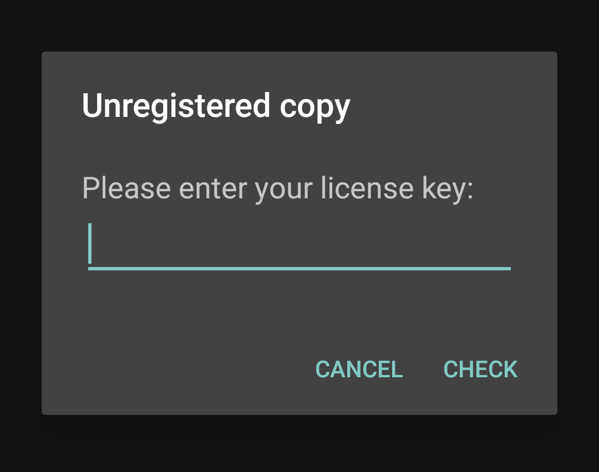
Installing the app
You can use ADB to install APK files!
./adb install HackMe.apk
You may have to confirm “OK” on your phone
Done? Try a few random keys!
Clearly, random guessing isn’t practical...

Slide 7
Our task
1. Make the app accept our license code
2. ???
3. Profit!

Slide 8
What is an APK?
Android (Application) Package
… which was based on the JAR (Java Archive) format…
… which was based on the ZIP format.
In other words, APK files are ZIP files!

Slide 9
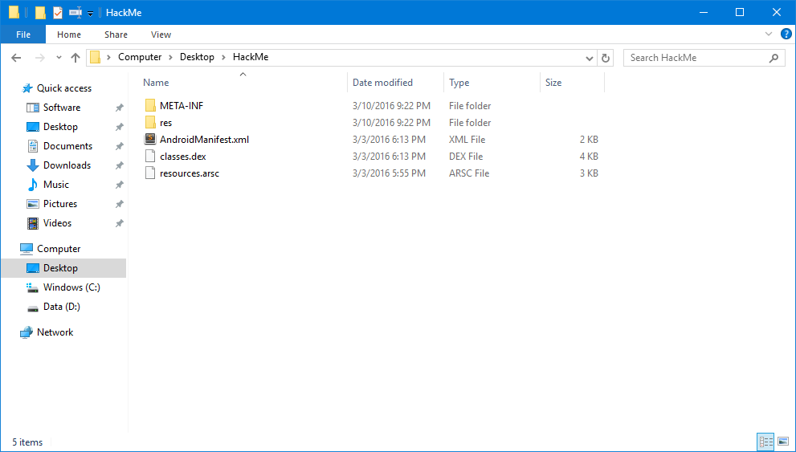
Inside an APK file

Slide 10
Inside an APK file
META-INF
Contains metadata about the file
Makes sure that your file hasn’t been tampered with by the bad guys!
If you modify the APK, you must re-sign it (more on that later)
res
Compiled resource files
Icons, layout files, etc.
resources.arsc
More compiled resources
Strings, colors, themes, etc.

Slide 11
Inside an APK file
classes.dex
Where all the compiled code is (more on that later)
AndroidManifest.xml
Tells the system what’s inside the APK
What to run when the user opens your app
Any permissions your app uses
It’s what makes your ZIP file a runnable app!
Others
assets (non-compiled resources)
lib (C/C++ libraries)

Slide 12
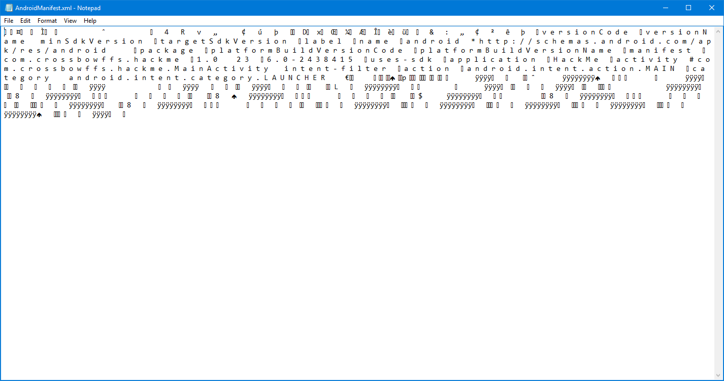
AndroidManifest.xml

Slide 13
Apktool to the rescue!
Converts from binary (fast) to plain text (human readable)
Decompiles classes.dex file into Smali code
Converts resources back into XML form
./apktool.sh d HackMe.apk -o HackMe-decompiled
Decode (decompile) mode
Input APK file
Output (decompiled) directory

Slide 14
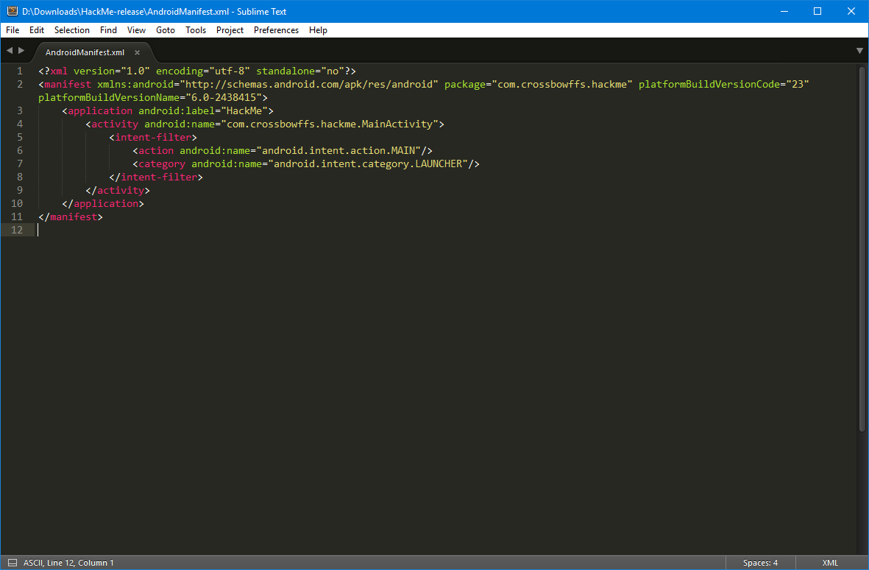
AndroidManifest.xml, take two

Slide 15
ProGuard
Tool to obfuscate Android apps
Used to deter people like us :-(
Renames classes, fields, methods
checkLicense() -> a()
displayAds() -> aa()
SuperEvilClass -> a
How will we find the code we’re looking for?

Slide 16
Finding the code
We know what happens when we enter an invalid license...
High level pseudocode:
Ask for license
If license is NOT valid then show error dialog
Otherwise ???
If we can find where the dialog is being created, we can backtrack to where the condition is checked!
There can be many dialogs, but only one error message...

Slide 17
It’s hacking time!
Goal: to make the app think we have a valid license
Plan:
1. Find out where the dialog is being created
2. Find out how it decides whether the license is valid
3. Make the app accept our license

Slide 18
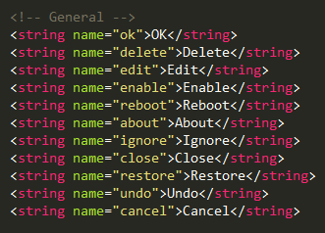
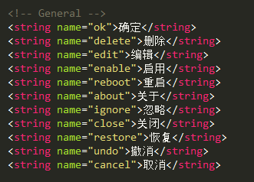
And now… a lesson on strings
getString(R.string.ok)
English (en)
values-en/strings.xml
Chinese (zh-CN)
values-zh-rCN/strings.xml
“OK”
“确定”

Slide 19
Resource IDs
Generated R.string class
R.string.ok=0x7f010000
strings.xml
R.string.cancel=0x7f010001
Android Asset Packaging Tool
(AAPT)
<string name=“ok”>OK</string>
R.string.hi=0x7f010002
<string name="cancel">Cancel</string>
resources.arsc
<string name=“hi”>Hello world</string>
0x7f010000=“OK”
0x7f010001=“Cancel”
0x7f010002=“Hello world”

Slide 20
Resource IDs
R.string class
Resource Manager
Source code
getString(R.string.hi)
Compiled DEX
getString(0x7f010002)
Runtime
“Hello world”
Compiler
App

Slide 21
Finding our strings
1. Search for the raw text in res/values/strings.xml
We have: string = “Sorry, your license is invalid! :-(“
We get: resource name = license_check_fail
2. Search for the resource name in res/values/public.xml
We have: resource name = license_check_fail
We get: resource ID = 0x7f030004
3. Search for the resource ID in smali/
We have: resource ID = 0x7f030004
We get: where the string is used in the app!

Slide 22
Finding our strings
1. Search for the raw text in res/values/strings.xml
We have: string = “Sorry, your license is invalid! :-(“
We get: resource name = license_check_fail
2. Search for the resource name in res/values/public.xml
We have: resource name = license_check_fail
We get: resource ID = 0x7f030004
3. Search for the resource ID in smali/
We have: resource ID = 0x7f030004
We get: where the string is used in the app!
strings.xml

Slide 23

Finding our strings
1. Search for the raw text in res/values/strings.xml
We have: string = “Sorry, your license is invalid! :-(“
We get: resource name = license_check_fail
2. Search for the resource name in res/values/public.xml
We have: resource name = license_check_fail
We get: resource ID = 0x7f030004
3. Search for the resource ID in smali/
We have: resource ID = 0x7f030004
We get: where the string is used in the app!
strings.xml
public.xml

Slide 24
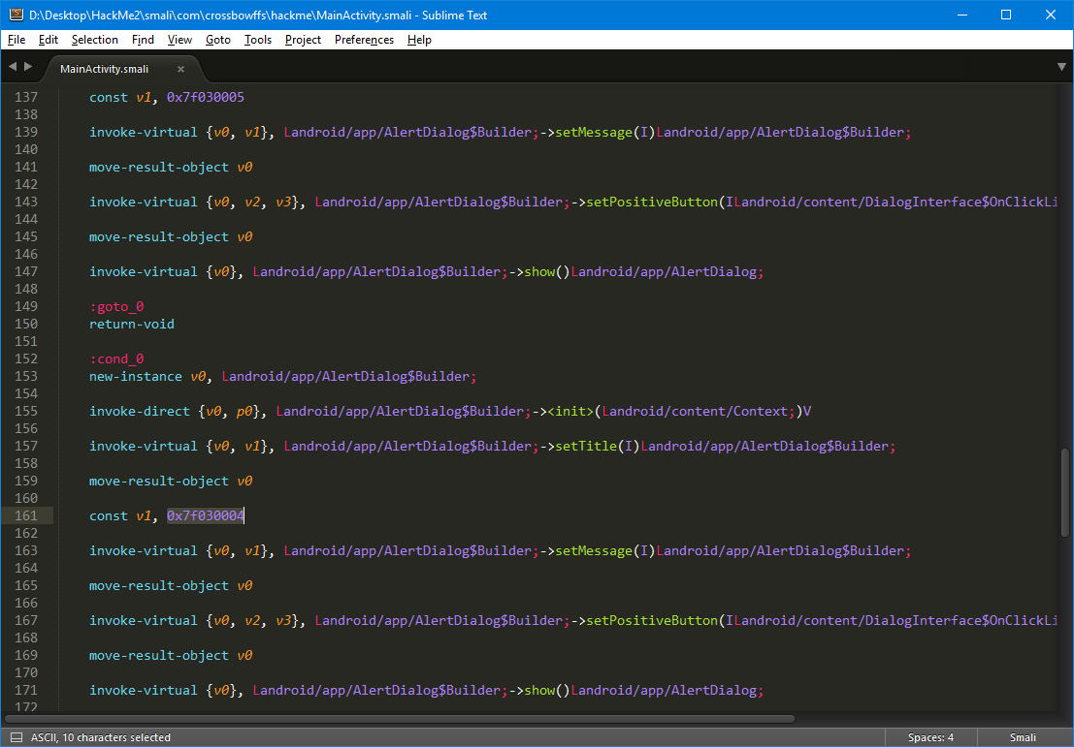
By the power of CTRL-F!
But wait, this isn’t Java! How will you modify this?!
To understand Smali, you must first understand Dalvik...

Slide 25
It’s hacking time!
Goal: to make the app think we have a valid license
Plan:
1. Find out where the dialog is being created ✓
2. Find out how it decides whether the license is valid
3. Make the app accept our license

Slide 26
DEX file format
Dalvik Executable
Runs on Android’s version of the Java Virtual Machine
Dalvik (pre-Android 4.4)
Android Runtime (Android 5.0+)
Mostly backwards compatible, so Dalvik files run on ART w/o changes
Register-based virtual machine
Consists of Java .class files, converted into Davlik-compatible bytecode
.java
.class
.dex

Slide 27
What is Smali?
Human-readable representation of Dalvik bytecode
Android Java “assembly language”
Apktool converts DEX files into Smali
3 basic concepts for reverse engineering:
Variables
Conditionals
Methods

Slide 28
Variables in Smali
Java:
int a = 255;
int b = a;
Smali:
const v0, 0xff
move v1, v0
v0, v1 are registers (for all practical purposes, a 32-bit location in memory)
Can be reused for different values (v0, v1 don’t have “types”)
Misleading name: “const” does not mean you cannot change the value of the register!

Slide 29
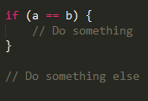
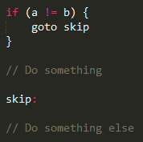
Conditionals in Smali
CPUs do not have a concept of “if-then”
How do we run code only if a condition is true?
Answer: skip over the code if the condition is NOT true!
What you see
What your CPU does

Slide 30
Conditionals in Smali
if-eq <a>, <b>, :label
if a == b, goto label
if-ge <a>, <b>, :label
if a >= b, goto label
if eqz <a>, :label
if a == 0, goto label
... and many other variants.
What you see
What your CPU does

Slide 31
Method calls in Smali
Java:
int value = object.foobar(1, true, “blah”);
Step 1: Put the parameters into registers
Step 2: Call the method
Step 3: Store the return value into a register

Slide 32
Method calls in Smali
int value = object.foobar(1, true, “blah”);
3 parameters, so we need 3 registers
Some special notes:
Dalvik has no boolean type, booleans are represented by integers 0 (false) and 1 (true)
Strings use a special instruction, const-string
Putting this all together, we get...
const v1, 0x1
const/4 v2, 0x1
const-string v3, “blah”

Slide 33
Method calls in Smali
Java:
int value = object.foobar(1, true, “blah”);
Step 1: Put the parameters into registers ✓
Step 2: Call the method
Step 3: Store the return value into a register

Slide 34
Method calls in Smali
For simplicity, assume methods are public, non-static, and non-final
It’s trivial to adapt this to other types of methods, though!
invoke-virtual {v0, v1, v2, v3}, Lcom/example/MyObject;->foobar(IZLjava/lang/String;)I
Opcode
Parameters
Method signature

Slide 35
Method calls in Smali
Java:
int value = object.foobar(1, true, “blah”);
What’s the method signature?
Java: class MyObject { int foobar(int param1, boolean param2, String param3); }
Smali: Lcom/example/MyObject;->foobar(IZLjava/lang/String;)I

Slide 36
Method calls in Smali
Java:
int value = object.foobar(1, true, “blah”);
What’s the method signature?
Java: class MyObject { int foobar(int param1, boolean param2, String param3); }
Smali: Lcom/example/MyObject;->foobar(IZLjava/lang/String;)I

Slide 37
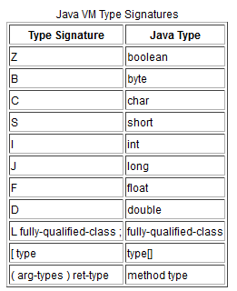
Method calls in Smali
Java:
int value = object.foobar(1, true, “blah”);
What’s the method signature?
Java: class MyObject { int foobar(int param1, boolean param2, String param3); }
Smali: Lcom/example/MyObject;->foobar(IZLjava/lang/String;)I

Slide 38
Method calls in Smali
Java:
int value = object.foobar(1, true, “blah”);
What’s the method signature?
Java: class MyObject { int foobar(int param1, boolean param2, String param3); }
Smali: Lcom/example/MyObject;->foobar(IZLjava/lang/String;)I

Slide 39
Method calls in Smali
Java:
int value = object.foobar(1, true, “blah”);
What’s the method signature?
Java: class MyObject { int foobar(int param1, boolean param2, String param3); }
Smali: Lcom/example/MyObject;->foobar(IZLjava/lang/String;)I

Slide 40
Method calls in Smali
Java:
int value = object.foobar(1, true, “blah”);
What’s the method signature?
Java: class MyObject { int foobar(int param1, boolean param2, String param3); }
Smali: Lcom/example/MyObject;->foobar(IZLjava/lang/String;)I

Slide 41
Method calls in Smali
Java:
int value = object.foobar(1, true, “blah”);
Step 1: Put the parameters into registers ✓
Step 2: Call the method ✓
Step 3: Store the return value into a register

Slide 42
Method calls in Smali
move-result v5
Must be run immediately after a method call to store the return value
If not used, the return value is discarded
Operand (v5 in this case) = which register to store the value in
....
That’s it! Simple, right?

Slide 43
Method calls in Smali
Java:
int value = object.foobar(1, true, “blah”);
Step 1: Put the parameters into registers ✓
Step 2: Call the method ✓
Step 3: Store the return value into a register ✓
Let’s put it all together!

Slide 44
Method calls in Smali
Java:
int value = object.foobar(1, true, “blah”);
Smali:
const v1, 0x1
const/4 v2, 0x1
const-string v3, "blah"
invoke-virtual {v0, v1, v2, v3}, Lcom/example/MyObject;->foobar(IZLjava/lang/String;)I
move-result v5

Slide 45
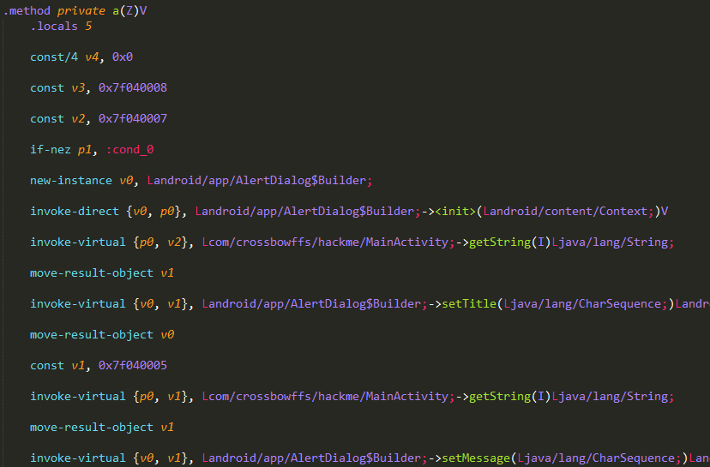
Back to our example...
private void a(boolean p1) {
For non-static methods, p0 == this
if (p1 != 0 <false>) goto cond_0;
v0 = new AlertDialog.Builder(this);
v1 = this.getString(0x7f040005);
v0.setMessage(v1);

Slide 46
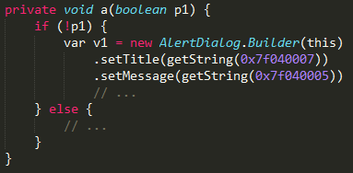
Reconstructing source code
Translating that into pseudo-Java, we get...
This code is only run when p1 is false...
Remember this number? It’s the ID of our error message!
We can deduce that p1 must be the “license entered correctly” condition!

Slide 47
Finding the data origin
We can’t just patch the dialog to display a success message!
Chinese proverb: you fixed the symptoms, but not the cause
Where is this parameter being calculated?
Put in a different way, who is calling this method?
Just search for the method signature!
MainActivity;->a(Z)V

Slide 48
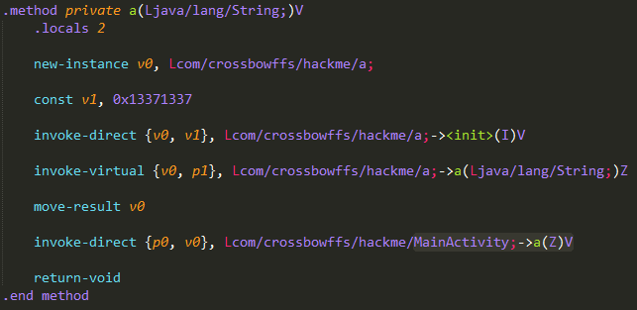
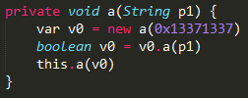
Found it!

Slide 49
Are we there yet?
Let’s analyze this code closely...
There is a class (“a”) which has a method...
... which takes a string as a parameter...
... and returns a boolean...
... which we deduced is whether our license is valid.
Jackpot!

Slide 50
It’s hacking time!
Goal: to make the app think we have a valid license
Plan:
1. Find out where the dialog is being created ✓
2. Find out how it decides whether the license is valid ✓
3. Make the app accept our license

Slide 51
Three methods
A: Reverse engineer the license checking algorithm to generate valid keys (“keygen”)
Pro: Users will not have to install a modified app
Con: More time consuming (may be impossible)
B: Patch the method to always return true (“crack”)
Pro: Much easier compared to method A
Con: Users have to install a modified app
C: Runtime hook using Xposed
Pro: No modified app, not much harder to make than method B
Con: Only works if the user has Xposed installed (requires unlocked bootloader + root)

Slide 52
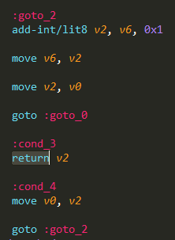
Plan B: Return value patching
Open up a.smali
Look for a method with the signature:
public boolean a(String)
Make it always return true!
CTRL-F for “return” operation(s)
Luckily, there’s only one in this case...
Meaning: return the value stored in v2
So... we just have to write “true” to v2!

Slide 53
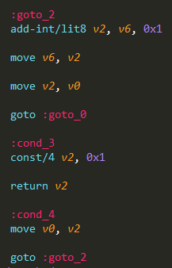
Plan B: Return value patching
How do we do that?
Solution: Just store the value 0x1 in v2!
Use the const/4 instruction
const/4 {destination}, {value}
destination = v2
value = 0x1

Slide 54
It’s hacking time!
Goal: to make the app think we have a valid license
Plan:
1. Find out where the dialog is being created ✓
2. Find out how it decides whether the license is valid ✓
3. Make the app accept our license ✓

Slide 55
Recompiling your app
Apktool to the rescue, again!
./apktool.sh b HackMe-decompiled -o HackMe-unsigned.apk
Build (recompile) mode
Input (decompiled) directory
Output (recompiled, unsigned) APK file

Slide 56
Signing your app
Remember the META-INF folder?
Prevents people (like us) from making unofficial modifications
You will need to re-sign your APK file!
./signapk.sh HackMe-unsigned.apk HackMe-new.apk
Input (unsigned) APK file
(created in last step)
Output (signed) APK file

Slide 57
Uninstalling the original app
If you try to install the APK, you will get an error!
Your signing key is different from the original author’s
Only APK files signed with the same key can be upgraded
Solution: uninstall the original app first
./adb shell pm uninstall com.crossbowffs.hackme
Package name

Slide 58
Installing the new app
And now for the moment of truth...
./adb install HackMe-new.apk
Signed APK file

Slide 59

Questions?
if (questions.size() == 0) { class.dismiss(); }

