Slide 1
Growing Pythons: Observability Guide
Alex Ptakhin

Slide 2
Why me?

Slide 3
Shared
Developing multiple services
We want to see logs, metrics, traces across all services
We not only store them locally, but send to some central service
Why for developers?

Slide 4
Shared
Elastic+Kibana DSL+Ruby
Fluentd DSL+Ruby
We choose vector
Linux

Slide 5
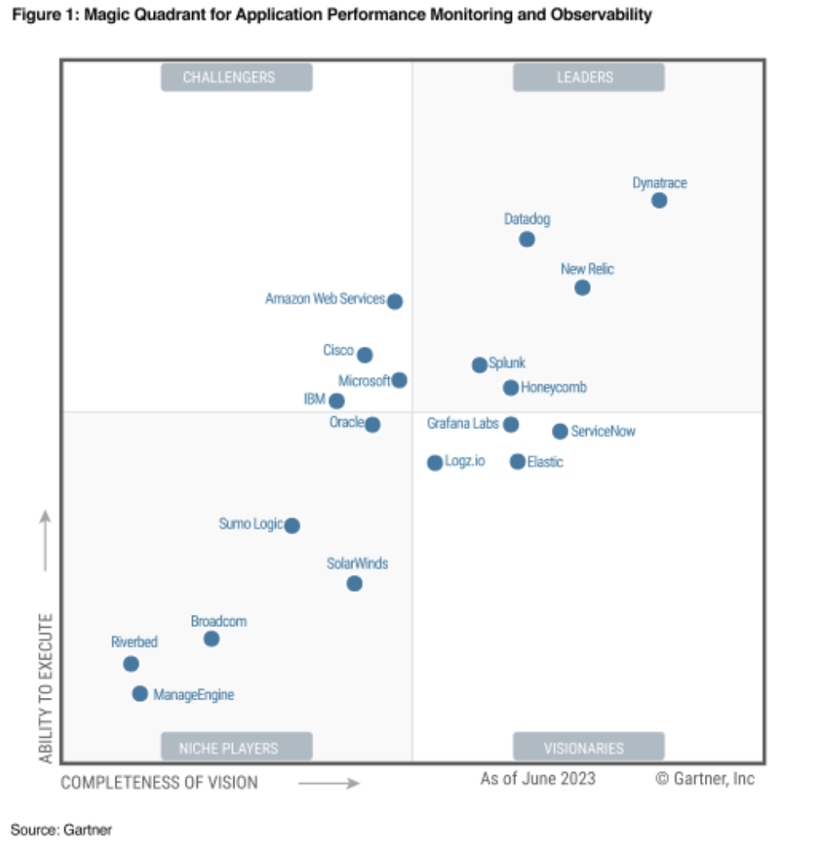
Grafana
Datadog
Honeycomb
New Relic
Dynatrace
logzio
Cloud-based
Notes:
https://www.honeycomb.io/gartner-magic-quadrant-apm-observability-2023

Slide 6
Logs

Slide 7
Logs with libraries
Not only save logs on the host machine, but send them

Slide 8
logging

Slide 9
12 factors: logs go to output
https://12factor.net/logs

Slide 10
Stdout
version: 1
formatters:
simple:
format: '%(asctime)s - %(name)s - %(levelname)s - %(message)s'
handlers:
console:
class: logging.StreamHandler
level: DEBUG
formatter: simple
stream: ext://sys.stdout
loggers:
simpleExample:
level: DEBUG
handlers: [console]
propagate: no
root:
level: DEBUG
handlers: [console]
Notes:
https://pypi.org/project/python-json-logger/

Slide 11
12 factors: logs go to output in JSON format

Slide 12
JSON
import logging
from pythonjsonlogger import jsonlogger
logger = logging.getLogger()
logHandler = logging.StreamHandler()
formatter = jsonlogger.JsonFormatter()
logHandler.setFormatter(formatter)
logger.addHandler(logHandler)
logger.info({"special": "value", "run": 12})
logger.info("classic message")
Notes:
https://pypi.org/project/python-json-logger/

Slide 13
Logs
VDS
systemctl
https://vector.dev/docs/reference/configuration/sources/journald/
Ansible:
Install system-packages + install Python / Conda
Virtual environment
Add systemctl processes
Health checks
Collect logs

Slide 14
Logs
Docker

Slide 15
Logs
Kubernetes

Slide 16
Metrics

Slide 17
Metrics
https://opentelemetry.io/docs/instrumentation/python/exporters/#metrics-1
from opentelemetry import metrics
from opentelemetry.exporter.otlp.proto.grpc.metric_exporter import OTLPMetricExporter
from opentelemetry.sdk.metrics import MeterProvider
from opentelemetry.sdk.metrics.export import PeriodicExportingMetricReader
from opentelemetry.sdk.resources import SERVICE_NAME, Resource
# Service name is required for most backends
resource = Resource(attributes={
SERVICE_NAME: "your-service-name"
})
reader = PeriodicExportingMetricReader(
OTLPMetricExporter(endpoint="localhost:5555")
)
provider = MeterProvider(resource=resource, metric_readers=[reader])
metrics.set_meter_provider(provider)

Slide 18
Metrics
VDS

Slide 19
Metrics
Docker

Slide 20
Metrics
Kubernetes

Slide 21
Tracing

Slide 22
Jaeger
OpenTelemetry

Slide 23
Manual instrumentation
Spans
def do_work():
with tracer.start_as_current_span("span-name") as span:
# do some work that 'span' will track
print("doing some work...")
# When the 'with' block goes out of scope, 'span' is closed for you
Notes:
https://opentelemetry.io/docs/instrumentation/python/manual/

Slide 24
Manual instrumentation
Nested spans
def do_work():
with tracer.start_as_current_span("parent") as parent:
# do some work that 'parent' tracks
print("doing some work...")
# Create a nested span to track nested work
with tracer.start_as_current_span("child") as child:
# do some work that 'child' tracks
print("doing some nested work...")
# the nested span is closed when it's out of scope
# This span is also closed when it goes out of scope
Notes:
https://opentelemetry.io/docs/instrumentation/python/manual/

Slide 25
Manual instrumentation
Spans
@tracer.start_as_current_span("do_work")
def do_work():
print("doing some work...")
Notes:
https://opentelemetry.io/docs/instrumentation/python/manual/

Slide 26
Automatic instrumentation
Django, Flask, FastAPI, sqlalchemy, gRPC
https://opentelemetry.io/ecosystem/registry/?language=python&component=instrumentation

Slide 27
Traces
from opentelemetry import trace
from opentelemetry.exporter.otlp.proto.grpc.trace_exporter import OTLPSpanExporter
from opentelemetry.sdk.resources import SERVICE_NAME, Resource
from opentelemetry.sdk.trace import TracerProvider
from opentelemetry.sdk.trace.export import BatchSpanProcessor
# Service name is required for most backends
resource = Resource(attributes={
SERVICE_NAME: "your-service-name"
})
provider = TracerProvider(resource=resource)
processor = BatchSpanProcessor(OTLPSpanExporter(endpoint="your-endpoint-here"))
provider.add_span_processor(processor)
trace.set_tracer_provider(provider)
# Merrily go about tracing!

Slide 28
Finally

Slide 29
Grafana

