Slide 1
Making and Programming Drones
Gareth Owenson

Slide 2
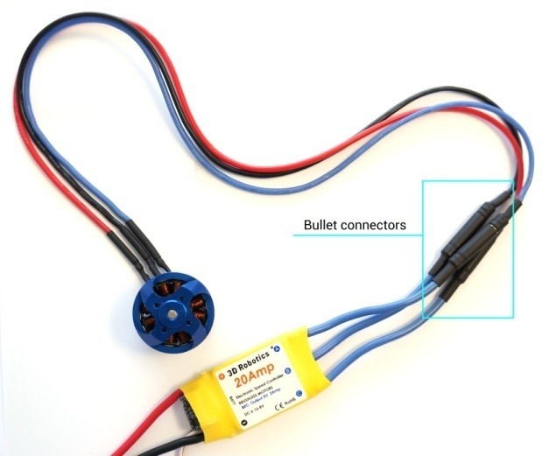
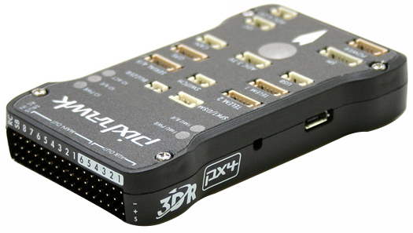
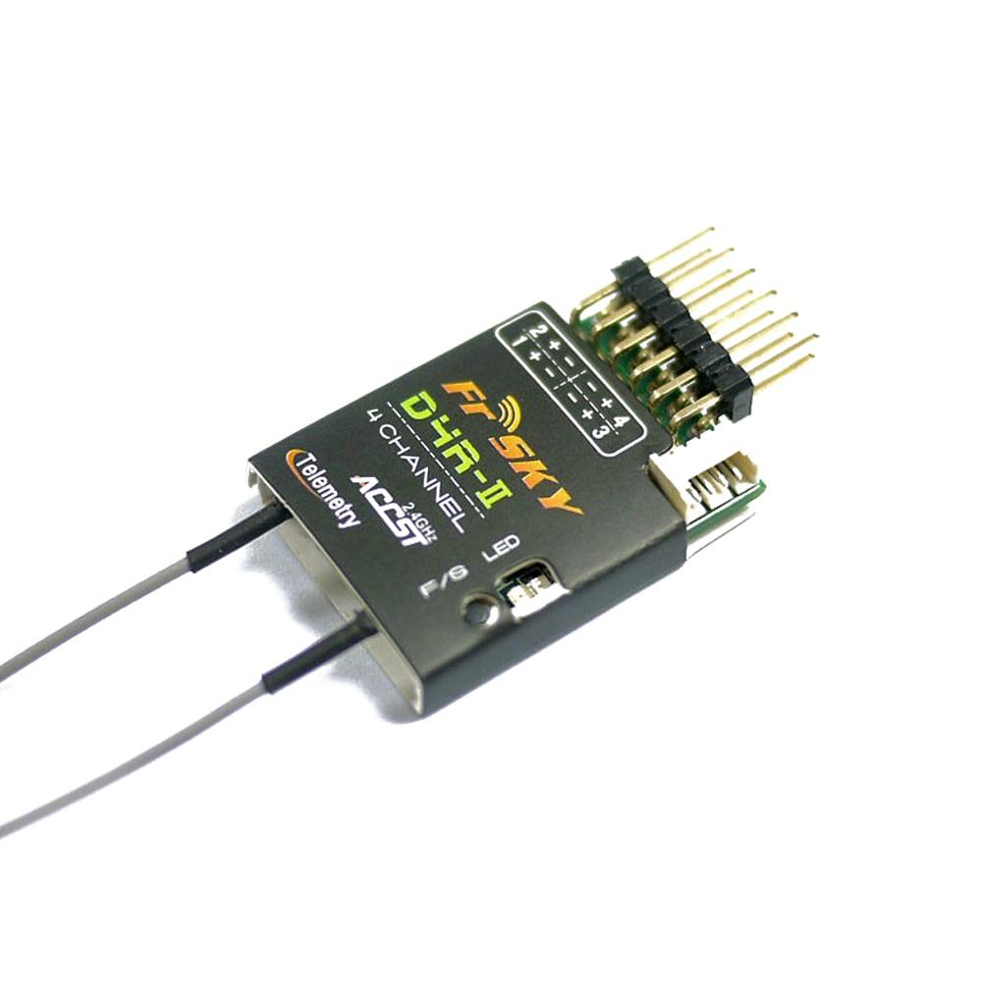
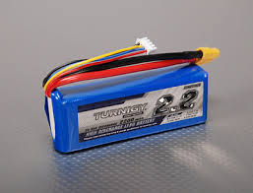
What’s a drone made of?
Autopilot
(Speed Controller+Motor)*4
Control Radio Receiver
Lithium Polymer Battery

Slide 3
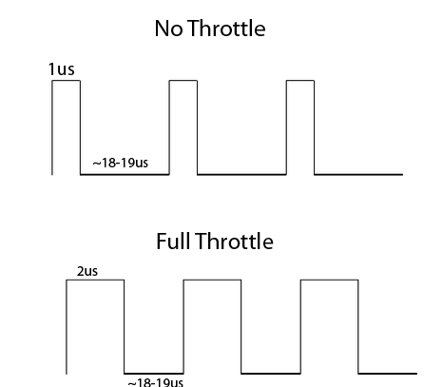
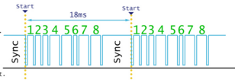
Receiving Control and Controlling

Slide 4
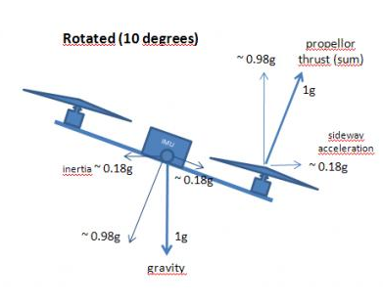
Determining Orientation

Slide 5
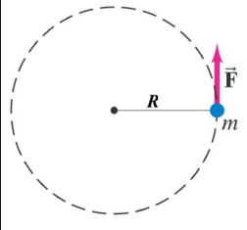
Flight Control and PIDs

Slide 6
Cascaded PIDs on Pitch axis
Desired pitch
Commanded rate
Desired Angle to rotation rate
Desired rotation rate to motor thrust differential
Current pitch
Thrust differential
Error = desired – current
Output = 4.5*error
Current rotation rate from gyros

Slide 7
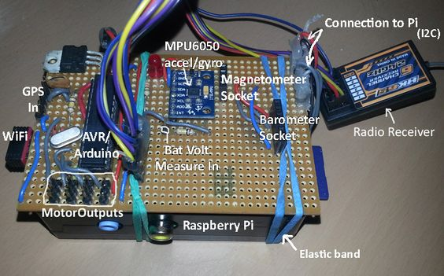
My First Homemade Flight Controller
The eponymous owenquad, first ever Pi quadcopter (I think).

Slide 8
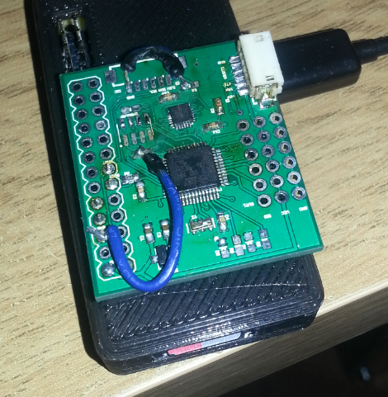
Three Years Later

Slide 9
Ways to get started
Buy a Hubsan X4 or little micro-quad first
Just want to take photos? Buy a DJI Phantom/Mavic.
Initial costs are high, but afterward quite cheap
  Initial costs: battery charger, goggles (£200), radio transmitter (£50)
Costs per drone:
  Frame, ESC+Motors, Flight Controller (£125+)
  Camera, video transmitter (£50)
  Optionally: GPS (£15), Telemetry (£25), On-screen display (£10)

Slide 10
Questions
Guide to programming a drone from scratch:
  http://owenson.me/
Projects
  We have two drones in the department.
  Note: you pay for repairs if you break it :-)
Questions please!

