Slide 1
GIỚI THIỆU KHÓA HỌC LẬP TRÌNH ỨNG DỤNG WEBSITE

Slide 2
Nguyễn Hải Nam
Scrum Master/Team Leader tại Axon Active Việt Nam
Cử Nhân Công Nghệ Phần Mềm – Đại Học Duy Tân
Cử Nhân Quản Trị Tài Chính – Đại Học Kinh Tế Đà Nẵng
Tìm hiểu thêm tại namcoi.com
XIN CHÀO

Slide 3
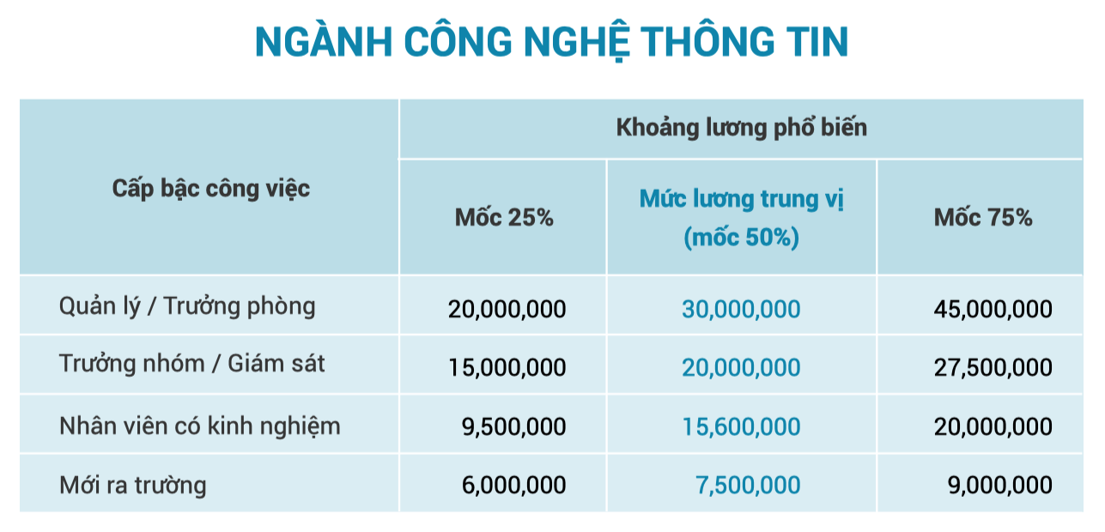
BÁO CÁO MỨC LƯƠNG

Slide 4
Cài đặt Git
Cài đặt Visual Studio Code
Cài đặt Chrome Browser
PHẦN MỀM CẦN CÀI ĐẶT

Slide 5
YOUR TURN
Come over here, one by one and speak loudly to the class :
What’s your name ?
What’re you doing?
Describe your programming experience.
What’re you looking for from this class?

Slide 6
WEB DEVELOPER 2019 ROADMAP
https://github.com/kamranahmedse/developer-roadmap

Slide 7
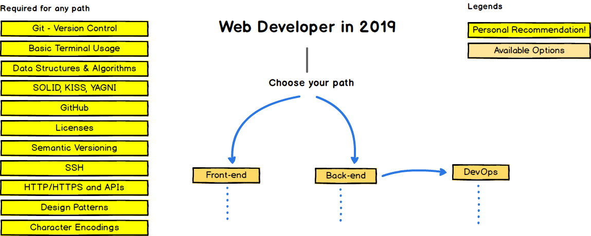
FROM WHAT YOU ARE LOOKING FOR

Slide 8
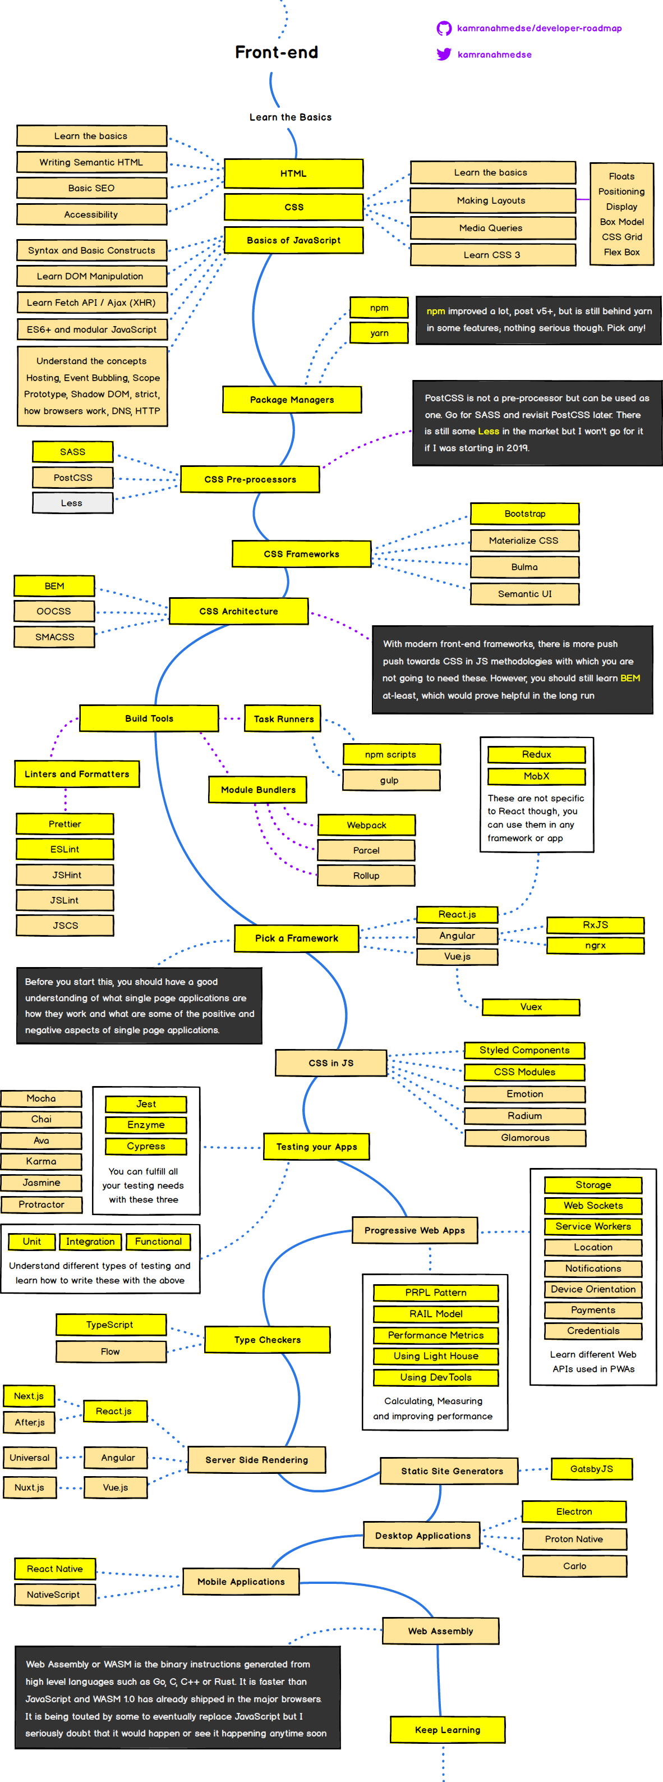
FROM WHAT YOU ARE LOOKING FOR

Slide 9
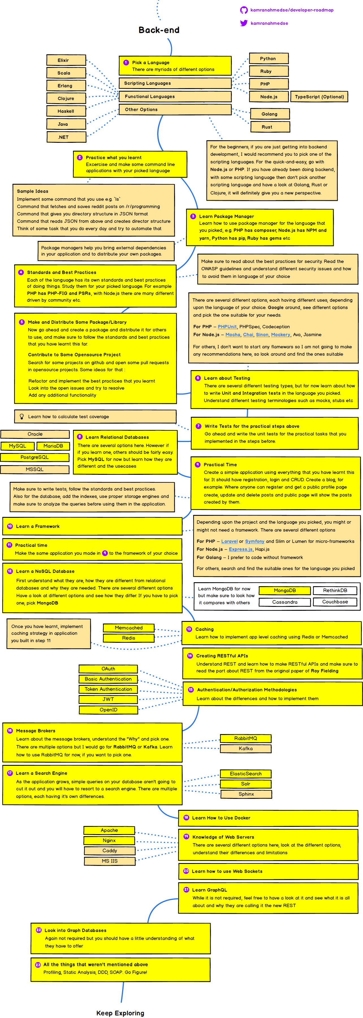
FROM WHAT YOU ARE LOOKING FOR

Slide 10
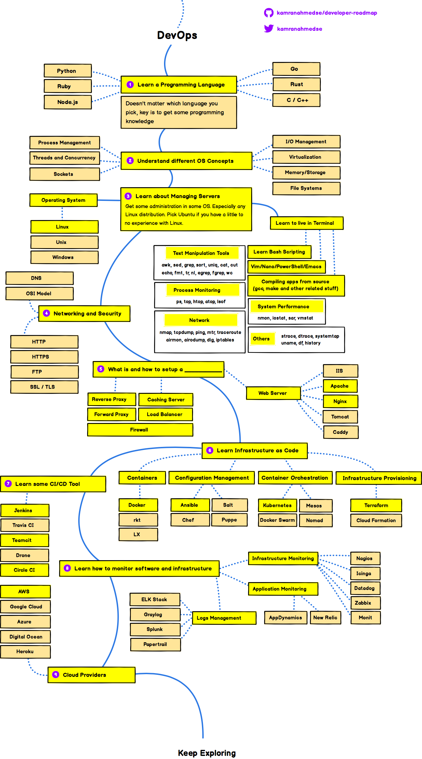
FROM WHAT YOU ARE LOOKING FOR

Slide 11
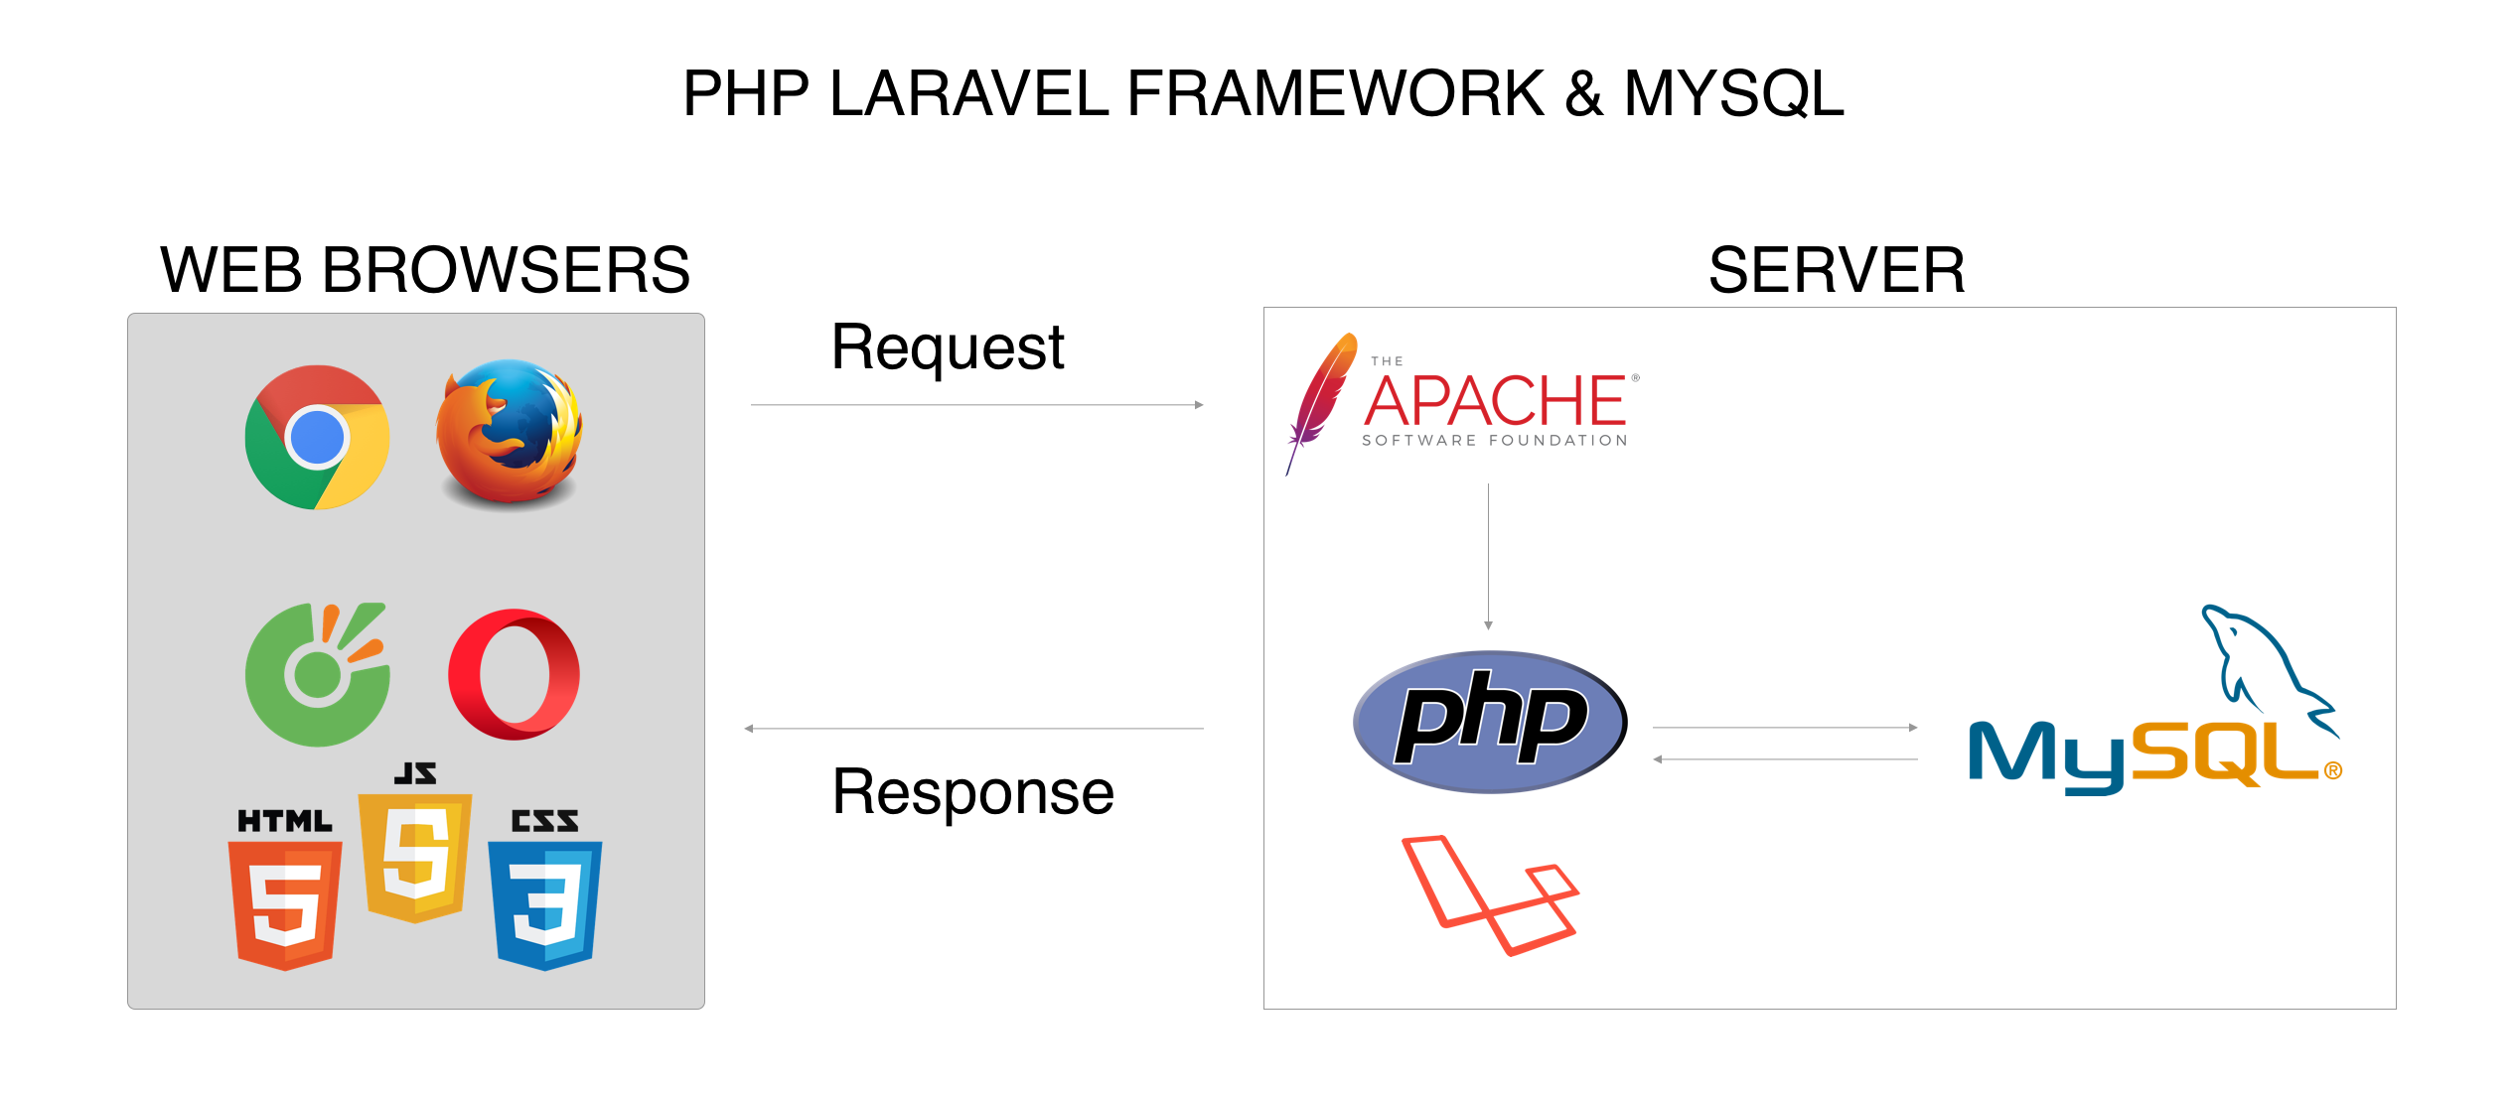

Slide 12
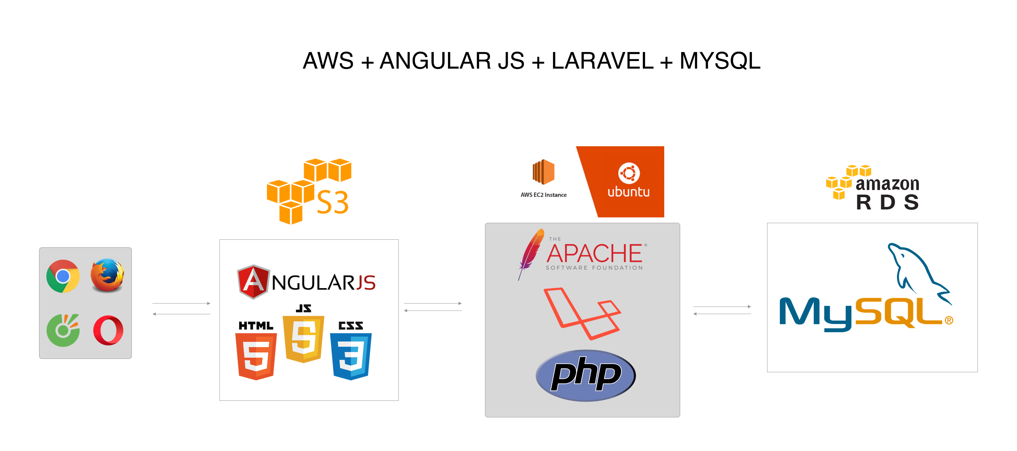

Slide 13
OUR SCHEDULE
We only have 60 hours – 15 sessions :
Introduction & Environment : 4 hours – 1 sessions.
HTML & CSS & Bootstrap 4 : 32 hours – 8 sessions.
JavaScript & jQuery & AJAX & JSON : 16 hours – 4 sessions.
Project News Website Template : 8 hours – 2 sessions.
* Git Hub, Git Page, VS Code, Command Line will be guided in some session.

Slide 14
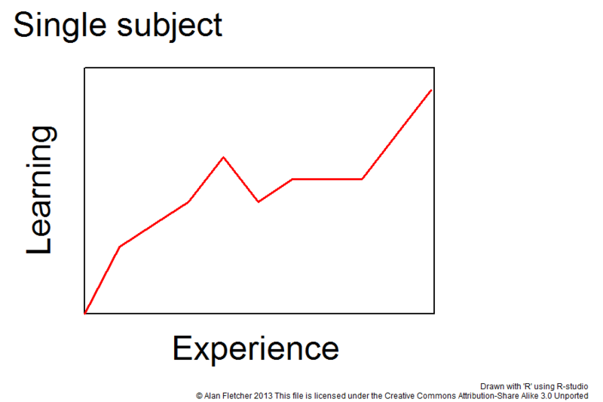
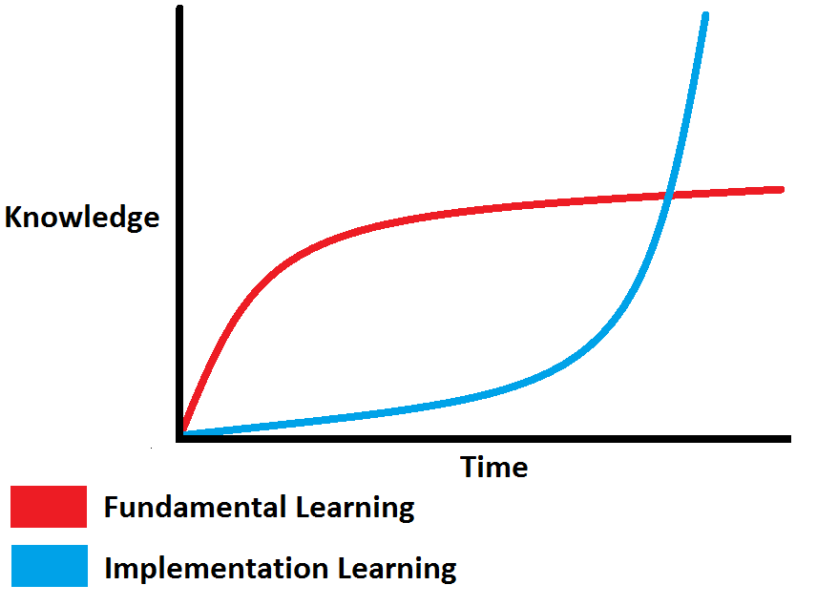
HOW TO GET ALL OF IT ?
Do one by one.
From zero to hero.
Cost by time.
Learn from friends.
Learn from games.
Learn everytime and every sources you have.

Slide 15
MY RESOURCES
Freecodecamp.org
W3schools.com
Udemy.com
Lynda.com
Medium.com
Viblo.asia
Kipalog.com
Tutorialspoint.com
Freetuts.net
Vietjack.com

Slide 16
LET’S DO IT TOGETHER !!!

