Slide 1
INASP: Effective Network Management Workshops
Unit 5: The Bandwidth Challenge

Slide 2
About these workshops
Authors:
Dick Elleray, AfriConnect
Chris Wilson, Aptivate
Date: 2013-04-29

Slide 3
Objectives
On completion of this session, we hope you will know about:
Importance of Internet in network management
Why is Internet bandwidth particularly scarce?
Why is that a problem?
How does it relate to IT/network management?
How can we fix it? What can we change?

Slide 4
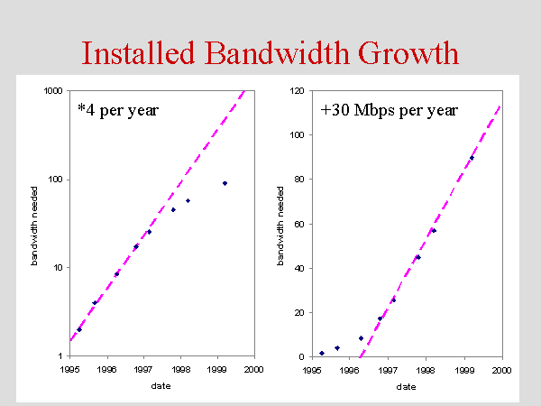
Why do we care about Internet access?
What is your Internet connection used for?
Why else do you have a campus network?
What is it used for? Do you know? (Monitoring can tell you)
How much do you spend on your campus network? On your Internet connection?
Please share your views with the group about whether having an Internet connection is important to your university.
JANET is the UK NREN (National Research and Education Network), providing Internet and inter-university connectivity, support and services. (Basically the equivalent of your University internet/NREN connection).
163 UK universities are connected, at an average cost of £32,000 (USD 50,000) per year. <https://community.ja.net/sites/default/files/network-charges-calculation-12-13-issue-1.xls> Their total budget is £6.4 million (USD 10 million).
JANET installed bandwidth grew approximately 400% per year between 1995 and 2000 (old figures, I know):
About 60% of JANET's traffic came from outside JANET (i.e. the Internet).

Slide 5
Why is it so expensive?
African universities pay 50x more for the same bandwidth as Europeans:
"While a university in Germany might pay about US $4000 per month for 1 gigabit per second of bandwidth, a school in Kenya can expect to pay $200 000 for the same service." IEEE Spectrum, Feb 2013.
Notes:
The Association of African Universities (AAU) conducted a connectivity
survey during 2008 from universities in West and Central Africa. The study identified a bandwidth deficit for universities in the region and that... these universities would fall further and further behind their own estimated bandwidth requirements and the level of bandwidth which is required for performance-leading work and teaching conditions.
` The Socio-Economic Impact of Broadband in sub-Saharan Africa: The Satellite Advantage <http://www.cto.int/wp-content/themes/solid/_layout/dc/ptojects/Socio-Economic_Impact_of_Broadband_The_Satellite_Advantage.pdf>`_
How did this happen?
Lack of infrastructure, especially copper and fibre networks
Lack of competitive service providers
High costs of installing infrastructure
Long delay in investment and deregulation

Slide 6
Key findings from ATICS survey 2006
African university = European home
Pays 50x more than European home
Limited bandwidth per computer
Always congested (over 60% of the time)
59% of institutions do not monitor or manage bandwidth
Notes:
Note: this survey was in 2006, the results may be outdated.

Slide 7
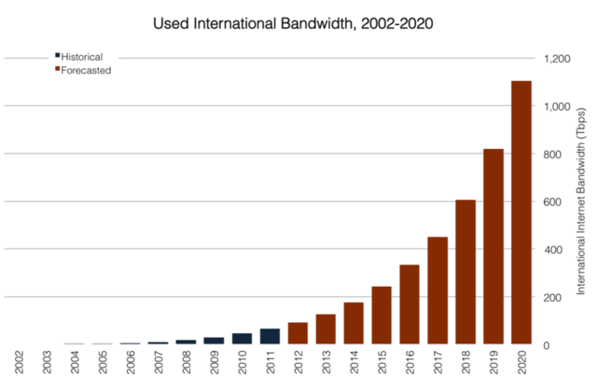
Demand for bandwidth is increasing everywhere

Slide 8

Abuse of shared resource hurts others
Notes:
In economics, the tragedy of the commons is:
the depletion of a shared resource by individuals,
acting independently and rationally according to each one's self-interest,
despite their understanding that depleting the common resource is contrary to the group's long-term best interests.
This happens on a network when:
there is no incentive for users to limit their use of bandwidth
for example, financial cost, punishment, self-harm
users are allowed to use bandwidth to the point that it affects others
network or bandwidth management is not used (the default)
Shared resources always need management. More users -> more management. This is not unique to African universities!

Slide 9
Effects of bandwidth challenges
What Internet resources are hard to use?
How much money and time is wasted?
What effect does this have on the university?
Notes:
Difficulties in using Internet based information resources and communication tools:
Digital library resources are under utilised
Resource license costs can be less effective
Free or low cost resources are difficult to take advantage of
The digital library revolution is difficult to participate in
Continued digital divide
Under utilisation of ICT capacities and investments:
Bandwidth charges of $5,000 per month that result in an unusable link – is that money well spent?
Infrastructure costs e.g. PC computer labs that users spend most of their time sitting around waiting for pages to display – is that money well spent?
Impacts on a university’s core activities, especially those that require up to date and a wide range of information resources e.g. teaching and research.

Slide 10
Possible solutions?
Doing nothing
More bandwidth and at lower cost
Better management of existing resource
Combination of the above
Notes:
What would happen if we doubled your bandwidth?
It will always need managing to ensure maximum efficiency

Slide 11
Group Discussion
What challenges does your institution face with network management?
What impact are they having on:
User satisfaction?
User perception of IT staff performance?
How the outside world sees your institution?
How are these issues being addressed within your institution?
Notes:
Technically?
With policies?
With both?
If not, why not?
Time? Resources? Money? Wrong incentives?
You may want to nominate a group representative to capture the key points of the discussion on a flipchart sheet.

Slide 12
Plenary Discussion
Please present the results of your group discussions.
One representative, 5 minutes per group.
Please focus on your top three-five challenges/solutions.
During the discussion of other groups’ results, please consider:
Are there similarities with your institution?
Are there differences?
Are there lessons that you can learn?

Slide 13
Can you help?
What problems are you experiencing?
Have you found a good tool or skills?
Give us the benefit of your experience: especially with a successful problem resolution!
Share your knowledge with others, don't hide or sell it.
Build a community in your country.

