Slide 1
How do we mitigate faults?
Make faults less likely:
redundant systems
automatic failover
automatic updates (some risk)
more reliable technology
failure prediction and prevention
test your disaster plans!
Make faults less severe or urgent:
how can users continue to work without this system?
Notes:
Reducing severity of faults means a higher level of user satisfaction and quality of service. The whole university network runs better.

Slide 2
Solutions to consider
How can users continue to work (maybe more slowly or less conveniently) without some system:
a computer lab they could use instead of their desktop?
a spare computer they could borrow?
a wireless network they could use instead of the LAN?
some way to send mail even if the main mail server is down?
a backup (slower) internet connection/provider?
Look at your list of faults, and identify how you could mitigate each one, making it less likely or less severe. Use the Internet or brainstorm in a group to generate ideas.

Slide 3
Automatic Failover
In some cases you can make the fallback system automatic. This is known as automatic failover. This usually requires the most work to set up and keep running. For example:
Most servers can use redundant power supplies and disks and error-correcting (ECC) RAM to reduce the risk that hardware failure will cause an outage. Sometimes a failed part can be replaced without bringing the system down for maintenance (hot swap).
Web, database, file and mailbox servers can be configured in a cluster with automatic replication, so that the backup server has a full copy of all the latest data, changes and configuration, and will be activated automatically if the primary fails.
Virtualised servers can often be moved to a new host without downtime (VMWare ESXi, OpenVZ and Proxmox support this).
Many routers allow hot failover of the IP address from a primary to a backup router, but this requires you to keep the configurations manually synchronised between the two. Alternatively you could have different configurations using different Internet connections, and still have the router's internal IP address switched from the master to the secondary automatically, using VRRP or CARP. Open TCP/IP connections will be disrupted, so this should only be done when really necessary.
Some routers can automatically switch from a primary to a secondary
Many IP phone systems allow calls to automatically be forwarded to another number, such as the user's mobile phone, if their desk phone is faulty (switched off or unplugged).
Some print servers allow multiple printers to service the same queue, and the next available printer will handle each job.
Email (SMTP) can be handled using backup mail exchangers (MXes) which hold and deliver outbound mail, or queue incoming mail to the server holding the user's mailbox.
Some redundant systems protect against hardware failure, but not against user accidents such as files being deleted or corrupted. Therefore it's important to have other protection mechanisms too, such as backups.

Slide 4
Backups
Backups fall into three broad categories:
Full system images
Continous file protection
Incremental backups
It's usually a good idea to have both full system images (for quick restore in case of a complete failure) and continuous file protection (for quickly restoring individual corrupted files, and the latest changes after a complete system failure).

Slide 5
Hot Spares
Sometimes it's too difficult to keep the backup server exactly synchronised with the main one (especially mailbox and file servers). In these cases you might have a physical spare server that's kept running (a hot spare) and synchronized every hour, or every day, with the master server. If you need to fail over to the hot spare, users will still have some service, but they may lose their most recent work.

Slide 6
Cold Spares
You can also keep spare hardware available but switched off (a cold spare) ready to be put into service by having a system image backup restored to it. Virtualisation alternatively allows you to temporarily overload some host servers in case of a failure, which will make systems slower but they will continue to function.

Slide 7
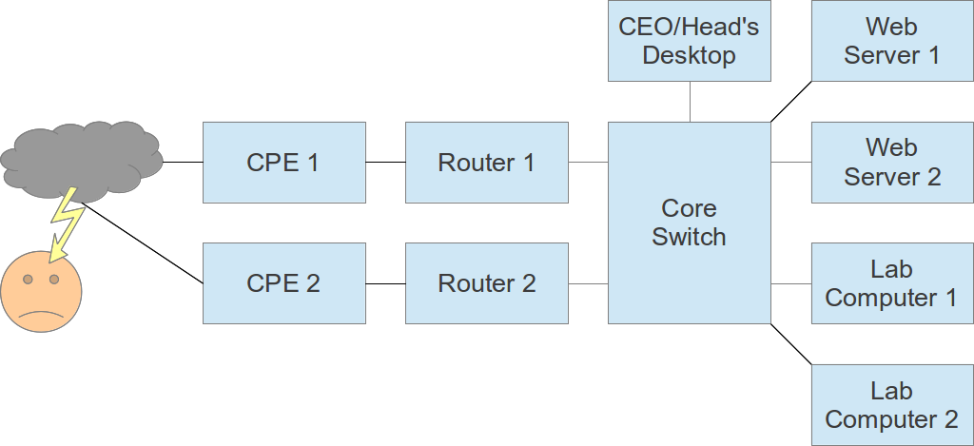
Redundancy Example
Study this network diagram and identify the single points of failure, and possible solutions including fallbacks (lower capability):

Slide 8
How do we keep users informed?
Why does it matter to users?
When do you notify them?
What do you tell them?
How do you tell them?
Notes:
By notifying users when a fault has occurred, we allow them to plan their time, to avoid frustration and wasting time. This results in a higher level of user satisfaction and quality of service.
The network does not run better, but people are happier if their time is not being wasted.
We can notify users in advance, as soon as we know that a fault or reduced service will occur. The more advance warning they have, the better they can plan, and the less effect the downtime will have on them. But it will never be zero, so it's still better to avoid or mitigate downtime if possible.
If we did not notify them in advance, we can notify them as soon as possible when a fault has occurred.
In both cases, we can tell them when it will be fixed by. If we can't do that, we should make it clear why we don't know, what we are doing to find out, and when we expect to have more information by.
We can keep users informed of current and future status, for example by having a network status and planned outages web page. We can encourage users to check this page before contacting IT support or submitting fault reports. We can make the page easy to find and to update.

Slide 9
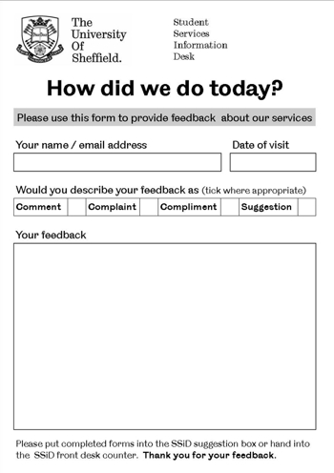
How do we get better?
Desire to improve
Reflect on what we did
Inquire into other possibilities
Share knowledge with peers
Ask users for their opinion
Notes:
From Reflective Practice on Wikipedia:
Reflective practice is "the capacity to reflect on action so as to engage in a process of continuous learning", which, according to the originator of the term, is "one of the defining characteristics of professional practice".It involves "paying critical attention to the practical values and theories which inform everyday actions, by examining practice reflectively and reflexively. This leads to developmental insight".Reflective practice can be an important tool in ... individuals learning from their own professional experiences, rather than from formal teaching or knowledge transfer. It may be the most important source of personal professional development and improvement. As such the notion has achieved wide take-up, particularly in professional development for practitioners in the areas of education and healthcare.The question of how best to learn from experience has wider relevance however, to any organizational learning environment. In particular, people in leadership positions have a tremendous development opportunity if they engage in reflective practice.
One great value of a support ticket system is in examining closed tickets. Regularly take a sample and ask yourself:
How do you know it was resolved?
Has it happened again since?
How many times has this happened?
How much frustration or difficulty does it cause?
Could you reduce the risk or severity of it happening?
How long did it take to resolve? Could it be faster?
Could you add monitoring to detect if it happens again?
Also, look at the users of the system. How many people will come back next time they have a problem? If not, why not? Does the system reward or discourage them?
What fraction of support tickets are duplicates? How much extra work do they create? Can the system do anything to reduce them, such as searching for similar tickets and offering them to the user? Can you provide self-help information, such as instructions on resolving common problems?
How long does it take to resolve a support request/ticket? Is the time reasonable? Could it be reduced?
If some requests are denied, because they fall outside the scope of the IT department's responsibility or contradict policy:
How many requests are successfully resolved and how many denied?
Do successful and denied requests fall into categories?
Could you help users to know in advance whether their request is likely to be accepted or denied?
It's a good idea to schedule time regularly to work on these issues. Preferably, leave a minimal support staff at the office, and work from a quiet place with phones off, where you can think clearly without distraction.
Personally I like to reflect, immediately after a problem is resolved, to find two sensible ways to prevent that problem from happening again, or detect it more quickly; and implement both of them.
If you don't have time to implement them immediately:
Make a list of things to do.
Schedule a reasonable amount of time each month to work on them.
Recognise and reward staff who provide excellent service to users.
Tell people about what you do. Write an organisational blog about the changes you've made to improve service. If users believe that you can change, they are likely to try to change you. This is an excellent thing.
Your users know what the biggest problems are. Who are your most important users? Do you talk to them?

