Slide 1
INASP: Effective Network Management Workshops
Unit 6: Solving Network Problems

Slide 2
About these workshops
Authors:
Dick Elleray, AfriConnect
Chris Wilson, Aptivate
Date: 2013-04-29
Portions of this chapter reused from the e-book How to Accelerate your
Internet under the Creative Commons Attribution-ShareAlike 2.5 license.

Slide 3
Objectives
On completion of this session, we hope you will know about:
Importance of troubleshooting in network management
Troubleshooting vs. monitoring
Good troubleshooting technique
Troubleshooting a rogue DHCP server
Troubleshooting a slow Internet connection

Slide 4
What is troubleshooting?
Identify the problem
By manual, logical deduction
To help us fix it

Slide 5
Troubleshooting is not monitoring
Once the network is working well, we set up monitoring to:
warn us if it stops working well
help us troubleshoot more quickly
The next unit is about monitoring.
Notes:
For example, if you can't access your mail server, what would you do?
You troubleshoot, and discover that the mail server has crashed.
You set up monitoring (Nagios) to alert you if the mail server crashes again, before your users complain, so that you can fix it faster.
You set up monitoring to find out why the mail server is crashing, for example you enable crash dumps and CPU and memory use logging.

Slide 6
Troubleshooting is not management
Emergency quick fixes (fire-fighting) will not keep the network running well! But it's a necessary part:
unexpected things will happen
need to understand to fix them quickly
and to prevent them happening again
or detect and resolve more quickly next time

Slide 7
Proper troubleshooting technique
Prepare for problems (see Unit 4/Disaster Response)
Responding to a problem
Identify possible causes
Eliminate causes

Slide 8
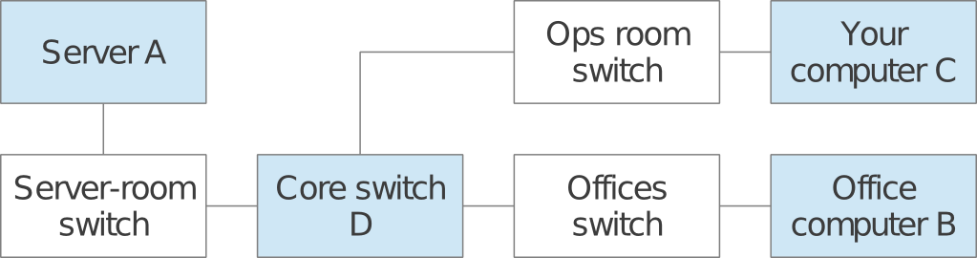
Responding to a problem
You might want to print this out and display on your wall!
Don't panic
Find a quick test
Understand the problem
Is it plugged in?
What was the last thing changed?
What is "known good"?
Make a backup
Change one variable at a time
Do no harm
Notes:
In more detail:
Don't panic
Find a quick test
Understand the problem
Is it plugged in?
Is it apparently OK?
switches and computers have link lights for network ports;
a desktop computer should display a graphical screen and respond to mouse movements;
a server should display a console and respond to keyboard or mouse movements;
you should be able to open a website such as Google, or an internal server;
you should be able to ping a server, desktop or managed switch.
What was the last thing changed?
Eliminate possibilities
What is "known good"?
Change one variable at a time
Do no harm

Slide 9
Example: Internet access not working
How would you troubleshoot it?
Notes:
Some hints:
Check other websites and applications
Ping some servers
Check your DNS
Traceroute to find the break
It happens all the time. Suddenly, the network isn't working at all. What do you do? Here are some basic checks that will quickly point to the cause of the problem.
First make sure the problem is not just with the one web server you want to contact. Can you open other websites such as www.google.com? If you can open popular web sites but not the one you requested, the problem is likely with the site itself, or with the network between you and the other end.
If your web browser cannot load pages from the Internet, next try to browse to a server on the local network (if any). If local sites are shown quickly, then that may indicate a problem with the Internet connection or the proxy server. If not, then you most likely have a problem with the local network.
If you suspect a problem with the proxy server, try accessing information with a different program, such as an email client. If you can send and receive email, but web browsing still doesn't work, then this may further indicate problems with the proxy server.
Your web browser and mail client can only provide so much information. If nothing seems to be working at all, it's time to switch to a more useful diagnostic tool such as ping.
Try pinging a server on the Internet with a well-known IP address such as 4.2.2.2 or 8.8.8.8:
$ ping 4.2.2.2
PING 4.2.2.2 (4.2.2.2) 56(84) bytes of data.
64 bytes from 4.2.2.2: icmp_seq=1 ttl=247 time=85.6 ms
64 bytes from 4.2.2.2: icmp_seq=2 ttl=247 time=86.3 ms
64 bytes from 4.2.2.2: icmp_seq=3 ttl=247 time=84.9 ms
64 bytes from 4.2.2.2: icmp_seq=4 ttl=247 time=84.8 ms
--- 4.2.2.2 ping statistics ---
4 packets transmitted, 4 received, 0% packet loss, time 3012ms
rtt min/avg/max/mdev = 84.876/85.436/86.330/0.665 ms
If you can ping an IP address then your basic connectivity is working, so the problem may be another setting. If not, the problem may be at your ISP, or your connectivity to them. traceroute may help you to identify where the problem is.
Try pinging a well-known web server that responds to pings, such as www.google.com:
$ ping www.google.com
PING www.l.google.com (66.102.9.99) 56(84) bytes of data.
64 bytes from 66.102.9.99: icmp_seq=1 ttl=243 time=30.8 ms
64 bytes from 66.102.9.99: icmp_seq=2 ttl=243 time=31.6 ms
64 bytes from 66.102.9.99: icmp_seq=3 ttl=243 time=30.9 ms
--- www.l.google.com ping statistics ---
3 packets transmitted, 3 received, 0% packet loss, time 2016ms
rtt min/avg/max/mdev = 30.865/31.176/31.693/0.395 ms
If this works as well, it indicates that your network connection is working just fine, and the problem is very likely with your proxy (or your web browser's proxy settings).
If you can ping an IP address but not a domain name, then the network is fine but your computer is unable to convert the domain name (www.google.com) into an IP address (66.102.9.99). Check to make sure that your DNS server is running and is reachable.
If you can't ping an Internet IP address, then it's a good idea to make sure that your local network connection is still working. Does your computer have a valid IP address? Use ifconfig on UNIX or ipconfig on Windows to make sure your IP settings are correct.
If you don't have an IP address then you are definitely not connected to the Internet. Check the cables from your computer (or the wireless settings if using wireless). Also check that your DHCP server is up and running, if you use DHCP. If you have an IP address but it is incorrect, then there are only two possibilities. Either your machine is using the wrong settings, or there is a rogue DHCP server on the local network. Either change your local settings or track down the bad DHCP server.
If you do have a valid IP address, try pinging the gateway's IP address:
$ ping 192.168.0.1
PING 192.168.0.1 (192.168.0.1) 56(84) bytes of data.
64 bytes from 192.168.0.1: icmp_seq=1 ttl=64 time=0.489 ms
64 bytes from 192.168.0.1: icmp_seq=2 ttl=64 time=0.496 ms
64 bytes from 192.168.0.1: icmp_seq=3 ttl=64 time=0.406 ms
64 bytes from 192.168.0.1: icmp_seq=4 ttl=64 time=0.449 ms
--- 192.168.0.1 ping statistics ---
4 packets transmitted, 4 received, 0% packet loss, time 2999ms
rtt min/avg/max/mdev = 0.406/0.460/0.496/0.035 ms
If you can't ping your gateway then the problem is definitely in your local network -- maybe the switch or router needs to be restarted. Check all the cables (both network cables and power cables).
If you can ping your gateway, then you should next check the Internet connection. Maybe there is a problem upstream. One good test is to log into your gateway router and try to ping the gateway at your ISP:
If you cannot ping your ISP's gateway, then the problem is with your Internet connection.
If you can ping your ISP's gateway but no other Internet hosts, then the problem may exist beyond your ISP. It's probably a good idea to phone your ISP and check if they have a problem, or can help you with troubleshooting.
Is everything still not working? Then it's time to roll up your sleeves and get to work. You should reread the Responding to a problem section and settle down for some slow and methodical work, checking each part of your network bit by bit.

Slide 10
Example: Rogue DHCP server
One of the most common network problems: an unexpected DHCP server causes havoc by assigning users the wrong IP addresses.
Notes:
A misconfigured DHCP server, either by accident or intentionally malicious, can wreak havoc on a local area network. When a host sends a DHCP request on the local network, it accepts whichever response it receives the fastest. If the rogue DHCP server hands an incorrect address faster than your own DHCP server, it can potentially blackhole some of your clients.
Most of the time, a rogue DHCP server is either a misconfigured server or wireless router. Rogue DHCP servers are difficult to track down, but here are some symptoms to look for:
Clients with improper IP addresses, netmasks, or gateways, even though your DHCP server is configured correctly.
Some clients can communicate on the network, others cannot. Different IP addresses are being assigned to hosts on the same network.
Rebooting a client makes it randomly start working or stop working.
While sniffing network traffic, you see a DHCP response from a server IP or MAC address that you do not recognise.
Once you have determined the rogue DHCP server's MAC address from a packet trace, you can then make use of various layer 2 tracing techniques to determine the location of the rogue DHCP server, and isolate it.
It's almost impossible to completely prevent rogue DHCP servers from appearing on your network. But there are some steps you can take:
Educate your users on the dangers of misconfiguring or enabling DHCP services on your local LAN.
Windows and UNIX systems engineers and users setting up access points on your local LAN should be careful not to place such a service on the local LAN.
Some switching hardware platforms have layer 2 filtering capabilities to block DHCP responses from network interfaces that should never be connected to a DHCP server. On Cisco switching platforms, you may want to use the "dhcp snooping" feature set to specify trusted interfaces which are allowed to transmit DHCP responses (the ones connected to your DHCP servers). Apply these to server access ports and all uplink ports on your switch fabric.
Use a network monitor such as Nagios to detect unexpected DHCP server replies on your network and raise the alarm.

Slide 11
Example: Slow Internet connection
What do you need to check?
DNS speed
proxy server
ping times/latency
available bandwidth
free bandwidth

Slide 12
How slow is it?
What are response times (latency) for loading external sites?
Measure the speed loading a specific web page, for example http://www.google.com, using the ab utility:
ab -n 100 http://www.google.com/
This is ApacheBench, Version 2.3 <$Revision: 655654 $>
...
Requests per second: 18.16 [#/sec] (mean)
Time per request: 55.081 [ms] (mean)
Transfer rate: 17.52 [Kbytes/sec] received
Notes:
You need something to compare it to, for example:
How fast is it when the connection is not busy?
How fast is it using another ISP?
Is it less than one second?
Standard are arbitrary, but Jakob Nielsen argues that:
> 0.1 second delay loses the instant feeling.
> 1.0 second interrupts the user's flow of thought.
> 10 seconds and you lose the user's attention.
So if web pages load in 0.1 seconds that's really good; less than 1 second is OK, and over 1 second is bad (annoying).
You can automate this test using Nagios and receive an alert by email whenever the speed of web page loading becomes too slow.

Slide 13
What influences page loading speed?
DNS resolution, the available bandwidth and the latency are lower bounds:
if a DNS lookup takes 1 second, the page cannot load in less than 1 second.
a link with 1 Mbps free cannot load a 1 MB page in less than 8 seconds.
a link with 3 second latency cannot load any page in less than 9 seconds.
Notes:
Keep link latency and free bandwidth under control to ensure that web pages load fast.
DNS responses are cached, but it's worth monitoring how fast they are too, otherwise you can have random long delays which are hard to diagnose.
If you have a proxy server, it should be monitored too.

Slide 14
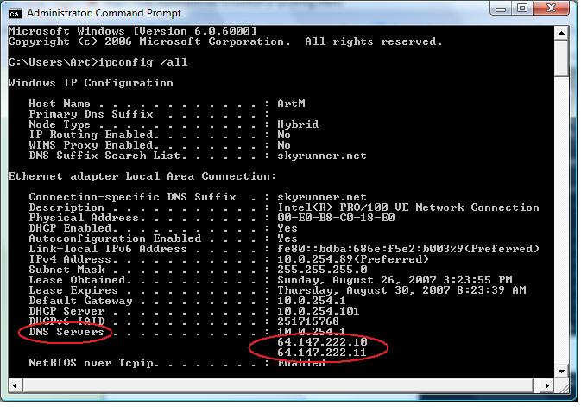
Check the DNS server
Notes:
You can check your DNS speed quickly using the UNIX host command-line tool, for example:
$ host www.google.com
www.google.com has address 173.194.41.180
The reply may take a second if you haven't looked up the site before. After that it should be immediate, because the DNS server should cache it. Try different sites, particularly ones that you haven't visited recently. Try inventing random nonexistent hostnames to test this:
$ host ldigvtliyh.google.com
Host ldigvtliyh.google.com not found: 3(NXDOMAIN)
If not, which DNS server are you using? The command ipconfig /all should tell you:
If you're not using a local, cacheing DNS server, you should be.
Don't use your ISP's DNS servers directly on your computers if you can help it. It's much better to use local cacheing DNS servers. These should be the only computers configured to use your ISP's servers as an upstream.
However you can use the UNIX host command to test a specific server, to see if it gives a faster response. For example, if one of your ISP's DNS servers is 192.168.14.40, you can test it like this:
$ host www.google.com 192.168.14.40
;; connection timed out; no servers could be reached
That means that your ISP's server has crashed. This will cause random slow page loading while your local caches wait for a reply from this server.
You can check all your local DNS servers (the ones listed by ipconfig) to make sure that they all reply, and quickly. If any fails to reply, that will cause random, slow page loading. It may mean that:
your DNS server has crashed; or
it has the wrong network configuration; or
it is using the wrong upstream servers; or
one of the upstream servers has crashed; or
your Internet connection is down or overloaded.
You can configure a network monitor such as Nagios to warn you if a DNS server stops responding, or takes too long.

Slide 15
Check the proxy server
Notes:
You can use the UNIX command-line tool ab (ApacheBench) to check a proxy server:
$ ab -P fen-vz-proxy.aptivate.org:3128 http://www.google.com/
This is ApacheBench, Version 2.3 <$Revision: 655654 $>
...
Complete requests: 1
...
Requests per second: 20.04 [#/sec] (mean)
Time per request: 49.895 [ms] (mean)
Time per request: 49.895 [ms] (mean, across all concurrent requests)
Transfer rate: 19.34 [Kbytes/sec] received
Or you can configure your browser to use the proxy server, and see if you can access web pages.
If that doesn't work (ab complete requests is not 1, or the page doesn't load) then try disabling the proxy in your browser, or running ab without the -P option. This will only work if your firewall allows you to bypass the proxy server, which is not recommended for network security. You may want to temporarily allow direct access, and disable it after testing.
You can configure a network monitor such as Nagios to warn you if the proxy server stops working.

Slide 16
Check ping times (latency)
Ping a server on the Internet, for example www.bbc.co.uk or www.google.com:
$ ping www.bbc.co.uk -n
PING www.bbc.net.uk (212.58.244.69) 56(84) bytes of data.
64 bytes from 212.58.244.69: icmp_req=1 ttl=56 time=19.6 ms
64 bytes from 212.58.244.69: icmp_req=2 ttl=56 time=19.4 ms
64 bytes from 212.58.244.69: icmp_req=3 ttl=56 time=19.2 ms
64 bytes from 212.58.244.69: icmp_req=4 ttl=56 time=19.4 ms
Notes:
As a rule of thumb, time to load a small web page is about 3 round trips. So based on Jakob Nielsen's results above, the ping time should be:
< 30 ms is really fast (feels instantaneous)
< 300 ms is noticeable but usable (for web access, not for Skype)
< 3000 ms to avoid losing the user's attention (unbearably slow)
From a broadband connection in the UK, ping time to www.bbc.co.uk would normally be under 30 ms.
You can configure Nagios to warn you if the ping time goes over this threshold.

Slide 17
Interactive applications
Latency sensitive
Usually less bandwidth intensive
May require bandwidth reservation
Notes:
Interactive applications include:
Real-time Voice over IP (VoIP) and videoconferencing applications, such as Skype;
Online whiteboards and collaborative tools (Kanban, Trello, games);
Remote desktop applications (Citrix, Microsoft Terminal Services).
These applications are able to operate with relatively little bandwidth, but are much more sensitive to latency, jitter (sudden changes in latency) and packet loss, all caused by congestion.
You may need to reserve bandwidth for these applications to enable them to run effectively.

Slide 18
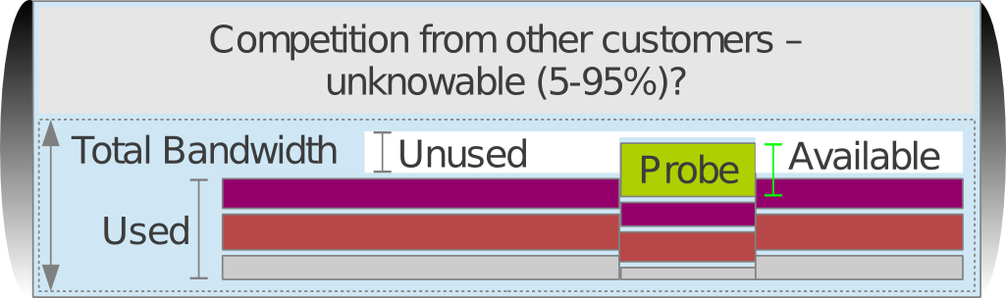
Available and Total Bandwidth
What do you know? What can you measure?
Notes:
Total bandwidth
Used bandwidth
Unused bandwidth
Available bandwidth
The TCP protocol contains a backoff mechanism, which causes it to reduce its bandwidth use when it detects packet loss.
Packet loss is caused by congestion, and randomly affects all flows, so TCP streams tend to share all bandwidth quite fairly between them.
When a new stream (such as a download test) enters the race, it jostles with existing streams, pushing them all to reduce their bandwidth use to some extent. So the available bandwidth is more than the unused bandwidth.
If you have a guaranteed, uncontended link then you know the total bandwidth. Otherwise, you can only approximately measure it by filling the link, which reduces unused bandwidth to zero.
Notice from the diagram above how inserting the Probe (speed test) into the network reduces the bandwidth of all other flows, and increases the Used bandwidth to nearly 100%.

Slide 19
Available bandwidth testing
There are various sites which offer speed tests:
http://www.speakeasy.net/speedtest/
http://www.megapath.com/speedtestplus/
http://www.speedtest.net/
Or just download a large file.
Notes:
A speed test will tell you how much available bandwidth there is:
how much is currently unused, plus
how much you can jostle for with other users.
This influences page loading speed (along with latency):
For smaller pages, and large pages with many resources, loading speed is dominated by latency.
For pages with a few large resource (such as images/flash) and downloads, loading speed is dominated by available bandwidth.

Slide 20
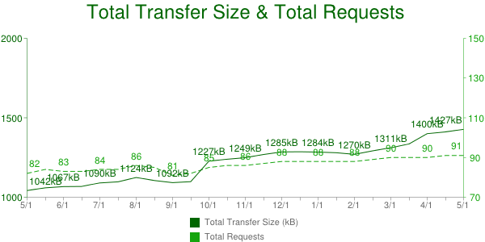
How much free bandwidth do I need?
Average web page was 1.4 MB in April 2013 (~11 Mbit).
HTTP Archive page size trends, May 2012-2013
To load in 0.1 second, you need 110 Mbps (instantaneous - unrealistic?)
To load in 1 second, you need 11 Mbps (~UK average broadband, fast)
To load in 10 seconds, you need 1 Mbps (acceptable)
Less than 1 Mbps available: really bad!
Notes:
You can measure available bandwidth on your network with a speed tester (see Available bandwidth testing).
Note that streaming video is very sensitive to available bandwidth. Normally it's encoded at a specific bit rate (e.g. 1 Mbps) and unless your connection can support that bitrate, you will have to download most of the video before it will play, or it will pause continuously to buffer more data.

Slide 21
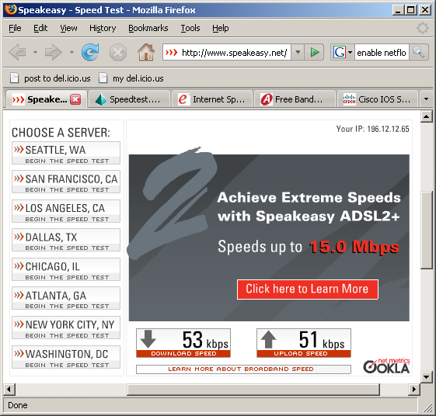
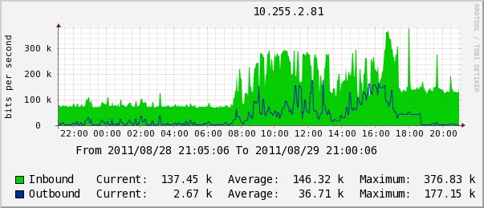
Available bandwidth and contention
Example speed test on an African network with 512 kbps bandwidth and a 10:1 contention ratio.
Notes:
Why would your available bandwidth be less than the total:
Of course, other users sharing your connection may be using it right now;
And your total bandwidth may be less than expected, because of contention.
Most Internet providers oversell their bandwidth (sell the same bandwidth multiple times). This is called contention. It means that you don't get guaranteed or reserved bandwidth, but you have to compete for it with other users (customers of the ISP):
When nobody else is using it, you get the full rated capacity of your connection.
When everyone is using their connection heavily, you get the contention ratio, 10% of your full rated capacity in this case (10:1 ratio).
It's difficult to measure your total bandwidth unless:
You have no contention (guaranteed/reserved bandwidth): then it should be the same as your guaranteed bandwidth; or
You can fill it completely and measure average bandwidth used on the router; or
You can empty it completely and then run a speed test (with no competition, total = available bandwidth).
If you report a low speed test to your ISP, they will usually tell you to repeat the test with no other computers connected, to measure the total bandwidth, not the available bandwidth.
Emptying the connection requires you to disrupt it, or switch all users to a backup connection. Measuring the average bandwidth used on the router is less disruptive.
Your Internet provider may be able to provide you with graphs from their side, for example using Cacti:
On a Cisco router you can get the used bandwidth average over the last five minutes with the show interface command:
r1>show interface GigabitEthernet0/0
GigabitEthernet0/0 is up, line protocol is up
Hardware is BCM1250 Internal MAC, address is 0011.2233.4455 (bia 0011.2233.4455)
Description: link 1
...
Input queue: 0/75/3208/72484 (size/max/drops/flushes); Total output drops: 1373910311
Queueing strategy: Class-based queueing
Output queue: 0/1000/12 (size/max total/drops)
5 minute input rate 79658000 bits/sec, 19312 packets/sec
5 minute output rate 140174000 bits/sec, 21984 packets/sec
The output rate on this interface (which might be download or upload, depending on whether it's the inside or outside interface) seems to be 140,174,000 bps (140 Mbps) averaged over 5 minutes. You can change the
averaging interval with the load-interval 30 command, for example to 30 seconds or 10, which is less accurate but more responsive.
You can also set up Cacti yourself, if your router supports SNMP. This is covered in Unit 7, Network Monitoring.
The symptoms of contention are just a reduction in available bandwidth.

Slide 22
Contended bandwidth
Ask yourself:
When are we likely to use our connection heavily?
When are other ISP customers likely to use their connections heavily?
Do we really get what we paid for, or only 10% of it?
Who benefits from the "fast" connection at off-peak times?
Notes:
Most Internet providers sell contended bandwidth. That means that they buy some bandwidth and sell it several times over.
Why? They guess that each customer won't use 100% of their bandwidth all the time. How much of your bandwidth do you use? For how much of the day?
Contended bandwidth works well for individual users. For example, Zen Internet, an Internet provider in the UK, offers a "Pro" package with 200 GB per month, intended for a single heavy user. This is on an ADSL line with a theoretical maximum speed of 16Mbps, i.e. 2 MB per second or 5,000 GB per month. They expect a "professional" user to use about 4% of their connection (12% if confined to office hours).
Contended bandwidth is not good for multiple users. They compete against each other for the line capacity, and against all the other users that their ISP sold the same bandwidth to.
With a contended service, you cannot measure how much bandwidth you actually have available at any time. Nor do you have any control over the other users (customers) of the ISP. So you can't allocate bandwidth fairly between users to guarantee quality of service (QoS) to them.
Contended services cannot be high-quality guaranteed services, ever.
As the speed test result under Available bandwidth and contention shows, when all 10 contending customers use the service at 100% of capacity, they each get about 10% of the bandwidth they expect.

Slide 23
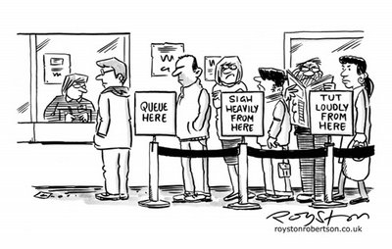
What is congestion
Congestion = full connection + long queue = unmanaged contention.
Notes:
Imagine a shop that serves one customer per minute:
If customers arrive at 0.99 per minute:
no queue, and each customer gets immediate attention.
If customers arrive at 1.01 per minute:
a queue builds up, customers wait longer and longer, some get bored and leave.
In the second case, the shop makes 2% more money, but the customers experience is completely different!
Congestion is related to, but worse than contention. Internet providers carefully manage queue length and fairness policies on their routers to avoid causing congestion when you use the maximum capacity available to you.

Slide 24
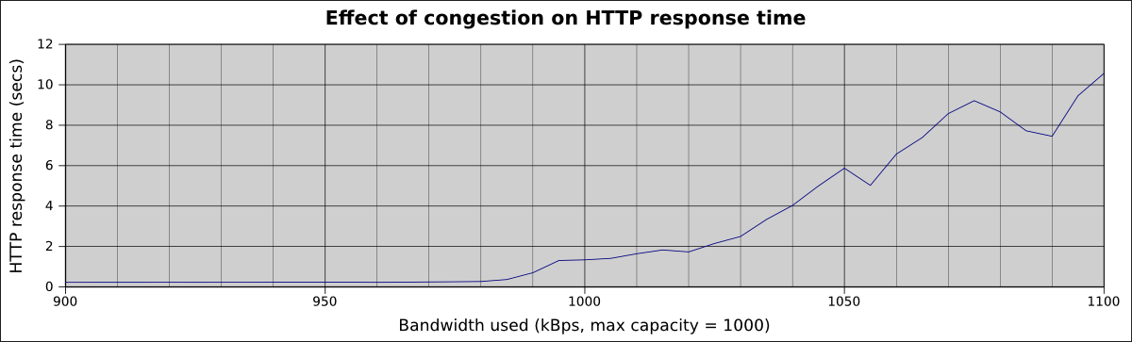
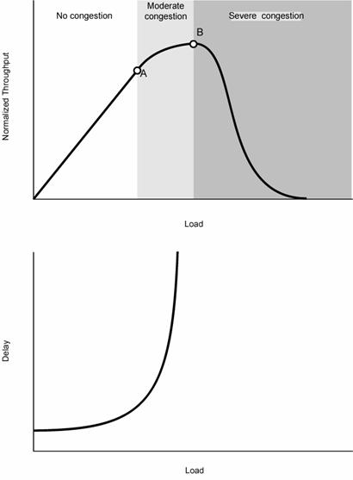
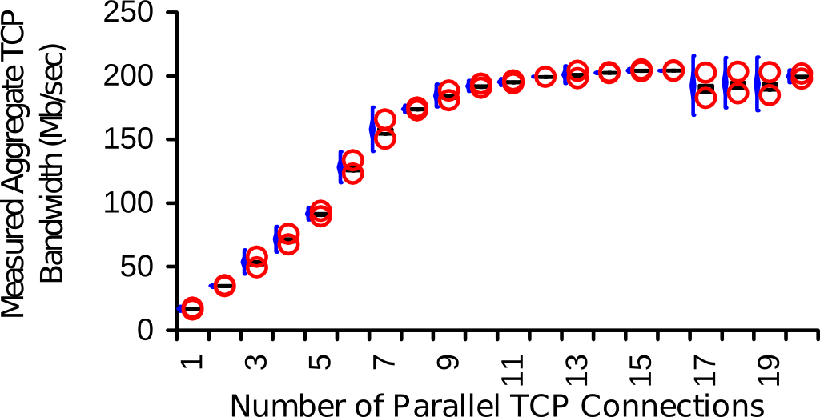
Effect of congestion
What happens when a link becomes full?
Notes:
Tests with a simulated (throttled) link with 1 Mbps bandwidth and 100 ms latency:
Web page loads very fast (~0.25 seconds) until connection is 98% full.
At 100% full it takes 1 second
At 105% full (5% packet loss) it takes 6 seconds
Congestion is closely related to contention:
full connection + short queue = contention (what your ISP does)
full connection + long queue = congestion
Your ISP is unlikely to be congested (that would be a sign of bad network management) but it could happen. They should shorten the queue length on their routers.
The symptoms of congestion are:
a reduction in available bandwidth
packet loss (should not happen normally)
an increase in latency (caused by excessive queueing).
Packet loss and duplicate packets can also be caused by faulty network equipment, or radio interference on a wireless link, so they are not enough to identify congestion by themselves unless you can rule these causes out.
Theoretical predictions show that:
Actual throughput falls off rapidly as the network becomes congested (packet loss increases)
Latency/delay climbs exponentially when the load is slightly higher than capacity.
(Credit: Lancaster University, Vasileios Asloglou, Advanced Networking and the Internet Coursework. Tutorial Topic: Congestion Control techniques. http://www.lancs.ac.uk/postgrad/asloglou/ (dead link))
Note that I could not find the source paper, and I found evidence that contradicts these models, in a paper called The End-to-End Performance
Effects of Parallel TCP Sockets on a Lossy Wide-Area Network. This paper appears to show that under some assumptions, multiple simultaneous TCP streams experiencing random fair packet loss will all back off together, and aggregate flow neither increases nor decreases as the number of connections rises:

Slide 25
Is my network congested?
Probably yes if:
It's much faster when nobody is using it, or
Available bandwidth is less than 1 Mbps, or
Latency is over 300 ms, or
You see non-trivial levels of packet loss.
Notes:
Congestion is most likely to be on your weakest link (your Internet connection), but it is possible that your Internet provider has congestion in their network as well/instead.
You can spot congestion by looking for large jumps in latency on a traceroute:
$ traceroute 10.0.156.214
traceroute to 10.0.156.214 (10.0.156.214), 30 hops max, 60 byte packets
1 10.0.156.130 (10.0.156.130) 52.161 ms 52.150 ms 52.129 ms
2 10.0.156.197 (10.0.156.197) 322.024 ms 322.018 ms 321.968 ms
3 10.0.156.214 (10.0.156.214) 321.949 ms 321.932 ms 321.913 ms
This traceroute has a jump in latency of 270ms between hops 1 and 2, which cannot be explained except by congestion. Compare with the same traceroute when the connection is unloaded:
$ traceroute 10.0.156.214
traceroute to 10.0.156.214 (10.0.156.214), 30 hops max, 60 byte packets
1 10.0.156.130 (10.0.156.130) 59.295 ms 59.259 ms 59.237 ms
2 10.0.156.197 (10.0.156.197) 119.209 ms 119.233 ms 119.218 ms
3 10.0.156.214 (10.0.156.214) 119.204 ms 119.189 ms 119.173 ms
The latency between hops 2 and 3 has dropped from 270ms to 70ms.

Slide 26
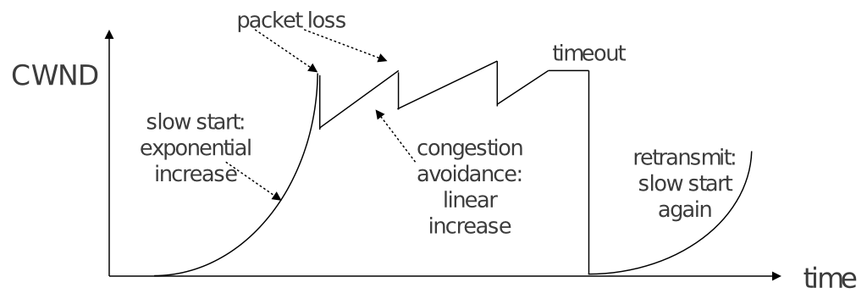
What causes congestion
TCP protocol
backoff only on packet loss
ability to saturate connection
excessive queue length
Notes:
IP (the Internet protocol standard) includes TCP (Transmission Control Protocol):
provides reliable delivery of large data streams
is used by most Internet traffic, including web pages, downloads and videos
tries to use maximum possible bandwidth
increases bandwidth use until packets are dropped
which only happens when a queue is full
therefore it creates congestion (fills a queue).
So congestion is inevitable if you have limited bandwidth. But you can reduce the effects by carefully controlling queue sizes, as ISPs do.

Slide 27
Solving the problem
If available bandwidth is the main problem:
slow page loading
slow downloads
high latency or packet loss
connection is full (congestion)
Then you need to increase supply of bandwidth and/or reduce demand. See Unit 9, Making a Difference.

Slide 28
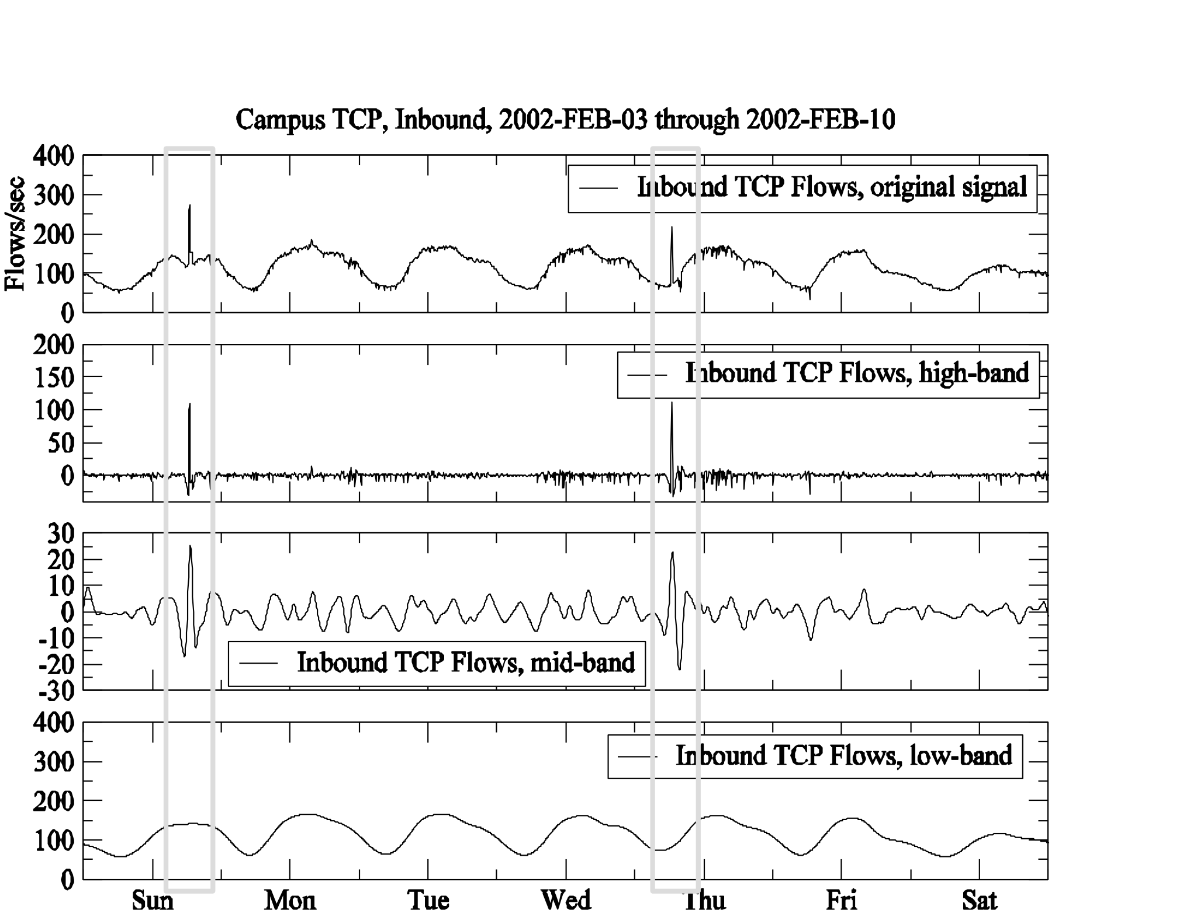
Example: Denial of Service Attack
Graphical tools can spot unusual changes in traffic levels, which may indicate an attack, and pinpoint start and stop times.

Slide 29
Summary
Hopefully you now feel more confident with:
Importance of troubleshooting in network management
Troubleshooting vs. monitoring
Good troubleshooting technique
Troubleshooting a rogue DHCP server
Troubleshooting a slow Internet connection
Notes:
In the next unit, we will cover how to understand in more detail how a connection is being used. That will help us to know whether we can change user behaviour to reduce overloading.

