Slide 1
INASP: Effective Network Management Workshops
Unit 7: Network Monitoring

Slide 2
About these workshops
Authors:
Dick Elleray, AfriConnect
Chris Wilson, Aptivate
Date: 2013-04-29

Slide 3
Objectives
On completion of this session, we hope you will know about:
Importance of monitoring in network management
Why continuous traffic monitoring is important
How network traffic monitoring is being done in representative institutions

Slide 4
Why Monitor?
Do you have the information you need:
Are getting what you paid for?
Is it being used for the purpose intended?
Is it being used efficiently?
What will you need in future?
Can you detect and troubleshoot problems quickly?
Can you enforce and improve the Acceptable Use Policy?
Can you provide good service to users?
Can you explain what you are doing and why?
Notes:
Monitoring with historical data collection leads to better service, because it allows to:
detect problems (changes from normal) before users notice and complain (Unit 4);
identify that some use complaints are not caused by a change in performance;
identify when two things are related, because they happened at the same time;
explain what we are doing to management and network users.

Slide 5
Group Discussion
If you are participating in a workshop, please discuss in groups:
What sorts/aspects of traffic could be monitored?
Why are those sorts/aspects of traffic monitoring important?
Which does your institution monitor?
What tools do you use? What works well or not?
Have you found it of use? How and why?
When you have finished, please summarise your results to the other groups.

Slide 6
Zimbabwe Example
Protocols
Dropped packets
IPs in use on LAN
P2P
Virus traffic
Hackers spoofing
SMTP (illegitimate mail)
Usage (who, what)
Applications using high bandwidth
Movies
Music
telnet
Voip/sip
Microsoft ds
Non business browsing
Amount of bandwidth (per user if poss)

Slide 7
Rwanda Example
Protocols
Dropped packets
IPs in use on LAN
P2P
Virus traffic
Amount of bandwidth (per user if poss)
Hackers spoofing
SMTP (illegitimate mail)
Usage who what
Applications using high bandwidth
Movies
Music
telnet
Voip/sip
Microsoft ds
Non business browsing

Slide 8
Are you getting what you paid for?
You need to know:
Is it working at all? If not, when will it be fixed?
How much capacity you actually have, when you need it (all day?)
How much you are supposed to get (e.g. 100 Mbps with 10:1 contention?)
Do you need instant answers or long-term measurement?
Notes:
Spot checks give an instant picture, but not complete. Automated monitoring can give you a long-term picture, identify whether your service provider is meeting their Service Level Agreement (SLA) with you, and help with trending and fault-finding.

Slide 9
What can you measure?
  Is the connection working at all?
      Can you get traffic through it both ways?
      Can you reach destinations on the Internet?
  How much traffic is passing in both directions?
      Traffic sizing is a primary tool for first-line diagnosis of problems
  What kind of traffic is it?
      Types of traffic and their size
      Important for investigating and fixing congestion (over-use)
Notes:
Checking whether the connection is working right now is relatively easy. In Unit 6 we cover investigative techniques, using tools like ping and traceroute, to check whether your connection is functioning at all, and if so how fast/well.
Checking the total amount of traffic is also quite easy, if your border router has built-in graphs of traffic use. If it supports SNMP, you can also set up long-term monitoring and graphing quite easily, with tools like Cacti.
Diving into traffic types, identifying the different streams and the volume of traffic that they constitute, is hard, and requires knowledge of how TCP/IP works, and how to use packet sniffing tools such as tcpdump or wireshark. The information is too large to store and process at reasonable cost. Capturing and using this information long-term requires you to be able to compress it into a more useful form, such as flows, which requires knowledge of tools that generate, store and process Netflow data, such as Cisco routers, pmacct, nfsen and argus.

Slide 10
How much capacity do you have?
How can you monitor this long-term?
Spot checks give an instant picture, but not complete.
Automated monitoring helps with trending and fault-finding.
Notes:
We covered how to measure speed instantaneously in Unit 6. But you want a long-term solution, and manual speed tests take a lot of time. You can use Nagios to check for contention at your ISP:
packet loss
latency
available bandwidth (speed test)
You will get false alarms when your own connection is congested, so:
either eliminate that (with careful bandwidth management), or
subtract the percentage of time when the local connection is the problem.
You may want to measure other providers (collaborate with other universities?) to see if they offer a better service.
Creating the Nagios service to measure bandwidth will require:
An iperf server hosted on the Internet (don't know of a public one); or
A public bandwidth testing server (maybe Web100 with adapted client?), or
A large file downloaded with wget or ab (limited results)
TODO measure some data or use the GPRS benchmark data to show how to monitor and interpret contention and congestion.

Slide 11
How is it being used?
We need to analyse traffic on the connection:
Is it being used for the purpose intended?
Is it being used efficiently?
Even if bandwidth is doubled, it will still need managing to ensure maximum efficiency
Notes:
Otherwise, we won't know whether the organisation is getting value from their investment in the Internet connection, nor argue for more funding for a faster or more reliable connection.

Slide 12
When to measure

Slide 13
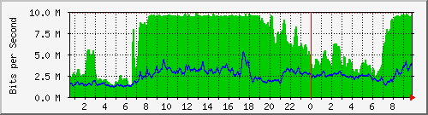
Overall traffic level
A good indicator of network health is lack of congestion.
Is this link congested? When and for how long?
Notes:
This graph was generated by MRTG, collecting data from a router's SNMP counters or directly from the interfaces.
The characteristic flat top between 0800 and 1900 on the graph indicates that the network is fully utilised, which means it's very likely to be congested. The graph cannot prove this, because it doesn't measure latency, packet loss or available bandwidth (the signs of congestion; see Unit 6/Is my network congested?).
Why is it likely to be congested? Normally a flat top means that at least one TCP connection is running, since TCP tries to use all available bandwidth. TCP keeps increasing its bandwidth use until packets start dropping. This normally happens when the queue is full, so TCP normally tries to fill up the link, causing congestion.
In practice there were probably hundreds or thousands of TCP flows active between these times. The total amount downloaded is 10 Mbps (~1.25 MBps) for 11 hours, which is ~50 GB. It's unlikely that one person was downloading a single 50 GB file for the entire day!

Slide 14
Congestion questions
Good questions to ask about network congestion:
Is it happening?
When is it happening?
How bad is it? What are the consequences?
What applications, protocols, servers and users are contributing to it?
How busy (%) is the network on average, and during the periods of peak usage/congestion?

Slide 15
Group Discussion
What is your experience of congestion?
Scope
Regularity
Impact
Recoverability
Prevention
Notes:
If you are working in a group, please share your experience with the others. If you are studying alone, please have a look at your network monitoring systems, and try to identify congestion. Is your network congested right now?

Slide 16
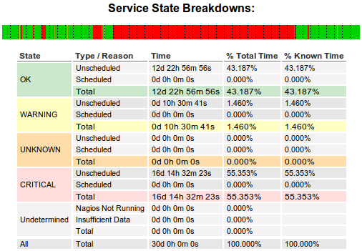
Long-term congestion reporting
can generate congestion reports if properly configured.
Notes:
If you configure Nagios to monitor your link for congestion, you can generate reports showing how much of the time the network was congested for. Some information on this is provided in the previous unit.

Slide 17
Solving congestion
  Congestion is not usually your ISP's fault!
      unless it occurs in their network!
Buy more bandwidth
Optimise the efficiency of the circuit
Reduce wasting of bandwidth (botnets, worms, packet loss)
Charge by usage (tolls)
Censor/block some websites or types of traffic
Shift "undesirable" traffic out of business hours
Limit the damage caused by undesirable traffic
Need to understand (investigate) traffic patterns for all of this!
How can you block/reduce popular traffic and not be blamed for it?
Notes:
Affecting "popular" traffic (entertainment such as Facebook, YouTube and other videos, sports and fashion websites) will always be unpopular. The only ways to avoid being blamed are:
If people understand the higher good that is being served (faster Internet access for their work).
If the traffic is blocked or affected following a policy set by someone higher up (e.g. organisation management).

Slide 18

Traffic types
What sort of content?
Is size important ?
Is quantity important?
Is time important?
Is it user or system traffic?
Is it desirable traffic?

Slide 19
Levels of analysis
From least to most detail:
Total traffic volumes
Top talkers
Applications (by port number)
Applications (by deep packet inspection/DPI)
Websites (by DPI or proxy server)
Traffic flows (Netflow etc)
Individual packets (pcap, Wireshark)
Notes:
Top talkers are PCs, servers, and users generating the highest volumes of network traffic based on IP or MAC address. If they are end users, they are people you might want to have a word with. If they are servers, then you need to know how much traffic is local (where there is plenty of bandwidth) and how much is going over the scarce Internet link.
Some applications can be identified by port number. For example, web sites and web services use HTTP, which is almost always on port 80 or 443, and thus easy to identify. Some applications such as Skype and Bittorrent use many different ports or try hard not to be detected and classified.
Because web traffic is so varied, you may need to investigate deeper into which individual websites and types of content are being transferred, to differentiate between preferred, commodity and undesirable traffic.

Slide 20
Breakdown of traffic
Knowing the types of traffic on your network can answer some useful questions:
Which servers and users are the top talkers
What is the average utilization level
When are your periods of highest and lowest utilization
What effect is congestion having on critical business applications and user productivity
What unauthorized applications are being used on the network
How much recreational traffic is on the network
Which users are consuming the most resources
Which applications are consuming the most resources
Are low-priority applications impacting core business applications?

Slide 21
Desirability of traffic
According to your Acceptable Use Policy (AUP), you should be able to classify each stream as:
Preferred/prioritised/institutionally important
Politically necessary/expedient
"Best effort" commodity traffic
Undesirable
Forbidden
Notes:
Examples might include, depending on your AUP:
Preferred/prioritised/institutionally important traffic
Politically necessary/expedient traffic
"Best effort" commodity traffic
Undesirable traffic
Forbidden traffic

Slide 22
Traffic classes
Those to protect others from:
Top-uploaders (and repeat-offenders)
Peer-to-peer applications
Those to protect from each other:
Control
Voice/Video/Streaming Media
Academic TCP
Residual ‘recreational’ TCP
Non-TCP (ICMP? UDP? SIP?)

Slide 23
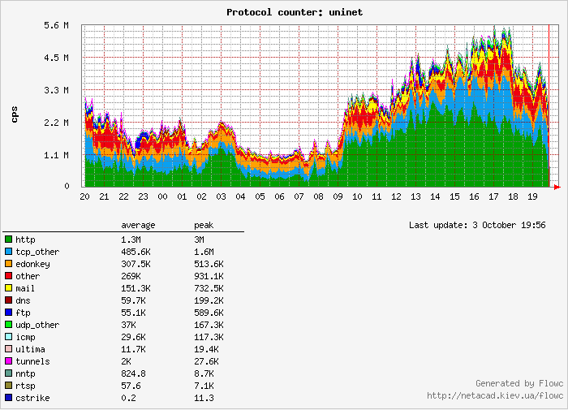
Monitoring traffic types
In some cases you can identify whether the traffic is desirable just by protocol.
Which of these traffic classes are desirable?
Notes:
This graph was collected by the Flowc netflow collector, analysing data collected by a Cisco router and sent to a monitoring station using the Netflow protocol.
Flowc provides an overview of the traffic, but cannot help you to break down traffic by destination website (e.g. journals vs. YouTube) or local client. Skype and HTTP traffic are difficult to identify using Netflow. It also requires that you have a Cisco router, or another that can export Netflow data.
Argus and NfSen allow you to perform more detailed investigation into your network traffic, including Top talkers on your local network. However they are difficult to use.
pmGraph also allows such detailed analysis, and can collect data from a monitoring station that is not a Cisco router. It's also designed to be easy to use and powerful.

Slide 24
Institution Group Discussion
Of those traffic patterns outlined previously:
What impact are they having on user satisfaction?
What impact are they having on bandwidth utilisation?
Are these being monitored within your institution?
With what technology?
At what intervals?
Is any action taken as a result of monitoring?
If none is being used please discuss why this has happened (Time? Resources? Money?)

Slide 25
Some commercial monitoring tools
There are many tools to be aware of, these are just a few:
Agilent FireHunter
Apparent Networks
ixia IxChariot
NetMon.ca
Netscout Sniffer
OPNET ACE
PRTG
Solar Winds
Spirent SmartBits
Various CISCO / 3COM / HP NMS tools
Notes:
These are here just to show the range available, and to allow you after the course to research their capabilities. You can then compare these against your choice of no/low cost tools.

Slide 26
Some free monitoring tools
Aguri
Argus
BandwidthD
bwmon
Cacti
darkstat
Etherape
Flowscan
ifTop
Iperf
Microsoft Network Monitor (netmon)
MRTG
Munin
Nagios
NeDi
nfSen
Ngrep
NMAP
Ntop
OpenNMS
pmacct/pmgraph
Snort
tcpdump
Tele Traffic Tapper (ttt)
Wireshark
TODO give detailed explanations and practical experience of all of these!

Slide 27
Free vs. commercial tools
Advantages of commercial tools:
usually more features
usually easier to use
Disadvantages:
(more) expensive
proprietary lock-in
Some shops refuse to use free tools; some refuse to use commercial.

Slide 28
Monitoring traffic levels
MRTG (Multi Router Traffic Grapher) is a tool to monitor the traffic load on a network:
Generates HTML with PNG reports
Provides a LIVE (5 minutes old) visual representation of historic traffic
Allows monitoring and analysis of many data centre functions (router, server, latency, utilization, temperature, etc.)
Countless ways to utilize for data visualization

Slide 29
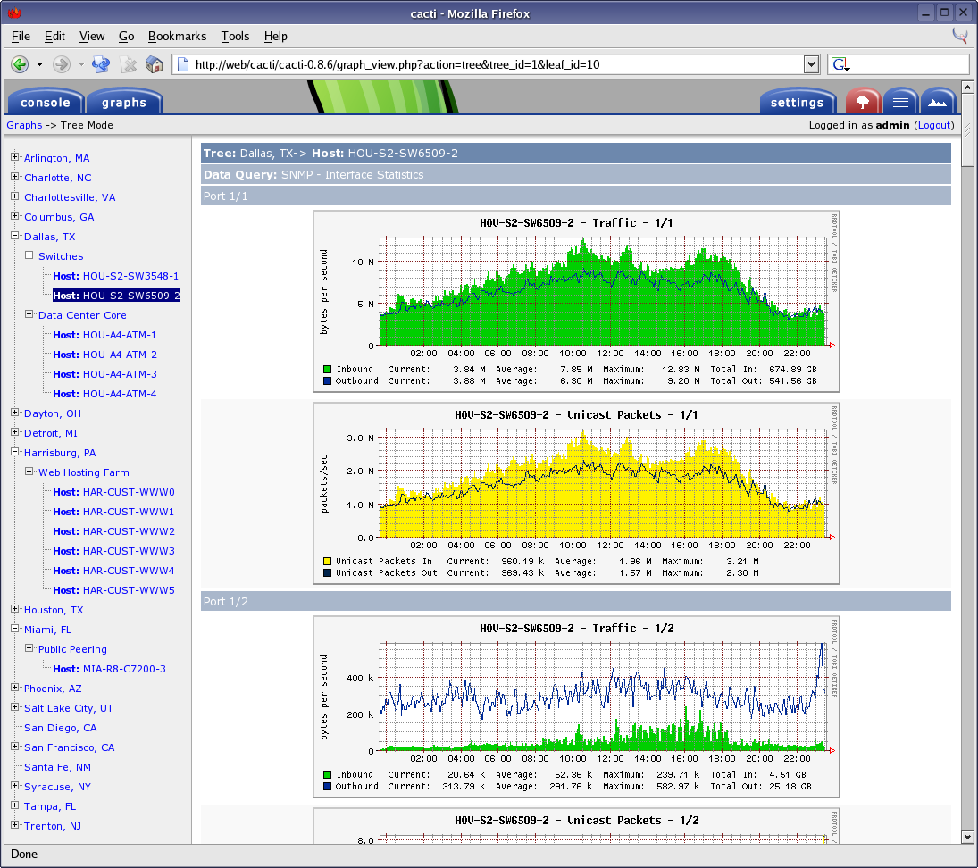
Monitoring routers and switches
Cacti is an open source tool to monitor devices on the network via web browser.
Generates HTML with PNG reports
Provides a live (5 minutes old) visual representation of historic traffic
Allows monitoring and analysis of many data centre functions
Collect network port, CPU, latency, utilization, temperature, etc. using SNMP or scripts
On the fly ability to magnify interesting graphs
Notes:
You can download more information, exercises and worksheets for installing and configuring Cacti on the AfNOG SSE course website, and many other places on the Internet.

Slide 30
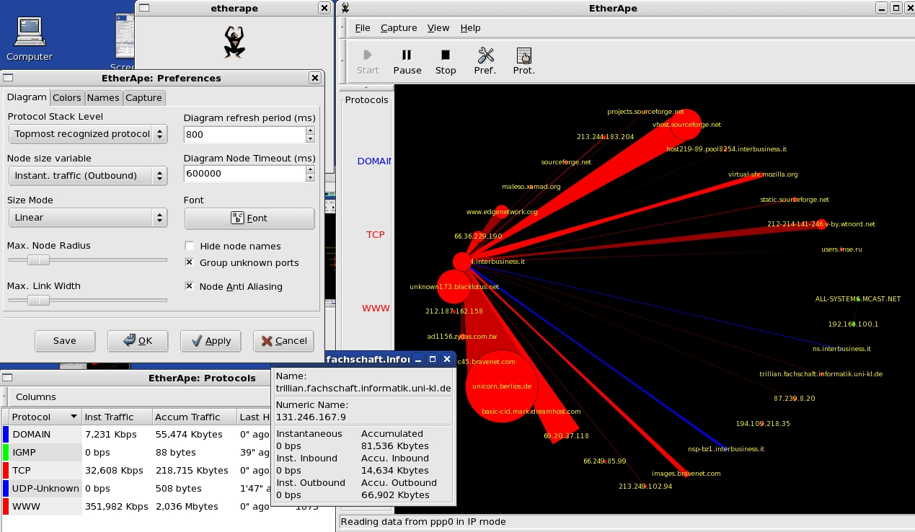
Hosts and flows
Etherape is a graphical network monitor for Unix:
Network traffic is displayed graphically
'Top Talkers' indicated visually
Select protocol stack of focus
Network filters
View internal traffic, end to end IP, or port to port TCP
Can read saved tcpdump file
Many protocols supported

Slide 31
Detailed host information
nTop collects and displays information about hosts, using a web interface:
Data sent/received
Used bandwidth
IP Multicast
TCP sessions
UDP traffic
TCP and UDP services used
Traffic distribution
IP traffic distribution

Slide 32
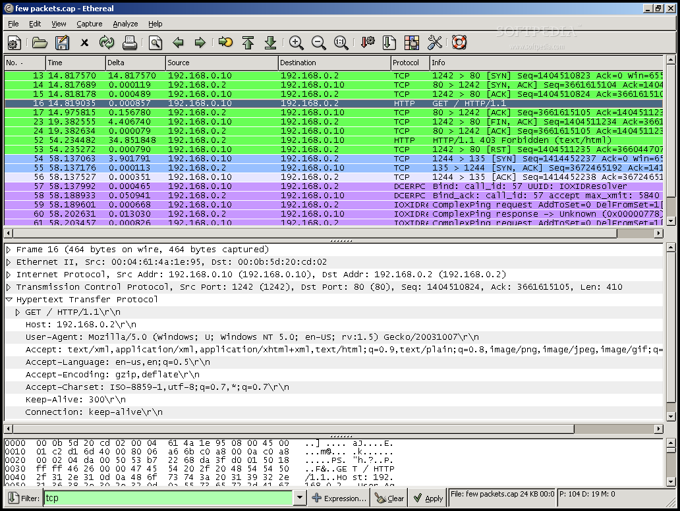
Packet level analysis
Wireshark is a network protocol analyzer (sniffer):
It shows exactly what is happening on your network, packet by packet.
Examine data from a live network
Examine saved capture file
Supports many capture formats
Reasonably intuitive interface
View reconstructed TCP sessions
Filters and graphs (not very easy to use!)
Notes:
Wireshark captures, displays and analyses every packet that it's configured to capture. Unfortunately this level of information can be overwhelming. On a busy network (say 10 Mbps, fully utilised) there can be 10,000 or more packets per second!
Wireshark includes filters, so you can restrict the capture to certain hosts or traffic types that interest you, and tools to break down traffic by protocol, although they can be slow. You can also investigate which website an individual connection is accessing, if you intercept the first packets of the conversation.
This volume of data (~1 MB per second, 84 GB per day) is too much to store and process in reasonable time, so this is only really useful as a real-time diagnostic tool.

Slide 33
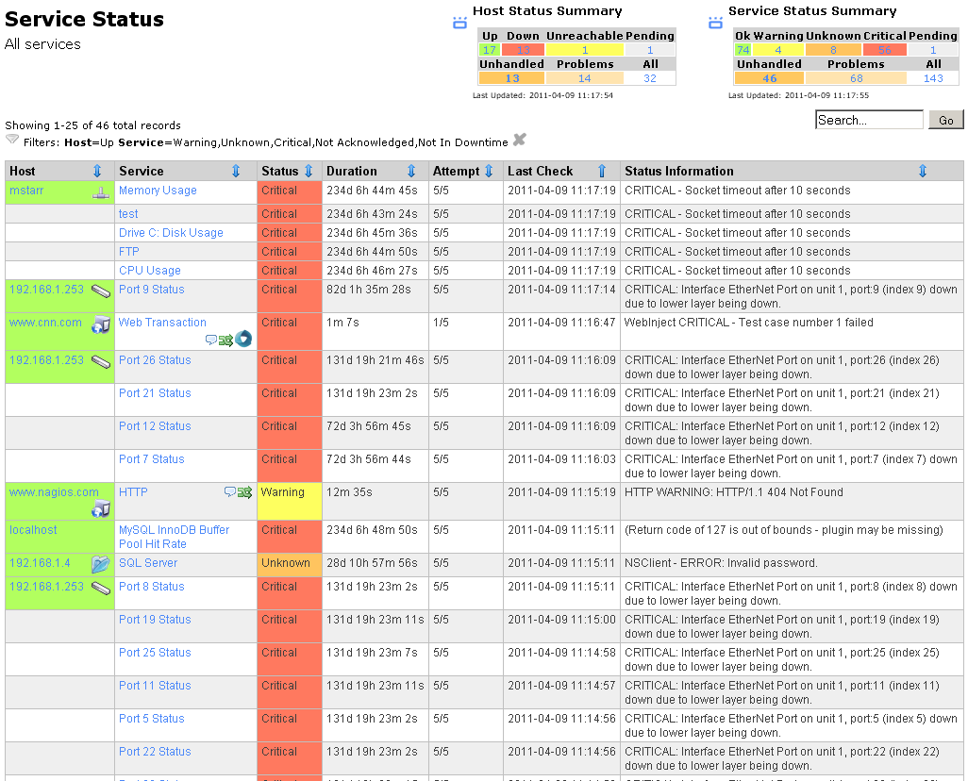
Service monitoring
is a network host and service monitor.
Accessed via web browser
Services (POP, PING, HTTP, etc)
Host resources, Environmental factors
Option of distributed monitoring
Acknowledge issues via web interface
Notification / event handlers
Modular, allows for plug-ins
Notes:
Nagios monitors hosts and services by regularly running plugins that check the status. There are hundreds (perhaps thousands) of plugins for common services, and it's easy to create new ones.
Nagios has a commercial version and several competitors, such as Zenoss, Zabbix, OpenNMS and Hyperic. The competitors may be easier to use, but Nagios is infinitely flexible, powerful and lightweight.
You can download more information, exercises and worksheets for installing and configuring Nagios on the AfNOG SSE course website, and many other places on the Internet.

Slide 34
Network management framework
OpenNMS is a Network Management System framework.
Integrates "everything you need" for network management in one place.
Notes:
Some people prefer a "one stop shop" that integrates many features in one place. (This is counter to the Unix philosophy, where you have many small, independent and flexible tools, making it easier to upgrade and replace just one of them).
OpenNMS includes:
Action daemon
Collection daemon
Capability daemon
Discovery daemon
Events manager daemon
Notification daemon
Outage manager daemon
Poller daemon
SNMP trap daemon
Threshold daemon
OpenNMS is big, and therefore heavy, and takes a while to learn your way around.

Slide 35
Port scanning
Nmap is a utility for network exploration or security auditing. It detects open ports (running services) on network hosts.
Can rapidly scan large networks
Detects application name and version (sometimes)
Detects OS version
Detects firewalls etc.
Easy to use

Slide 36
Security auditing
Nessus is a simple graphical tool which searched for common software vulnerabilities over the network (remotely).
Detects service on non-standard ports
Will try to exploit remote service vulnerabilities
Very up to date
NASL (Nessus Attack Scripting Language)
Client-server architecture
Can test multiple host simultaneously
Exportable reports in multiple formats

Slide 37
Intrusion Detection
Snort is an open source Intrusion Detection System (IDS):
Real-time traffic analysis/alerts
Packet logging
Protocol analysis
Content searching/matching
Detect attacks/probes
Flexible rules language
Web console
Mature

Slide 38
Institution Group Discussion
Experience of these products:
Which have been used within institution?
Do you have experience of any others?
Are these being monitored within your institution?
Technically of these products:
Which APPEAR to be a solution to monitoring needs?
Why?

Slide 39
Plenary Discussion
Shared experience of those products
Technically of those products, which APPEAR to be a solution to most monitoring needs? Why?

Slide 40
Open-source versus proprietary products
Balance cost and capabilities:
  Limitations:
      Money
      Skills
      Resources
      Equipment
      Processes
  Opportunities
      Optimise bandwidth
      Gain experience
      Share experience

Slide 41
Evaluation Criteria
  Learning Curve
      Skills
      Equipment
      Shared experience
  Capabilities
      Point solution
      Quick Fix
      Breadth
      Integration

Slide 42
Conclusion
What have we learnt about solutions?
Reviewed some technology solutions for network traffic monitoring
Identified key products to monitor/graph the top five traffic patterns
Been able to choose between cost effectiveness of open-source versus (perhaps) more functional proprietary solutions
Gained an insight into looking for such products and making value based judgments on future products.

