Slide 1
What makes a good policy?

Slide 2
Objectives
Review the characteristics of good policy.
Assess the degree to which the policy documents of participating institutions/other institutions meet the definition of good policy.
Consider ways in which the policy documents can be improved.

Slide 3
What is policy, anyway?
Cognate terms: polis, police, political (with a small “p”)
Who owns policy?
How is it different from strategy?
How is it different from regulations?

Slide 4
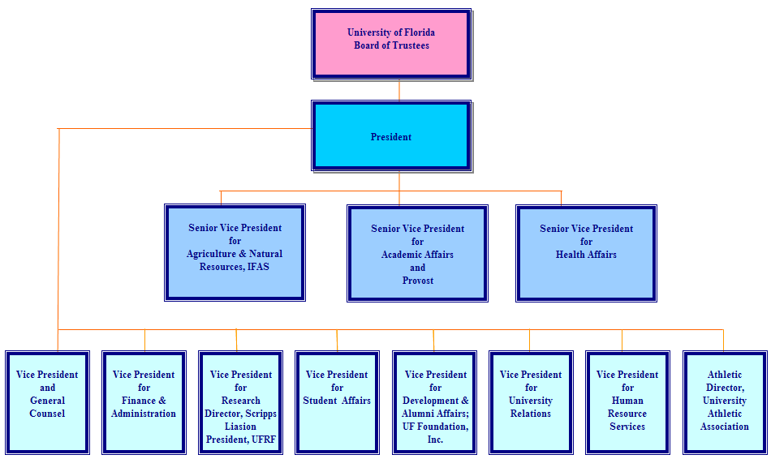
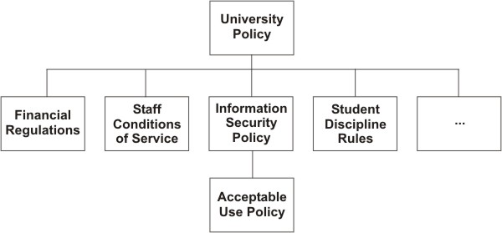
Example organisation structure
Note how the policy structure mirrors the organisation structure:
Authority is delegated down the tree, to write the rules governing some aspect of users' behaviour and interactions within the organisation.

Slide 5
Characteristics of good policy
has an enabling purpose
linked to a wider objective
has clear ownership
is clear and short
managed by a process
confined by a defined authority
is enforced
is adaptable

Slide 6
Good policy has an enabling purpose
Policy is not just a set of restrictions.
It is a set of restrictions with a purpose: * to make things possible
It encourages and enables users, it is not just a list of do's and don'ts

Slide 7
Good policy is linked to a wider objective
Why have the policy (at an institutional level)? * Why should I support this policy? * Be prepared for this question and be able to answer it
The only way to win support for the policy * Rather than reluctant acceptance

Slide 8
Good policy has clear ownership
Who owns the policy? * Is this clear from the policy document?
Is it the "right" ownership to ensure support and buy in?
It should not be the IT department * Imagine your plumbers making rules about what you can or can't use your pipes for?
It should generally be the highest authority in the institution that there is
Notes:
Your plumber is providing a service to you, for a fee. They don't own your pipes. You do, and you're entitled to use them how you want. But you don't flush poisons or machine oil down them, because that would be breaking the law.
Similarly, the IT department doesn't own the Internet connection. It belongs to the unversity/organisation, and exists for the benefit of all, not just the IT department.

Slide 9
Good policy is clear and short
If we want it to be a live and useful document, then it should be:
Clear and well written; no technical or legal jargon
Short; easily read and digested by end users
You can have two versions if you really insist (one for all users to read and understand, and a supporting, full “legal” document) but not recommended! Just make one, short, simple, non-legal document.

Slide 10
Good policy arises from a process
Processes are what secure buy-in and a sense of ownership
Both essential for successful policy development and implementation
Consensus is the process most likely to persuade all users * But the hardest to implement, for the same reason.
Policy should not be static either! * Respond to changing needs of users. * The process needs to enable this, for example users propose amendments and they are voted on by a board.

Slide 11
Good policy is confined by a defined authority
Good policy works within the confines of a defined authority, for example:
The IT department is authorised to restrict or suspend the access of some users, for limited time, to maintain the health of the IT services for other users.

Slide 12
Good policy is enforced

Slide 13
Good policy is adaptable

Slide 14
Finding the Policy
What is the Acceptable Use Policy (AUP) for your network? Where is it?
Ask someone who uses your network to outline the policy from memory. Compare it with the real policy.
Ask someone to find a copy of it, and watch them try.
Notes:
Consider how well your users understand your policy. Test them. Test the next person you see: is action X allowed by the policy or not?
How is your policy enforced, by who, and how well? Who follows the policy, who fights against it? How could you get them on side?
It's been said that "5% of users use 50% of the traffic, so 95% should be on your side." Do you agree? How many people abuse your network or cause problems for you? Do the others understand the problem and the benefits of reasonable, fair use? If not, how would you show them?

Slide 15
Who is responsible?
Who needs to be involved in network management, and why?
Executive management
Senior IT management
Technical staff involved in the day-to-day implementation
Academics, librarians and other legitimate Internet users
Notes:
What roles do they play in managing a network?
Executive managementhave the power to create or change policy and budgets.
Senior IT managementbridge the gap between staff on the ground, executives and the rest of the university.
Technical staffhave the skills to understand the problem, implement changes, and identify policy violations.
Legitimate Internet usersare the reason why the University pays so much for its Internet connection and the IT department. They are your customers!

Slide 16
Outline of a plan
Simple overall aim * One to Three simple specific objectives * Simpler is safer (K I S S)
An objective must be specific and measurable
Justification * improving effectiveness * return on spend/investment
Consequences * Of doing or not doing
How do you manage risks during implementation * Go/No Go gates
How will you monitor and review * Regular milestones
Who are the key people (stakeholders)
Timetable

Slide 17
Fair Deal
Everyone gets 1 Mbps, without exception
Pros: * Easy to implement * No policing required
Cons: * Network resource will be under-used * Conversely, if everyone uses their 1 Mbps then capacity will be exceeded * Important work-related downloads may be slowed

Slide 18
Punish repeat offenders
Heavy users: * Those who transfer over 650MB/day off-campus are placed in heavy-user bucket * Heavy-users get limited bandwidth (e.g. 1.5Mbps aggregate) * Further reduction for repeat offenders
Pros: * Heavy users get amplified negative feedback * No deep packet inspection required
Cons: * Network resource will be under-used * Important work-related downloads may be slowed * Arbitrary limits are difficult to justify

Slide 19
Nuisance applications
Define list of "nuisance" apps and identify their traffic
All nuisance app traffic goes into a fixed bucket (e.g. 10 Mbps)
Pros: * Low maintenance * Nuisance app users get amplified negative feedback
Cons: * What is a nuisance app? How to identify it? * Users will discover new ways to abuse bandwidth * Requires a bandwidth manager with deep packet inspection

Slide 20
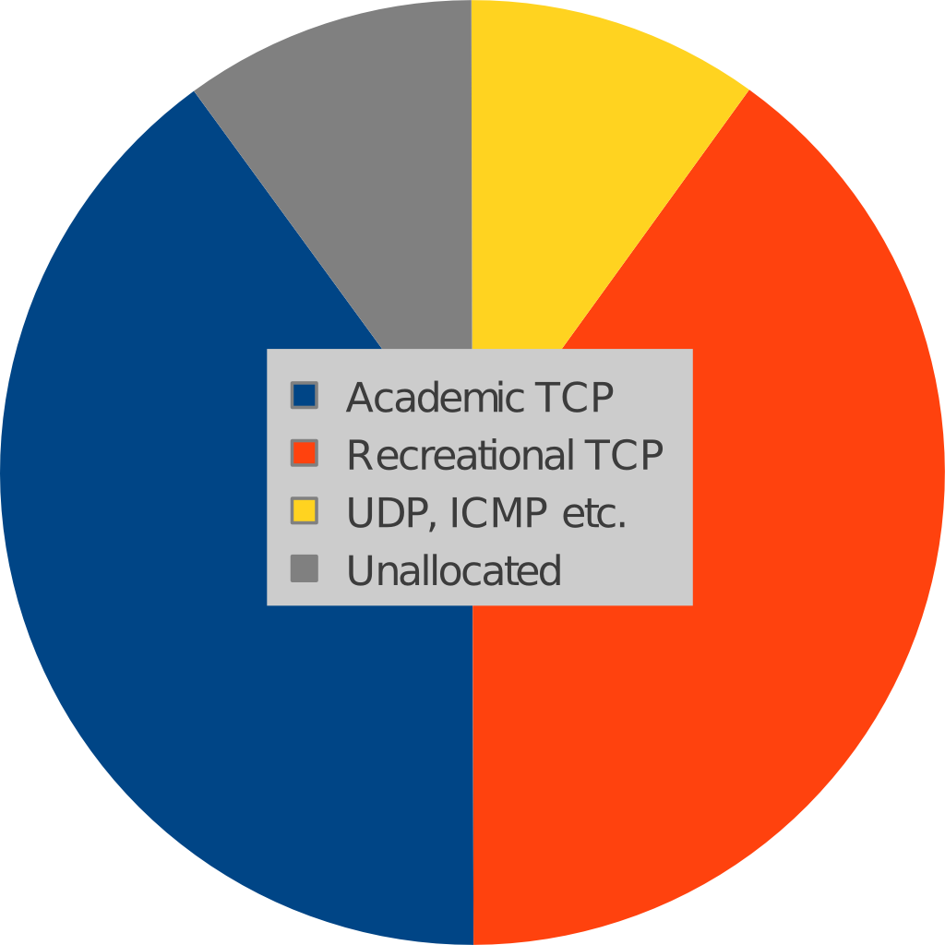
Protocol mix
Academic TCP and Recreational TCP are "equal" * 40% each for Academic and Residential TCP
Non-TCP and TCP don’t necessarily play well together * 10% for non-TCP
Leave 10% unallocated (burst, control plane)
Possible add-ons * Individual flow or user policing * Priority queuing
Pros: * Low maintenance * Recreational users get amplified negative feedback
Cons: * How to identify academic/recreational traffic? * Requires a bandwidth manager with deep packet inspection * Is 10% enough for VoIP applications and VPNs?

