Slide 1
INASP: Effective Network Management Workshops
Unit 9: Making a Difference

Slide 2
About these workshops
Authors:
Dick Elleray, AfriConnect
Chris Wilson, Aptivate
Date: 2013-04-29

Slide 3
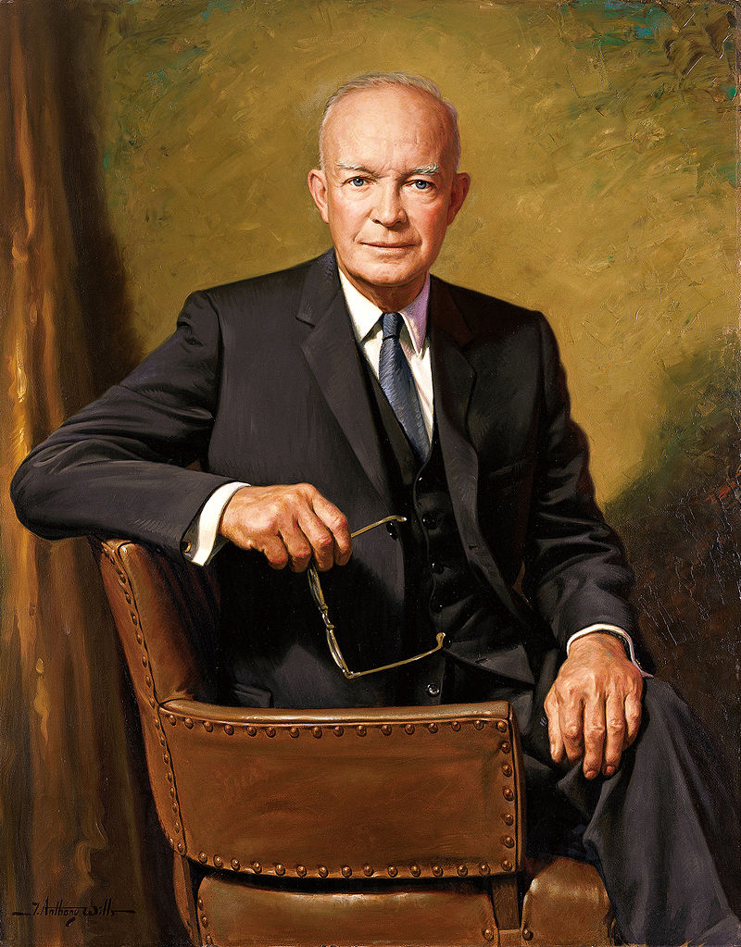
Planning
US President Dwight D. Eisenhower once said:
I have always found that plans are useless but planning is indispensable.
Things you might want to plan for:
Monitoring to establish baselines
Detecting and responding to performance changes
Disaster recovery
Professional development through reflection
Revising your plans as you discover new things
Don't forget:
Who needs to be involved
Who will it affect
How to win their support
When and how to review and improve the plan

Slide 4
Recovering from problems
  Identify problem
    Alarm system trigger
    Abnormal activity
    User complaints
  Contain problem
    Localise the problem to some service, network branch, etc.
    Prevent the problem from spreading if necessary
    Isolate the segment or device(s) causing the problem
    Diagnose problem and fix
  Test the resolution
    Change monitoring level temporarily to reduce noise?
    Reintroduce device(s) to network
    Compare monitoring to baseline in real-time
  Learn from the problem
    Identify process to reduce risk of reoccurrence or reduce severity
    See Unit 4, Section 7 (How do we mitigate faults?) for details

Slide 5
Solving bandwidth problems
If available bandwidth is the main problem:
slow page loading
slow downloads
high latency or packet loss
connection is full
Then you need to increase supply of bandwidth and/or reduce demand.
  Congestion is not usually your ISP's fault!
    unless it occurs in their network!

Slide 6
Solving congestion problems
Reduce waste (botnets, worms, updates, packet loss)
Buy more bandwidth
Optimise the efficiency of the circuit
Charge by usage (tolls)
Censor/block some websites or types of traffic
Shift "undesirable" traffic out of business hours
Limit the damage caused by undesirable traffic
Need to understand (investigate) traffic patterns for all of this!
How can you block/reduce popular traffic and not be blamed for it?
Notes:
Affecting "popular" traffic (entertainment such as Facebook, YouTube and other videos, sports and fashion websites) will always be unpopular. The only ways to avoid being blamed are:
If people understand the higher good that is being served (faster Internet access for their work).
If the traffic is blocked or affected following a policy set by someone higher up (e.g. organisation management).
If you have no choice, for example it is blocked by your ISP.

Slide 7
Better management of existing resources
Optimisation to ensure value for money and fitness of purpose. For example:
Monitoring of bandwidth to know how it is being used
Implementation of policies to guide effective use
Technical tools and resources to optimise use
Different people need to be involved in this:
Executive management
Senior implementation management
Technical staff involved in the day-to-day implementation

Slide 8
Reducing waste of bandwidth
  Can make a big difference
    Use monitoring to identify whether it's needed or not
Often provides a basis for further action
Almost never a complete solution
What kind of technical issues?

Slide 9
Examples of reducing waste
  House-keeping
    Microsoft updates, virus definition files, automated patches of all kinds
  Spam, virus and worm outbreaks
    valueless traffic that might be eating bandwidth
  Caching
    DNS caching can make a huge difference to page loading speed
    web caching can speed up some pages, and reduce bandwidth use by 40%

Slide 10
Monetary Options
Buy more bandwidth
Charge for bandwidth used

Slide 11
Buying more bandwidth
May be difficult:
Expensive
Often only a short-term solution
Can make things worse (encourage bad behaviour)
Important to benchmark costs
How can you justify the cost?
Perhaps the only way to justify the cost is to show that it's all being used for the intended purpose, which requires monitoring.

Slide 12
Charging for bandwidth used
Controversial:
Very effective at dampening demand
Can fund growth of the circuit
Highly damaging to educational and research objectives
Requires monitoring to know how much each person/department has used.
Perhaps the only way to justify the bill is to show what traffic each department has caused to incur the bill, which requires monitoring.

Slide 13
Other incentives for good behaviour
Understand how your connection is being used (requires monitoring)
Try to change user behaviour (requires policy)
  Empower users to diagnose and understand network problems
    Recruits users onto your side!

Slide 14
Empowering users
You could call these users "Guard Dogs"
  Give them tools and knowledge to identify if network is really broken
    Provides a sense of empowerment
    Local departmental resource
    Campus, Link, national, international
    Even if they don’t understand what it means
    Even if they cannot contact an admin
  For example: access to Nagios, service status page, basic diagnostic software.
    Needs to be appropriate to users' level of understanding and desire to help.

Slide 15
Affecting users
Make sure an apparent network problem effects your Chancellor/Vice Chancellor !!
This is a risky strategy! Will it work? How?
Notes:
Will we lose our jobs if we don't give the senior executives special treatment?
Will we be able to fix the problems quickly enough to keep our jobs?

Slide 16
Monitoring summary
You need to monitor in detail to:
Justify an increase in capacity (expense)
Bill users or departments for their usage
Inform policy development and maintenance
Enforce policy (however softly)
Check whether your changes are having the desired effect
Would you build a building with your eyes closed?
Notes:
Basically you must monitor the use of your connection in detail. There is no excuse or alternative.

Slide 17
Changing user behaviour
Change in behaviour must be voluntary.
You need an Acceptable Use Policy (AUP);
It must allow you to take some kind of action (including monitoring);
  All users must have read it, and agreed to follow it.
    They must understand how and why it benefits them to follow it.
It must be fairly and consistently used (enforced).
Otherwise, the users will be fighting against you instead of for you. And there are more of them.

Slide 18
Policy health warning
If you take action without a policy, who is responsible for the consequences?
If you take action within a policy, who is responsible?
It's much safer to follow a policy! See Unit 10 for assistance with policy development.

Slide 19
Behaviour changing tactics
Give users feedback about how much bandwidth they're using.
Give each users a limited bandwidth quota.
Ensure that abusive users hurt themselves, not others.
  Engage with highest bandwidth users.
    "Have a chat" with them, or name and shame them
Block or deter access to some sites or services.
Which of these require monitoring to implement them?
Notes:
All of these require monitoring, except "Ensure that abusive users hurt themselves, not others" which can be automatic.

Slide 20
Blocking access to resources
  Unpopular with users
    They want Facebook and Youtube!
  Least preferred option!
    But technically easiest.
  How much impact will it have?
    Is it worth the cost?
Reduce bandwidth available at peak times instead of blocking?

Slide 21
Actually blocking access to resources
  Block by protocol
    But you can't really block all websites (port 80 and 443)
  Block by IP address
    IP addresses change, e.g. Facebook, Google, Dropbox
    Normally done on a firewall using a packet filter
  Block by hostname
    Requires intercepting HTTP proxy (or DNS tricks)
    Can sometimes be evaded by using IP address instead of hostname
Both blocking by IP and by hostname can be evaded using proxy servers, VPN tunnels.

Slide 22
Alternatives to blocking
Because blocking is so unpopular, you may wish to:
Reduce speed instead of blocking
Offer an alternative such as a "commodity" wireless network, with less bandwidth allocated to it, or mobile dongles
Allow during certain hours, e.g. out of business hours

Slide 23
Technical solutions
  Technical optimisation
    Critically important
    Often provides a basis for further action
    Almost never the complete solution
  Control/Censor
    Technically possible
    Policy driven, Political
Benchmark (continually)
Monitor (continually)
Audit (frequently)

Slide 24
Packet filtering
Depending where you want to apply the filtering:
On a Cisco router: use Cisco ACLs.
On a Linux transparent bridge or firewall: use iptables.
On a FreeBSD transparent bridge or firewall: use ipfw or pf.
On a Windows firewall: use Microsoft ISA Server.
TODO: describe Cisco ACLs and FreeBSD firewalls.

Slide 25
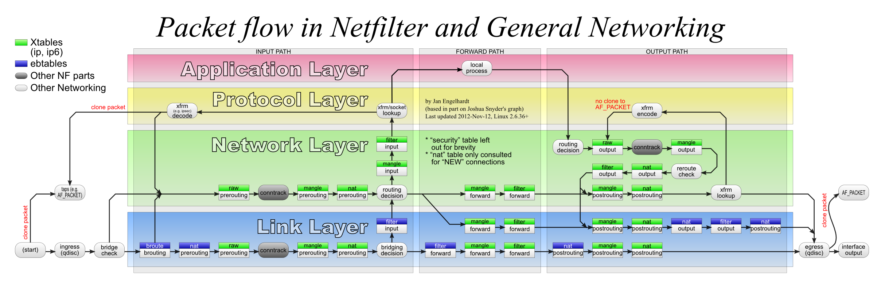
iptables
Multiple tables (nat, filter, mangle)
Multiple chains in each table (INPUT, FORWARD, OUTPUT)
Rules live in a table and chain (e.g. filter FORWARD)
Each rule contains a match (e.g. protocol, port) and a target (action)
Each matching rule applied in turn
Some targets are terminating (ACCEPT, DROP), others are not (LOG)
First rule applied with a terminating target ends processing for that packet.
Example iptables rule to block all port 8080 traffic:
iptables -t filter -A FORWARD -p tcp --dport 8080 -j DROP

Slide 26
Blocking websites
You can use DansGuardian as a web proxy to block all pages containing certain keywords:
http://www.sussex.ac.uk
http://www.expertsexchange.com
http://196.21.99.105/archive/img097.jpg
Notes:
The first two would be blocked if you blocked all URLs that contain "sex".
The third is an example where you have no way of knowing what the image contains.

