Slide 1
Do it remotely
If possible, diagnose and repair faults remotely:
Saves you travelling time.
Allows you to check many potential causes quickly.
First step towards automation.
But sometimes, face-to-face contact is more important! (When?)
Notes:
Faster diagnosis of faults means a higher level of user satisfaction and quality of service. The whole university network runs better.
Discuss in your groups:
How would you check the printer status remotely?
How would you tell if the user's computer is running slowly remotely?
How would you tell if the user's computer is connected to the network remotely?
How would you tell if the Internet connection is OK remotely?

Slide 2
Remote diagnosis tools
What problems could these tools help you with?
Printer's built-in web server
Switch's built-in web server
Windows remote destop (mstsc)
Windows performance counters
ping
traceroute
A network diagram
Notes:
There are many useful command-line and graphical tools that can help you to diagnose problems remotely:
Most printers have a web server that tells you their status, if you connect them to the network.
You can use Windows Remote Desktop or VNC to log into a computer and Task Manager to check its performance.
You can enable Windows' Performance Counters and access these remotely over the network. (Memory, swap, disk and CPU usage would be particularly useful).
You can use the ping command to check the network connection of a computer or the Internet.
You can use the traceroute command to identify routing hops between you and a target computer, locally or on the Internet (layer three).
Managed switches have web interfaces that you can use to check port link status (you did write down what's connected to each port? :-) and connected MAC addresses (in case you didn't).
You can use Netdot to automatically draw network diagrams at layer two, to help you diagnose layer two faults (between switches).
Look at your list of faults, and identify which tools you could use to diagnose them. Use the Internet or brainstorm in a group to generate ideas.

Slide 3
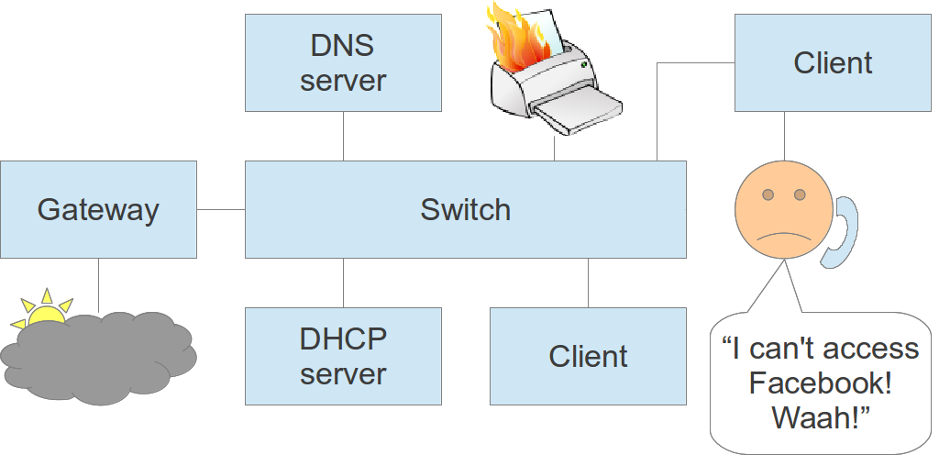
Practical session
A fault has been reported
Don't just dive in and fix it!
Brainstorm ideas for what to check
The facilitator will answer your questions
You may have been given a real, faulty piece of equipment, or if all our equipment is working perfectly, the facilitator may simulate a fault for you. If it's a real fault, you may be able to use network tools to investigate it yourself.
Your facilitator might ask you to refer to this network diagram:
If you are the facilitator, you may want to set up a test network like this for practice purposes.

