Slide 1
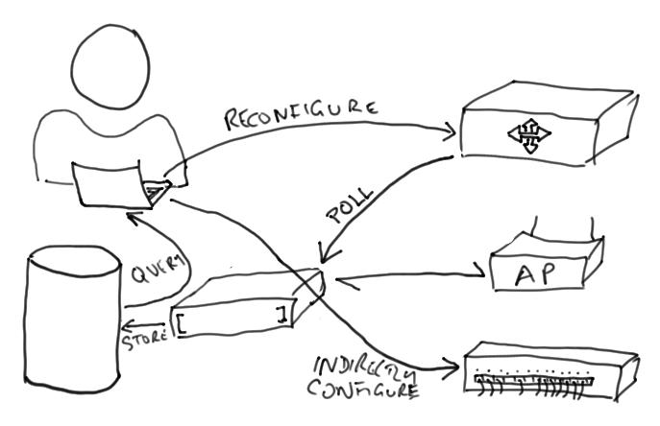
What is Configuration Management?
Recording changes to configuration of network devices, for example:
configuration file management,
inventory management,
software management.
package management.

Slide 2
Why use Configuration Management?
Configuration Management helps us to answer the following questions:
What changed?
When did it change?
Why did it change?
Can we put it back?
Can we solve the problem a better way?
Notes:
Thus, it helps us to solve two important problems:
We often need to understand what caused a problem in terms of changes to a system, in order to reverse them or find a better solution.
We often want to repeat the changes, for example setting up a new router or server in minimal time, or reconfiguring all routers at the same time.
Configuration management is a form of version control, applied to system configurations: configuration files, installed packages and updates, registry changes, connection maps and diagrams.

Slide 3
Benefits of Configuration Management
Always have an up-to-date network map for troubleshooting.
Replace hardware more quickly.
Faster testing of new configurations, with quick reversion.
Easier and more reliable creation of test labs.
Inventory for insurance, updates, patching and impact assessment.
Diagnosing and repairing a fault caused by a configuration change.
Better communication in a network management team.
Better license compliance.

Slide 4
Configuration management is hard
Includes the entire state of every device:
The partition layout, entire filesystem and registry of servers;
The physical connections between machines and network devices;
The configuration files of devices.
That's a lot of data! Where will you put it?

Slide 5
Configuration management of servers
Another reason to have backups!
Can you quickly identify file and registry changes?
How quickly can you restore a server?

Slide 6
Configuration management of the network
Tools like Netdisco and Netdot can automatically draw network maps for you.
RANCID can collect
A lot of data! Do you have space?
How would you do it?
Notes:
Some problems with this scope:
Do you have space to back up your entire servers?
Do you have the software and time to run those backups?
How quickly can you identify a one-file change in a 400GB full-system backup?
How do you monitor or backup physical connections between devices?
How do you backup devices that don't have an automated interface?
How do you cope with encrypted, binary or unreadable configuration files?
How do you deal with dynamic configuration, such as IP addresses?
What happens if you forget to document a change, or don't have time?
Some possible solutions:
Can automatically monitor some switches and routers configurations with RANCID: Cisco routers, Juniper routers, Catalyst switches, Foundry switches, Alteon switches, and HP Procurve switches among others.
Netdot can automatically generate network maps for you.
Can configure Linux and FreeBSD servers using Puppet or Chef to make initial configuration easier.
Can standardise and automate installation of servers.
Can use full-system backups that support listing the changes between two abitrary increments, and restoring just those files (e.g. rdiff-backup or duplicity plus shell scripting).
Can reduce the number of people allowed to make configuration changes.
Can set policy to require documentation for changes.
Can monitor servers and routers for unexpected or unauthorised changes, for example using tripwire or backup systems.

