Slide 1
Bandwidth Management with pfSense

Slide 2
Objectives
On completion of this session, we hope you will be able to:
Configure traffic queues in pfSense
Classify traffic into queues
Monitor and debug bandwidth management
Notes:
If you are the facilitator, please tell the group:
At the end of session I will ask if we have met the objectives – if not, we will discuss again.

Slide 3
License
Some materials reused under the Creative Commons Attribution-NonCommercial-ShareAlike 2.5 license:
the Web Caching manual, by Richard Stubbs of TENET;
the BMO Book, by various authors;
the Squid Cache Wiki, by Amos Jeffries and other.

Slide 4
Introduction

Slide 5
What is bandwidth management?
Similar to traffic management on roads:
Give some vehicles priority over others (e.g. emergency services)
Keep one lane clear for priority vehicles
Limit the number and length of car journeys
Efficiency savings: reduce the need for car journeys (public transport, local markets and supermarkets)
Make better use of unused capacity: encourage spreading of load into off-peak periods
Increase the cost of petrol, or charge tolls
Arrest people for driving slowly
Also called traffic shaping (which is reasonable) and packet shaping (which is not. What shape are your packets?)

Slide 6
Wired Magazine's take
Most ISPs actively engage in traffic shaping, bandwidth throttling, connection denial or some such tactic to keep the amount of bandwidth consumed by high traffic applications on their networks to a minimum. While this does often ensure better performance for everyone in the neighborhood, it can mean painfully slow transfer speeds for [peer to peer file sharing applications.]While there are valid arguments for and against shaping, we're not here to debate. We just want the fastest BitTorrent transfers possible.http://howto.wired.com/wiki/Optimize_BitTorrent_To_Outwit_Traffic_Shaping_ISPs

Slide 7
What are the limitations?
From Ginsberg's theorem (Laws of Thermodynamics):
You can't win.
You can't break even.
You can't even get out of the game.
Some other limitations:
Traffic doesn't declare its type or priority.
Bandwidth management is hard to do.
Notes:
For example you might have to differentiate between:
Skype voice traffic (UDP encapsulated, encrypted, random ports, might be direct or via a gateway in Czechoslovakia or a Microsoft IP address)
VPN traffic to a BitTorrent anonymiser in the Netherlands? (OpenVPN to UDP port 1194).
Your own VPNs (OpenVPN to UDP port 1194).
Or how about distinguishing between large HTTP/SSL downloads and ordinary web page browsing?
You may have to write rules, exceptions and exceptions to exceptions, one per class of traffic, to stay on top of assigning traffic to the correct classes.
Sometimes it's easier to create a whitelist: for example you can filter traffic from known good sites (academic publishers, etc.) into classes with high priority access to bandwidth/capacity.

Slide 8
What can we do with pfSense?
Keep one lane clear (reserve bandwidth)
Limit the number and length of car journeys (restrict bandwidth)
Efficiency savings (block some kinds of traffic)

Slide 9
Why use pfSense?
Linux also has a traffic management framework. Why do we use pfSense instead of Linux?
Advantages: * Nice point and click interface * Graphical display of bandwidth used by each class * Slightly easier to use
Disadvantages:
Limited features: no SFQ? no per-connection byte counters?
Notes:
For more information you can read:
OpenBSD PF: Packet Queueing and Prioritization (pfSense uses the same pf packet filter as OpenBSD).
Managing Traffic with ALTQ (pfSense is based on ALTQ).
Hierarchical Fair Service Curve
ALTQ/CBQ Performance (CPU overhead of scheduling packets)
How Unfair can Weighted Fair Queuing be? (limitations of work-conserving qdiscs).

Slide 10
How do we start?
Limit the maximum bandwidth in and out of firewall.
Advantage: allows us to control the queues.
Disadvantages: * Requires that we know how much bandwidth is available; * Reduces the available bandwidth; * Limits are per-interface, so interface load balancing doesn't work.
Notes:
Why is this a problem? Because we often don't know exactly how much bandwidth is available to us. Contention at the ISP may result in us having less bandwidth than expected at peak times. In order to control the queue, we have to limit bandwidth to the worst case that we expect, or live with imperfect control.
The ISP may impose their own bandwidth management on our traffic, which is outside our control.

Slide 11
Kilobits and kilobytes
Questions:
What does kbps mean?
What does kBps mean?
Convert 128 kbps to kBps
Convert 128 kBps to kbps
Why do we use different units?
Notes:
Answers:
kbps is kilobits per second (little b = bits, because bits are smaller), also called Kbit/s or Kb/s.
kBps is kilobytes per second (big B = bytes, because Bytes are Bigger), also called Kbyte/s or KB/s.
128 kbps / 8 = 16 kBps
128 kBps * 8 = 1024 kbps
We use different units because interfaces transmit one bit at a time, so their capacity is measures in bits per second; but computers work with whole bytes, so bytes per second is a more logical measure?

Slide 12
Example configuration
Limit total bandwidth to:
1024 kbps download
256 kbps upload
Decide how much bandwidth we want to allocate, and to what. For example:
Upload: * 50% reserved for Voice over IP (VoIP). * 30% reserved for HTTP, plus borrowing from remaining traffic (70%). * 20% remaining for all other traffic.
Download: * 12.5% reserved for Voice over IP (VoIP). * 70% reserved for HTTP, plus borrowing from remaining traffic (70%). * 17.5% remaining for all other traffic.
Question? How much bandwidth (kbps) is reserved for each class?
Why different policies for upload and download?
Notes:
Answers:
Upload: * VoIP: 50% x 256 kbps = 128 kbps * HTTP: 30% x 256 kbps = 76.8 kbps * Other: 20% x 256 kbps = 51.2 kbps
Download: * 12.5% x 1024 kbps = 128 kbps * 70% x 1024 kbps = 716.8 kbps * 17.5% x 1024 kbps = 179.2 kbps
VoIP tends to be symmetrical. We'd like to allocate 128 kbps in both directions, which is a much bigger share of our upload bandwidth. (Welcome to asymmetric connections.)
HTTP tends to be highly asymmetric, and we want it to be fast, so we allocate the most download bandwidth to it.

Slide 13
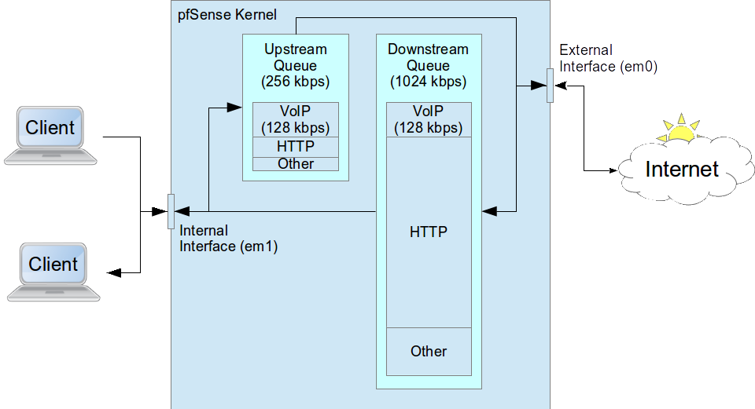
Bandwidth Allocation

Slide 14
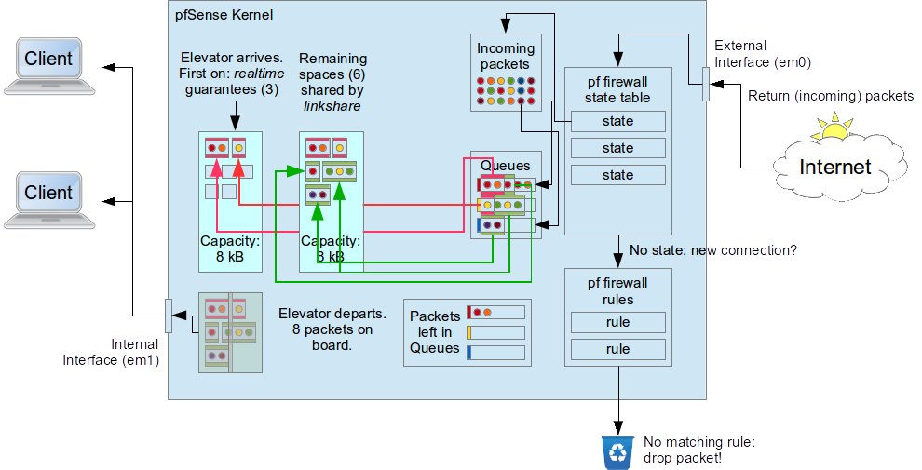
How HFSC Works
Notes:
Imagine that an elevator arrives every second, with space to carry some packets to the other side.
Packets are assigned to queues by firewall rules. In pfSense, the queue has the opposite direction to the firewall rule. So a rule that allows incoming packets places the replies into the specified queue. That's normally what you want, because in most client-server protocols, the replies from the server are much bigger than the request.
So you have a rule that allows HTTP connections outwards. The replies are placed in a queue of your choice, coming back inwards.
pfSense uses the FreeBSD ALTQ framework, with a choice of schedulers:
We will use HFSC for this exercise.

Slide 15
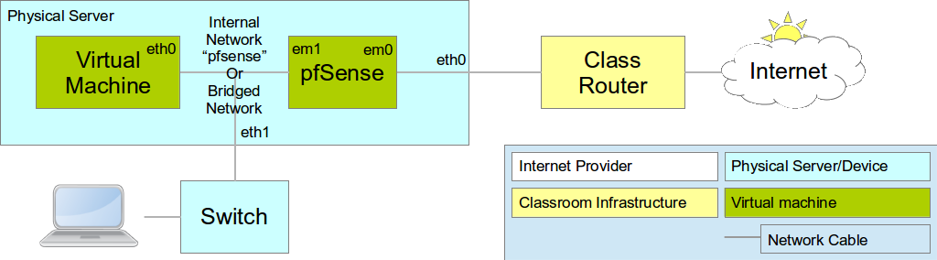
Configure pfSense as your router
To do these exercises using pfSense, configure your virtual network as follows:
In other words:
The external interface of the pfSense virtual machine (Network Adapter 1) is Bridged with the external interface of your server (probably eth0).
If your server has two network interfaces, then the internal interface of the pfSense virtual machine (Network Adapter 2) is Bridged with the internal interface of your server (probably eth1), and so is the only network interface (Network Adapter 1) of your client Virtual Machine. This allows you to connect laptops to eth1 and use them to test your connection, as well as the client Virtual Machine.
If your server has only one network interface, then the internal interface of the pfSense virtual machine (Network Adapter 2) is connected to the Internal Network pfsense, and so is the only network interface (Network Adapter 1) of your client Virtual Machine. This only allows you to test your connection from the client Virtual Machine.

Slide 16
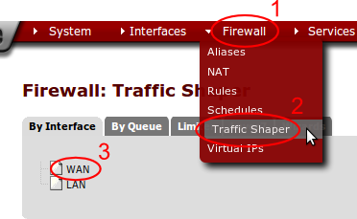
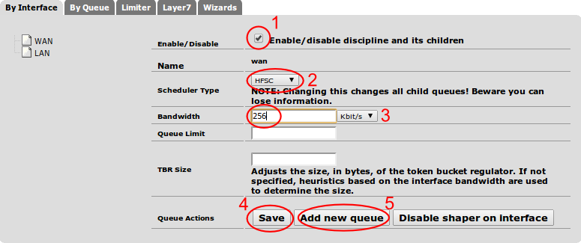
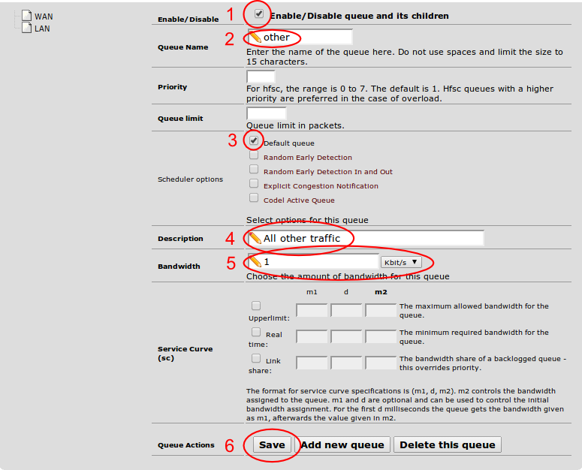
Configure the Interfaces
We need to set the total bandwidth and the scheduler on each interface:
Open the pfSense webConfigurator and log in.
From the menu choose Firewall/Traffic Shaper.
Click on the WAN interface.
Check the box Enable/disable discipline and its children.
Ensure that the scheduler type is set to HFSC.
Set the Bandwidth to 256 Kbit/s.
Click on the Save button.
Now we need to add a queue to the interface.
Click on the Add new queue button.
Check the box Enable/Disable queue and its children.
For the Queue Name enter Other.
Check the box Default queue.
For the Description enter All other traffic.
For the Bandwidth enter 20 and choose %. * This is the WAN interface, so we are configuring the upstream bandwidth.
Click on the Save button.
Repeat the whole process for the LAN interface, but set the Bandwidth of the interface to 1024 Kbit/s instead of 256. Create a queue called other on the LAN interface as well, but with the Bandwidth set to 17.5%.
Notice that pfSense tells you that you need to apply the changes to the traffic shaper configuration. Click on the Apply button.
Questions:
Why do we have to create a queue?
Why do we have to make it the Default queue?
What speed will traffic be limited to on this interface?
Which queue will all traffic be placed into, and why?
Notes:
Answers:
There needs to be at least one queue, otherwise pfSense will not apply any bandwidth limits. If there is no Default queue, then traffic will not be placed into any queue, and therefore not be limited at all. pfSense will complain if there is at least one queue on the interface and none of them is the default queue, but it doesn't complain if there are no queues at all, it just doesn't work.
No traffic is classified by any firewall rules, yet, so all traffic will go into the default queue.

Slide 17
Testing
From a computer behind the pfSense router (either your laptop or the client Virtual Machine), download a large file, for example:
$ wget -O /dev/null ftp://www.mirrorservice.org/sites/mirror.centos.org/6/isos/x86_64/CentOS-6.4-x86_64-bin-DVD1.iso
What speed do you get? How does it compare with the speed allocated to Other traffic above?
What happens if you edit the Other class on the LAN interface, enable Upperlimit and set the Upperlimit m2 to 35%?
Notes:
You should get a download speed of approximately 128 kBps, which equals 1024 kbps. This is because the Other class is allowed to borrow more bandwidth until it reaches the Upperlimit, or the speed limit on the interface, whichever is lower. In this case there is no Upperlimit set, so it can borrow up to 1024 kbps.
If you set an Upperlimit of 35% then it should not be able to use more than 35% of 1024 kbps, which is 44.8 kBps.

Slide 18
Traffic and Ping times
Try pinging the pfSense firewall (which will have the IP address 192.168.1.1 unless you've changed it in class.)
What happens to ping times with and without a download in progress? Why the difference?
Notes:
Without a download in progress, you should see very short ping times, around 1 ms:
PING 192.168.1.1 (192.168.1.1) 56(84) bytes of data.
64 bytes from 192.168.1.1: icmp_req=1 ttl=64 time=0.480 ms
64 bytes from 192.168.1.1: icmp_req=2 ttl=64 time=0.385 ms
64 bytes from 192.168.1.1: icmp_req=3 ttl=64 time=0.537 ms
64 bytes from 192.168.1.1: icmp_req=4 ttl=64 time=0.350 ms
64 bytes from 192.168.1.1: icmp_req=5 ttl=64 time=0.454 ms
With a download in progress, you should see much longer ping times, around 150 ms:
PING 192.168.1.1 (192.168.1.1) 56(84) bytes of data.
64 bytes from 192.168.1.1: icmp_req=1 ttl=64 time=147 ms
64 bytes from 192.168.1.1: icmp_req=2 ttl=64 time=136 ms
64 bytes from 192.168.1.1: icmp_req=3 ttl=64 time=154 ms
64 bytes from 192.168.1.1: icmp_req=4 ttl=64 time=163 ms
64 bytes from 192.168.1.1: icmp_req=5 ttl=64 time=132 ms
This is because the ping packets must wait in the queue behind the download packets, when a download is in progress.
We can reduce this, at the cost of some dropped packets, by reducing the Queue limit on the WAN interface, Other class, to 5 or 10 packets. If a ping arrives when the output queue on the interface is full, then the reply packet will be dropped instead of placed in the queue.

Slide 19
Adding more queues
Edit the WAN interface and add two new classes:
From the pfSense menu choose Firewall/Traffic Shaper.
Click on the WAN interface.
Click on the Add new queue button.
Check the box Enable/Disable queue and its children.
For the Queue Name enter VoIP.
Make sure that the checkbox Default queue is not checked.
For the Description enter Voice over IP.
For the Bandwidth enter 50 and choose %. * This is the WAN interface, so we are configuring the upstream bandwidth.
Check the box Linkshare and enter 30% for the m2 value.
Click on the Save button.
Add another queue called HTTP, with the description Web traffic, with 30% bandwidth and 30% linkshare.
Edit the LAN interface and add a queue called VoIP, as above, but with 12.5% bandwidth.
Finally add another queue to the LAN interface, named HTTP, as above, but with 70% bandwidth.

Slide 20
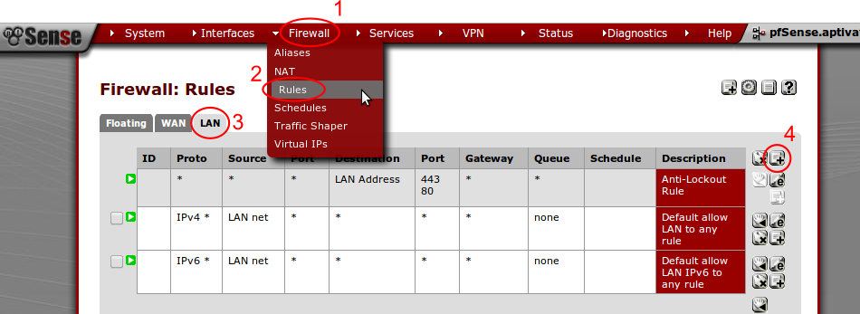
Filtering traffic into queues
We use firewall rules to assign traffic to a queue. The rule allows the outbound traffic, and at the same time assigns the returning packets into a queue.
From the pfSense menu choose Firewall/Traffic Shaper.
Click on the LAN tab.
If you already have a rule that applies to outbound HTTP traffic, you will need to change it, instead of creating a new rule:
If you create a new rule before that rule, it will override that rule because the firewall will match the new rule first.
If you create a new rule after that rule, then it will never be hit, and your traffic will never be placed into the http queue.
Notes:
If you have two rules left over from the Web Caching session, one which allows HTTP from the proxy server and one which blocks HTTP from all other computers, then you need to decide whether to only allow and restrict the speed of HTTP from the proxy server, or to allow all computers again.
I recommend that you modify the proxy server rule, to restrict traffic through the proxy. You'll also need to use the proxy server when conducting download speed tests below.

Slide 21
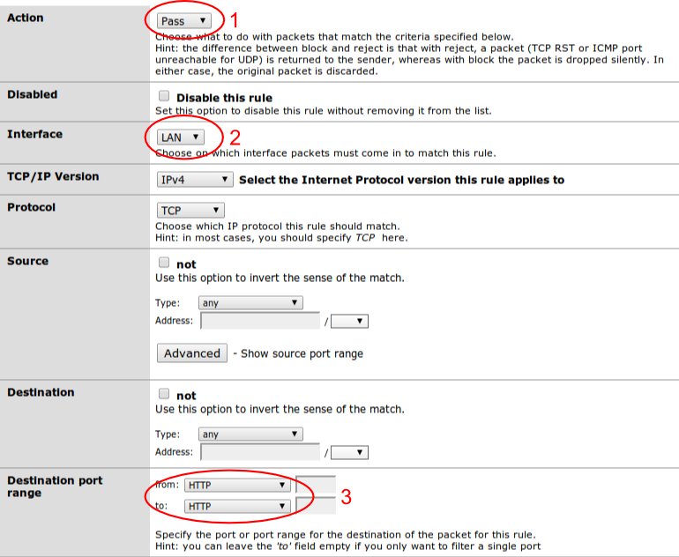
Adding filtering rules
Click on the Add Rule button.
For Action choose Pass. (should be the default).
For Interface choose LAN (should already be set to this).
For Destination port range choose HTTP.
For Description enter Place web traffic into http queue.
For Ackqueue/Queue click on the Advanced button, and choose none/http. * This is backwards for some bizarre reason. You probably always want to specify the queue and not the ackqueue).
Click on the Save button.
Create another rule to filter UDP traffic into the VoIP queue:
Click on the Add Rule button.
For Action choose Pass. (should be the default).
For Interface choose LAN (should already be set to this).
For Protocol choose UDP.
For Description enter Place UDP into VoIP queue.
For Ackqueue/Queue click on the Advanced button, and choose none/voip.
Click on the Save button.
Finally, create a very similar rule to place ICMP traffic (pings) into the VoIP queue. This allows us to measure VoIP latency and packet loss using the ping command.
You should see a prompt to apply changes to the firewall rules:
Click on the Apply changes button.
Notes:
Note that we don't need to classify any traffic as Other. Because this is the default queue, all unclassified traffic will be placed in it automatically.

Slide 22
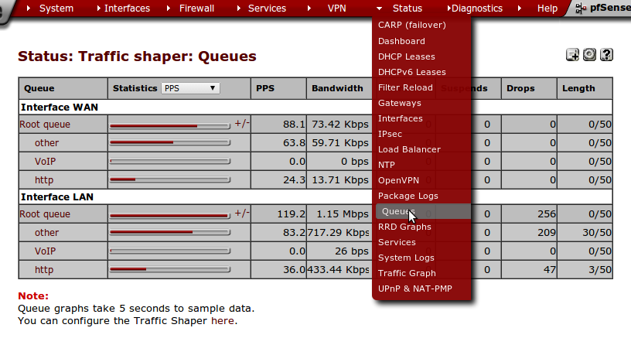
Testing
What effect is this likely to have on download speeds and ping times?
Download speed is still about the same (119 kBps).
Ping times massively reduced, to an average of 6 ms. (compared to 0.6 ms with no cross traffic, and 50-600 ms with cross traffic in the same queue).
How do classes share traffic?
If you run two downloads at the same time, for example run the following commands in separate terminals or on separate client VMs:
$ wget -O /dev/null ftp://www.mirrorservice.org/sites/mirror.centos.org/6/isos/x86_64/CentOS-6.4-x86_64-bin-DVD1.iso
$ wget -O /dev/null http://www.mirrorservice.org/sites/mirror.centos.org/6/isos/x86_64/CentOS-6.4-x86_64-bin-DVD1.iso
They should share bandwidth in the ratio of the Bandwidth assigned to each queue. So we'd expect to see something like this, assuming that the VoIP bandwidth is not being used, and therefore shared between the other classes in the ratio of their bandwidth allowance.
Protocol Realtime/Minimum Linkshare Total (%) Total (kbps) ======== ================ ========= ========= ============ HTTP 70% 10% 80% 819 FTP 17.5% 2.5% 20% 205 ======== ================ ========= ========= ============
Unfortunately the allocations are not very accurate, probably because the queues are sometimes empty, so there's no packet to send (see How Unfair can Weighted Fair Queuing be? for details of their results.)
You can see the current bandwidth used in each queue by choosing Status/Queues from the pfSense menu, which will give you a page like this:
Note that the Queue Length will vary as the TCP streams try to adjust their speed to the amount allocated by the traffic shaping. Every dropped packet will cause a TCP stream to reduce its speed, and cause the queue length to drop. The TCP stream will then try to adjust its speed slowly upwards, searching for the limit again. When the speed is higher than the allocated bandwidth, the queue will lengthen. When it becomes full again, another packet will drop and the speed will be reduced again. This process repeats as long as the TCP stream is running, like this:

Slide 23
Classifying inbound connections
Put a large file on the internal web server (Squid proxy VM). Add a port forwarding rule in pfSense, classifying traffic as HTTP:
Choose Firewall/NAT from the pfSense menu.
On the Port Forwarding tab, add a new rule.
For Destination port range choose HTTP.
For Redirect target IP enter 192.168.1.100 or the IP address of the internal web server/Squid proxy VM.
For Redirect target port choose HTTP.
For Description enter Forward HTTP to internal web server.
Click on the Save button.
Now click on the Edit button next to the rule to edit it again, scroll down to Filter rule association and click on View the filter rule.
Scroll down to Ackqueue/Queue, click on the Advanced button and choose none/none. Then click on the Save button.
We also want to ping the pfSense external interface from outside, to measure the queue responsiveness. To do that, add a rule that Passes:
Protocol ICMP, ICMP type echo-request
Destination: WAN address
Description: Allow pings to pfSense external.
You should see a prompt to apply changes to the firewall rules:
Click on the Apply changes button.
How can you test this?
Notes:
Try to retrieve the file using the pfSense firewall's external IP address, which is forwarded to the internal server, and assuming that the pfSense WAN IP address is 192.168.6.128, use the following command:
$ wget http://192.168.6.128/bigfile -O /dev/null
And ping the external interface. What ping times do you get?
Now edit the NAT rule again, View the filter rule, and change the Ackqueue/Queue to none/http. Save the rule and click Apply changes.
You'll need to start the wget command again. What happens to the ping time, with and without the wget running?

Slide 24
FIN
Any questions?
Notes:
Have we met the objectives?
Configure traffic queues in pfSense
Classify traffic into queues
Monitor and debug bandwidth management
Please let us know if we haven't.

