Slide 1
Bandwidth Monitoring
  Chris Wilson
  Aptivate Ltd, UK
  AfNOG 2009

Slide 2
Why is my connection slow?
What do we mean by “slow”?
  completely down?
  packet loss (tcp backoff)
  long ping times (round-trip times)
  long DNS lookup times
  jitter (mostly affects VoIP)
Where is the problem?
  one machine?
  your network?
  one remote site?

Slide 3
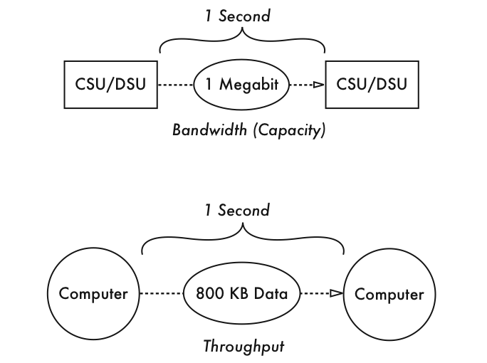
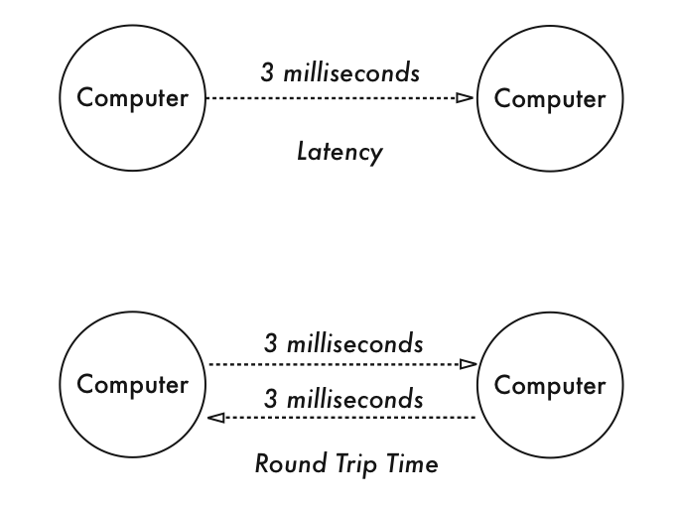
Definitions

Slide 4
Diagnosing the Problem
Check that your connection works
Check that your DNS works
Traceroute to the remote server, looking for:
  complete loss of trace
  sudden increase in ping times
  sudden increase in packet loss
  jitter (standard deviation changes)
  identify between which hops this occurs
Ping the remote server
Monitor repeated problems with nagios, smokeping

Slide 5
Using MTR
Install MTR (Matt’s Traceroute)
  sudo pkg_add -r mtr
  mtr -r -c10 4.2.2.2
  HOST: noc.sse.ws.afnog.org Loss% Snt Last Avg Best Wrst StDev
  1. 196.200.219.254 0.0% 10 0.4 0.5 0.4 0.5 0.0
  2. rtr-tedata.mtg.afnog.org 0.0% 10 0.9 0.8 0.8 0.9 0.0
  3. host-196.219.220.81-static.t 0.0% 10 6.0 6.7 2.8 12.1 3.2
  4. host-163.121.160.229.tedata. 0.0% 10 8.0 9.1 3.1 35.6 10.0
  5. ABBSR003 0.0% 10 8.3 4.0 3.3 8.3 1.6
  6. host-163.121.186.253.tedata. 0.0% 10 3.5 3.5 3.3 3.9 0.2
  7. host-163.121.202.129.tedata. 0.0% 10 3.5 6.5 3.5 31.3 8.7
  8. so-6-0-1.edge1.Paris1.Level3 0.0% 10 61.6 62.5 61.2 68.7 2.4
  9. ae-32-56.ebr2.Paris1.Level3. 0.0% 10 63.7 69.8 62.1 82.6 5.7
  10. ae-1-100.ebr2.Paris1.Level3. 0.0% 10 61.1 63.8 58.3 70.5 4.5
  11. ae-61-61.csw1.Frankfurt1.Lev 0.0% 10 61.3 67.6 61.3 82.0 6.6
  12. ae-11-69.car1.Frankfurt1.Lev 0.0% 10 61.8 64.1 61.4 76.2 4.6
  13. ae-11-69.car1.Frankfurt1.Lev 0.0% 10 61.7 61.7 61.4 61.8 0.1
  14. vnsc-bak.sys.gtei.net 0.0% 10 62.0 63.4 61.5 77.7 5.0
Problem is between hops 7 and 8?

Slide 6
Who Controls the Broken Link
Every link is between two hops
May be able to identify them from reverse DNS, or looking at your network map
Both ends are responsible for the link
Usually cannot tell which end has the problem except by swapping it out
Who controls them?
  You? (try debugging your side first)
  Your ISP? (call your ISP)
  Their carrier? (call your ISP, or pray)

Slide 7
In Case of Repeated Fires
Sometimes (not always!) the problem will be that your connection is too full (used to capacity)
You can ping the router on your side without problems, but pinging your ISP’s router shows:
  very high latency (over 1 second) to your ISP
    Windows reports latency over 4 seconds as “request timed out”
  packet loss over 1% to your ISP
  DNS timeouts or slow replies from your ISP (not cached)
  high jitter (subjective, maybe over 20 ms stdev?)
Could also be a faulty link or router on either end

Slide 8
Reasons for Busy Connections
If your link is full, it could be:
  inbound traffic
    downloads, bittorrent, attacks, incoming spam
  outbound traffic
    uploads, bittorrent, virus or worm-infected PCs, outgoing spam
  both at the same time
Total volume of traffic is not helpful
You need to identify the source of the traffic
Identifying the destination may not help

Slide 9
Finding the Culprit
Switch LEDs may help you track down busy ports
  Do not discriminate between local and remote traffic
Managed switched can have traffic on each port monitored remotely by SNMP
Flows are the next level down
  Cisco or Juniper router with NetFlow/sFlow
  Unix router or bridge running pmacct or ntop
Packets are the lowest level
  Unix router or transparent bridge running Wireshark
  Expensive hardware network analysers

Slide 10
Going with the Flow
Flows are useful tools for traffic monitoring
  Identify who is talking to who, and often the protocol or type of traffic
A flow is (usually) a unique:
  pair of IP addresses
  pair of ports
  protocol
Flows are sampled (number of bytes reported) at fixed time intervals to add a sixth dimension
Get flow data from a Cisco or a Unix router/bridge

Slide 11
Enabling Netflow on Cisco
You should enable Netflow on all active interfaces
rtr-tedata> show interface summary
Interface IHQ IQD OHQ OQD RXBS RXPS TXBS TXPS TRTL
----------------------------------------------------------------------
FastEthernet0/0 0 0 0 0 0 0 0 0 0
* FastEthernet0/1 1 0 0 0 1684000 369 1944000 315 0
* Serial0/0/0 0 0 0 0 957000 148 703000 165 0
* Serial0/0/1 0 0 0 0 1324000 182 1223000 201 0
* Serial0/2/0 0 0 0 0 469000 101 887000 140 0
rtr-tedata# conf t
rtr-tedata(config)# interface FastEthernet0/1
rtr-tedata(config-if)# ip route-cache flow
rtr-tedata(config-if)# exit
rtr-tedata(config)# interface Serial0/0/0
rtr-tedata(config-if)# ip route-cache flow
rtr-tedata(config-if)# exit
rtr-tedata# show ip flow top-talkers
SrcIf SrcIPaddress DstIf DstIPaddress Pr SrcP DstP Bytes
Se0/0/0 213.136.96.104 Fa0/1* 196.200.216.77 11 04AA 04A4 1539K
Se0/0/0 24.17.17.180 Fa0/1* 196.200.216.125 06 A6CE 1C2A 1522K
Se0/0/0 188.24.50.177 Fa0/1* 196.200.216.125 06 E87A 1C2A 1433K
Se0/2/0 207.148.178.122 Fa0/1* 196.200.216.125 06 BE90 1C2A 834K
Se0/0/1 195.226.227.100 Fa0/1* 196.200.216.125 06 EEA3 1C2A 647K

Slide 12
Setting up a Netflow Collector
cat > /usr/local/etc/nfacctd.conf <<EOF
daemonize: false
! debug: true
pidfile: /var/run/nfacctd.pid
logfile: /var/log/nfacctd.log
syslog: daemon
nfacctd_port: 4096
plugins: mysql
aggregate: src_host, src_port, dst_host, dst_port, proto
sql_db: pmacct
sql_table: acct_v6
sql_history: 1m
sql_history_roundoff: m
sql_table_version: 6
sql_host: 127.0.0.1
sql_user: pmacct
sql_passwd: XXXXXXXXX
sql_refresh_time: 60
sql_dont_try_update: true
sql_optimize_clauses: true
sql_preprocess: minb = 10000
EOF

Slide 13
Exporting Netflow Data from Cisco
If your collector’s IP address is 1.2.3.4:
  ssh cisco
  enable
  conf t
  ip flow-cache timeout active 1
  ip flow-cache timeout inactive 60
  ip flow-export version 5
  ip flow-export destination 1.2.3.4 4096
  exit
  write

Slide 14
Creating the pmacct Database
mysqladmin create pmacct
mysql pmacct <<EOF
CREATE TABLE `acct_v6` (
`ip_src` char(15) NOT NULL,
`ip_dst` char(15) NOT NULL,
`src_port` int(2) unsigned NOT NULL,
`dst_port` int(2) unsigned NOT NULL,
`ip_proto` char(6) NOT NULL,
`packets` int(10) unsigned NOT NULL,
`bytes` bigint(20) unsigned NOT NULL,
`flows` int(10) unsigned NOT NULL,
`stamp_inserted` datetime NOT NULL,
`stamp_updated` datetime default NULL,
KEY `isdb`(`stamp_inserted`,`ip_src`,
`ip_dst`,`src_port`,`dst_port`,`bytes`);
GRANT ALL ON pmacct.* TO pmacct@* IDENTIFIED BY ‘XXXXXXXX’;
EOF

Slide 15
Starting the Netflow Collector
/usr/local/sbin/nfacctd -f /usr/local/etc/nfacctd.conf
mysql pmacct -u root
mysql> select ip_src, ip_dst, src_port, dst_port, bytes, stamp_inserted from acct_v6 limit 5;
+----------------+----------------+----------+----------+-------+---------------------+
| ip_src | ip_dst | src_port | dst_port | bytes | stamp_inserted |
+----------------+----------------+----------+----------+-------+---------------------+
| 196.200.223.2 | 196.200.208.4 | 60346 | 22 | 37792 | 2009-05-09 17:22:00 |
| 196.200.223.2 | 196.200.208.4 | 52755 | 22 | 37872 | 2009-05-09 17:27:00 |
| 196.200.216.38 | 196.200.208.20 | 50689 | 22 | 12976 | 2009-05-09 17:48:00 |
| 196.200.216.51 | 196.200.208.20 | 52059 | 23 | 12108 | 2009-05-09 17:48:00 |
| 196.200.216.32 | 69.147.102.99 | 64980 | 80 | 10292 | 2009-05-09 17:50:00 |
+----------------+----------------+----------+----------+-------+---------------------+
5 rows in set (0.00 sec)

Slide 16
Installing Tomcat
Not tested – bad Internet access!
cd /usr/ports/java/jdk16
sudo make install clean
  follow the instructions to download any required files
  this may take some time to download 120 MB
cd /usr/ports/www/tomcat6
sudo make install clean

Slide 17
Configuring pmGraph
Download pmgraph-1.0.war from http://pmgraph.sourceforge.net
/usr/local/etc/rc.d/tomcat6 start
cd /usr/local/apache-tomcat6/webapps
cp /tmp/pmgraph-1.0.war pmgraph.war
sleep 5
cd pmgraph/WEB-INF/classes
cp database.dist.properties database.properties
vi database.properties
  DatabasePass = XXXXXXXX
/usr/local/etc/rc.d/tomcat6 restart

Slide 18
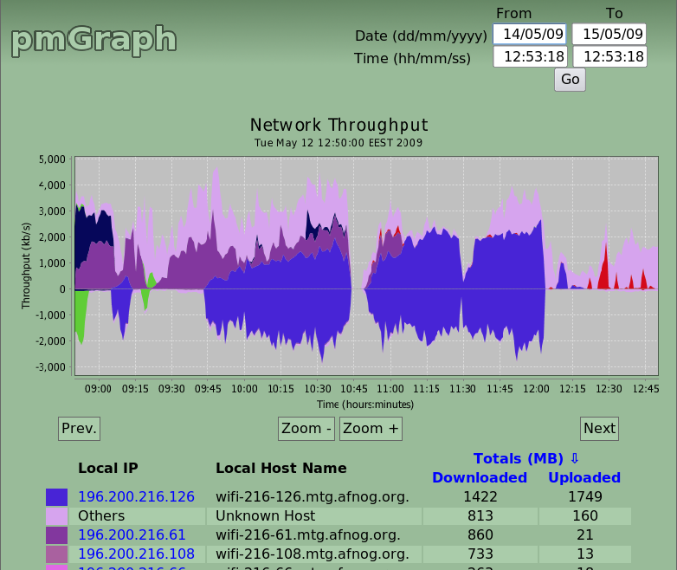
Testing pmGraph
Open http://localhost:8080/pmgraph:

