Slide 1
COMPUTER PROGRAMMING PROJECT
Software Project Title: SURVIVING CAR
Prepared By :
Habibullah
Roll: 38
Apu Kumar Chakroborti
Roll: 50

Slide 2
‘SURVIVING CAR’
It is a very exiting game.
By the name of surviving car we mean
Player has to survive from enemy car coming towards him.
The game ends when enemy car run over the player or even touch the car.

Slide 3
Difficulties & Rules
There is no particular rules in this game . All you have to do is to survive from enemy cars.
The speed of the game will increase time by time .
Though there is no level but difficulties are different depending on score .
To move left player has to press ‘a’
To move right player has to press ‘d’
To move middle player has to press ‘s’

Slide 4

Symbols used:

Slide 5
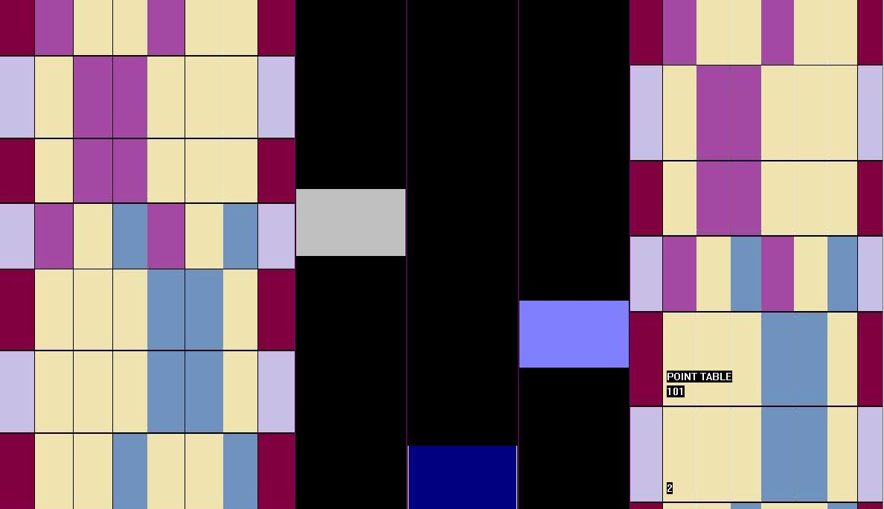
A quick overview of the project interface:

Slide 6
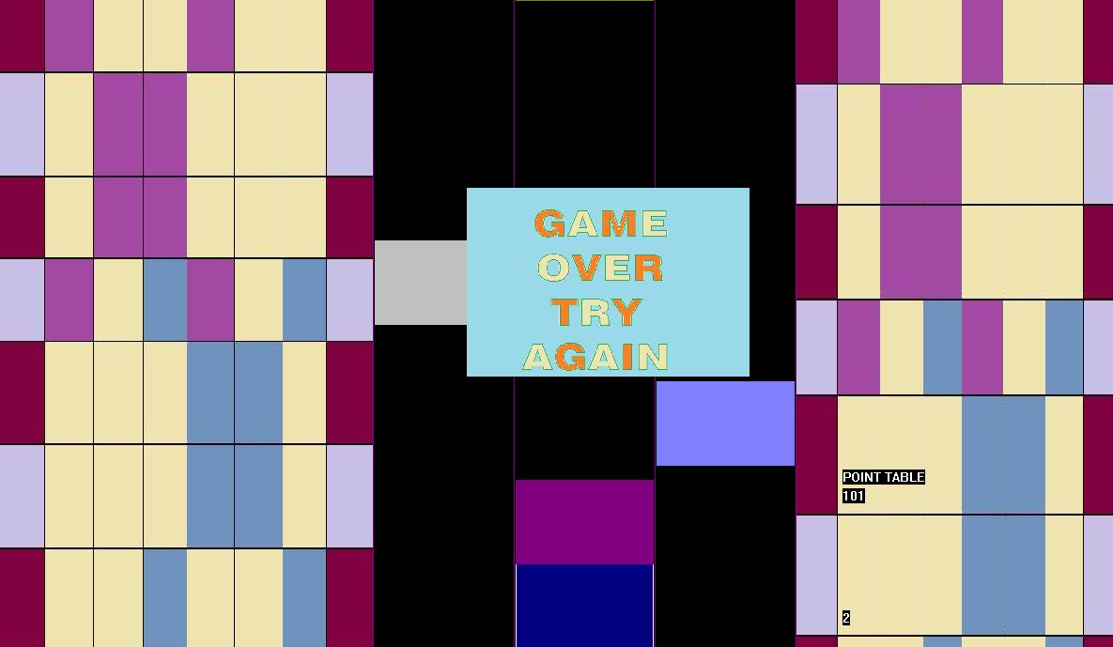
A quick overview of the project interface:

Slide 7
Utility of the project:
It is an efficient way for passing idle-time.It will provide entertainment.
It is a continuous game . If you wanna survive you have to concentrate. Here’s something to learn.

Slide 8
Limitations:
This project has a few drawbacks. These draw backs are as follows :
There no level that can be direct played.
We have use there keys but it reduce the game’s fun as its become easy though we tried to give the enemy car more speed.
There is no menu bar .
The graphical environment of this project is not
attractive enough.

Slide 9
Reference:
Programming in ANSI C- E Balagurusamy

