Slide 1


04 December 2025 / Privacy Aware Computing
Seedless & Seed-based Deanonymization
Membership Inference Attack on DisTilBert Model
S. Vignesh Kumar Pandian[1], Apu Kumar Chakroborti[1]
[1] Department of Computer Science, Georgia State University

Slide 2
Outline
Individual Project - Vignesh
Individual Project – Apu Kumar Chakroborti
Group Project
Future Scope
1

Slide 3
Section 1
Individual Project
Vignesh Kumar
Section 1
Section 1.1
Section 1.2
Section 2
Section 2.1
Section 2.2
Section 3
Section 4
Notes:
Initial data generator
Local Implementation

Slide 4
Seed-based Deanonymization
Multi-hop neighborhood
  Distance-based Weighting for hop importance
Threshold Scheduling
Quantile-based Thresholding
Sparse Matrix computation
Repeated Training (dropped)
GPU-based Training
Ablation
  Network Hops
  Eccentricity threshold
  Quantile-based threshold
2
Section 1
Section 1.1
Section 1.2
Section 2
Section 2.1
Section 2.2
Section 3
Section 4

Slide 5
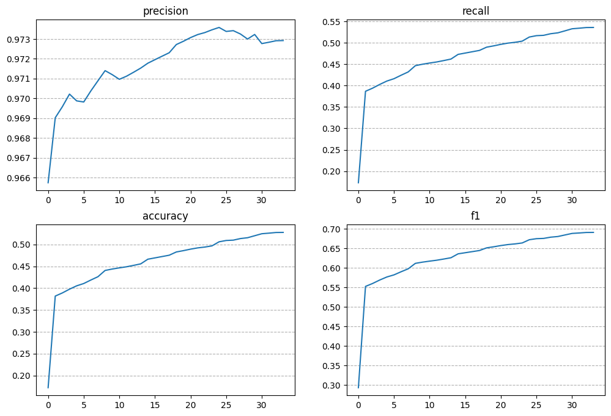
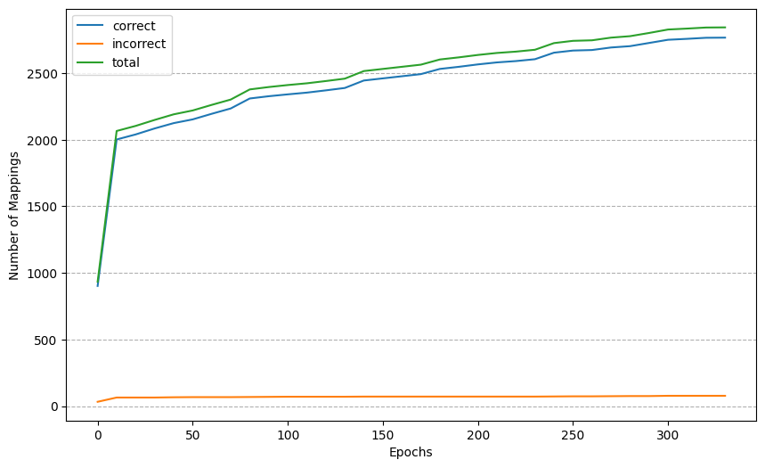
Results on Validation
3

Slide 6
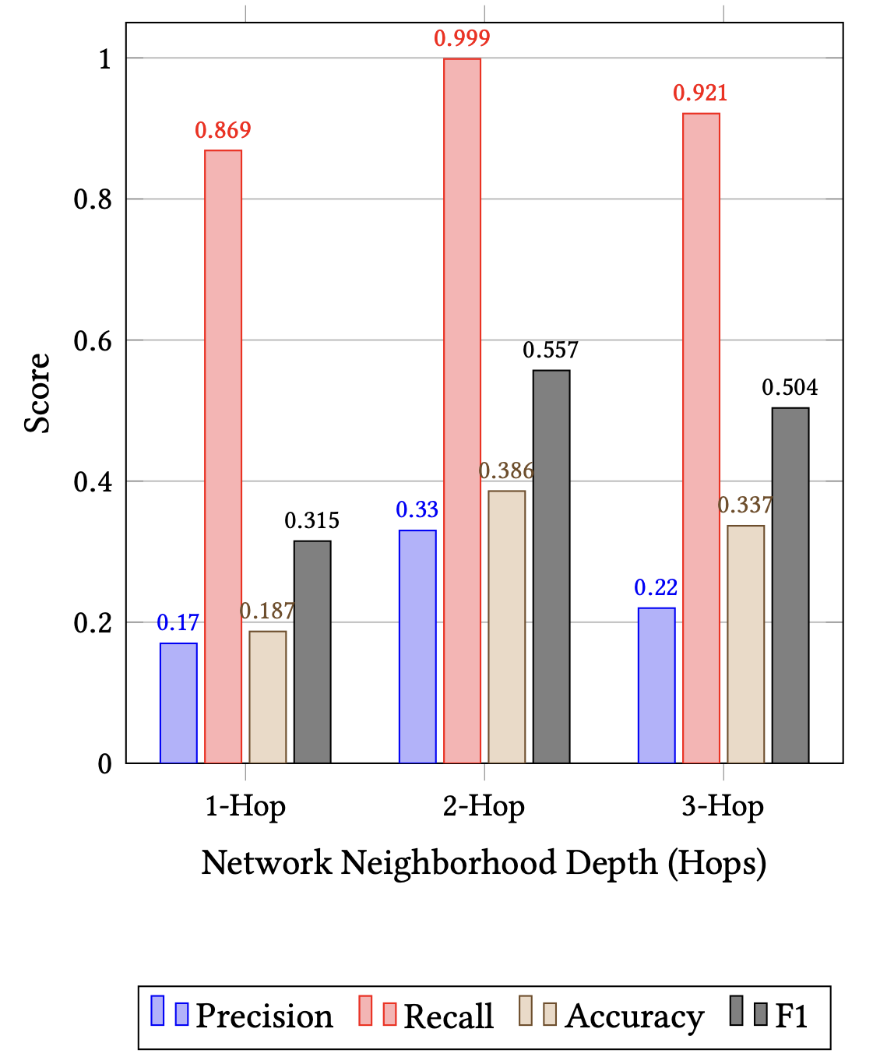
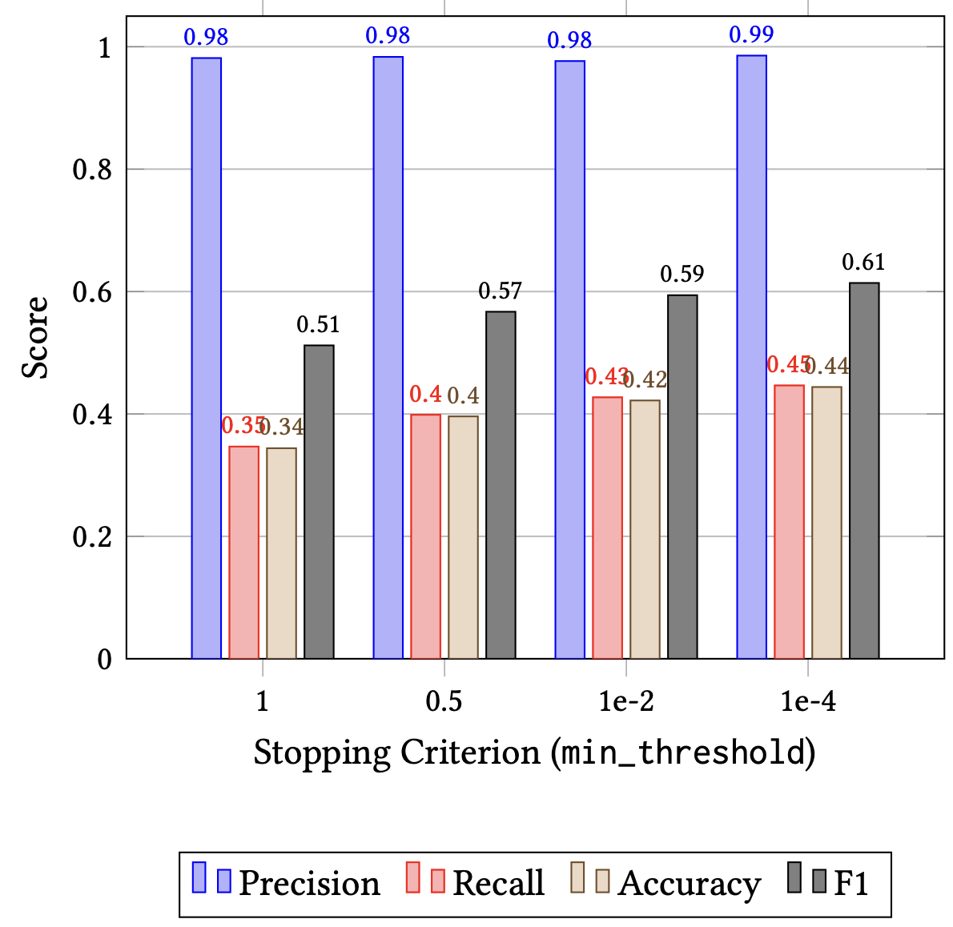
Ablation
4

Slide 7
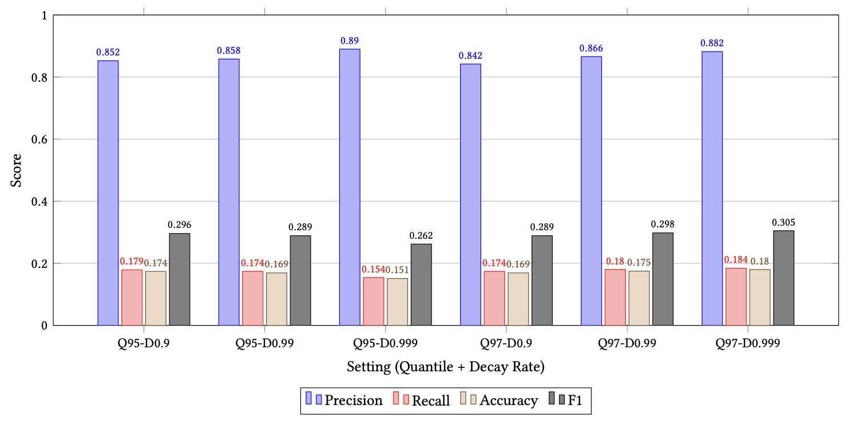
Ablation
Best Model Performance
Correct :2767
Incorrect : 77
Missing : 2398
Precision : 0.97292
Accuracy : 0.52785
F1 score : 0.69097
Recall : 0.53572
Configuration
2-Hop
Threshold 6
0.99 threshold decay
5

Slide 8
Seed-free Deanonymization
Calculate Pseudo labels using heuristics
  Degree
  Two hop neighbours
  Average neighbour degree
  Clustering coefficient
Use Seed-based method using Pseudo labels
Threshold Scheduling
Sparse Matrix computation
GPU-based Training
Best Model Performance
Correct :2376
Incorrect : 233
Missing : 2662
Precision : 0.91057 Accuracy : 0.46792
F1 score : 0.63870
Recall : 0.47866
Configuration
2-Hop
Threshold 10
0.99 threshold decay
Min_threshold 1e-2
6
Section 1
Section 1.1
Section 1.2
Section 2
Section 2.1
Section 2.2
Section 3
Section 4

Slide 9
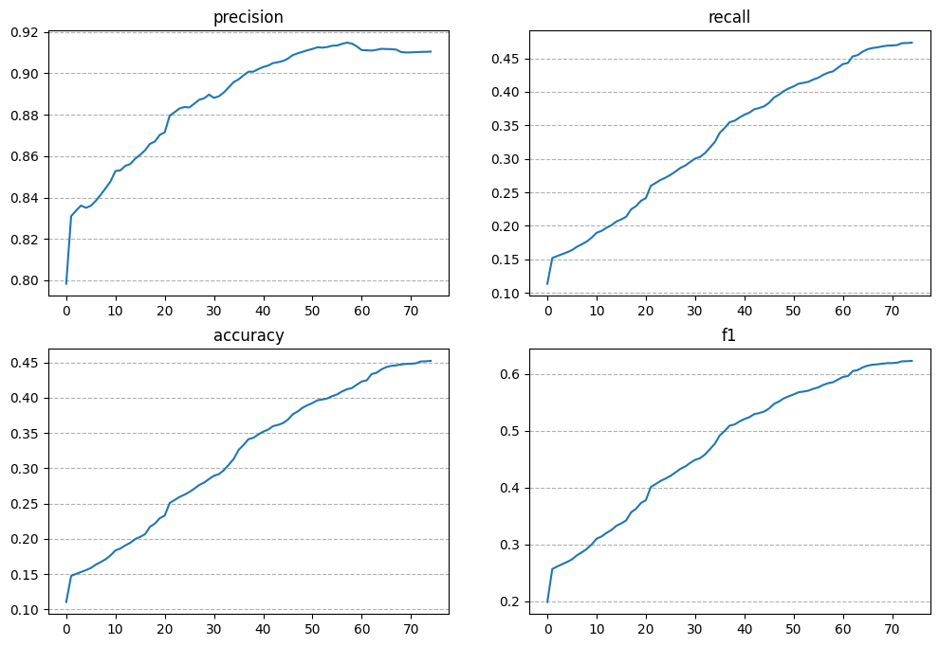
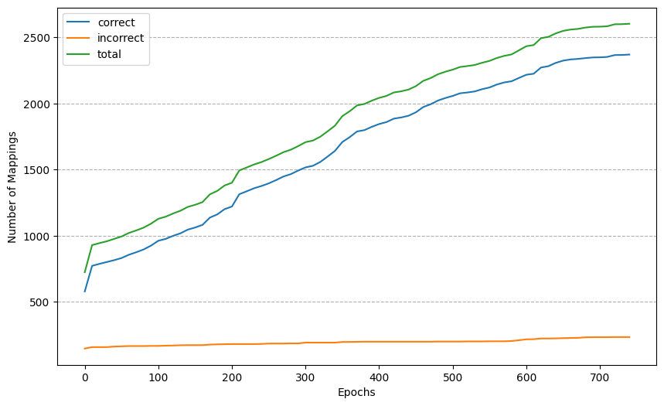
Results on Validation
7

Slide 10
Section 2
Individual Project
Apu Kumar Chakroborti
Section 1
Section 1.1
Section 1.2
Section 2
Section 2.1
Section 2.2
Section 3
Section 4
Notes:
Initial data generator
Local Implementation

Slide 11
Introduction
Many real-world datasets (social networks, communication graphs, mobility networks) are anonymized by replacing user identities with random labels.
Graph deanonymization aims to recover the true correspondences between two graphs 𝐺1 (original/anonymized) and 𝐺2 (auxiliary graph with identity information) based on structural similarity.
Two problem settings:
  Seed-based deanonymization: a subset of node pairs (𝑢𝑖, 𝑣𝑖) is already known.
  Unseeded deanonymization: no initial mappings; algorithm must infer initial matches automatically.
Goal: produce a reliable full mapping 𝑓:𝑉(𝐺1)→𝑉(𝐺2) using structural, neighborhood, and iterative propagation techniques.
8

Slide 12






Seed based/free Deanonymization Method
Seed Based Method:
Initial mapping
G1
Propagation Method
Final Complete
Mapping from G1 to G2
G2
Seed free Method: structures: degree, local clustering coefficient, and page rank
9

Slide 13
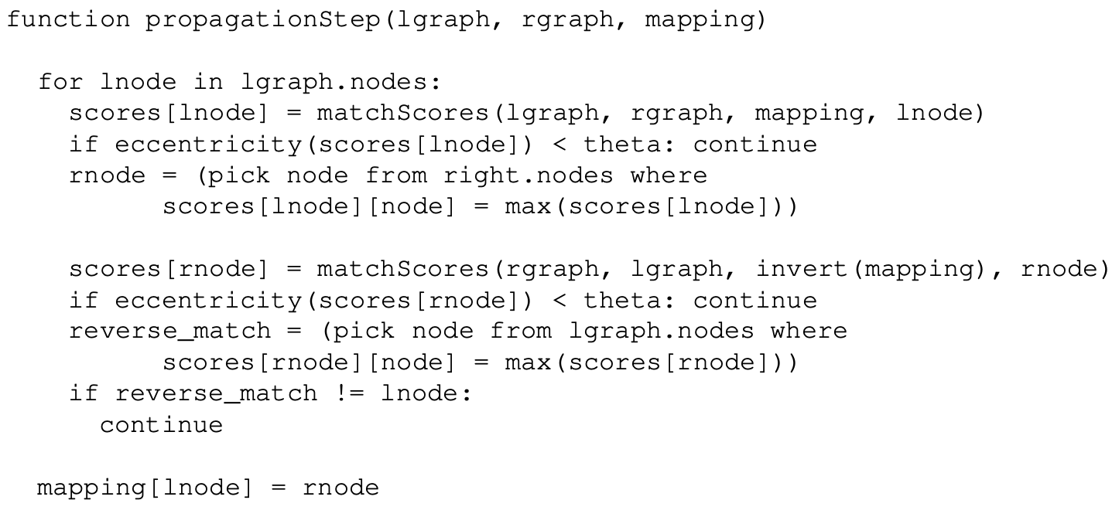
Propagation Method(1)
10

Slide 14
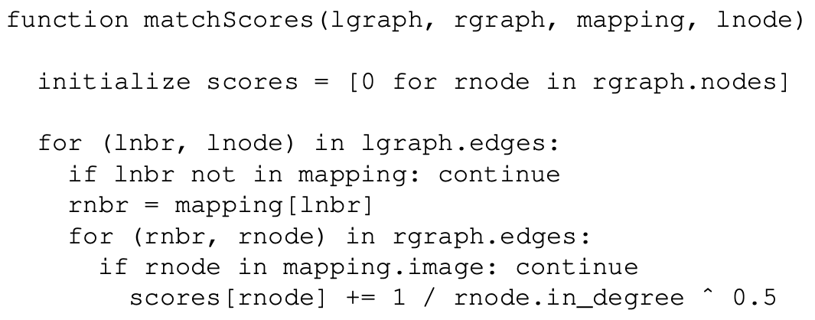
Propagation Method(2)
11

Slide 15
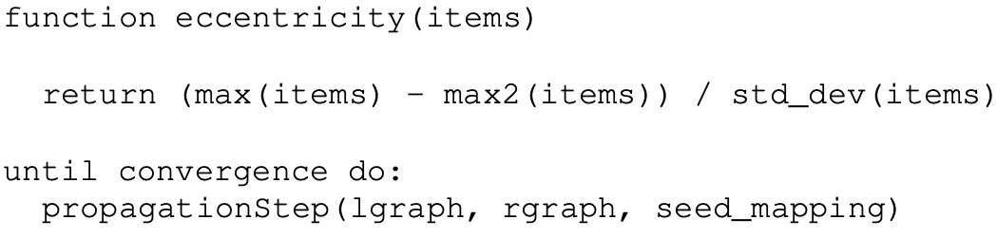
Propagation Method(3)
12

Slide 16
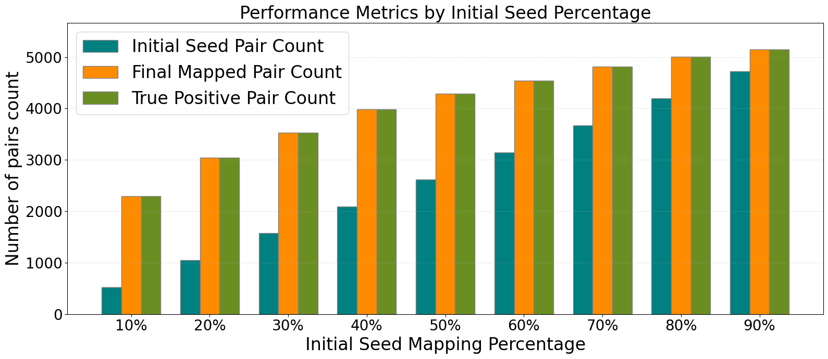
Ablation Results on Validation Datasets(1)
13

Slide 17
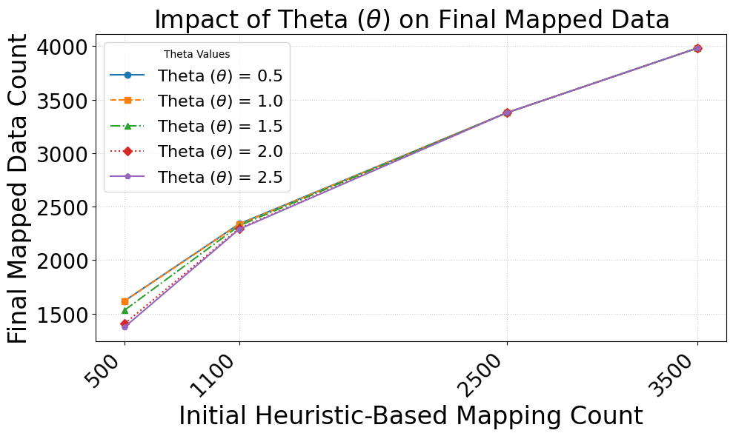
Ablation Results on Validation Datasets(2)
14

Slide 18
Group Project
Membership Inference Attack
Section 3
Section 1
Section 1.1
Section 1.2
Section 2
Section 2.1
Section 2.2
Section 3
Section 4

Slide 19
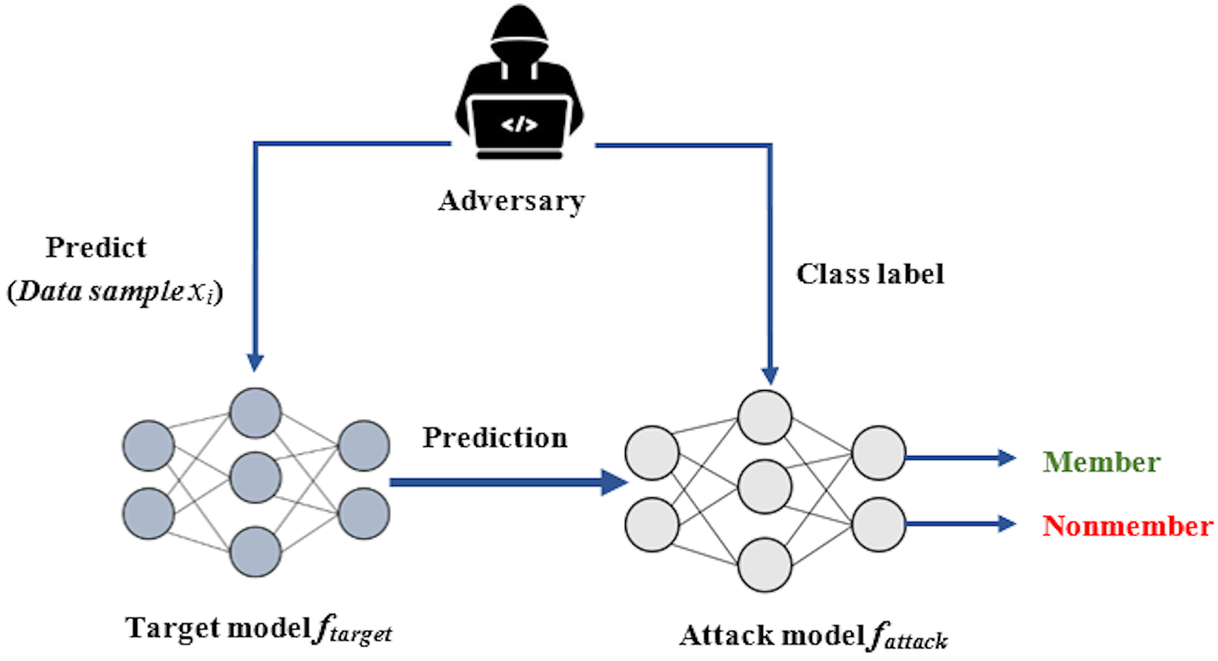
What is Membership Inference Attack?
A privacy attack where the adversary predicts whether a sample was part of a model’s training set
Exploits the fact that models often behave differently on training vs non-training samples (overfitting, confidence differences, loss shape)
Critical for privacy-sensitive domains: medical data, financial data, recommendation systems, NLP datasets
15

Slide 20
Problem Setting
Model
  Transformer model DistilBERT
Dataset
  AG news dataset
  1 million news articles
  4 classes
  30K training for each class
  1900 testing for each class
Membership Inference Attack
Black-Box MIA
White-Box MIA
Loss-based
Gradient-based
Conf-based
Activation-based
Entropy-based
Training trajectory
based
Label-only
Shadow model
Cross-Domain
Distribution Matching
Arch. Matching
Synthetic data
Arch. Approximate
16

Slide 21
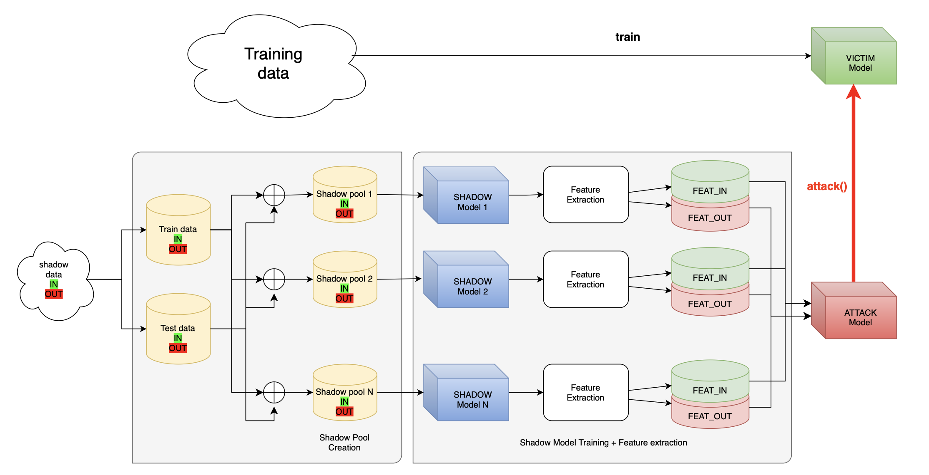
Working Methodology
Shadow dataset creation
Shadow model training
  5 shadows
  5 epochs per shadow
Feature Extraction
  Using victim model
Attack dataset creation
Attack model training
Evaluate on victim model
17

Slide 22
Novelty
Loss Criterion
Noisy Label Cross-Entropy for Shadow training
  Allows for misclassification
Focal Loss for Shadow training (rejected)
Multi-phase Optimization
AdamW followed by LBFGS
Model Selection
Random Forest
MLP (LayerNorm + LeakyRelu + Dropout)
XGBoost
Feature Extraction
Confidence-based features
  Confidence
  Margin (Top-1 – Top-2)
  Logit Margin
  Logit Norm
  correctness
Loss-based features
  Loss
Distribution-based
  Entropy
  Class Norm
18

Slide 23
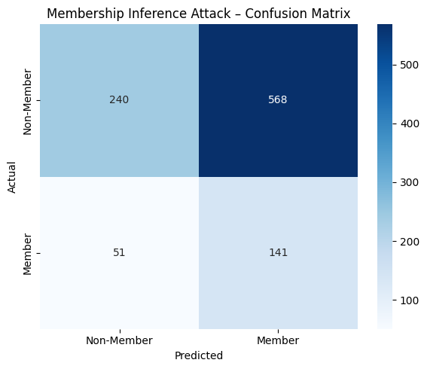
Results
Best Model Cofiguration
5 shadow models
Noisy Label CE (noise = 0.2)
Attack MLP model
  3 layers
  Layer Norm
  Leaky ReLU
  Dropout regularization
Metric | Value
ROC_AUC | 0.5312
Precision | 0.2188
Recall | 0.734
F1 | 0.3329
Accuracy | 0.381
19

Slide 24
Section 4
Future Plans
Section 1
Section 1.1
Section 1.2
Section 2
Section 2.1
Section 2.2
Section 3
Section 4

Slide 25
Future Plans
Cross-attention based features
GAN-based MIA
No-data MIA
20

Slide 26

Questions?

