Slide 1
Android – ContentProvider
Content providers manage access to a structured set of data.
Content provider can choose how to store data. Typically data is stored in a SQLite database but it could also sync via a cloud.
Resources managed by a provider are referenced through URIs whose scheme is “content://”
Clients use content resolvers to access, modify, and delete data by specifying content URIs. The API uses SQL-isms such as projections (which columns to retrieve) and selections (search terms to narrow down data)
Android offers some standard content providers (e.g., contacts provider and calendar provider)

Slide 2
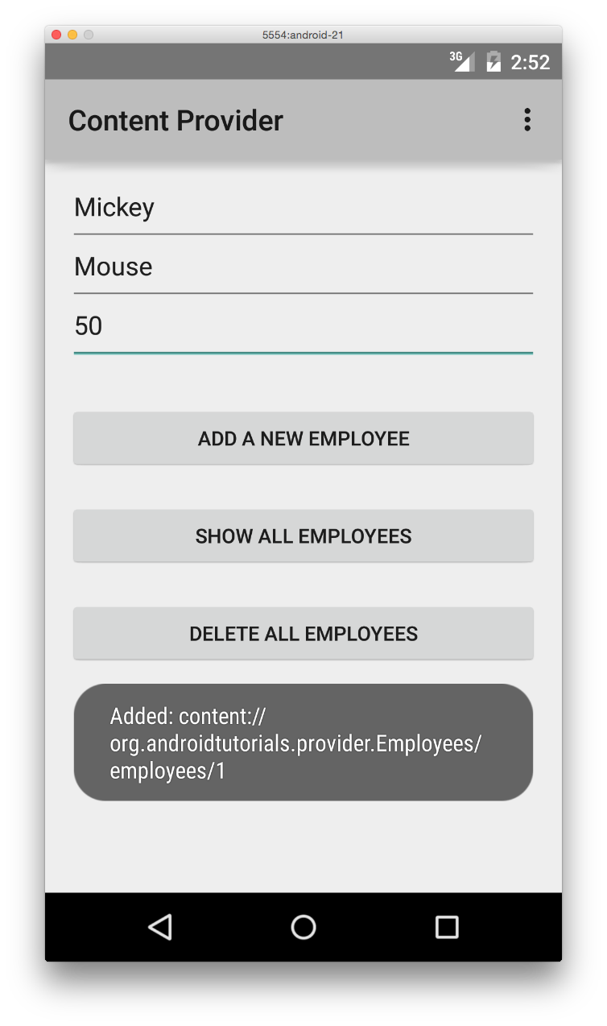
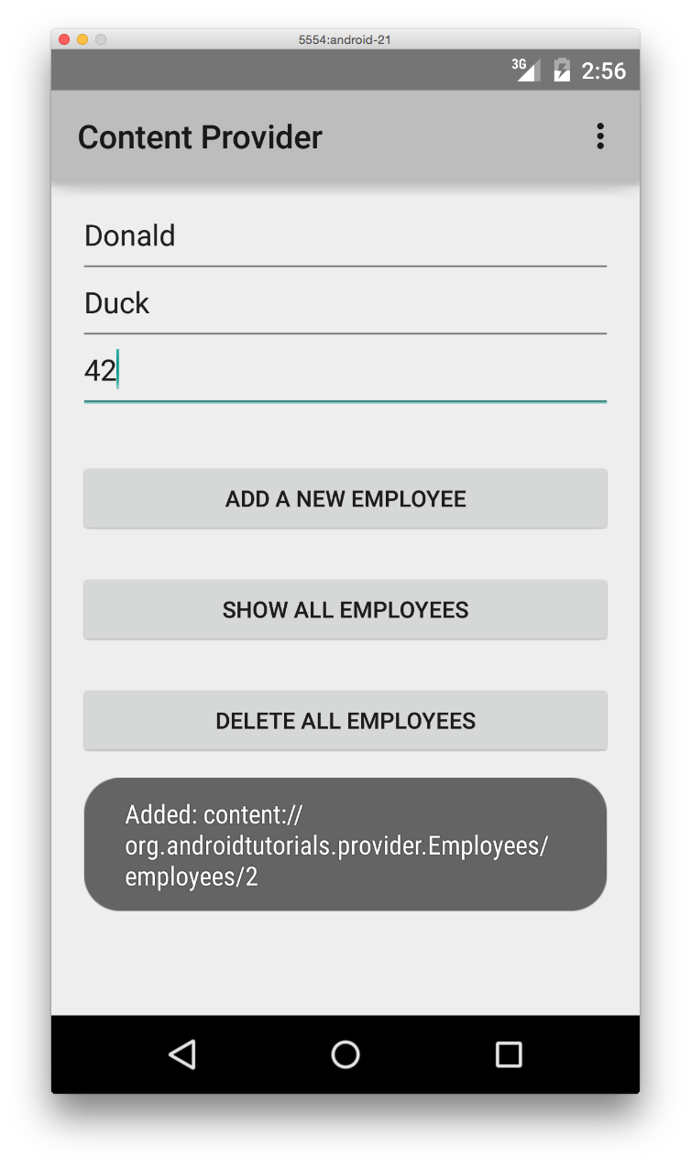
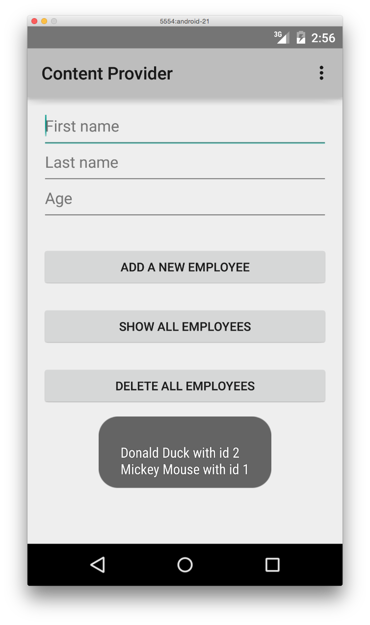
Add Mickey as an employee. Note the URI for the new employee.
Add Donald as
an employee.
Show all employees.

Slide 3
References
Overview of Content Providers
ContentProvider
ContentResolver
UriMatcher

Slide 4
Exercise
Add a custom permission for the content provider so that an external app needs to request this permission in order to use the content provider.

